Slide 1
COMPASS
Cardio-Oncology Multidisciplinary Patient Assistance Solution
21st January 2026
Coordinators: KCL/KHP – GE Healthcare
Targeting Topic 2 of IHI call 9

Slide 2
COMPASS
EU IHI Scope
Fund pre-competitive research & innovation in Novel tools, Methods, and Technologies to enhance disease prevention, diagnosis, treatment, and recovery.
Address unmet public health needs based on at least one of the below :
  High burden (severity & number of affected people)
  High economic impact on patients & society
  Transformational impact on healthcare innovation
Translation into real-world solutions that can be integrated/implemented into the healthcare ecosystem:
  Fit within fragmented EU healthcare systems
  Industry & patient-centric models
Target Populations & Needs:
  Underserved communities, limited-resource areas
  Address gaps in diagnosis or treatment Regulatory & Data Considerations
Plan for regulatory impact (EMA, HTA agencies, national authorities)
Consider Health Data Access Bodies under EU Health Data Space Synergies & Collaboration
Align with existing initiatives/projects to avoid duplication → Develop a synergy plan for integration & impact

Slide 3
COMPASS
EU IHI Expected Outcomes
Contribute to to at least one of IHI JU’s potential outputs linked to the IHI JU Specific Objective 2:
Integrate fragmented health research & innovation by bringing together industry sectors & stakeholders to tackle unmet public health needs.
Advance tools, data, platforms, & technologies for better disease prediction, prevention, diagnosis, and treatment.
Deliver safe, patient-centred, cost-effective, and accessible health innovations.
The expected outcomes may cover the entire spectrum of care and may be health technologies centred around:
Disease areas and/or key themes: Prevention, Diagnostics, Personalized medicine & Chronic disease management.
Key enablers: Digital health & AI Regulatory science, Sustainable healthcare, Implementation science.

Slide 4
COMPASS
Project Objectives
Our aim is to design an integrated cancer patient-centred programme to optimise cardiac health before, during and after cancer treatment.
By undertaking a multi-faceted, multidisciplinary approach which encompasses different stages of cardio-oncology, we aim to address several unmet needs of a global challenge for fragmented health services that is a worldwide problem for cardio-oncology, with the ultimate ambition to improve the cardiovascular health of cancer patients.
This will be achieved by several interwoven WPs with distinct objectives.

Slide 5




















COMPASS
Health Economy evaluation
Advanced Cardiac Imaging Biomarkers
Education, training, guidelines, dissemination
Education and Training Programs for Healthcare Providers
Patient Education and Engagement Platforms
Real-Time Data Analytics for
Treatment Monitoring
Telehealth Follow-Up Protocols
Cardio-oncology
Imaging, non-imaging
Biomarker Discovery and Validation
Digital Solutions – Predictive AI / CDS
to predict cardiotoxicity development
Multi-Disciplinary Care Pathways
Early timely diagnosis,
Treatment plan, patient follow up, home monitoring
Wearable Technology for
Continuous Monitoring

Slide 6
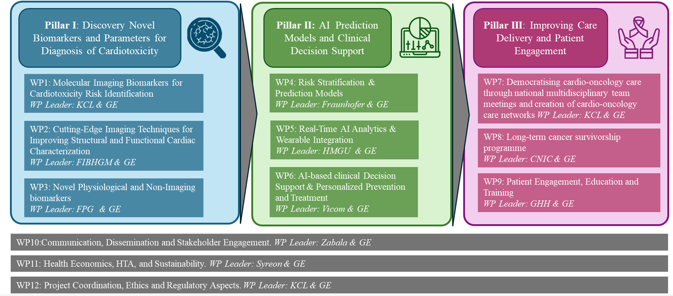
COMPASS

Slide 7
COMPASS CONSORTIUM
Type Of Entity | Count of Entity Name
Academic | 13
Hospital | 7
Industry | 18
Non-profit organisation | 2
RTO | 16
SME | 11
Total | 67

