Slide 1
Industrial production in the cardiovascular field and its environmental impact
Servier environmental sustainability strategy, challenges and actions
Shuo WANG
16/06/2026

Slide 2
An independent group committed to therapeutic progress and governed by a non-profit Foundation
Over
20,000
employees
The Group’s medicines are distributed in over
130 countries
15
brand-name medicines in Cardiovascular field
13
internal production facilities worldwide​

Slide 3



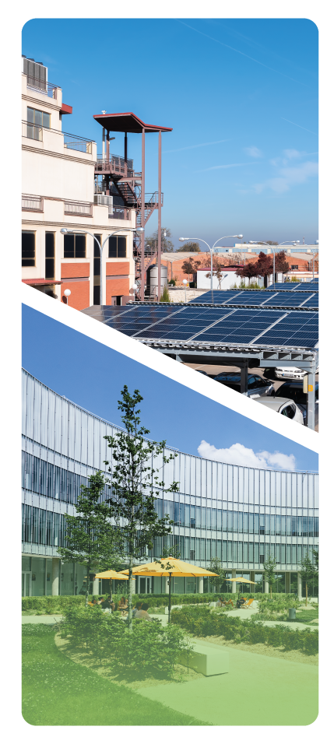
We maximize our health impact
By serving:
PATIENTS
PEOPLE
PLANET
SUSTAINABILITY GOVERNANCE: The Fundamentals
Notes:
The roadmap defines the actions we will take to deliver on our commitments. It also defines the measures we will take to ensure effective Governance of our responsibility across all three pillars.

Slide 4
We maximize our health impact
By serving:
PLANET
PATIENTS
PEOPLE
Bringing our therapeutic innovation to more patients
Partnering for prevention & improving health outcomes
Expanding access to health
Ensuring health, safety & wellbeing at work
Fostering an inclusive culture
Creating value for communities
Taking action on Climate
Preserving Nature
Developing more sustainable medicines
Notes:
The Patients pillar clearly affirms our commitment to global health. We work to expand access to healthcare within our business and through partnerships and, in particular, to our innovations; contribute to prevention within our therapeutic areas; improve early diagnosis; and support treatment adherence. Our responsibility does not end with medicine. It begins when a patient, wherever they live, can benefit from it. Through Act for Children for example, we aim from 2030 to help treat at least 15,000 children with cancer each year in countries where access to care remains limited. Our impact is measured in transformed lives, not intentions.
The People pillar is equally central to our social ambition. Servier is committed to providing healthy, safe, and inclusive work environments for all. We view health, safety, diversity, and inclusion as direct drivers of performance. Our responsibility also extends to the communities in which we operate – first by demonstrating our socio-economic impact and the value we bring and targeted health actions eg. prevention campaigns, screening initiatives, philanthropy, and employee engagement. Every interaction matters. Advancing local public health is an integral part of our role.
Because human health is closely linked to the health of the planet, the Planet pillar commits Servier to a profound industrial transformation. Reducing our environmental footprint, managing resources responsibly, accelerating the eco-design of our medicines and rethinking our distribution models are no longer matters of compliance alone. These choices directly shape the resilience and long-term viability of our business. Progress already achieved - whether through redesigning a synthesis process in oncology or significantly shifting towards maritime transport - demonstrates a clear reality: sustainable performance is not an option; it is an imperative.

Slide 5
OUR GROUP OBJECTIVES
PEOPLE
PLANET
PATIENTS
< 0,30 Lost Time Incident Rate in 2030
0 Serious injury & fatality work-related event, each year
Maintain Gender balance at all managerial levels & Increase International representation for Top 500 by 2030
Enhance our impact on local communities
-43% Scope 1&2 by 2030
Suppliers climate engagement by 2030
-67% Scope 3 per added value by 2035
Climate Resilience for strategic sites & raw material suppliers by 2030
-15% water use by 2030
<1% waste to landfill
Medicines & packaging with eco-design principles by 2030
Develop Access to health plans in Oncology by 26-27
Achieve our aspiration to contribute to the cure of at least 15,000 children every year, from 2030 onwards
(ACT For Children)

Slide 6

Our PLANET strategy to address environmental priorities of pharmaceutical industry
1. CLIMATE
2. NATURE
Across the value chain of Servier Group
We will reduce our GHG* emissions and improve our business resilience to climate risks.
We are committed to protect nature and reduce the adverse impact of our activities locally and globally.
Contribute to :
3. SUSTAINABLE PRODUCTS
We aim to integrate environmental considerations in product & process design to improve product environmental performance along the life cycle.
Along life cycle of Servier products
* GHG: Green House Gas

Slide 7
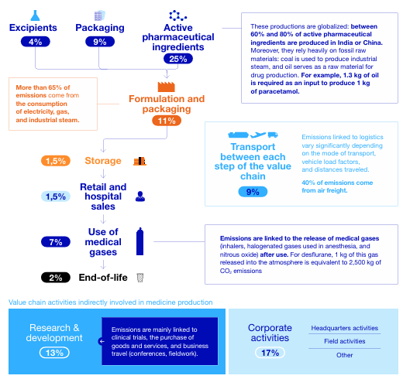
Production and upstream value chains drive most of the environmental footprint
Industrial activities represents >50% of carbon footprint
~80% of carbon footprint are from upstream of value chain (purchased goods & services), with less of operational control
* source: “Decarbonising the pharmaceutical industries” Report, The Shift Project, June 2025

Slide 8
Reducing environmental impact in a challenging context
API & Pharmaceutical manufacturing​
Packaging & Transport
Constraints
GMP* requirements
Dependency on materials & resources
Medicine protection
Supply chain reliability & access
Operational Challenges
Climate
Energy-intensive chemistry and controlled environments
Packaging design
Variable regulatory context vs. packaging standardization,
Patient experience & needs
Water
Process needs, cleanness requirement, treatment and residuals management
Low carbon transport
Urgency management
Shelf-life management
Waste
Regulated medical & hazardous waste
Environmental actions cannot compromise quality, availability and patient needs.

Slide 9
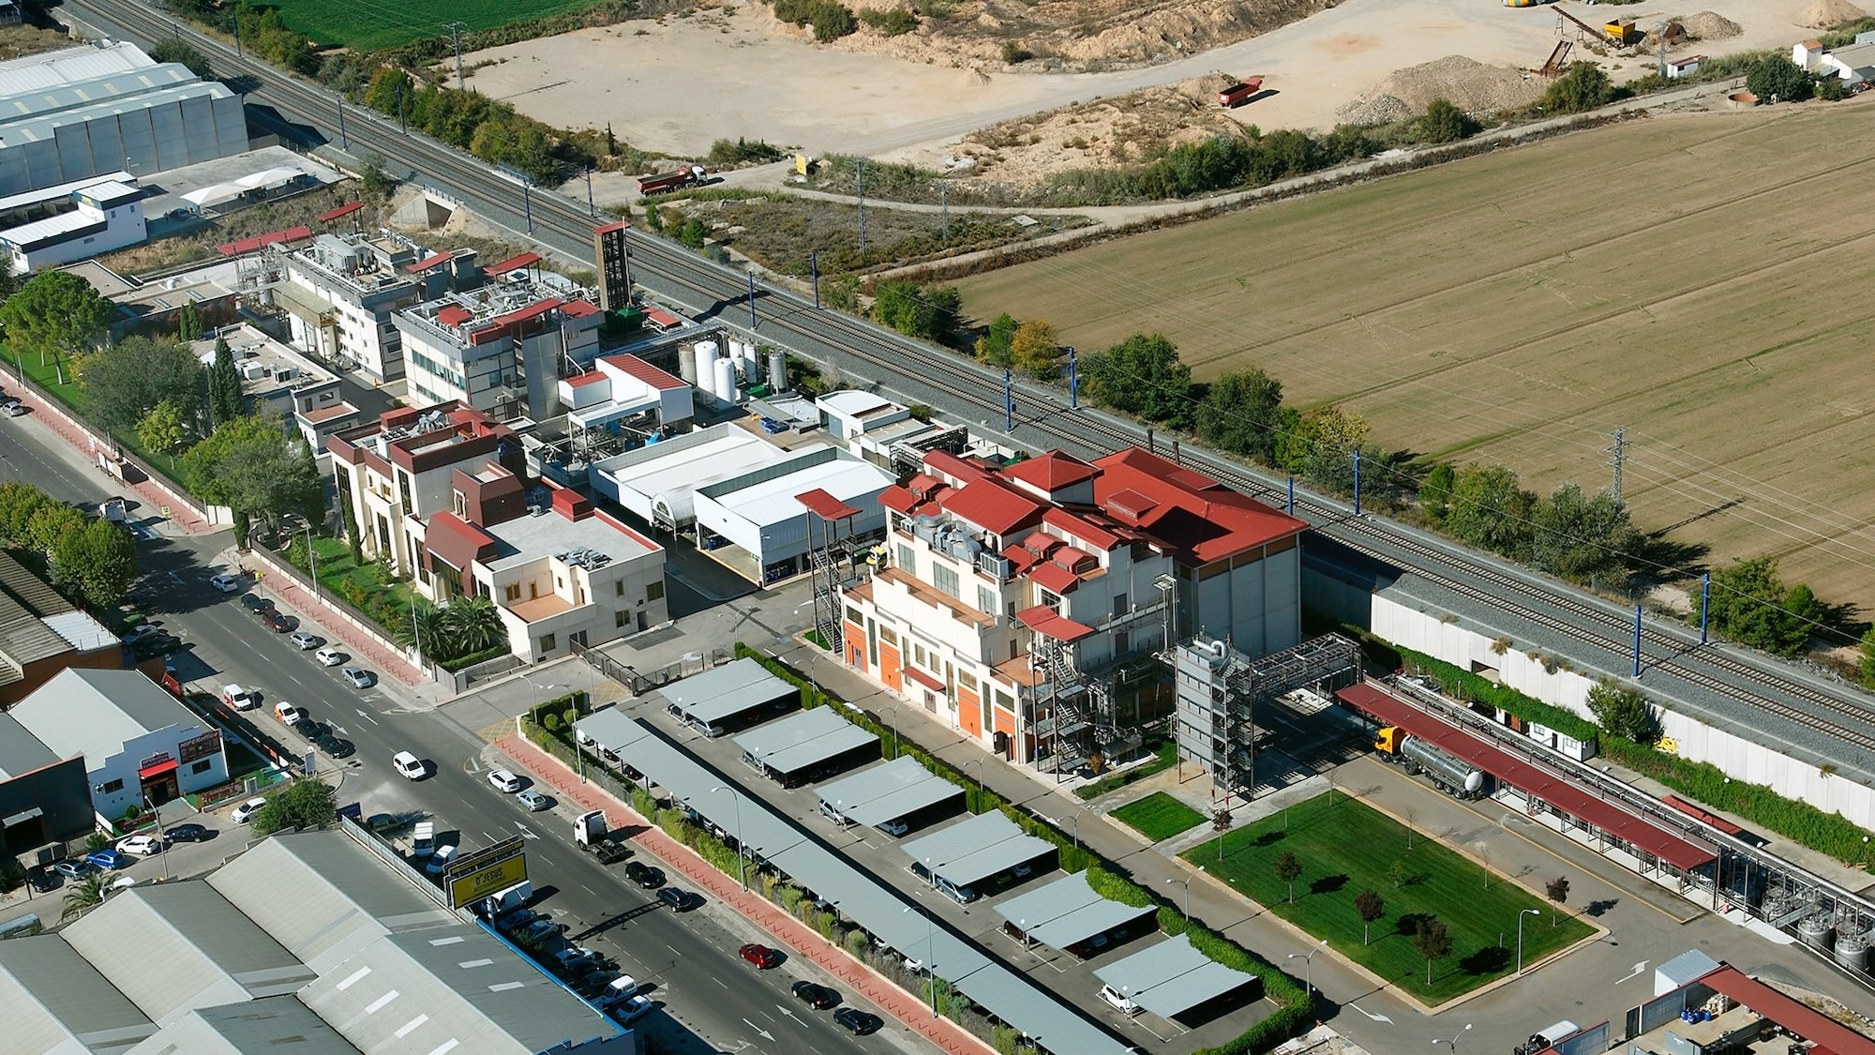
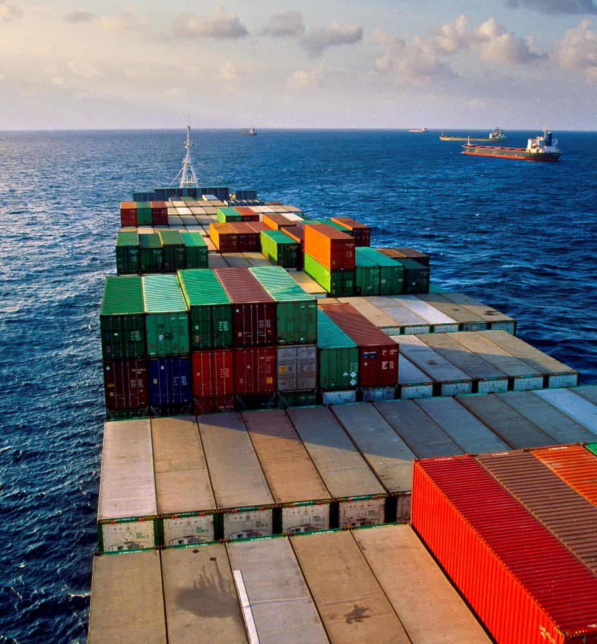
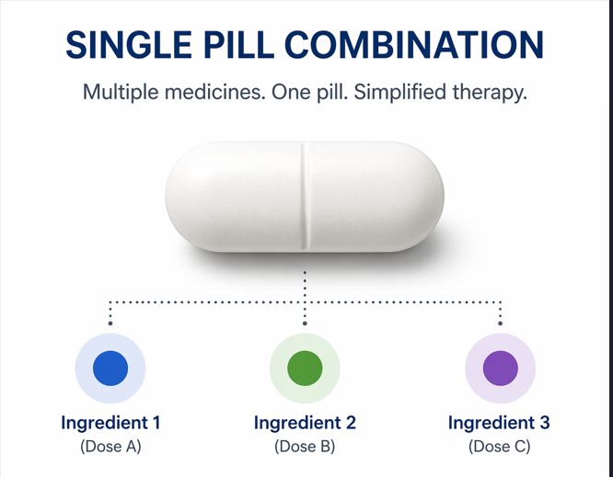
Actions and continuous improvement
In Toledo, an area of Spain facing high water stress, Servier implemented an evaporator-concentrator that reuses up to 6,000 liters of water daily and recovers 65% of the ethanol used
62% of the Group's intercontinental Princeps shipments were transported by sea in 2024/2025
Single pill combinations* allow to reduces by 50% the carbon footprint of packaging vs. a free combinations of several drugs

