Slide 1
Sustainable Cardiology: From Environmental Risk to Cardiovascular Responsibility
16 &17 June 2026
London, UK

Slide 2
From Brussels to the Bedside: Why European
Environmental Policies Matter to the ESC
Piotr Szymanski, Chair Regulatory Affairs Committee
16th June 2026

Slide 3
Revision of the Medical Device Regulation
(reprocessing of medical devices)

Slide 4
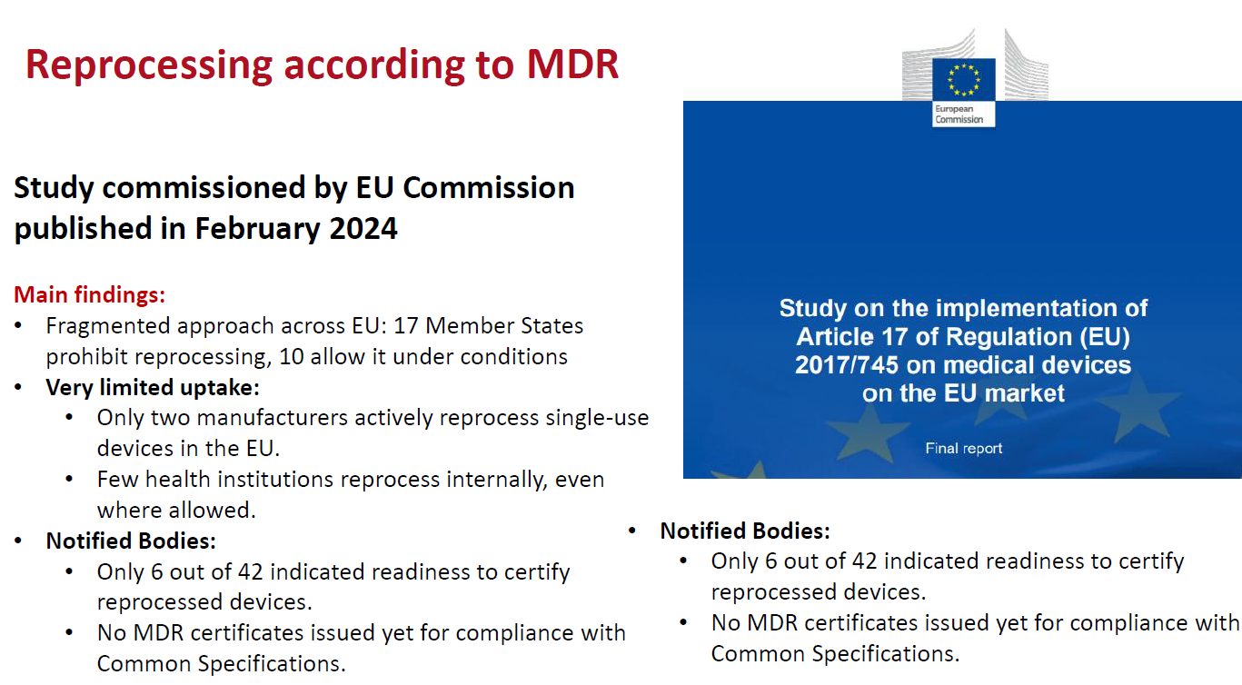
Cardiovascular
Round
Table

Slide 5
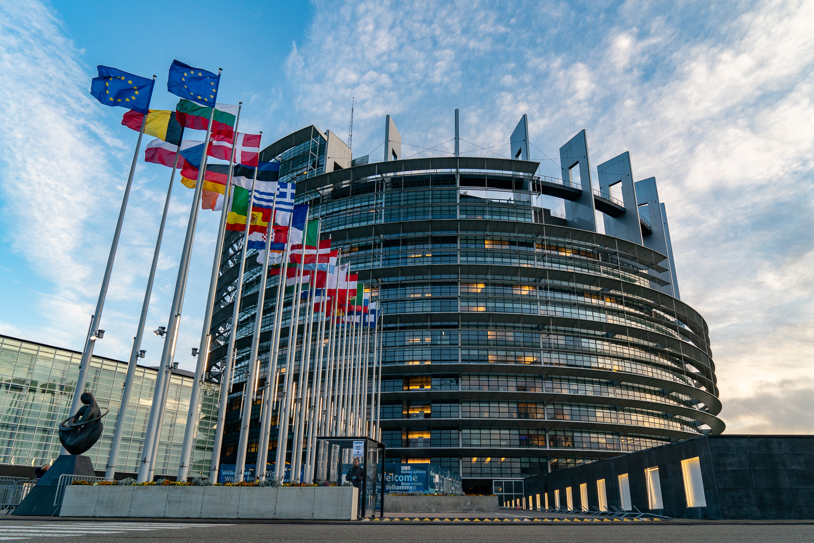
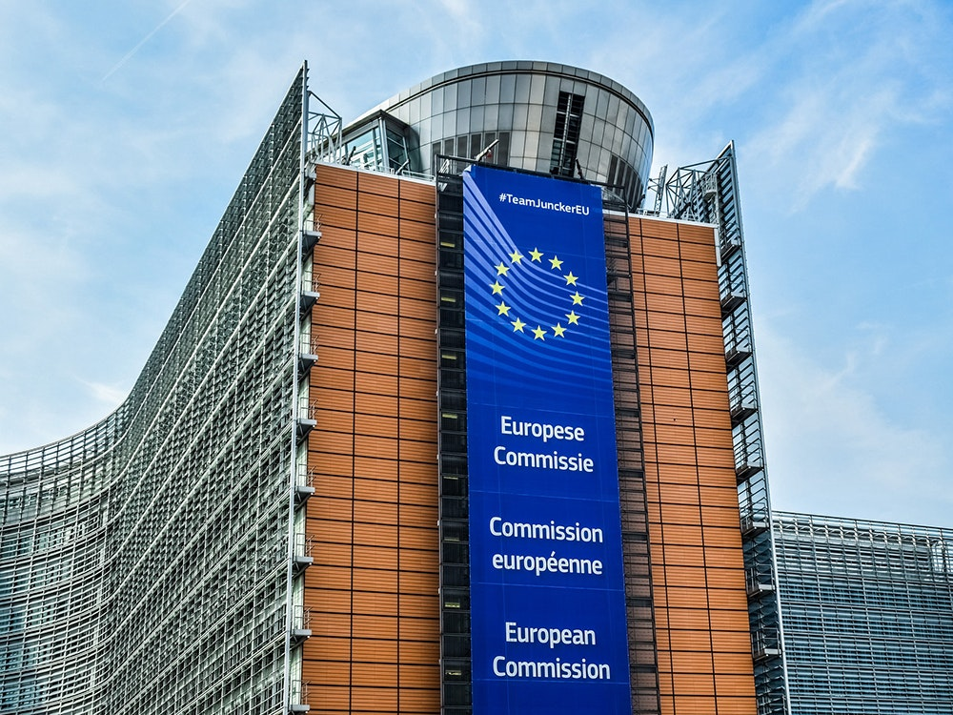
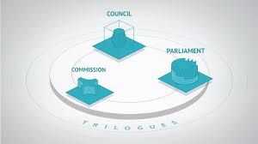

Where we stand
Parliament
Commission
Joint “trilogue” discussion
September 2026
Council
December 2025
February 2027
Adoption of the proposal for revision
February 2026

Slide 6









ESC-wide consultation
6 Associations
3 Working groups
2 Councils

Slide 7
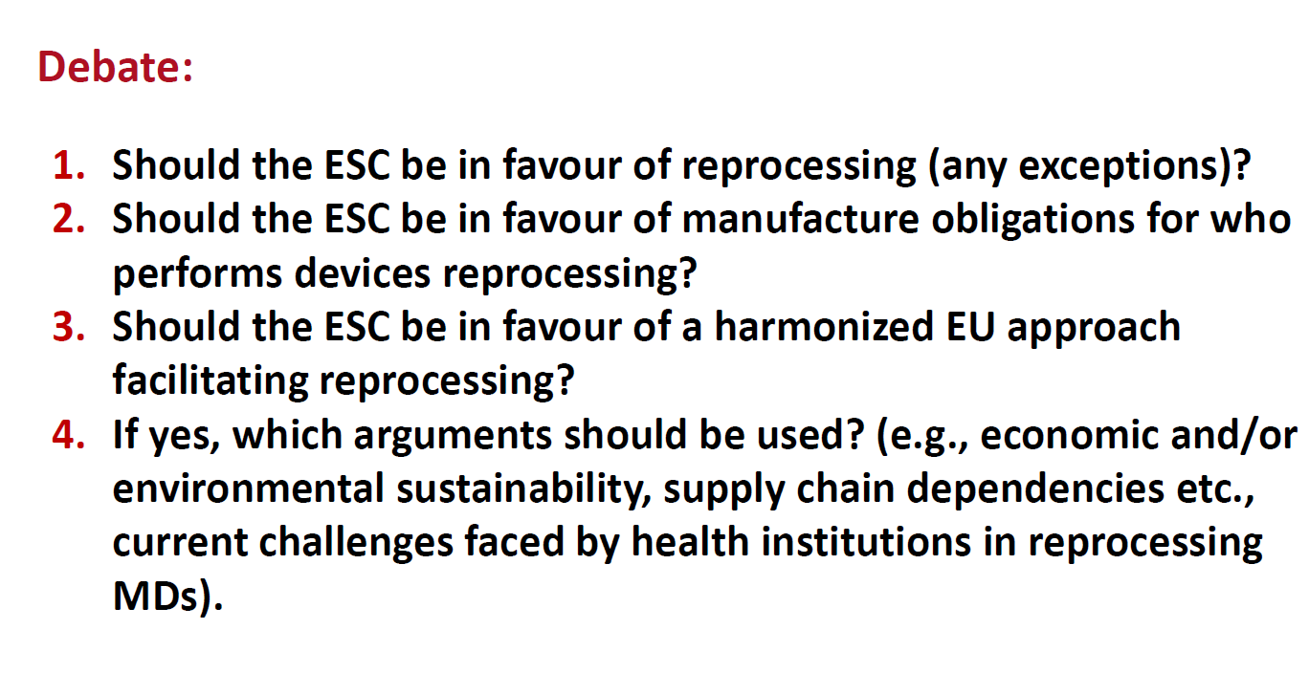
Reprocessing of medical devices?
Cardiovascular
Round
Table

Slide 8
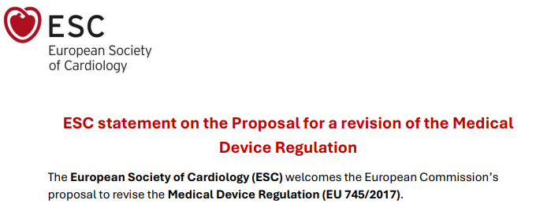

The ESC welcomes the proposal to harmonize the currently fragmented reprocessing landscape across the EU by introducing a unified framework applicable to all Member States
The ESC stresses the need for an objective, expert‑driven mechanism to evaluate single‑use claims and to ensure that reprocessing remains a viable option where safe and clinically justified
Manufacturers should make available to reprocessors or healthcare institutions the information necessary to assess whether reprocessing is technically possible, safe, and practically feasible in light of available infrastructure, expertise and resources
Take‑back and material‑reuse programmes for the reprocessing and refurbishing of medical devices should be encouraged to improve sustainability of health systems

Slide 9
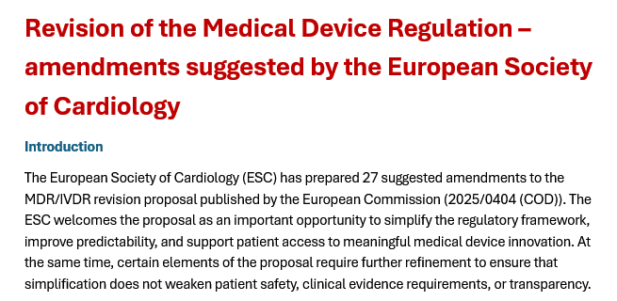
Cardiovascular
Round
Table
Amendement 15
Article 1 (15) Rev Article 17 MDR
Text proposed by the Commission | Proposed Amendment
1. A device shall only be intended for single-use where the manufacturer, in light of the design, construction, material, chemical, physical and biological properties of the device, cannot ensure that the device continues to meet the relevant safety and performance requirements when reused in accordance with its intended purpose after appropriate reprocessing. The manufacturer’s justification of an indication of single use shall be part of the technical documentation referred to in Annex II. | 1. A device shall only be intended for single-use where the manufacturer, in light of the design, construction, material, chemical, physical and biological properties of the device, cannot ensure that the device continues to meet the relevant safety and performance requirements when reused in accordance with its intended purpose after appropriate reprocessing. The manufacturer’s justification of an indication of single use shall be part of the technical documentation referred to in Annex II. The manufacturer’s justification for designating a device as single‑use shall be subject to assessment by the notified body as part of the conformity assessment, in accordance with the CS adopted by the Commission as provided by paragraph 4.
Justification
Given that the indication of single use from manufacturers as provided by the proposal, incurs in a conflict of interest due to legitimate commercial reasons, single use classification must be independently evaluated by Notified bodies and supported in its consistency by the adoption of Common Specifications by the Commission, upon due consultation with Healthcare professionals’, who can provide their expertise and insight on the reprocessing process.

Slide 10
Other files...
(related to wearable healthcare electronics)
The global device consumption is projected to increase 42-fold by 2050, approaching 2 billion units annually and generating 3.4 MtCO2-equivalent emissions alongside ecotoxicity and e-waste issues.

Slide 11
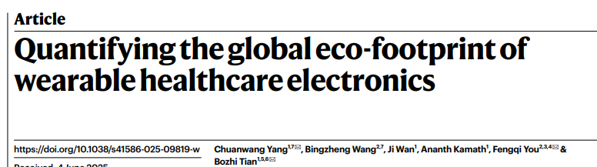
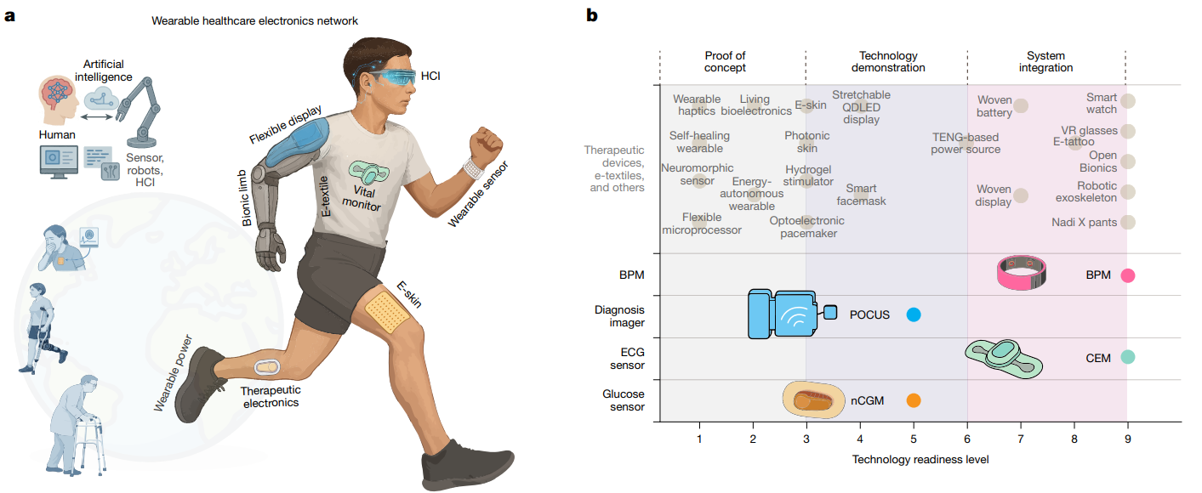
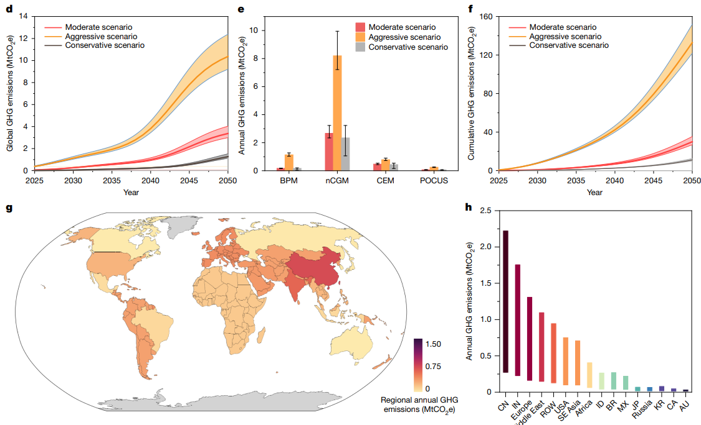
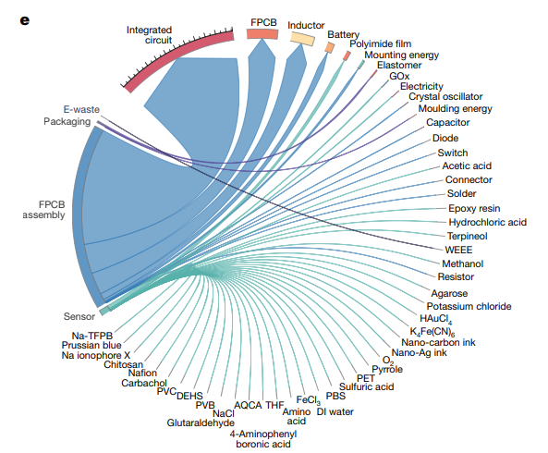

Slide 12
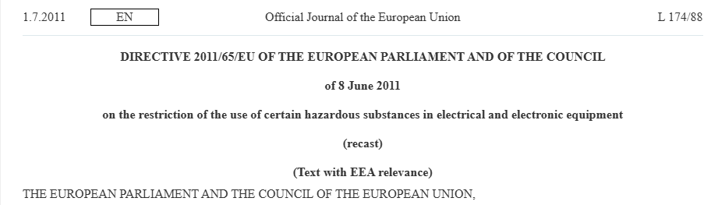
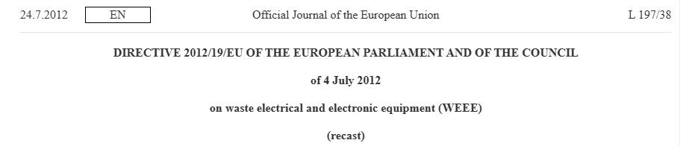
Restriction of Hazardous Substances in Electrical and Electronic Equipment (RoHS)
Waste from Electrical
and Electronic
Equipment (WEEE)

Slide 13
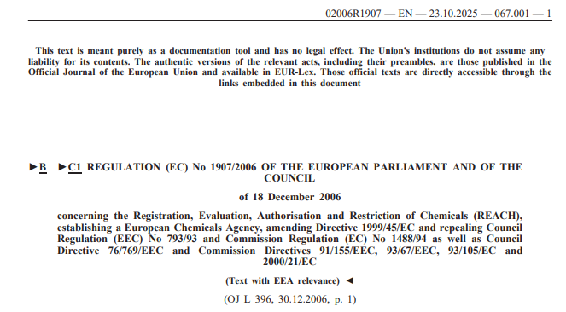
EU’s chemicals regulation, REACH
(Proposal to restrict per- and polyfluoroalkyl substances - PFAS)
ECHA’s updated PFAS restriction proposal is one important example,
but REACH also covers many other hazardous chemicals used in healthcare:
sterilants, disinfectants, plastics additives, phthalates, solvents,
laboratory reagents, device materials,
etc.

Slide 14
PFAS – what are the concerns
Major industry sectors using PFAS include automotive, aviation, food contact materials, textiles, construction and household products, electronics, food processing, and medical articles
The majority of PFAS are persistent in the environment (they are gases, liquids, or solid high-molecular weight polymers ). Some PFAS are known to persist in the environment longer than any other synthetic substance.
PFAS are released into the environment from direct and indirect sources, for example, from professional and industrial facilities using PFAS, during use of consumer products (e.g. cosmetics, ski waxes, clothing) and from food contact materials.
Certain PFAS are toxic for reproduction and can harm the development of foetuses. Several PFAS may cause cancer in humans. Some PFAS are also suspected of interfering with the human endocrine (hormonal) system.

Slide 15
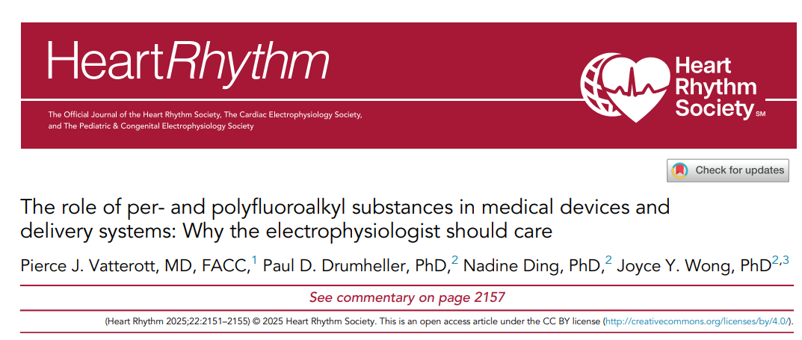
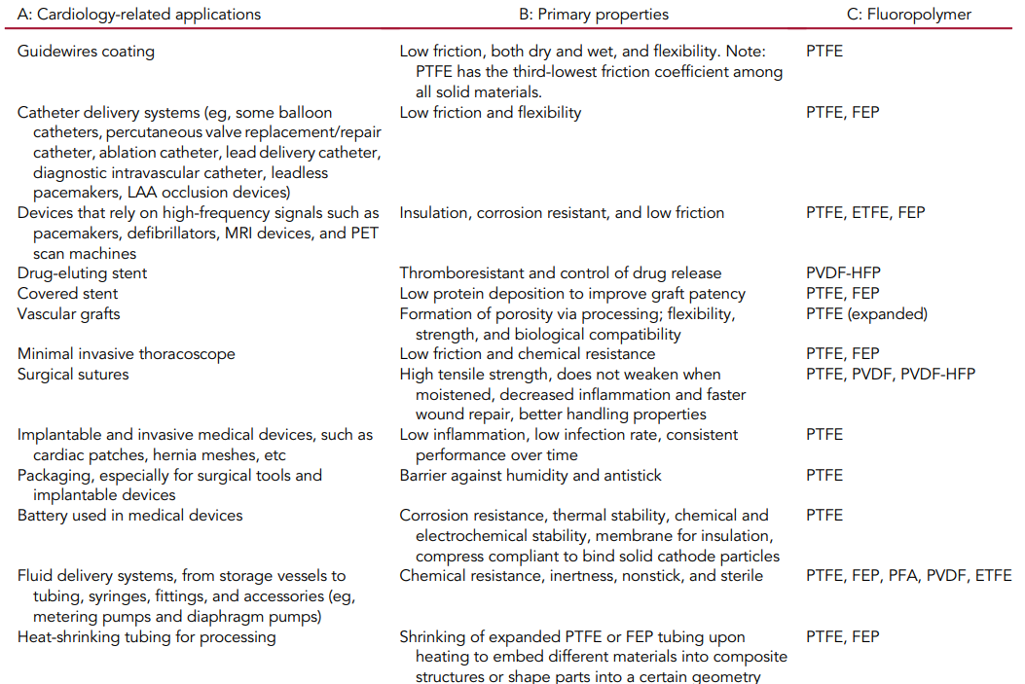
PFAS in cardiology

Slide 16
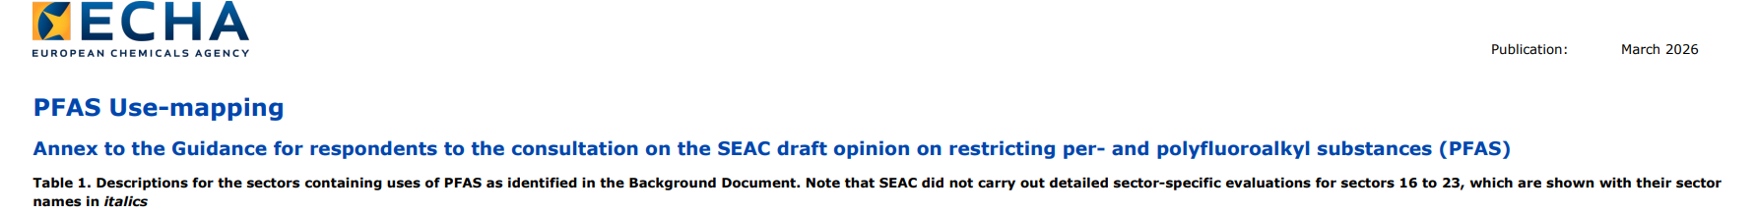
PFAS uses related to Medical Devices but NOT considered as part of this sector
Electronics & semiconductors: medical imaging equipment such as MRI and X-ray systems; medical electronics, except electronics in implantable or invasive medical devices.
Other medical applications: pharmaceutical excipients; drug-device combination products such as pMDIs, pre-filled syringes, injection pens, autoinjectors, on-body delivery systems and transdermal patches; immediate packaging for medicines.
Broader industrial uses: fluorinated gases used in medical-related industrial processes, including medical lasers.
Technical textiles: medical textiles such as blood filtration filters, transducer membranes, venting membranes, and virus or contaminant filtration membranes for water, air and other media.
TULAC sector: personal protective equipment, including protective clothing and medical drapes.
Construction products: PFAS-containing construction applications used in hospitals.
Food contact materials & packaging: packaging other than packaging for medical devices or medicines.

Slide 17
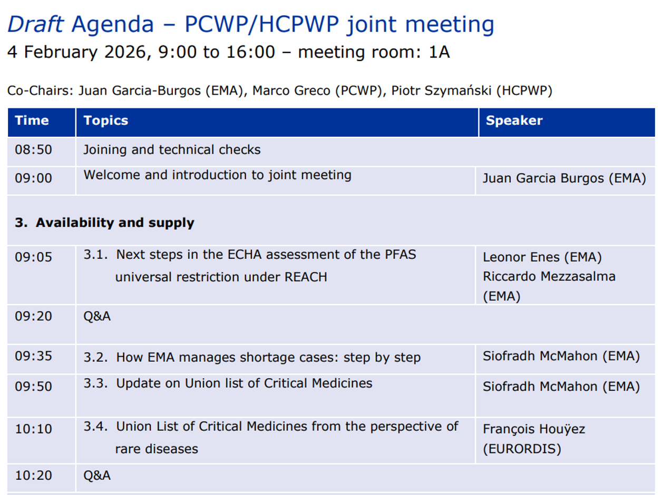

Slide 18
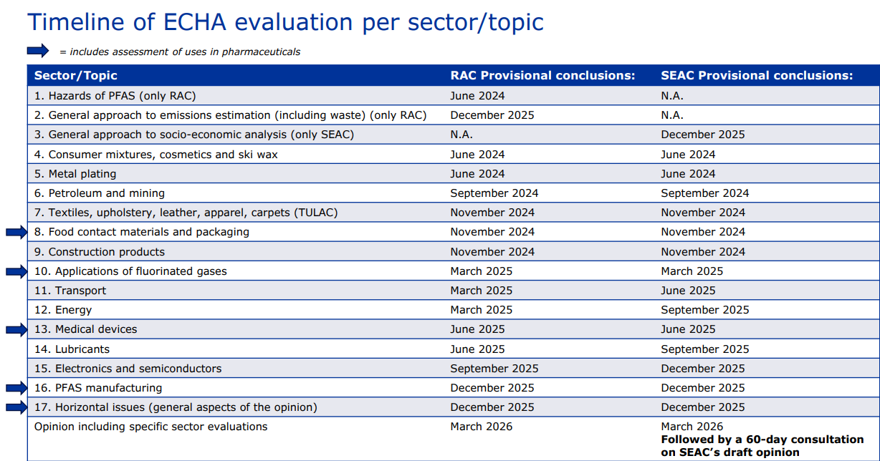


Slide 19
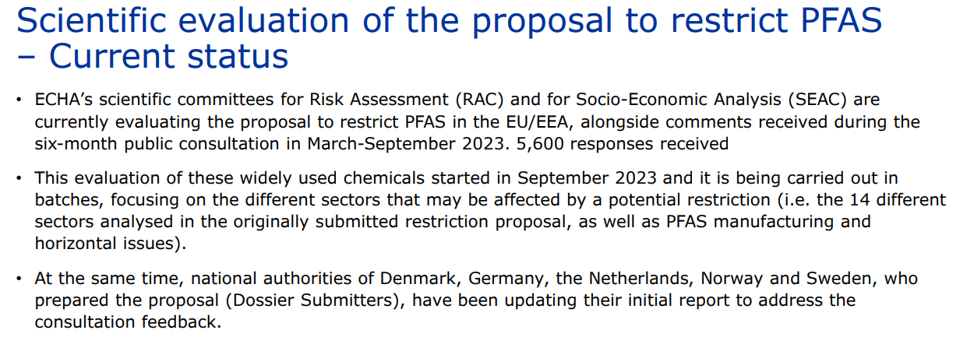
The European Chemicals Agency launched the 60-day consultation on SEAC’s draft PFAS restriction opinion on 26 March 2026. The consultation closed on 25 May 2026, with SEAC expected to adopt its final opinion by the end of 2026.

Slide 20
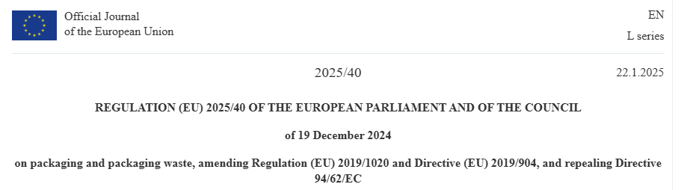
Packaging and Packaging
Waste Regulation
No „blanket exemption” for healthcare
Applies broadly to all packaging and packaging waste, regardless of material or sector. That includes packaging used for medicinal products, medical devices, IVDs, hospital supplies, sterile packs, transport packaging, pharmacy packs, e-commerce packs, lab consumables and logistics packaging. The regulation entered into force on 11 February 2025
and its general application date is 12 August 2026

Slide 21

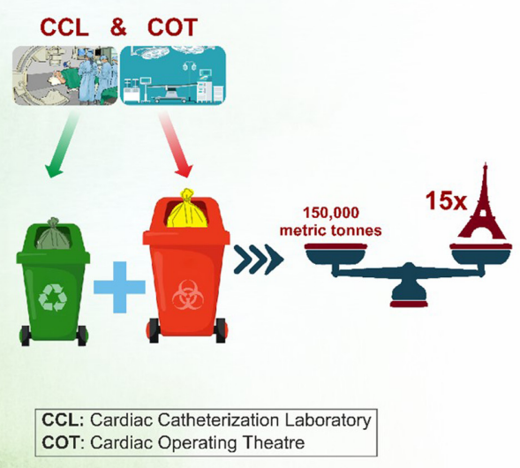
350 cardiac surgeries and 2900 interventional cases:
11,000 kg of recyclable waste
30,000 kg of contaminated waste are generated annually .
Extrapolated to all the cardiac cath labs and cardiac op. theaters globally, the anticipated annual waste production from invasive cardiac procedures is 150 million kg (150,000 metric tons)

Slide 22
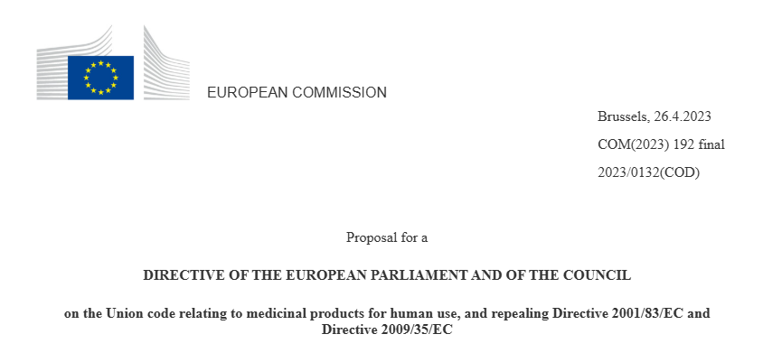
New Pharmaceutical
Regulation and Directive
The new pharma package strengthens
(Enviromental Risk Assessment) ERA requirements.

Slide 23
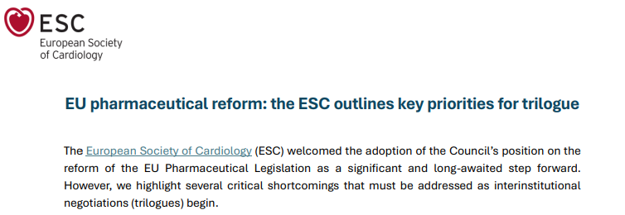

Key recommendations by the European Society of Cardiology:
Unmet Medical Needs (UMN) (Article 83, Directive)
Expanding the PRIME scheme (Article 60, Regulation)
Restored clinical influence in decision-making (CHMP) – inclusion of HCPs (Article 148)

Slide 24
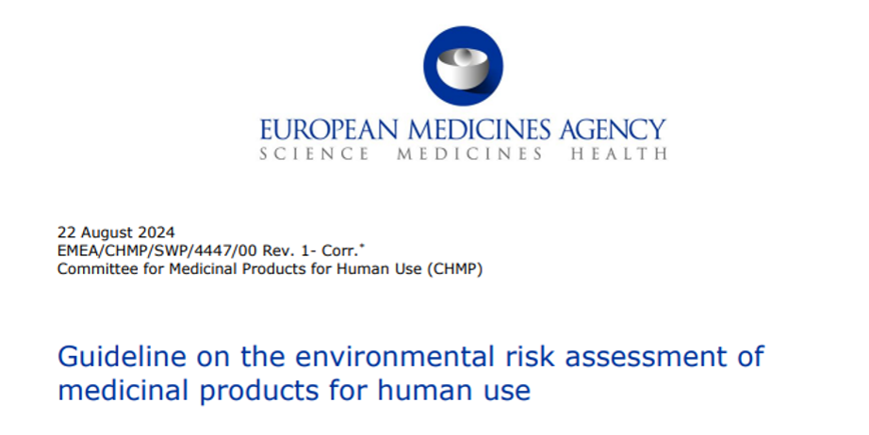
Environmental Risk Assessment
under the new EU pharma regulation
ERA becomes a stronger requirement in marketing authorisation applications.
Applicants must identify environmental risks and propose risk-mitigation measures.
Inadequate ERA or insufficient mitigation my affect authorisation decisions.
The scope expands beyond product use to a broader life-cycle perspective.
The aim is to reduce pharmaceutical residues in water and soil.
Notes:
First, after nearly two years of legislative debate, policymakers have reached a final deal on the pharmaceutical legislation reform last December. Country diplomats approved the final texts last Friday and the health committee of the European Parliament will vote next week. Then the file will be translated into all EU languages and formally adopted this autumn after a vote in plenary. We want to thank you very much for your input during the last months, on the legislative text first, then on the amendments and our various statements. It’s been a long journey - and we still have to go through the whole file (1k pages!) - but we checked those provisions on which we have been more vocal, and we can already share some key outcomes which are very much focused on HCP consultation [...]. + gender

Slide 25
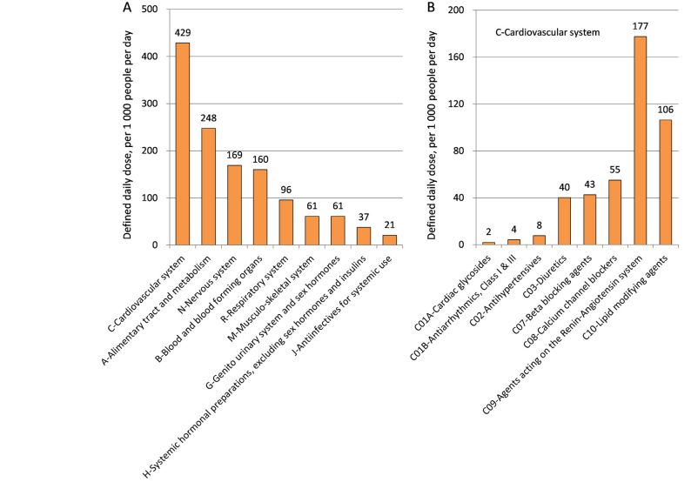
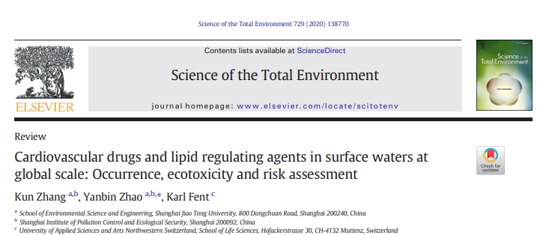
Drug consumption - OECD

Slide 26
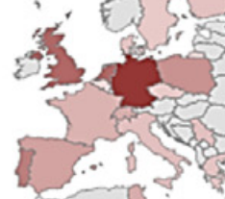
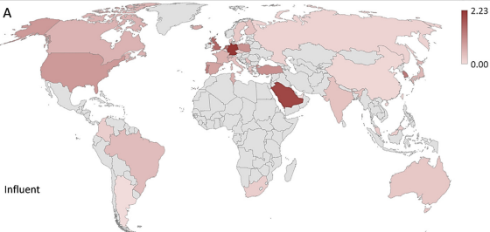
Concentrations of cardiovascular drugs and lipid regulating agents in municipal wastewaters

Slide 27
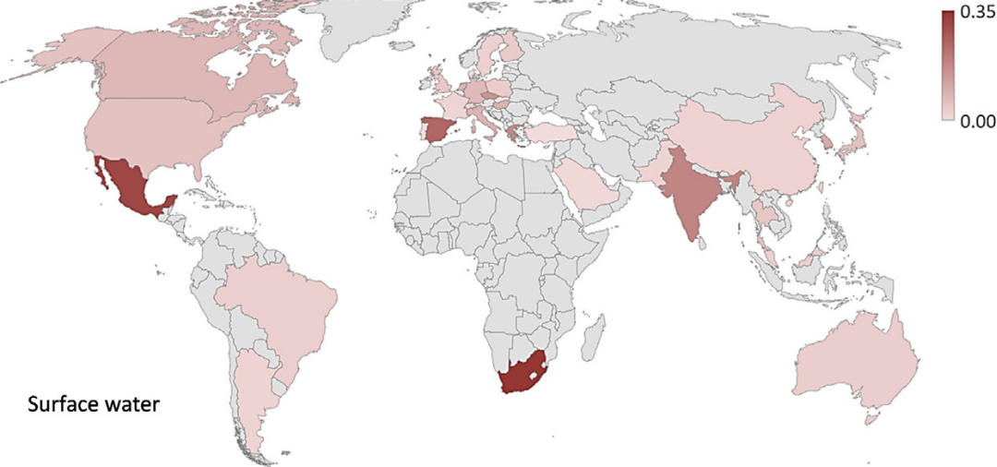
Concentrations of cardiovascular drugs and lipid regulating agents in surface waters

Slide 28
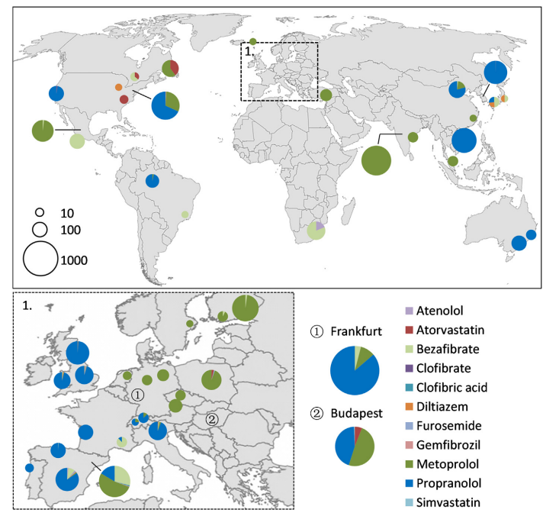
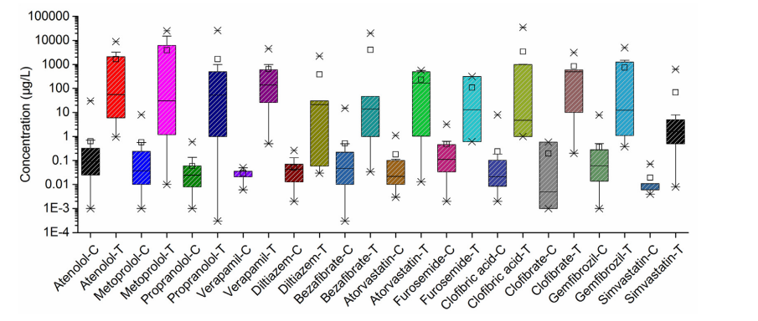
Environmental risks at global scale.
The risk index = ratio levels of drugs in water (C) and
lowest observed effect concentrations in aquatic organisms (T)

Slide 29
Stakeholders perspectives
on the environmental regulations

Slide 30
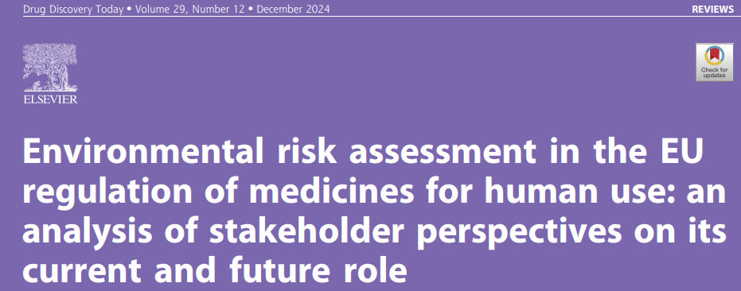
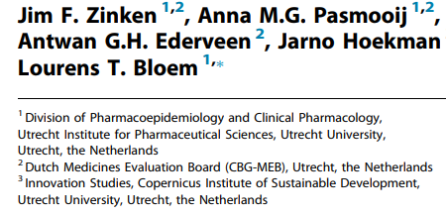
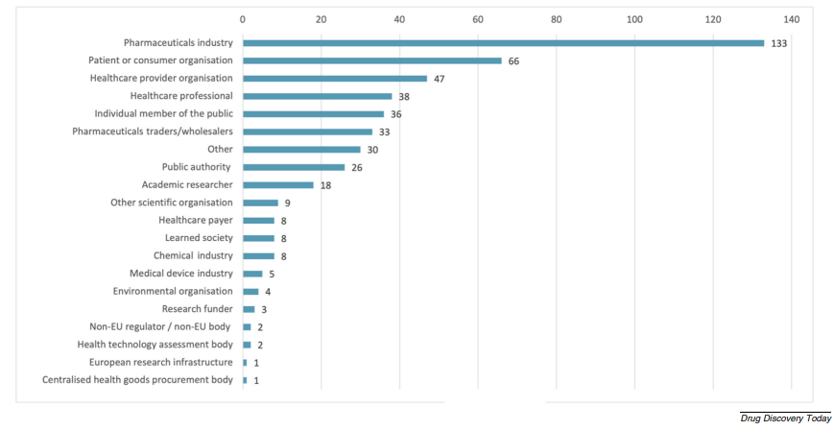

Slide 31
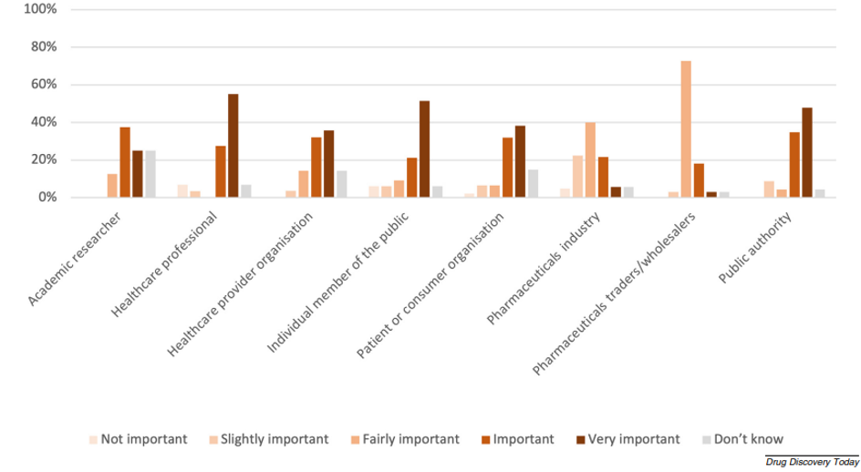
Stakeholders’ responses to the question: How would you assess the measure ‘Increase information to the health care professionals and the general public about the assessment of environmental risks of medicines’

Slide 32
Sustainable Cardiology: From Environmental Risk to Cardiovascular Responsibility
16 &17 June 2026
London, UK

Slide 33
Urban Wastewater Treatment Directive, especially micropollutants and extended producer responsibility for pharmaceuticals and cosmetics.
Water Framework Directive and related water-quality rules for pharmaceutical residues, antimicrobial residues and hospital discharges.
Industrial Emissions Directive for pharmaceutical manufacturing, sterilisation, chemicals, waste incineration and larger healthcare infrastructure.
Waste Framework Directive and the waste hierarchy.
Ecodesign for Sustainable Products Regulation.
Batteries Regulation for portable medical devices, implantables, emergency devices and digital health hardware.
Biocidal Products Regulation for disinfectants, sterilisation-related products and infection-control chemicals.
Energy Performance of Buildings Directive and Energy Efficiency Directive for hospitals and healthcare estates.
EU ETS, Effort Sharing Regulation, CSRD/ESRS, EU Taxonomy,
Corporate Sustainability Due Diligence Directive and Green Public Procurement.

