Slide 1
Green Innovation – lowering the environmental footprint of MedTech
Shikha Pillai,
Head of Sustainability, Siemens Healthineers
16th June 2026

Slide 2
Sustainability is a healthcare imperative
and MedTech innovation is critical to scale impact
Up to 5.5%
increased mortality risk
with every 1 °C rise in global temperature¹
Innovations in MedTech
key to better, scalable patient care – with lower environmental impact and cost
The healthcare sector is one of the biggest contributors to climate change.
Radiology is responsible for 7.5% of a hospital’s total energy consumption³
Healthcare sector fifth-largest emitter worldwide if it were a country²
Net CO₂ Emissions
Traditional MRI systems require ~1,500 litres of liquid helium – a finite, non-renewable resource
29% China
14% United States
7% India
When equipment reaches end-of-life, embedded materials are lost if scrapped (rather than refurbished or upgraded)
4.7% Russia
4.4% Healthcare sector
1 aboutDigitalHealth, “Net Zero Healthcare”: https://aboutdigitalhealth.com/2022/09/20/net-zero-healthcare-pharma, viewed October 25, 2023. | 2 Karliner J, Slotterback S, Boyd R, Ashby B, Steele K, Wang J. Health Care’s climate footprint: The Health Sector Contribution and opportunities for action. European Journal of Public Health. 2020;30 (Supplement_5) | 3 Aunión-Villa, J., Gómez-Chaparro, M. & García-Sanz-Calcedo, J. Study of the energy intensity by built areas in a medium-sized Spanish hospital. Energy Efficiency 14, 26 (2021)
Notes:
As a global MedTech company, we work every day to address life-threatening diseases, by advance technologies to support early diagnosis and comprehensive treatment toward better patient outcomes. But our own contribution to healthcare’s environmental impact is not insignificant.
Whether it is through energy-intensive equipment — especially in radiology — or through dependency on scarce planetary resources, or simply through not closing the loop well enough and therefore creating waste, we are part of the system that creates adverse planetary impact. And even as sustainability for us is very much “S” centered, we see ourselves accountable for the “E” - because human health depends on the health of the planet. In today’s world and looking ahead, it’s also clear that we will reach limits in scaling impact unless we decarbonize our value chains and work jointly toward a better, more resilient healthcare system.

Slide 3
Siemens Healthineers is committed
to preserving our planet’s resources
At Siemens Healthineers, we want to advance a world
where breakthroughs in healthcare create new possibilities
with a minimal impact on our planet.
“
We aim to minimize the environmental impact
throughout the lifecycle of our solutions.
For us as a company, business and sustainability are one integrated set of goals.
We are committed to driving decarbonization
across our value chain and promoting circularity.
“
We are committed to developing sustainably designed products and services that also help our customers meet their targets.
Bernd Montag
CEO, Siemens Healthineers
Notes:
This is why for us at Siemens Healthineers, sustainability is not a parallel agenda. It’s very much a part of how we create societal impact so we embedded sustainability into our purpose. And I quote Bernd here - business and sustainability are one integrated set of goals, and we believe business decisions need to pay into sustainability as sustainability decisions also need to make business sense. When we look at environmental priorities – the lifecycle of our products, the lifetime, and our operations and value chain – are all areas we intend to shift – not only to reaching our own goals, but also to enable our customers to reach their goals and to support better care for patients.

Slide 4
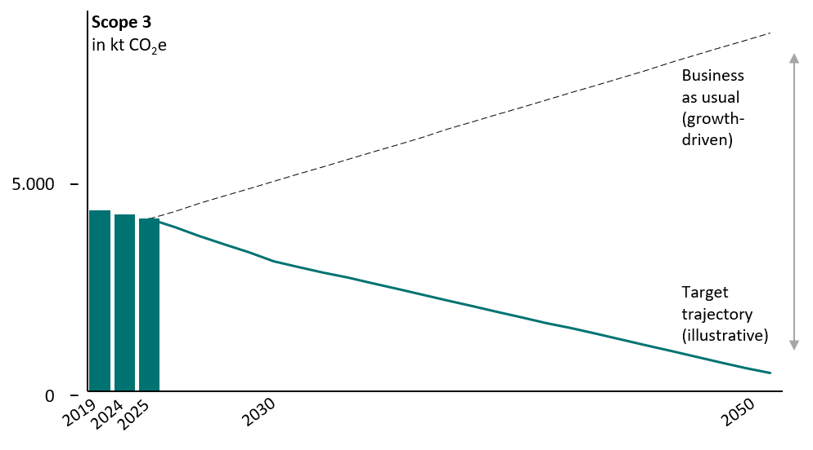
Net Zero, especially Scope 3 reduction, inherently challenging due to dependency on external factors
The Scope 3 challenge
Scope 3 represents 97% of our total emissions
Reduction requires structural decoupling of emissions from growth through key levers for e.g.
Supplier engagement and sourcing
Transportation
Product design and circularity
Customer engagement
Business travel
Notes:
However, the real challenge lies in Scope 3 emissions – because this is the majority of emissions – for us 97% - and contingent on factors beyond our control. Reducing absolute Scope 3 emissions is not a linear curve downwards – we have to compensate for growth so it is much harder to do as growth drives Scope 3 upwards. And with long product lifecycles, this reduction is also often flat in the first years with more steeper reductions when product level decisions start to have impact.

Slide 5


Embedding sustainability in product design and innovation is key to reduce Scope 3 emissions
Our commitment
Net zero
90% reduction in Scope 1 & 2 emissions by 2030¹
28% reduction in Scope 3 emissions by 2030¹,
90% reduction by 2050¹
Sustainable by Design
Lowering environmental impact through sustainably designed products and circular solutions
Key priorities for product design to lower lifecycle and lifetime footprint
Responsible Material Use
Energy Efficiency
Lifetime Optimization
Waste Reduction
Prioritizing low carbon and secondary materials
Optimizing energy consumption across the product lifecycle
Providing upgrades and refurbishment, advancing reuse
Reducing material waste –
in products and packaging
Limit dependency on scarce resources
ü
ü
ü
Lower end-of-life burden
ü
Scale resources for more patients
Reduce emissions and total cost of ownership
Preserve and recover equipment value
ü
1 Compared to baseline 2019
Notes:
How we addressed this: having set science based targets towards net zero in our own operations and value chain, that are also validated by SBTi, because such targets drive action across the company and help significantly in aligned priorities that are backed by the leadership at all levels. Like most others, we are able to drive significant progress in Scope 1 & 2 decarbonziation, but Scope 3 is where we have engaged most of our calories today. And while there are many levers where we do not have full control, what we can influence is our products and how we steer the design, manufacture and use of them. So we adopted the approach we call Sustainable by Design — this embeds EcoDesign and Circularity priorities in products at the outset, to advance along the 4 areas of
Responsible material use, choosing low-carbon and secondary material, as well as designing for reuse
Energy efficiency to reduce energy consumption in the use phase
Lifetime optimization through upgrades, refurbishment business models and repair processes
And waste reduction measures in products and packaging
These are key to reduce lifecycle and lifetime footprint — but they also directly translate into lower total cost of ownership, better utilization and the ability to serve more patients with the same resources.”

Slide 6
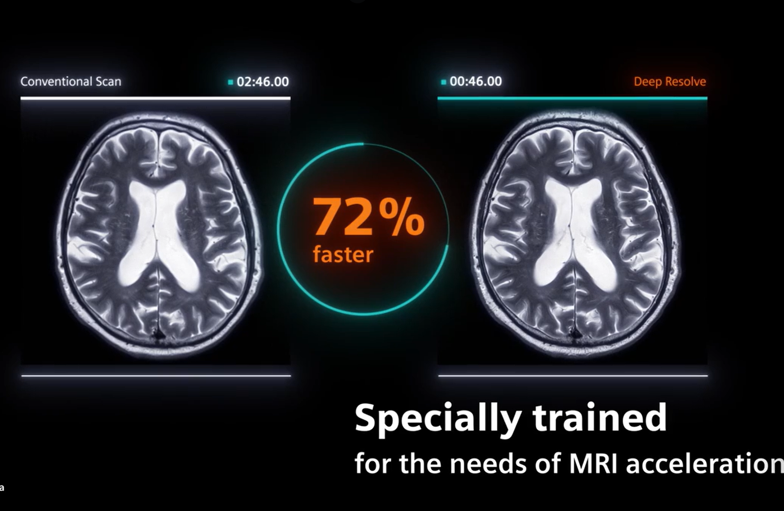
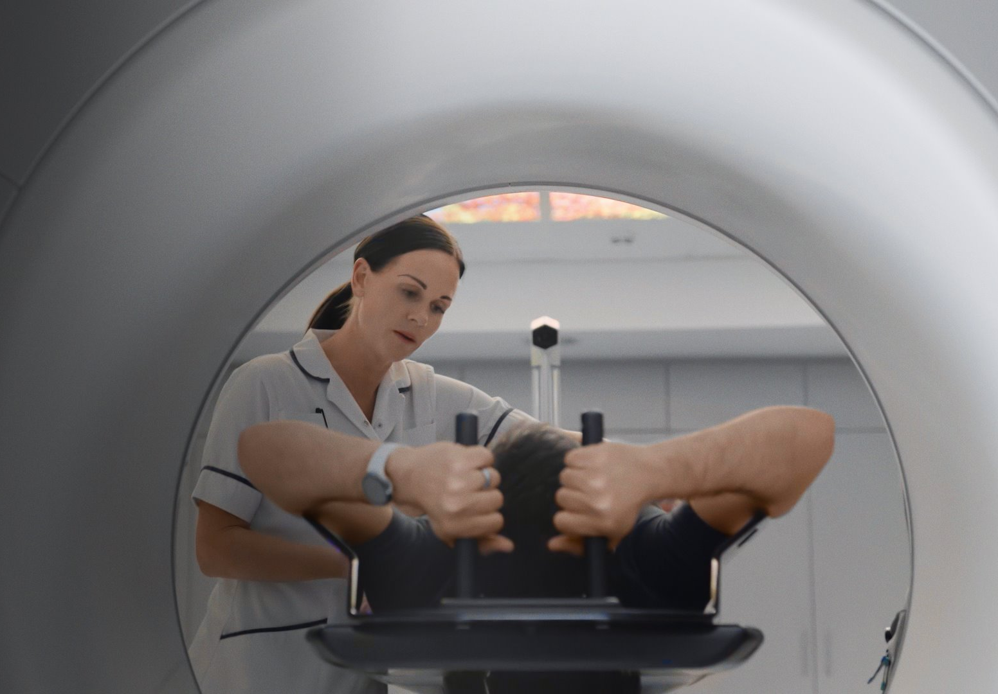
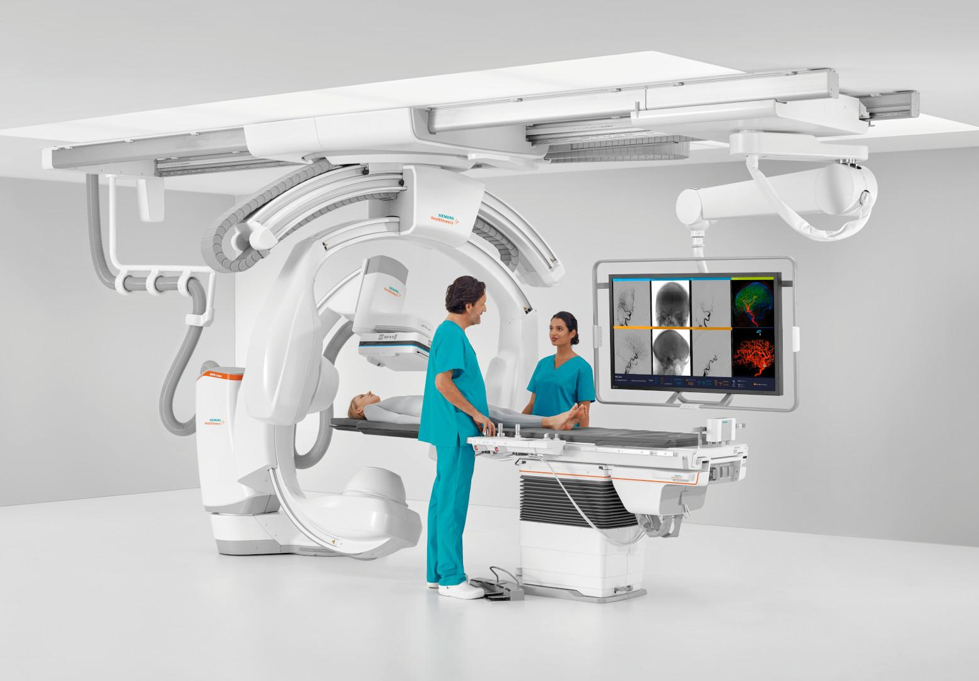
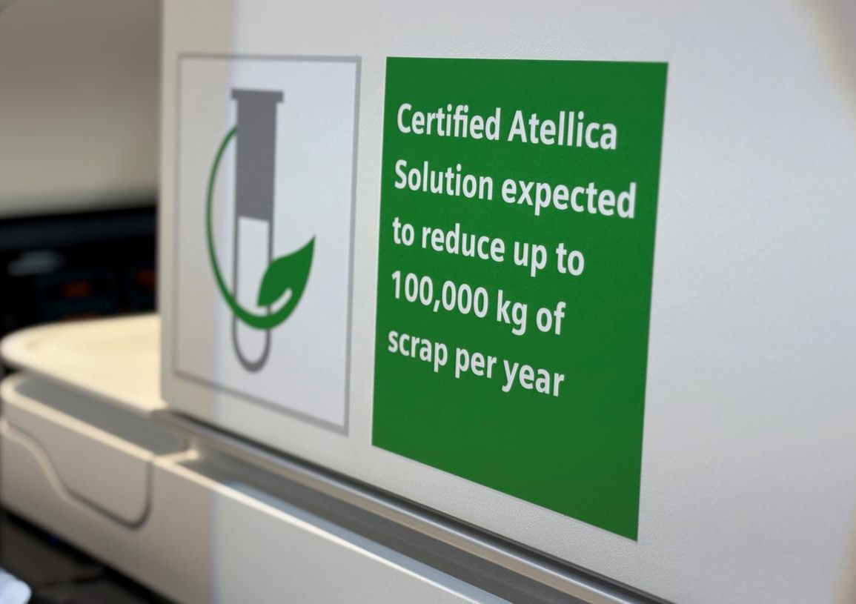
Innovation in action – key examples
Low-helium MRI
  DryCool technology uses only 0.7 liters of helium, reducing helium inventory in new MRI scanners by up to 99%¹
AI-driven Efficiencies
  Deep Resolve AI-based reconstruction solution enables up to 73% faster MRI scanning¹, reducing energy consumption
System Upgrades
  Upgrades modernize imaging systems while extending lifetime, and saving significant material-related emissions
Energy-Efficient Therapy
  Varian Halcyon system delivers more treatments using 70% less energy - lowering costs and environmental impact²
Sustainable Design
ARTIS icono designed for >95% recyclability, lower energy consumption and with packaging optimizations¹
Lower environmental footprint of Diagnostics
  Atellica solutions reduce plastic waste, water and CO₂ while increasing lab testing capacity significantly²
1 Data on file. 2. For more information. visit https://www.siemens-healthineers.com/sustainability-in-healthcare/environmental-sustainability
Notes:
Let me make this tangible through a few examples
With the DryCool technology, we’ve been able to reduces helium usage to as little as 0.7 litres — effectively removing dependency on a scarce resource.”
AI is a major lever today for efficiency – and our Deep Resolve AI-based reconstruction is able to enable faster MRI scanning that helps reduce energy consumption and improves patient throughput.
We provide upgrades and refurbished systems. Our CT FitUpgrade programme helps upgrade to the next generation of innovation, while preserving resource-intensive components and saving more than 80% of material-related CO₂ emissions compared to a full system replacement.
And we design radiation therapy and interventional imaging systems for lower energy consumption, higher recyclability, optimizations in packaging and transportation, and supporting more treatments. We are also the first in-vitro manufacturer to earn the MyGreenLab ACT EcoLabel for our Atellica solution that delivers measurable energy, water reduction and optimizes plastic waste and CO2 for labs. While increasing testing capacity. All of these are strong examples for how through product innovations, we preserve resources and reduce our footprint while helping to deliver more and better care.

Slide 7



Scaling sustainable healthcare requires systemic shifts
From opacity → transparency
From lighthouses → scalable models
From fragmentation → alignment
Standardized product-level data (EPDs¹, lifecycle data)
Transparency across the MedTech supply chain
Data-based decisions based on shared standards
Broader adoption of innovation and environmental priorities embedded in all key decisions
Scale through validated, repeatable models
Shaping green procurement frameworks and policies
Cross-sector collaboration and strategic partnerships to drive aligned Scope 3 action
Make environmental performance visible and comparable
Embed solutions at system level to scale impact
Align action across industry, providers and policymakers
1 Environmental Product Declarations
Notes:
But it’s important to position that product innovation alone is not enough. We see key shifts in addition that I would like to outline as imperatives for us and across healthcare:
First — driving transparency.
If we want better decisions, we need better data.
For us, that means doing lifecycle assessments and having environmental product declarations for our products, and credible data from our supply chain — but also adopting standards and getting external validation.
Second — building scalable models.
The examples show what is possible but we know that we have to embed environmental priorities in day-to-day decisions across operations, supply chain and product lifecycle to make this the default way of operating. Through collaborations with hospitals, we also have seen that combining technology with improvements in workflow and clincal practice can reduce footprint, create operational efficiencies and increase patient throughput.
And third — driving aligned action
because we cannot drive broader impact in healthcare if industry, providers and policymakers move in different directions. We are part of the Medical Equipment Proactive Alliance for Sustainable Healthcare that is driving the development of green procurement criteria. Tis is a good example of aligned action that sets standards and drives systemic long-term change.
In closing, I would emphasize that we need to work towards care that is sustainable by default. The challenge is no longer proving what works — it’s making it scale so that we all can elevate healthcare for every patient, everywhere.

Slide 8
Thank you!
Siemens Healthineers
Siemensstraße 3,
91301 Forchheim,
Germany
siemens-healthineers.com
  Shikha Pillai
  Phone: +49 1741967001
  Email: pillai.shikha@siemens-healthineers.com

