Slide 1
Impact of the cardiovascular field on the environment
Tom De Potter
16 June 2026
Notes:
Hello, good afternoon everyone.
I’m Tom De Potter, Cardiology resident and PhD researcher from Brussels. My research primarily focuses on the impact of environmental factors on cardiovascular health. But, for today’s session, however, I was asked to look at the issue from the opposite perspective: what is the impact of cardiovascular healthcare on the environment?

Slide 2
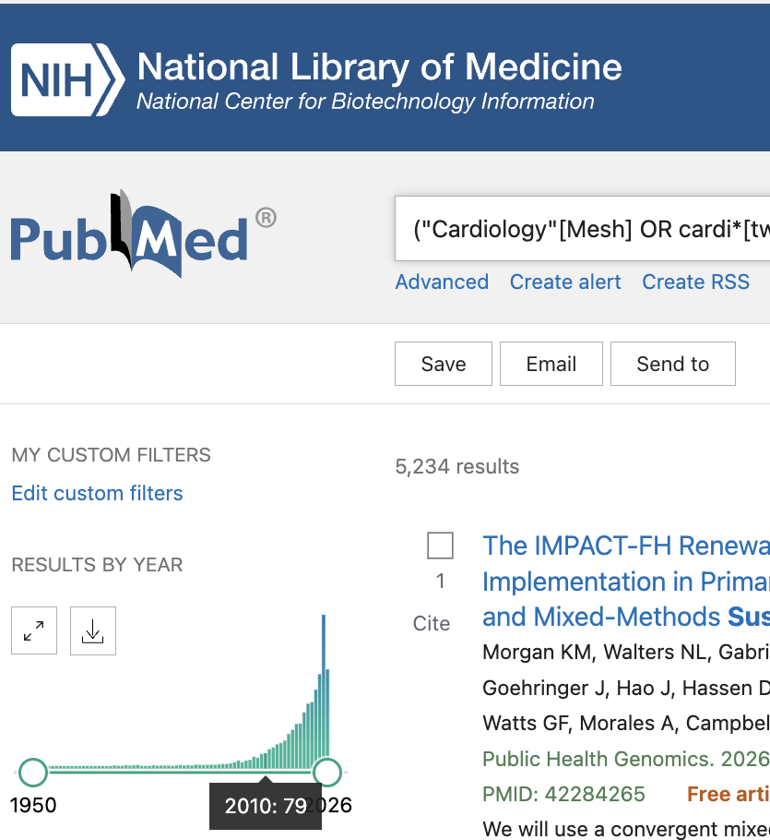
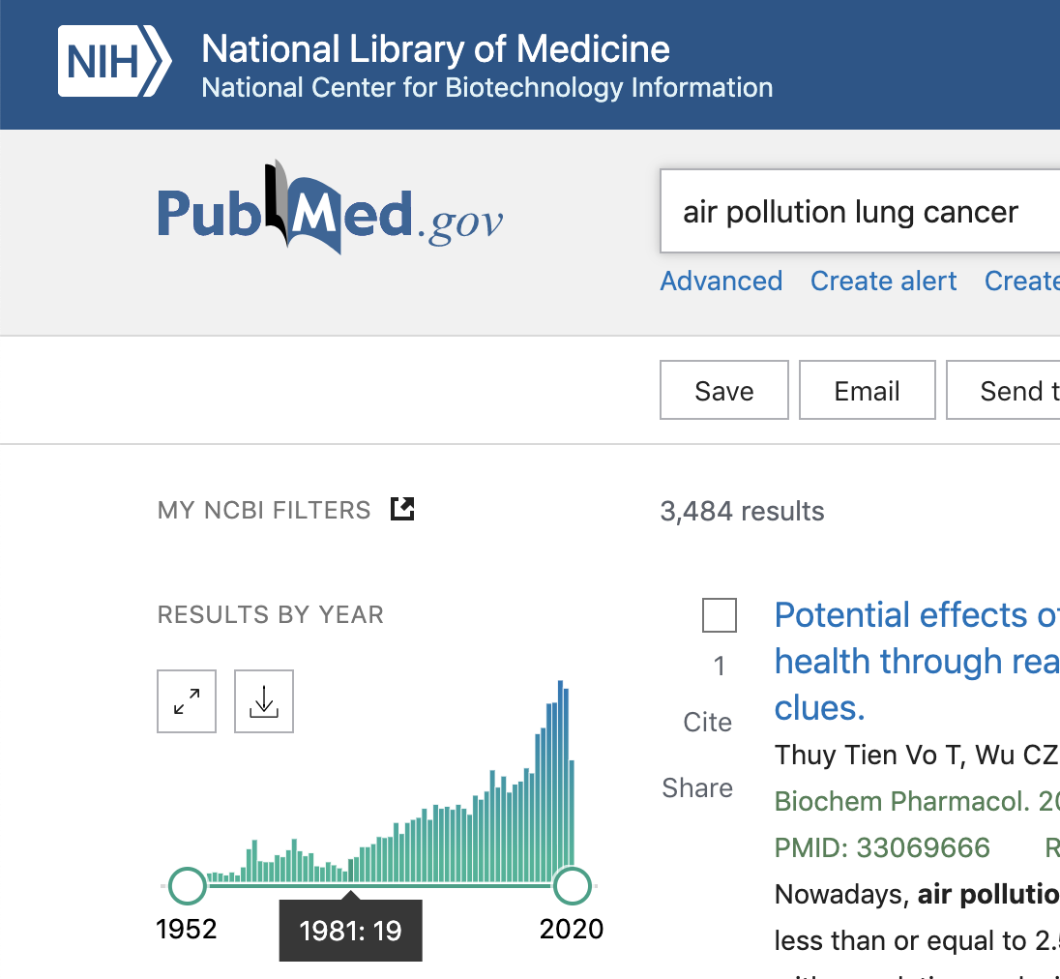
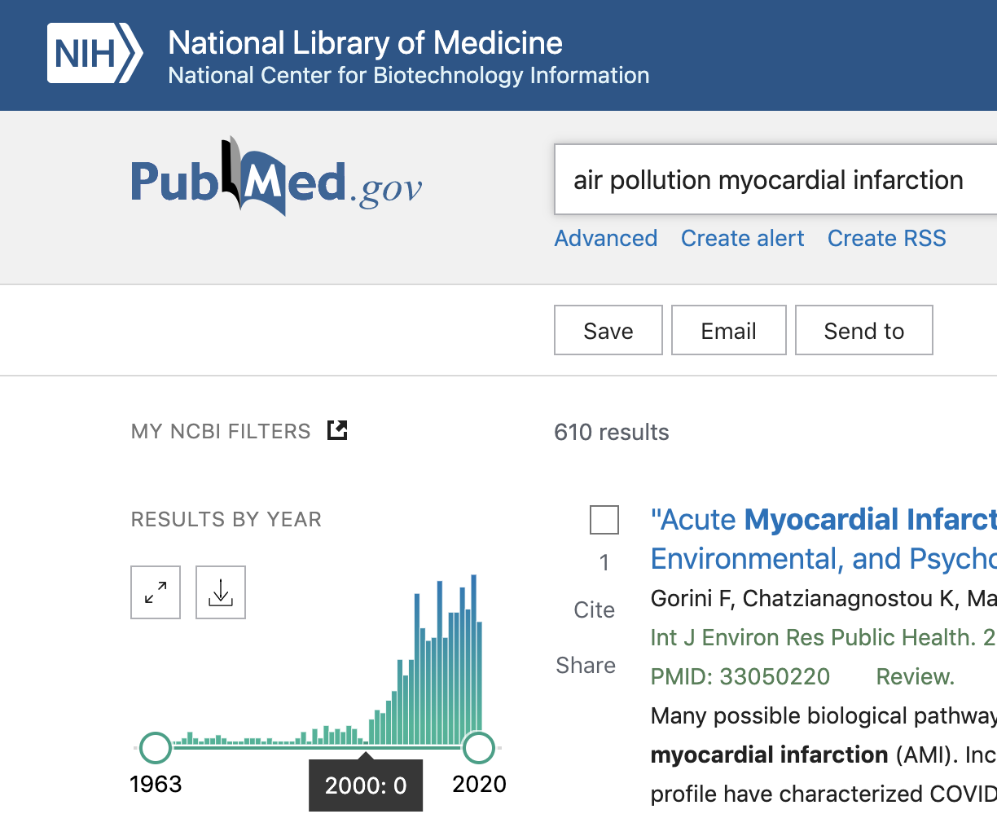
Late recognition
Notes:
I often start my presentations by highlighting that the environmental impact on cardiovascular diseases was recognized with a delay of 2 decades compared to the the link between air pollution and cancer. Today, we actually know that the cardiovascular burden exceeds the cancer burden with regard to the environment.
Interestingly, a similar delay occurred when considering the inverse relation: the impact of our cardiovascular healthcare on the environment

Slide 3
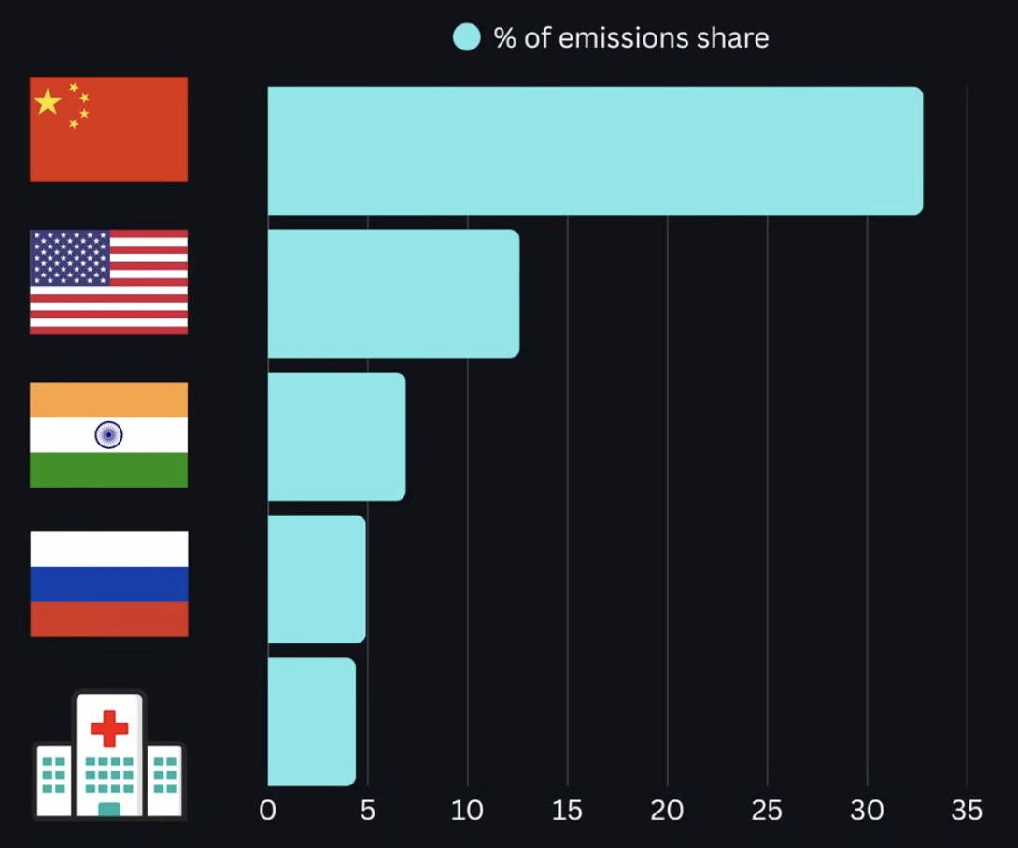
Health care sustainability
4-10% of greenhouse gas emissions
If global healthcare was a country…
Notes:
We now recognize that healthcare is a major contributor to global greenhouse gas emissions. Globally, healthcare accounts for 4.4% of total emissions. In some countries such as the United States, this figure may even reach 8 to 10%.
To put this into perspective, if global healthcare were considered a country, it would rank as the fifth-largest emitter of greenhouse gases worldwide.

Slide 4
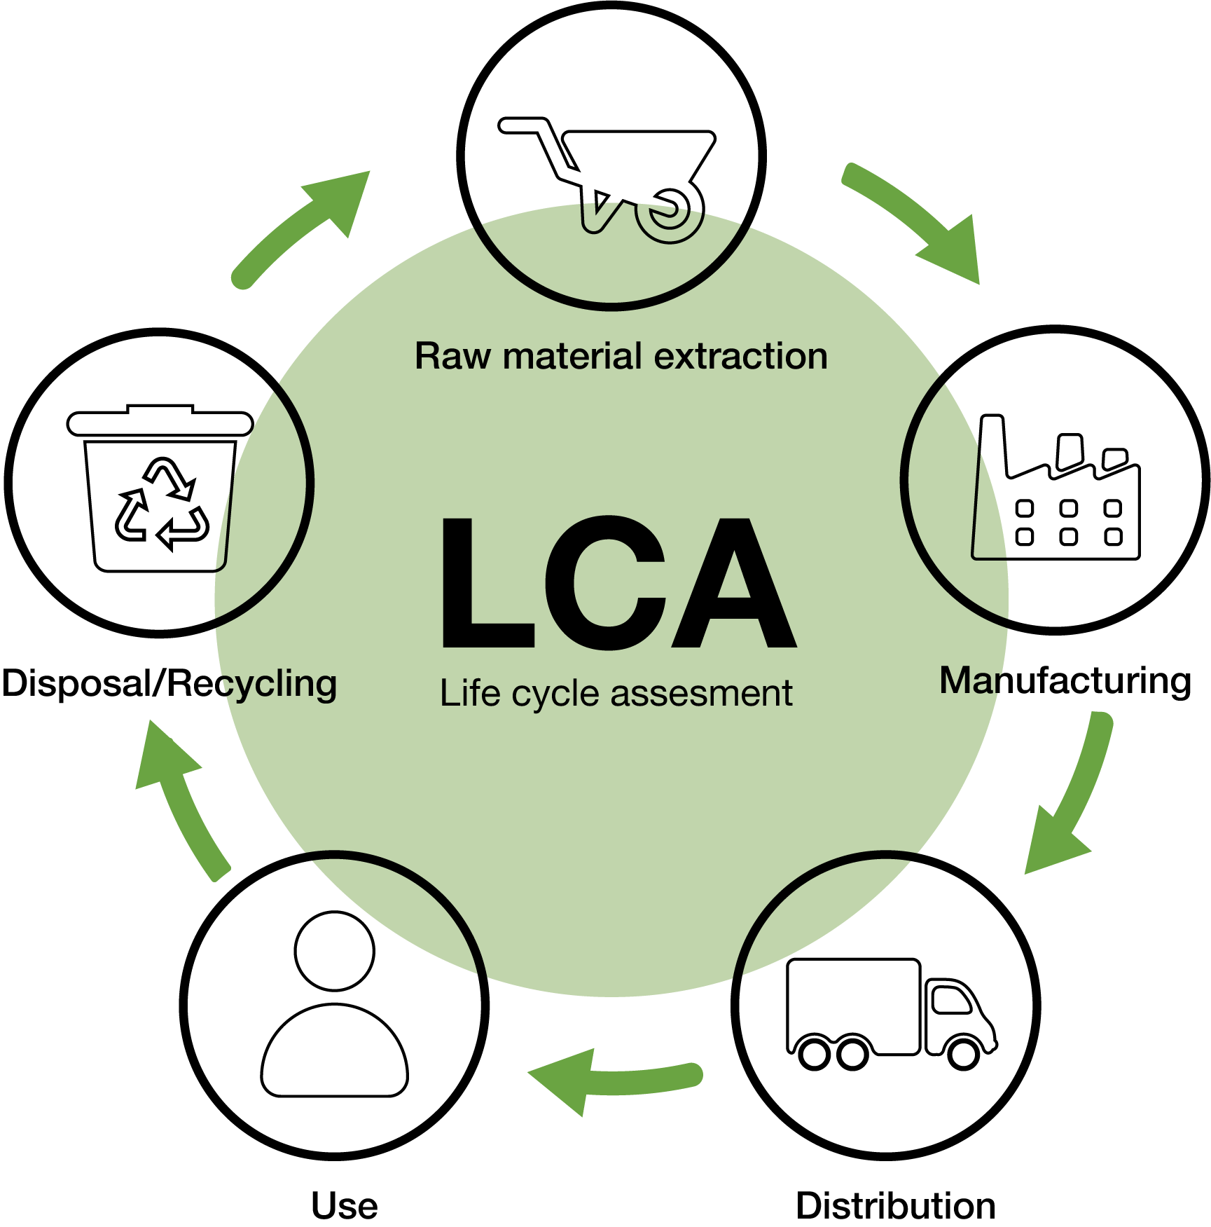
Carbon emission
Life cycle assessment
C + O₂ → CO₂ + heat
1L gasoline = 2.3 kg of CO₂
Carbon footprint per capita
  Western countries: 8.000 kg CO₂e
  Worldwide: 5.000 kg CO₂e
  Goal: 2.000 kg CO₂e
Notes:
So how do we actually quantify the carbon footprint of a product?
The most widely accepted approach is the Life Cycle Assessment, or LCA, evaluating every stage of a product’s life cycle, including raw material extraction, manufacturing, distribution, use, and finally disposal or recycling. The goal is to estimate the greenhouse gas emissions associated with each step.
At its core, this comes down to a simple chemical reaction: 1 carbon atom combines with 2 oxygen atoms to form carbon dioxide and release energy.
Including the atomic mass of carbon, the density and pureness of gasoline, burning one liter of gasoline results in approximately 2.3 kilograms of carbon dioxide emissions.
For reference, the average annual carbon footprint in most Western countries is around 8,000 kilograms of CO₂ per person, while the global average is somewhat lower, at approximately 5,000 kilograms.
However, if we are to meet the climate targets established under the Paris Agreement in 2015, this figure would need to decrease to roughly 2,000 kilograms of CO₂ per person per year.

Slide 5
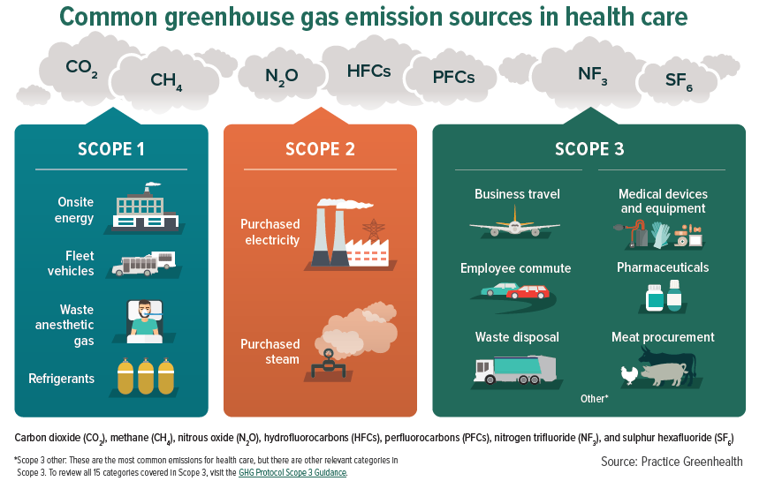
Direct vs indirect emmission
30% of waste coming from the OR
1 OR per day = family of 4 per week
70% considered hazardous waste…
± 20%
± 10%
± 70%
Notes:
When assessing the environmental impact of an entire healthcare system, a different framework is typically used: the Greenhouse Gas Protocol.
This framework categorizes emissions into three distinct scopes.
Scope 1 includes direct emissions generated on-site. In a hospital setting, this includes fuel combustion, hospital fleet vehicles, refrigerants, and anesthetic gases, accounting for approximately 20% of the total healthcare carbon footprint.
Scope 2 includes indirect emissions from purchased electricity, heating, cooling, and steam, contributing roughly 10%.
Finally, Scope 3 encompasses all other indirect emissions across the value chain. This is by far the largest contributor, accounting for approximately 70% of healthcare-related emissions. It includes pharmaceuticals, medical devices and equipment, employee commuting, business travel, food procurement, and waste management.
Importantly, this framework is not only useful for quantifying emissions—it also helps identify opportunities for reduction.
For Scope 1 and Scope 2 emissions, hospitals can transition towards renewable energy sources, improve energy efficiency, and reduce the use of high-impact anesthetic gases.
For Scope 3 emissions, interventions may include promoting public transportation, facilitating teleconsultations when clinically appropriate, optimizing supply chains, and reducing unnecessary consumption of single-use materials.
Today, however, I would like to focus on one specific component of Scope 3: waste management.
From a purely carbon perspective, waste management contributes only a relatively small proportion of total healthcare emissions, estimated at around 3%.
However, its impact extends far beyond greenhouse gases alone.
Healthcare waste contributes to environmental pollution through incineration emissions, landfill contamination, and the release of microplastics into different ecosystems, subsequently entering our food chain.
To give you some numbers: approximately 30% of all hospital waste originates from operating rooms and cath labs. In fact, a single operating room can generate as much waste in one day as a family of four produces in an entire week.
What is even more remarkable is that approximately 70% of the waste generated in these environments is ultimately disposed of as hazardous waste.
But is that actually justified?

Slide 6
Medical waste
Frequently
30%
70%
CDC/WHO
3-15%
Non-hazardous
Hazardous
  Sharp
  Infectious & pathological
  Chemical
  Pharmaceutical & cytotoxic
  Radioactive
“domestic”
No recycling
Needs to be sterilised
Special incineration/landfill
→ 10x higher cost, 4x higher carbon footprint
Notes:
To give you an overview: medical waste is traditionally divided into two broad categories: non-hazardous waste, considered as ”domestic” waste and hazardous waste. Hazardous waste can be further classified into different categories, but most importantly:
it cannot be recycled,
it needs to be autoclaved to be recategorized into non-hazardous waste, an additional energy-intensive process. And I hear you thinking, why doing so if everything is eventually incinerated or dumped into landfills.
Well, the conditions of incineration and landfill are far mor strict. In Belgium, for example, only 2 of the more than 70 incinerators, are allowed to handle hazardous medical waste. As a result, incorrect waste segregation may increase disposal costs by up to ten-fold and generate approximately four times more carbon emissions compared with appropriate disposal pathways.
In practice, studies have shown that up to 70% of waste generated in hospitals and operating rooms is disposed of as hazardous waste. However, according to World Health Organization guidelines, only approximately 5% of healthcare waste should actually require hazardous waste processing.

Slide 7
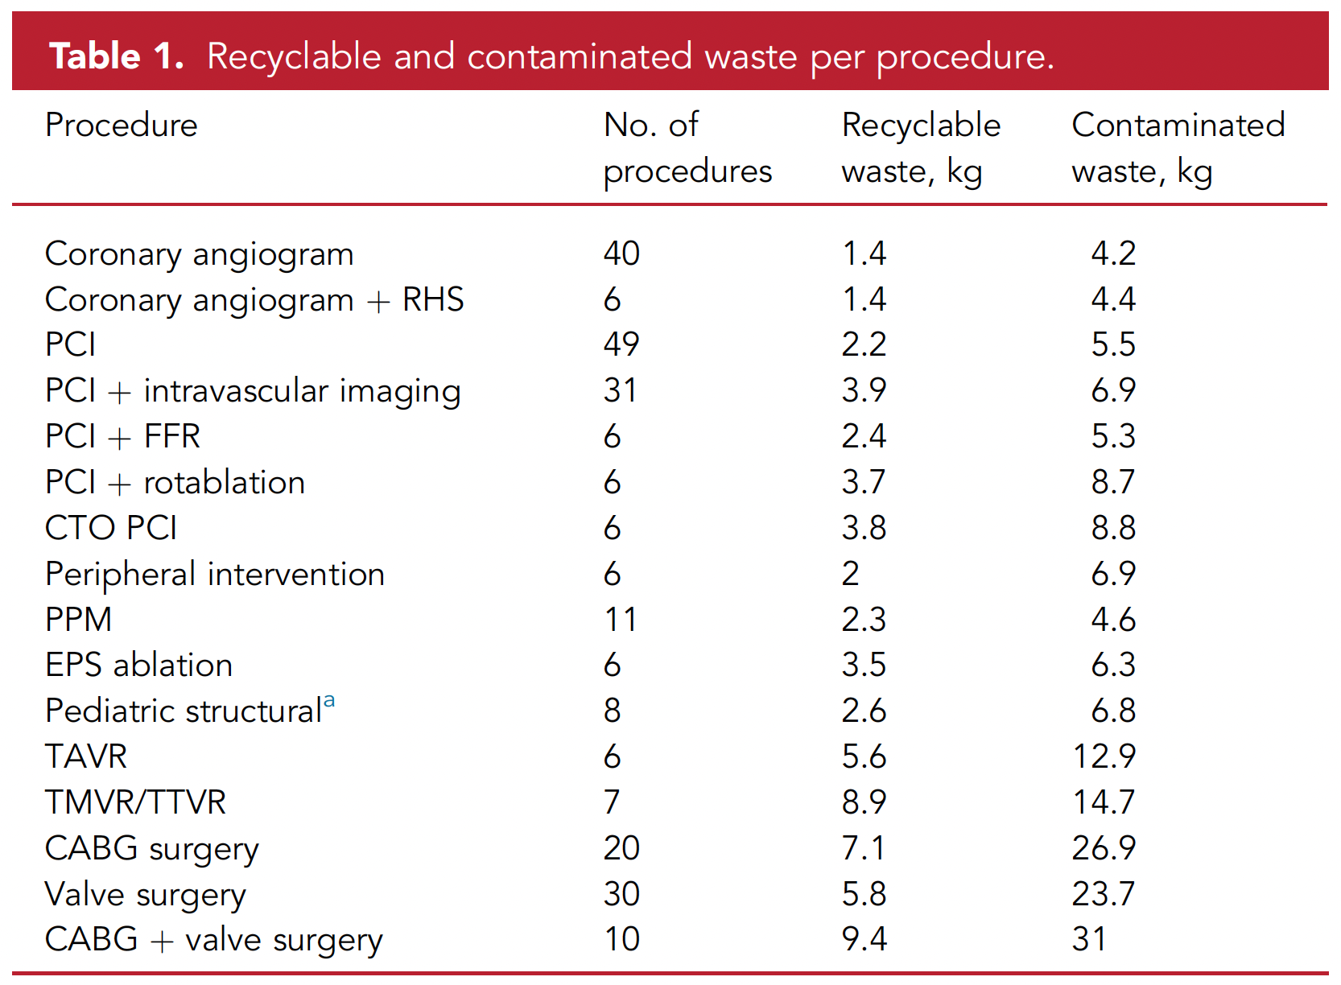
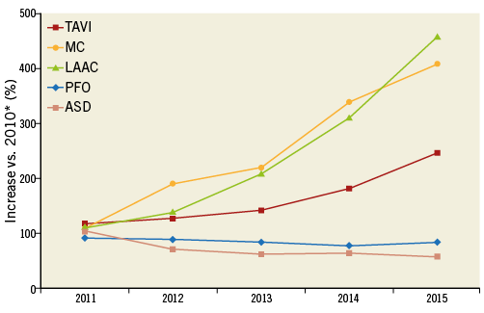
Focus on structural cardiology
TAVR: 280-360kg of CO2e
= 6 flights London-Brussels
Notes:
We wanted to illustrate the case of TAVR procedures. Because, as you know, structural cardiology is one of the fastest-growing fields within cardiovascular medicine, as reflected by the continuously increasing number of procedures performed across Europe. However, these procedures are also associated with substantial environmental impacts. Several studies have shown that structural interventions generate two to three times more waste than a standard percutaneous coronary intervention.
For example, the carbon footprint of a single TAVI procedure is estimated to be approximately 300 kilograms of CO₂-equivalent emissions. To put this into perspective, that is roughly comparable to three return flights between London and Brussels.
What makes this particularly interesting is the composition of the waste itself.

Slide 8
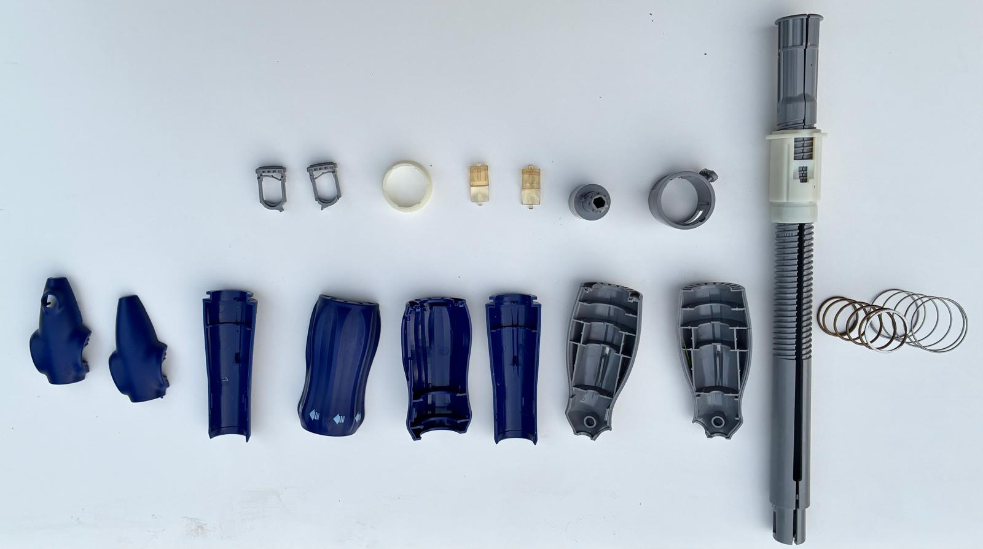
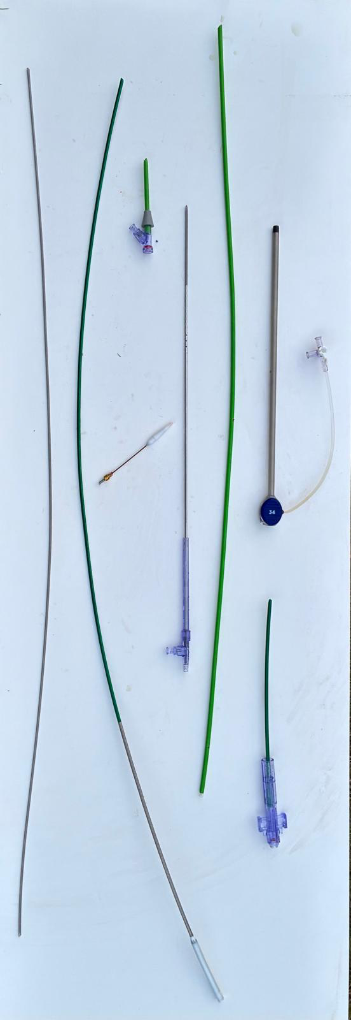
TAVR waste
Valve: 4 g
Waste: 1396 g > 99%
  Non-hazardous: 1320 g > 95%
  Hazardous: 76 g < 5%
Notes:
A transcatheter valve system, including the box it comes with, weighs approximately 1,400 grams. Yet the valve itself weighs only about 4 grams. In other words, more than 99% of the material entering the catheterization laboratory ultimately becomes waste.
Furthermore, the remaining waste consists of a complex mixture of plastics, metals, paper, cardboard, and potentially contaminated materials, making recycling challenging.
We therefore decided to take a closer look.
Excluding the outer cardboard packaging—which is generally recycled and is not shown here—we manually separated and categorized all components of a commercially available TAVR system.
Out of approximately 1,396 grams of material, we found that 1,320 grams, representing more than 95% of the total weight, could theoretically be recycled.
Only 76 grams of material had direct contact with patient blood and could reasonably be considered hazardous waste.
This example highlights a major challenge within cardiovascular healthcare. Although the overwhelming majority of material generated during these procedures is potentially recyclable, much of it is routinely discarded into hazardous waste streams, where recycling is no longer possible.

Slide 9
TAKE HOME MESSAGE
(CV) Healthcare has an important environmental footprint
Most emissions arise from the healthcare value chain (Scope 3)
Sustainability should be integrated into future CV innovation
  Optimize the waste-to-device ratio.
  Develop reusable components where feasible.
  Establish recycling pathways for disposable, non-contaminated or
  superficially contaminated, materials.

