Slide 1
ESC environmental responsibility
Reflections on conflict of interests
JF Riffaud
16 JUNE 2026

Slide 2
No conflict to declare
…except that my carbon footprint > 75t / year*
  * Carbon footprint 2023

Slide 3
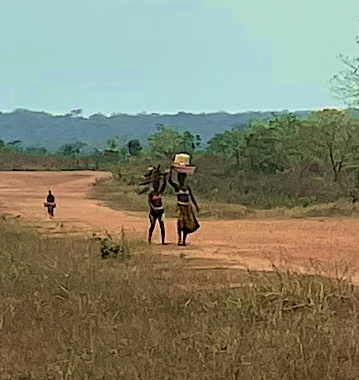
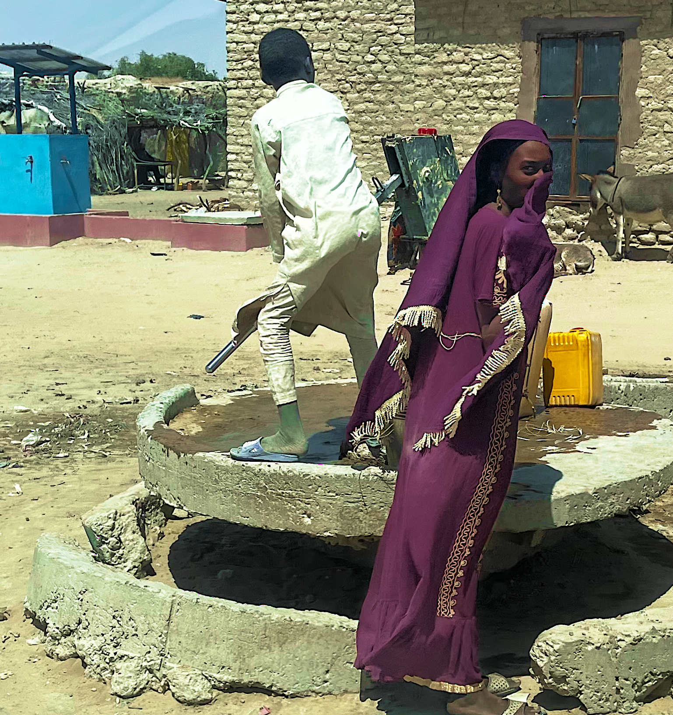
THE OBVIOUS DILEMNA
20km walk to get water
No development possible
Carbon : 0T
Water in the village
Development possible
Carbon : 10T / well

Slide 4
TABLE
THE VARIOUS ASPECTS OF OUR RESPONSIBILITY
  AS CARDIOLOGITS
  AS AN ORGANISATION (corporate citizenship)
  AS A NORMATIVE SCIENTIFIC SOCIETY
  SUMMARY

Slide 5

WHAT IS THE SCOPE OF OUR RESPONSABILTY?
What can I know?
What should I do?

Slide 6
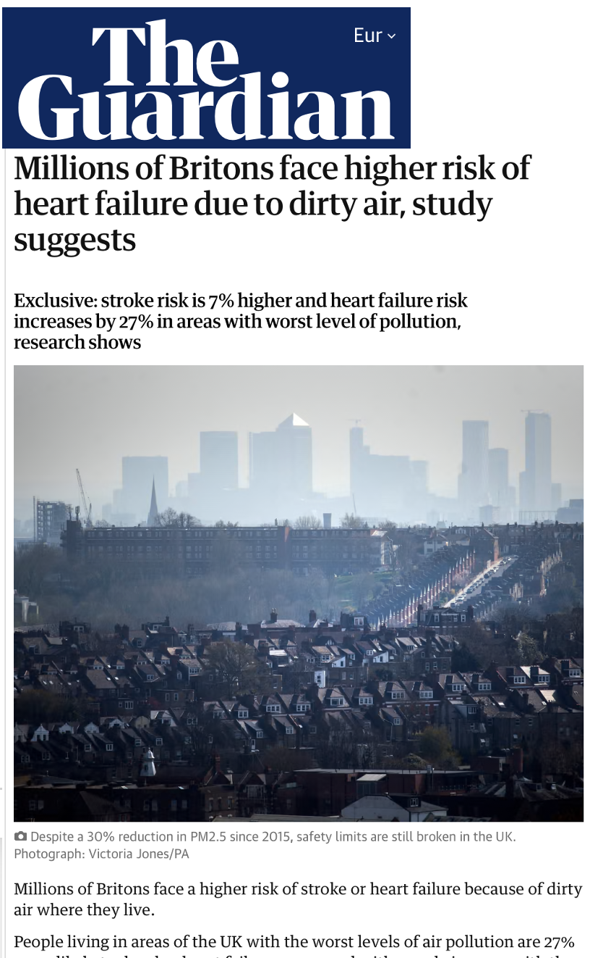
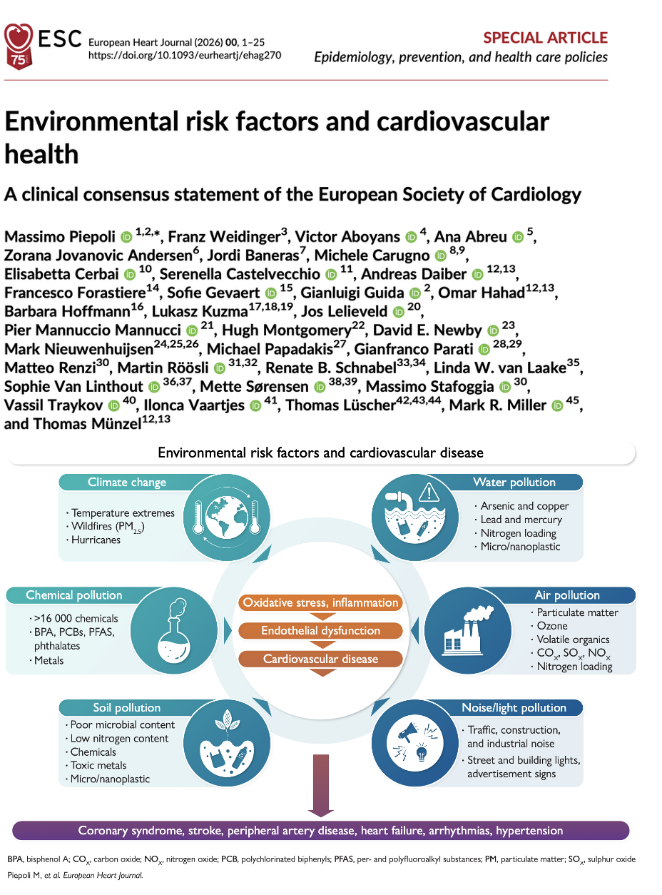
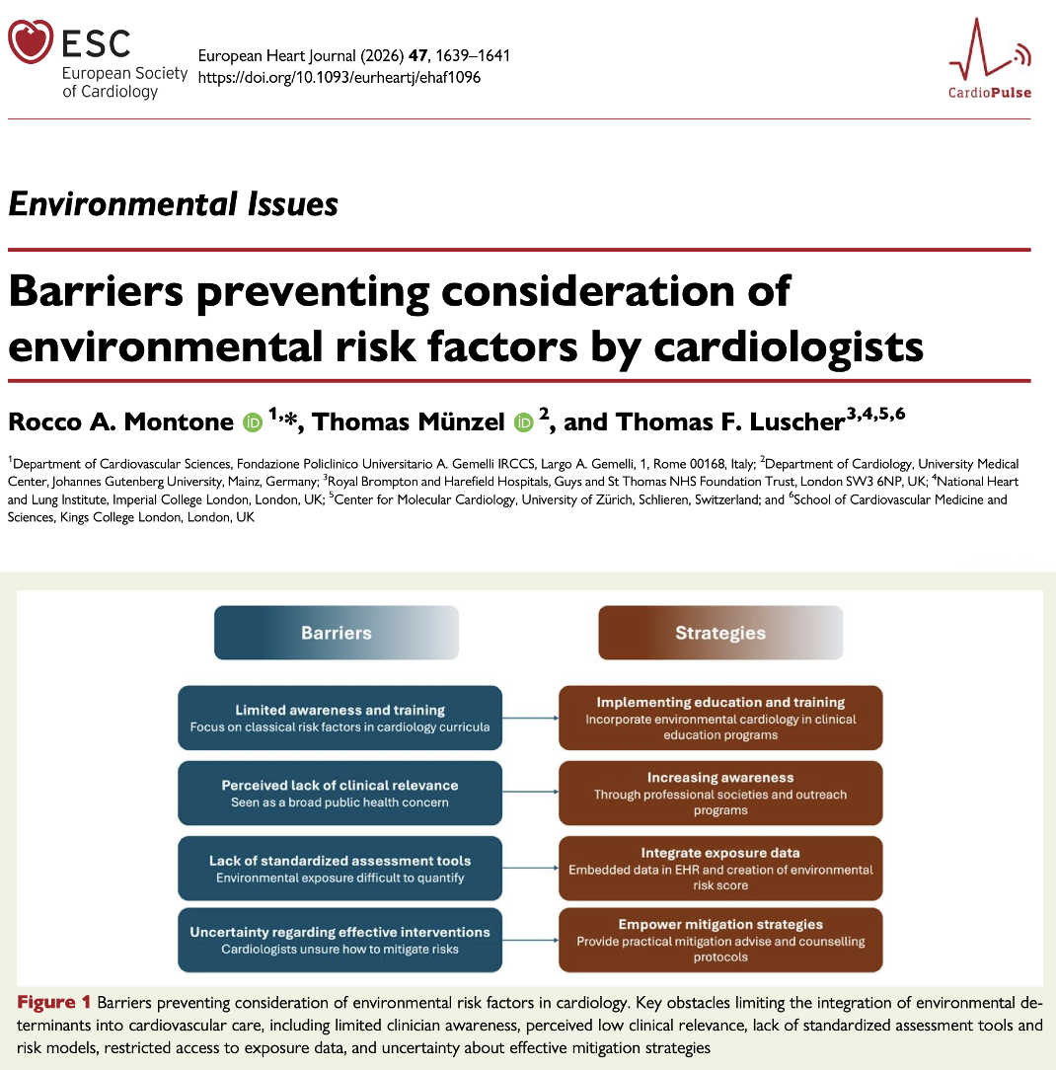
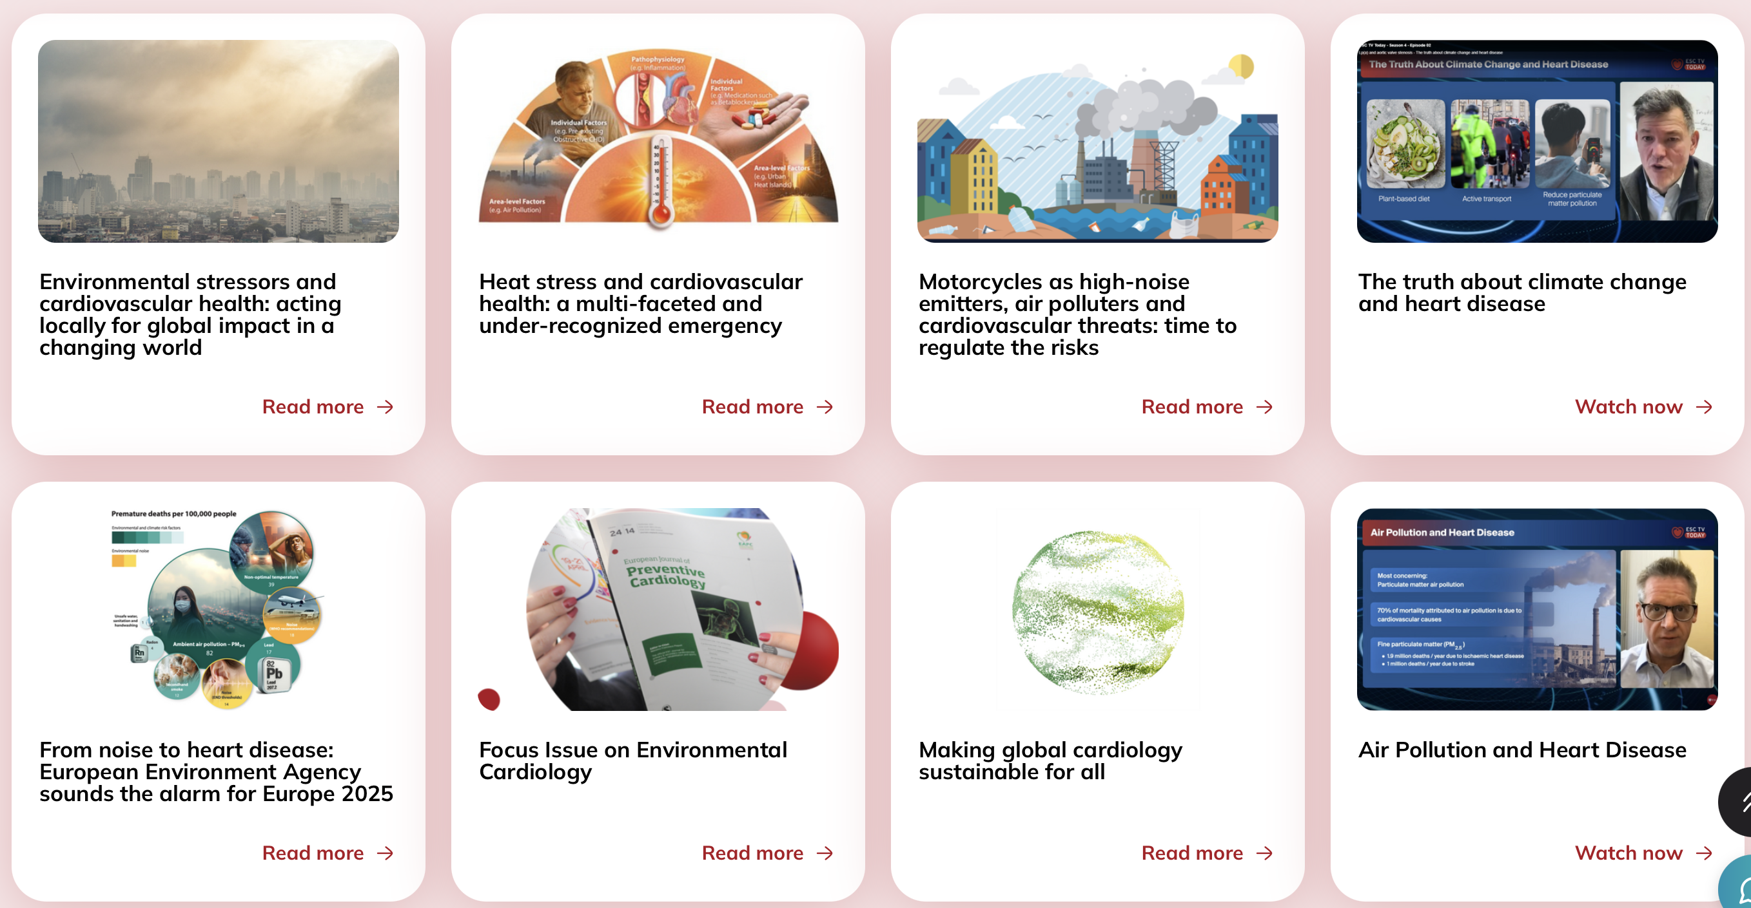
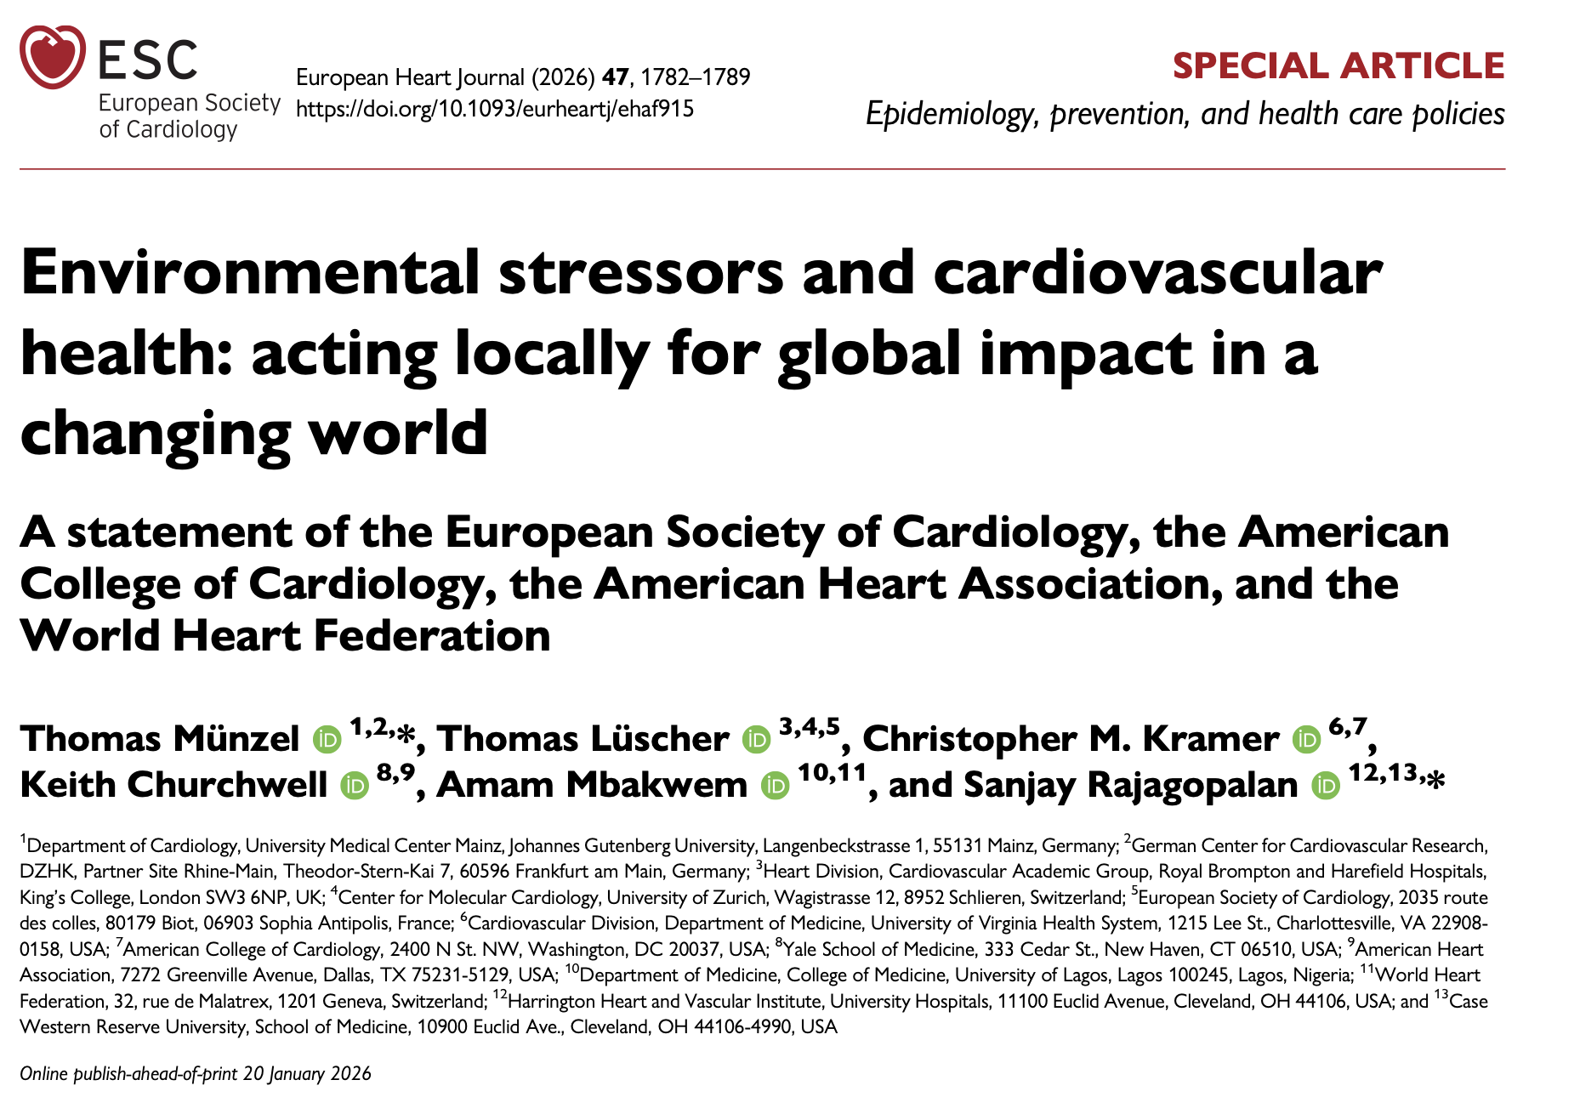

AS CARDIOLOGIST 1/2

Slide 7
AS CARDIOLOGISTS 2/2
WE FULFILL OUR CORE SOCIAL MISSION : REDUCING THE BURDEN OF CV DISEASE
WHEN WE LOOK AT THE PATIENTS,
ENVIRONMENT IS A RISK FACTOR

Slide 8
AS AN ORGANISATION 1/2
SUPPLIERS
ESC ACTIVITY
MEMBERS
INDUSTRY
MEDICAL AND ACADEMIC INSTITUTIONS

Slide 9
AS AN ORGANISATION 2/2
WHEN WE LOOK AT THE ENVIRONMENT
WE ARE THE RISK FACTOR TO THE ENVIRONMENT

Slide 10
WE ARE THE RISK FACTOR TO THE ENVIRONMENT
WE ARE A RISK FACTOR TO THE PEOPLE
THE ENVIRONMENT IS A RISK FACTOR TO THE PEOPLE

Slide 11
AS A NORMATIVE SCIENTIFIC SOCIETY
  WE SET THE STANDARDS
  WE RECOMMEND THE GOOD PRACTICE
CAN WE MAKE ESC GUIDELINES MORE ENVIRONMENTALY FRIENDLY?

Slide 12
AS A CORPORATE CITIZEN
E S C R E S P O N S I B I L I T Y
SUPPLIERS
ESC ACTIVITY
MEMBERS
INDUSTRY
MEDICAL AND ACADEMIC INSTITUTIONS

Slide 13
Next steps
Finalize our Carbon footprint assessment
Prepare an engagement ESC Environmental Charter
Set a goal for reduction of environmental impact and carbon footprint
Engage partners
Monitor and advocate

Slide 14
SUMMARY
It’s about science and moral conscience
It’s about our collective credibility as scientific and medical organisation
It’s about balance between individual short-term benefit and collective long-term survival
It’s a journey that ESC will continue
It’s a collective journey

Slide 15
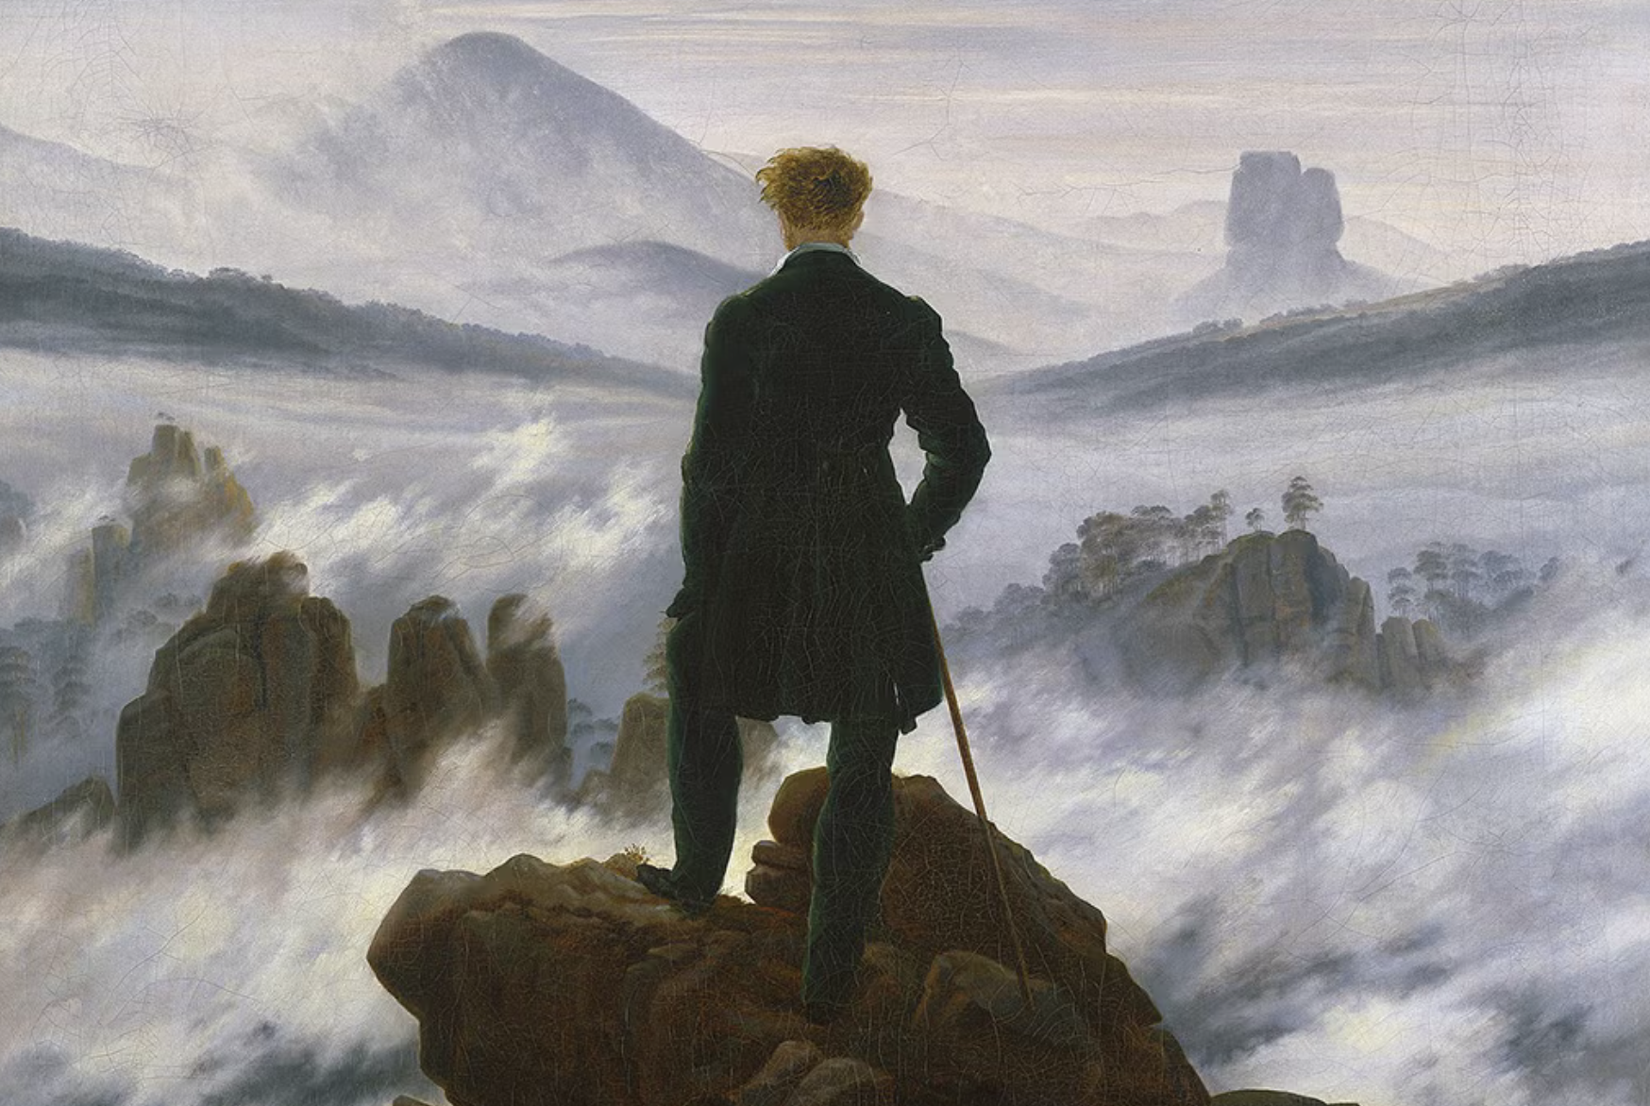
THANK YOU

