Slide 1
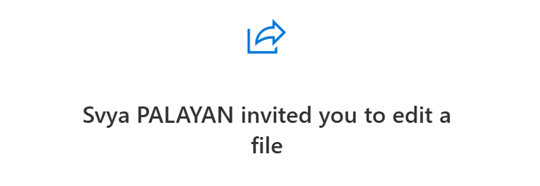

Ideas’ capture concept
Svya Palayan will invite you to access the slides on her one drive folder (check your mailbox)
You can submit your ideas and suggestions from now until 16:10 on the 3 slides corresponding to the barriers (for ESC ; Industry and Hospitals)

Slide 2
Group 1 : What are the key barriers for the ESC to reduce the carbon impact?

Slide 3
Group 2 : What are the key barriers for the INDUSTRY to reduce the carbon impact?

Slide 4
Group 3 : What are the key barriers for the hospitals to reduce the carbon impact?

