Slide 1
ESC impact and initiatives
CRT : Sustainable Cardiology - From Environmental Risk to Cardiovascular Responsibility
Ghislain DAVAL – Chief Operating Officer, ESC
16-17 June 2026

Slide 2
Initiatives
Sustainability focus group with Industry Partners
Carbon footprint of ESC Congress
Full Greenhouse gases (GHG) assessment of the entire ESC

Slide 3
The Environmental Sustainability Focus Group
Launched in 2024, the Sustainability Focus Group was established to bring together ESC teams, industry partners, venue stakeholders and external experts with a unified goal:
➡️ Define and implement a coherent, evidence‑based framework for reducing the environmental impact of ESC congresses.
Active participation from several industry partners: AstraZeneca, Boehringer Ingheleim, Bayer, Novartis, MSD, Pfizer, Satelia…
Collaboration with partners
  ExCeL London (venue)
  IFEMA Madrid (venue)
  TRACE/ISLA (platform for carbon reporting)

Slide 4
The Environmental Sustainability Focus Group
Key achievements
A complete toolkit (targets, guidelines, mapping, checklists).
Tested and implemented measures, proving feasibility and impact.
A shared ESC–Industry sustainability culture, now implemented.
Operational initiatives delivered and part of our processes/practice now:
More than 50,000 m² of carpeting eliminated, significantly reducing materials and waste.
Reusable infrastructure (Exchange Area framework valid for 3 years).
Water fountains and reduced plastic usage, unified reusable cup strategy.
Food waste donation programs with local social entities.
Green hotels prioritised across ESC accommodation platforms.
Public transport promotion & rail partnerships (Renfe, SNCF, DB).
Sustainability messaging integrated across ESC communication touchpoints.

Slide 5
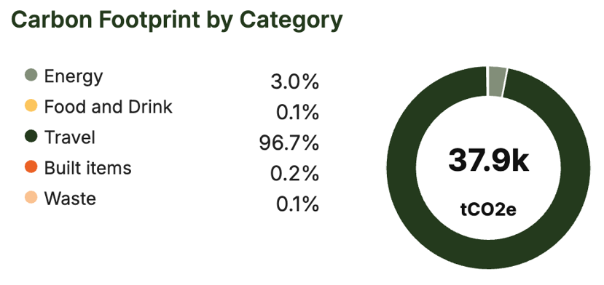
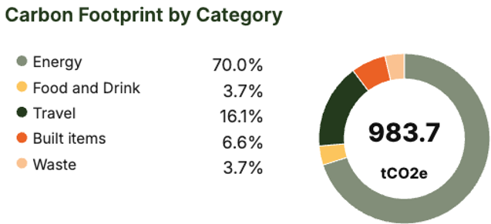
ESC Congress carbon footprint
ESC Congress 2025 Madrid
  Data collected with the Isla’s TRACE platform (a specialised event-specific carbon calculator designed to encompass the entirety of event-related emissions)
  Suppliers and staff trained
Result ESC Congress 2025
Delegate travel included
Delegate travel excluded
Notes:
Both ESC Congress and the wider events industry show that travel is the largest source of emissions (Isla 39% audience travel). For ESC, this effect is amplified by the highly international nature of the congress.
Apart from delegate travel, the second largest emission source for ESC Congress is venue energy

Slide 6
ESC Congress 2024 and 2025
Building a baseline
Having two years of data in place means we can now begin to track the pace of decarbonisation more accurately, identify trends, and focus on the areas where interventions will have the greatest impact.
Emission Category (tC02e) | 2024 - London 26 500 delegates | 2025 - Madrid 28 719 delegates
Total | 43,653.18 570.35 (without delegate travel) | 37,860.94 983.69 (without delegate travel)
Production and Graphics | 157.57 | 64.76
Energy | 133.14 | 1122.36
Event Transport | 64.97 | 47.402
Staff Travel* | 132.448 | 111.254
Delegate Travel ** | 42,984.159 (23,680 delegates) | 36,443.194
Food and Beverage | 179.69 | 36
Waste | 1.2 | 35.97
Online | 0.44 | 0.74
* Staff flights and all ground travel
** Excluding exhibitors & press

Slide 7
A full Greenhouse gases (GHG) assessment of the entire ESC
Offices (Sophia Antipolis and Brussels), staff, procurement, publications, digital activities, governance, and meetings and events combined.
  Started early 2026
  14 staff members directly involved (and many more indirectly)
  Coordinated by a dedicated agency (In-Extenso)
  Follows the GreenHouse Gases (GHG) protocol

Slide 8

The Scope of the ESC Carbon Footprint
Reference year
Scopes
Sites
Calendar year 2025
1, 2 and 3 (full)
Sophia Antipolis and Brussels
Scope 3 : Other indirect emissions
Staff commuting
Scope 1 : direct emissions
Scope 2 : Indirect energy emissions
Purchases of goods and services (consumables, services, etc.)
Business travel (staff, volunteers, visitors, event participants)
For each site
Digital activities
Subcontracting
Building consumption: energy, cooling
Inbound transport
Scope 1: 21t of CO2
Scope 2: 99t of CO2
Collection and treatment of generated waste
Depreciation (buildings, vehicles, IT equipment, etc.)

Slide 9
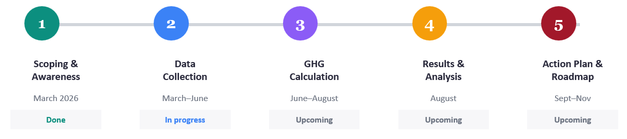
Timeline and next steps
Prepare an ESC Environmental Charter
Set a goal for reduction of environmental impact and carbon footprint
Engage partners
Monitor and advocate

Slide 10
Questions

