Slide 1
Which key metrics should be considered when evaluating the impact of cardiology in the EP lab at the hospital level?
SESSION 2.1: MEASURING IMPACT: METRICS, DATA, ACCOUNTABILITY
Emma Svennberg, MD, PhD, FEHRA, FESC
Karolinska University Hospital, Stockholm, Sweden
17th June 2026
Notes:
10 minutes

Slide 2

Disclosures
Consultant/Advisor Abbott, Astra Zeneca, Bristol-Myers Squibb-Pfizer, Boston, Johnson & Johnson, Medtronic
No personal renumerations
Funding Stockholm County Council, the Swedish Research Council (DNR 2022-01466), the Swedish Heart and Lung Foundation, CIMED
Guidelines Task force member for ESC 2024 Guidelines for the management of atrial fibrillation
Steering committee Treasurer (executive board) EHRA
Nominating committee member ESC
AF Screen International Screen Collaboration Steering committee
Editorial Deputy editor EP Europace
Senior editor ESC TV Today
Associate editor EHJ Digital Health
Notes:
Cumulative incidence of AF

Slide 3




Metrics to be considered
Disease related
Patient
Pathway
Procedure Related
Quality Related

Slide 4

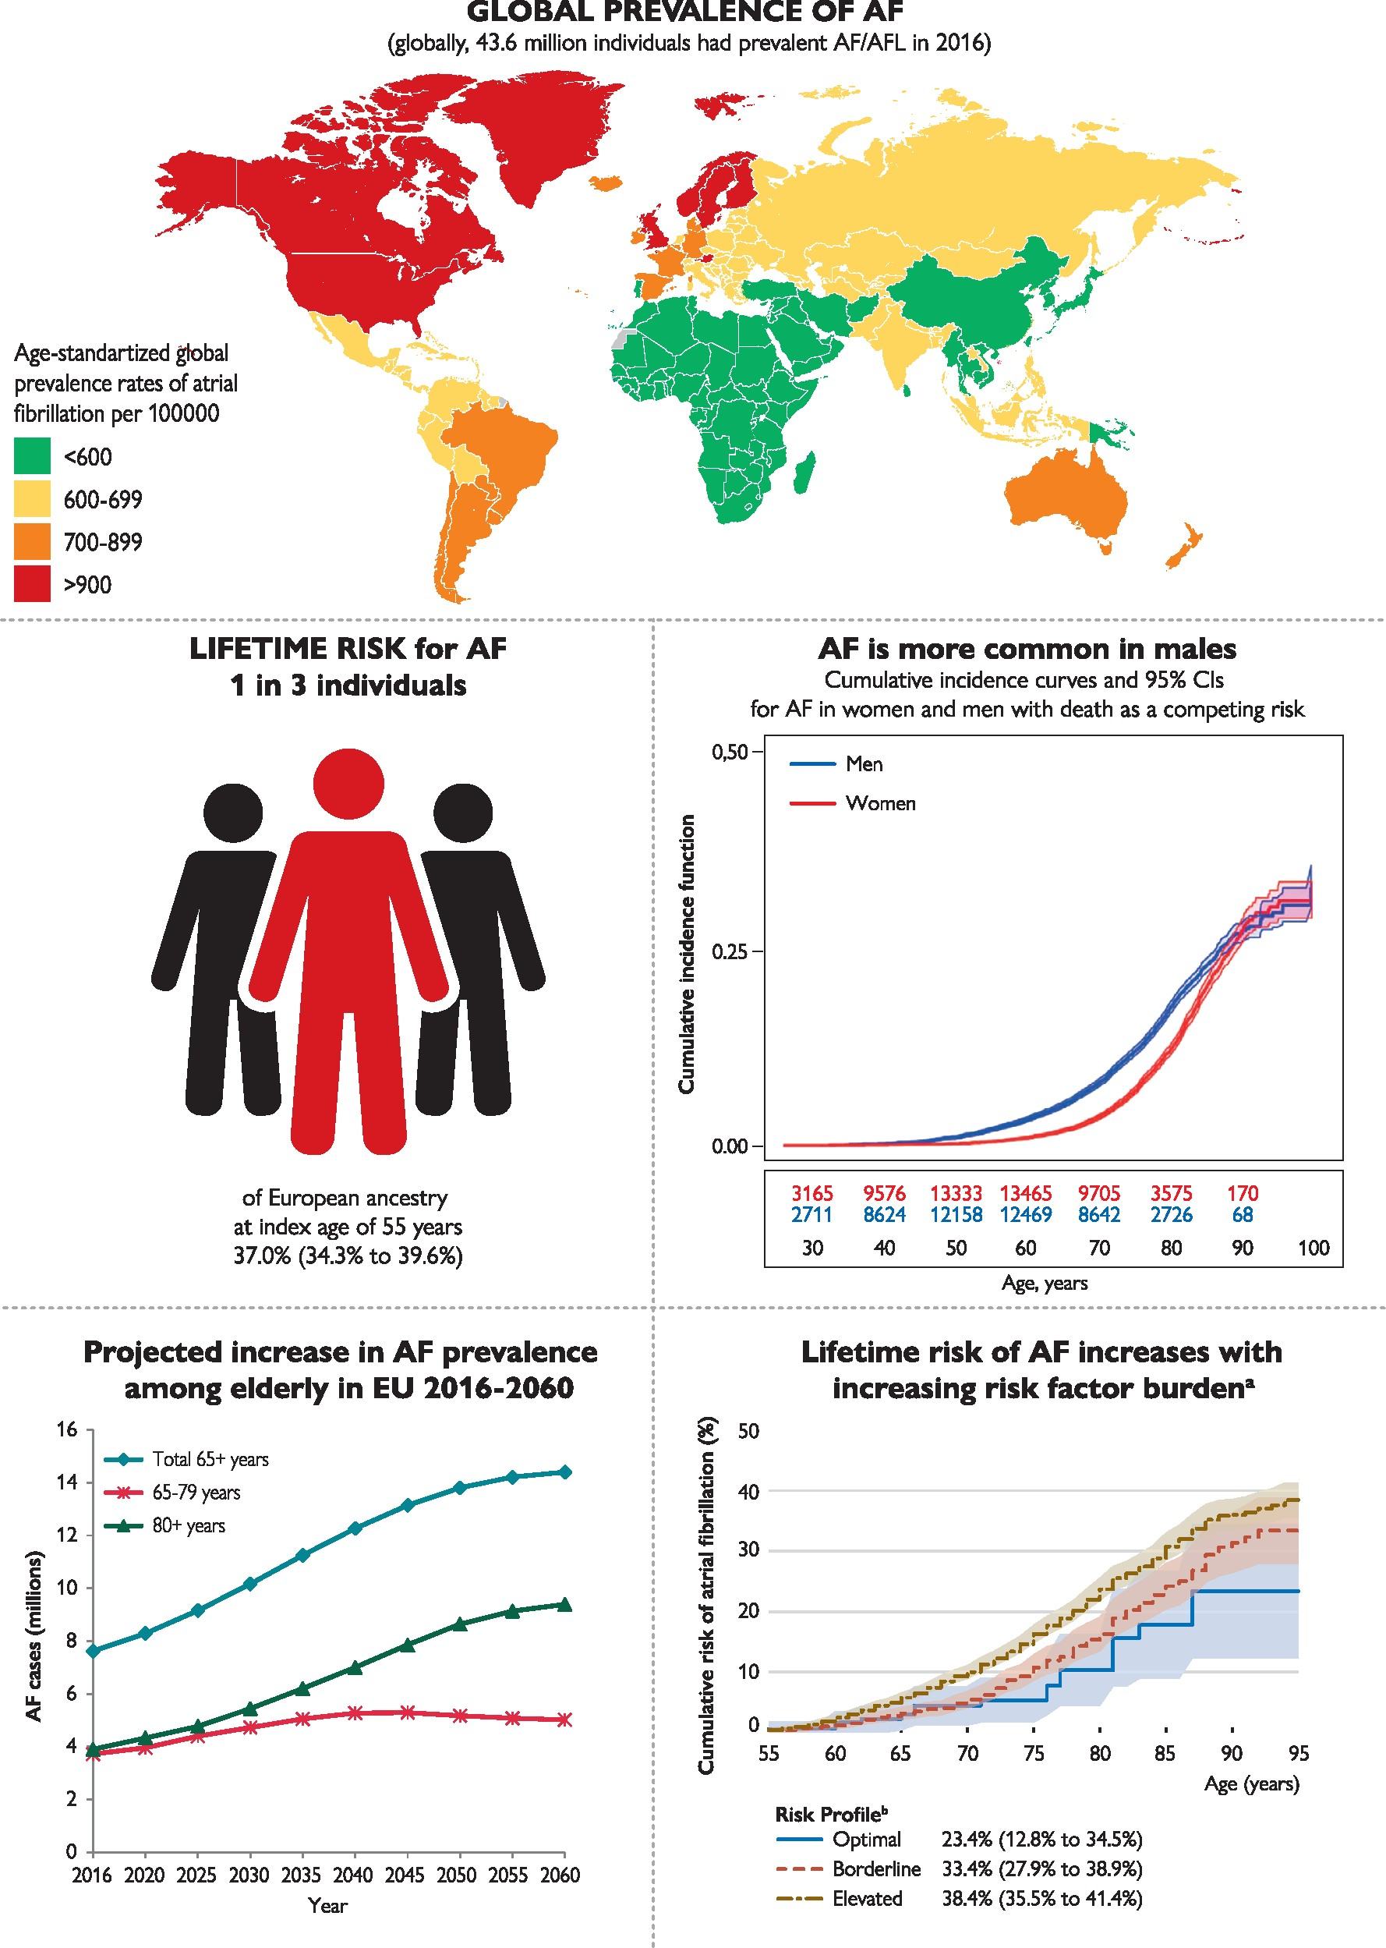

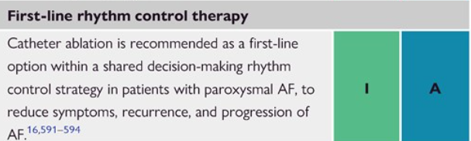
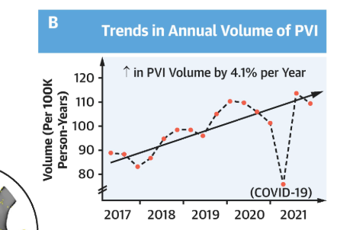
Disease-related metrics
60 million
2.6 %
9,409 Euros
Direct annual medical cost per/patient
Hindricks et al, ESC Guidelines AF 2020, Roth et al, JACC 2020, Velleca et al, EMJ 2019, Ferro et al, JACC Clin EP 2024, van Gelder et al, EHJ 2024
Notes:
2.6 % t is estimated that up to 2.6% of total annual healthcare expenditure is associated with AF in European countries. The high cost of AF is largely attributable to hospitalisations and complications such as stroke, i.e., in 2015, stroke was estimated to cost €45 billion a year in the European Union (EU)

Slide 5
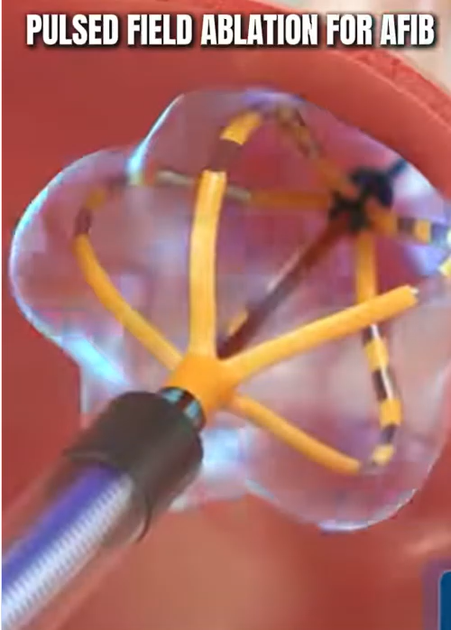
Disease-related metrics

Slide 6
Disease-related
Patient
Pathway
Procedure Related
Quality Related
Increasing prevalence
Health-care cost
Increase in ablations, %
Increased spenditure

Slide 7
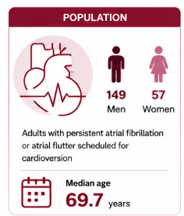
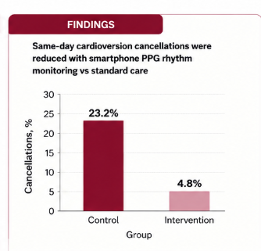
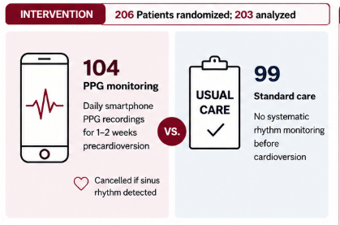
Patient-related Metrics
Metrics: Unnecessary visits, travel, resource consumption
Fernstad, Svennberg et al JAMA Cardiology 2026

Slide 8
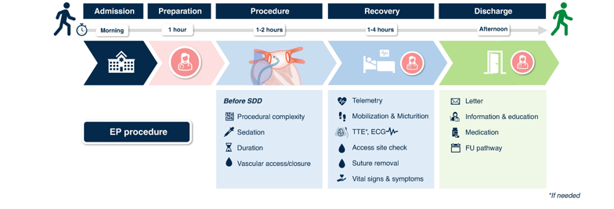
Same day discharge
% SDD, % in-hospital nights avoided, cost per patient
Scherr et al, EP Europace 2025

Slide 9
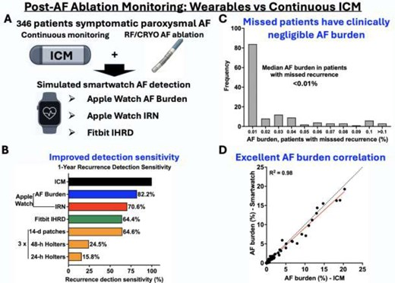
Remote follow-up
Metrics: Unnecessary visits, travel, resource consumption
Aguiar et al, EP Europace 2025

Slide 10
Disease related
Patient
Pathway
Procedure Related
Quality Related
Increasing prevalence
Travel %
Health-care cost
Hospital nights avoided
Increase in ablations
Same-day discharge %
Increased speenditure
Digital follow-up %

Slide 11
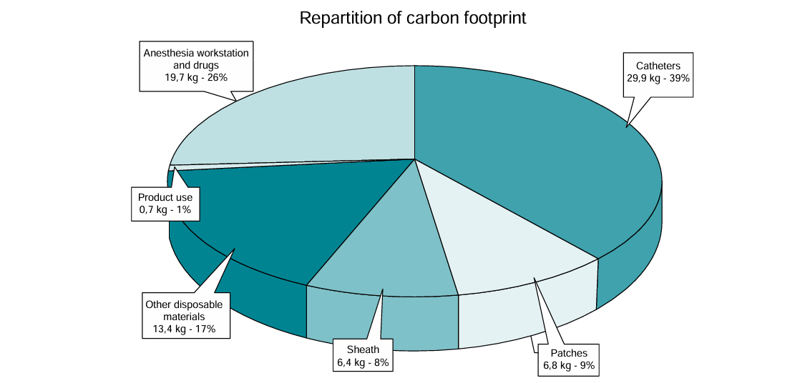
Procedure related Eco-Audit
Ditac, EP Europace 2023

Slide 12
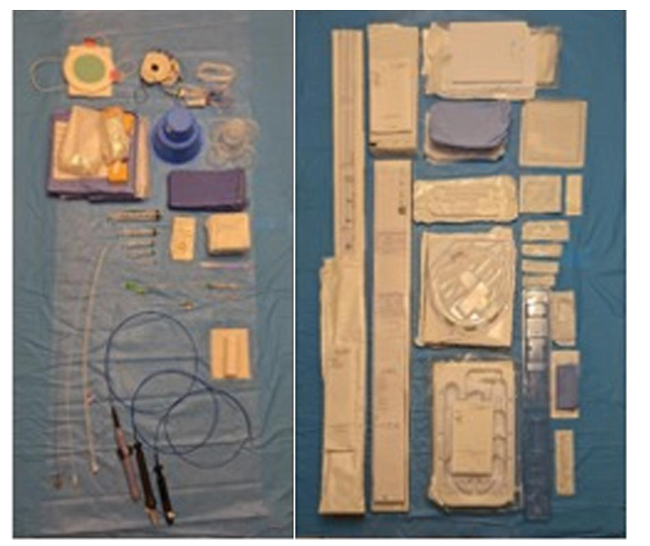
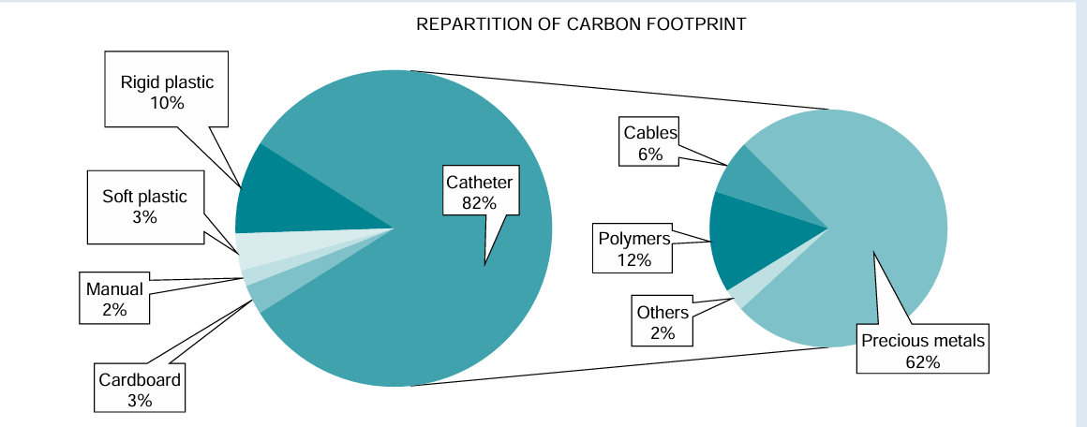
Procedure related Eco-Audit
Ditac, EP Europace 2023

Slide 13
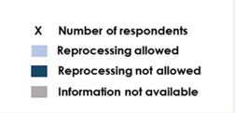
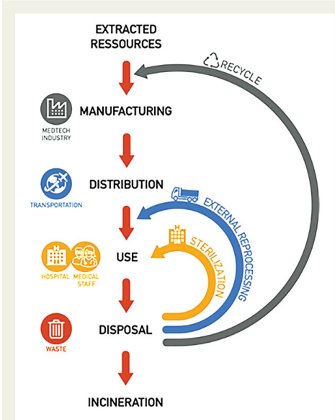
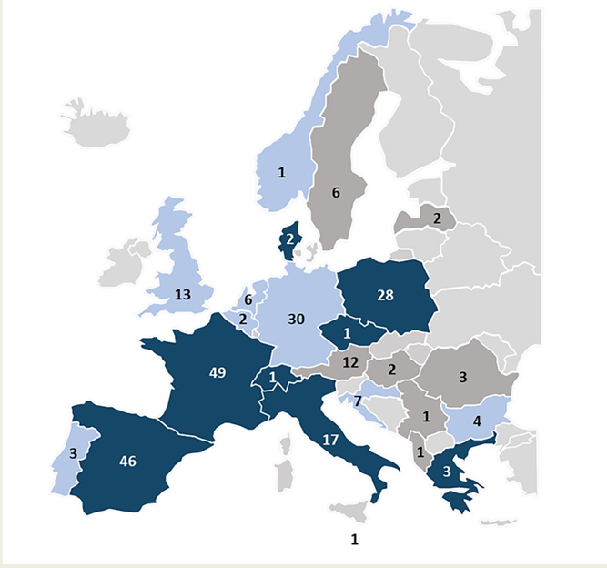
Procedure related Resterilization
Boussuge-Roze, EP Europace 2024

Slide 14
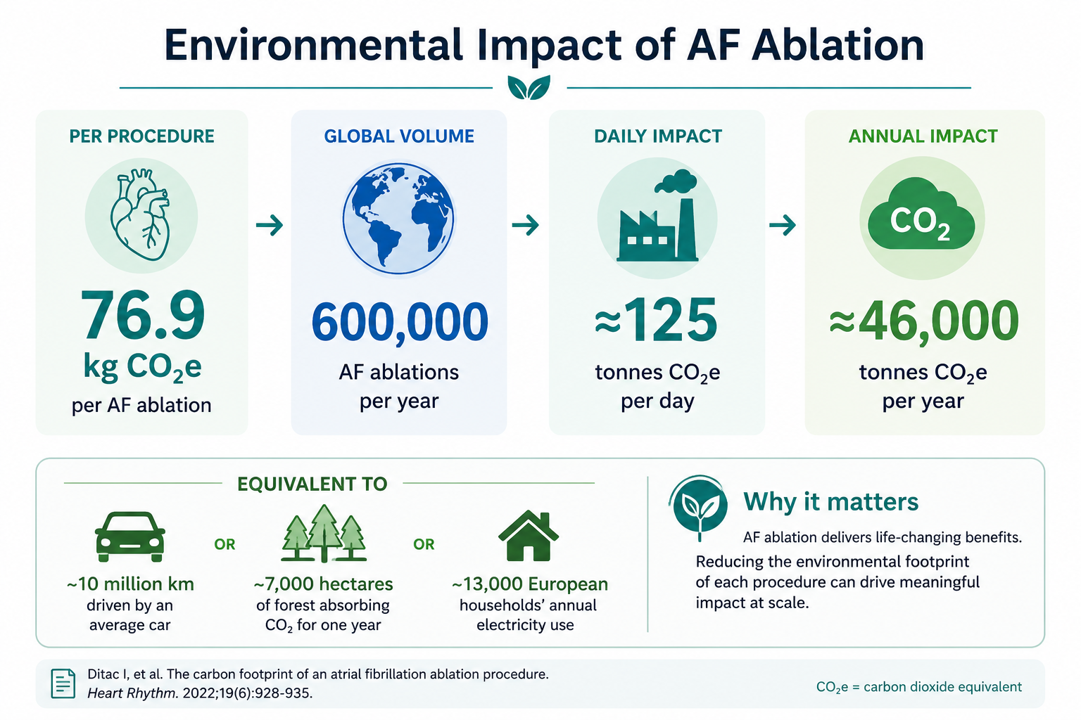
Impact of catheter ablation
Ditac, EP Europace 2023

Slide 15
Disease related
Patient
Pathway
Procedure Related
Quality Related
Increasing prevalence
Travel %
Recycle, %
Health-care cost
Hospital nights avoided
Resterilize, %
Increase in ablations
Same-day discharge %
Reprocess, %
Increased speenditure
Digital follow-up %
CO₂ footprint

Slide 16

Quality related metrics
ICHOM patient-centered AF outcomes

Slide 17
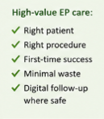
Disease related
Patient
Pathway
Procedure Related
Quality Related
Increasing prevalence
Travel %
Recycle, %
PREMs, %
Health-care cost
Hospital nights avoided
Resterilize, %
PROMs, %
Increase in ablations
Same-day discharge %
Reprocess, %
Success, %
Increased speenditure
Digital follow-up %
CO₂ footprint
Clinical outcomes

Slide 18
Disease related
Patient
Pathway
Procedure Related
Quality Related
GOOD METRICS
Right patient selection
Right procedure
Procedural success
Minimize waste
Digital
Increasing prevalence
Travel %
Recycle, %
PREMs, %
Health-care cost
Hospital nights avoided
Resterilize, %
PROMs, %
Increase in ablations
Same-day discharge %
Reprocess, %
Success, %
Increased speenditure
Digital follow-up %
CO₂ footprint
Clinical outcomes

Slide 22
