Slide 1
How do I ensure environmental safety in my research lab?
Cinzia Perrino MD PhD FESC
17/06/2026

Slide 2
No conflicts to declare

Slide 3
Why do research laboratories matter?
Laboratories occupy only a small fraction of institutional space (~5–10% in many universities and hospitals).
Yet they can account for 30–70% of total institutional energy consumption.
Typical wet laboratories consume 3–10 times more energy per square meter than office buildings.
Highly specialized facilities (animal facilities, clean rooms, biobanks) may consume 10–100 times more energy than standard offices.

Slide 4



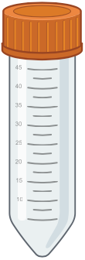

Carbon Emissions from Research Laboratories
Scope 1
Scope 2
Scope 3
Scope 3
INDIRECT
energy/facilities
INDIRECT
supply chain or services
DIRECT
Direct production (onsite):
Refrigerant leaks from cooling equipment
Natural gas heating
Emergency diesel generators
Laboratory fleet vehicles
Specialty gas losses
Purchased electricity used for:
Ultra-low temperature (-80°C/-70°C) freezers
Biobank storage systems
Refrigerators and cold rooms
Incubators
Biosafety cabinets
Fume hoods
Centrifuges
Microscopes and imaging platforms
Flow cytometers
Sequencing and omics platforms
PCR and molecular biology equipment
Cell culture facilities
Laboratory lighting
HVAC (heating, ventilation, air conditioning)
Servers and local data storage
Charging laboratory equipment and devices
Purchased heating, cooling, or steam:
District heating
District cooling
Centralized steam systems
Purchased goods and services
Plastic consumables
Cell culture plastics
Reagents and chemicals
Antibodies
Kits for molecular biology
Sequencing reagents
Laboratory animals
Biological samples purchased externally
PPE (gloves, gowns, masks)
Cleaning products
Capital Goods
Freezers
Sequencers
Microscopes
Flow cytometers
Imaging systems
Computers and servers
Laboratory furniture
2% of global plastic waste
Waste
Hazardous chemical waste disposal
Biohazard waste disposal
Sharps disposal
Animal waste disposal
Recycling services
Transportation and Distribution
Business Travel
Employee Commuting
Data and Digital Infrastructure
Animal Research Activities
Feed production
Bedding materials
Supply chains supporting animal facilities
Water and Utilities
Construction and Infrastructure
Biomedical laboratories can generate tens to hundreds of kilograms of plastic waste per researcher per year, with pipette tips among the largest contributors.

Slide 5
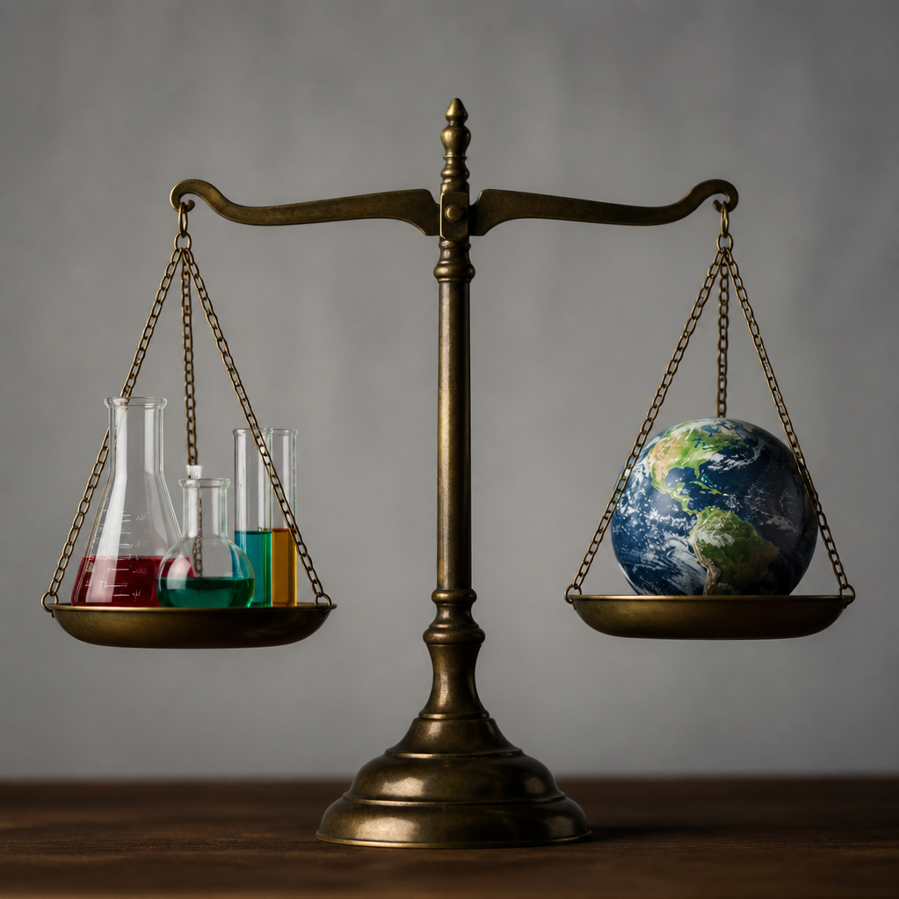
Environmental safety in the research
laboratory: at least two sides of the moon
Safety for People
  Focuses on preventing workplace hazards including chemical exposure, biological risks, airborne contaminants, and physical safety protocols.
Safety for the Planet
  Focuses on sustainability initiatives such as reducing energy consumption, managing waste, responsible disposal, and resource conservation.
Considering human protection and planetary responsibility

Slide 6
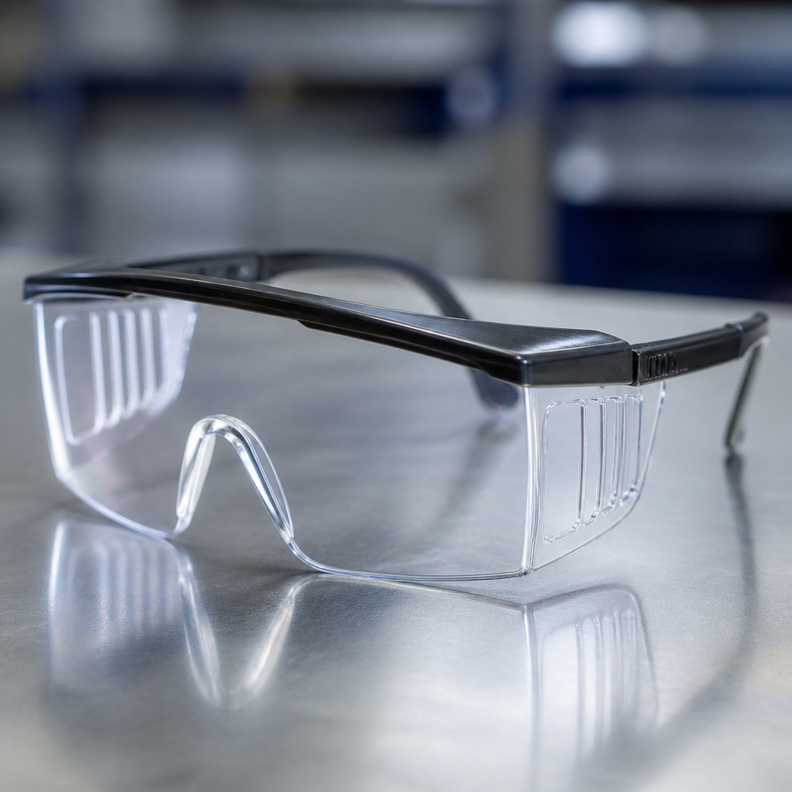
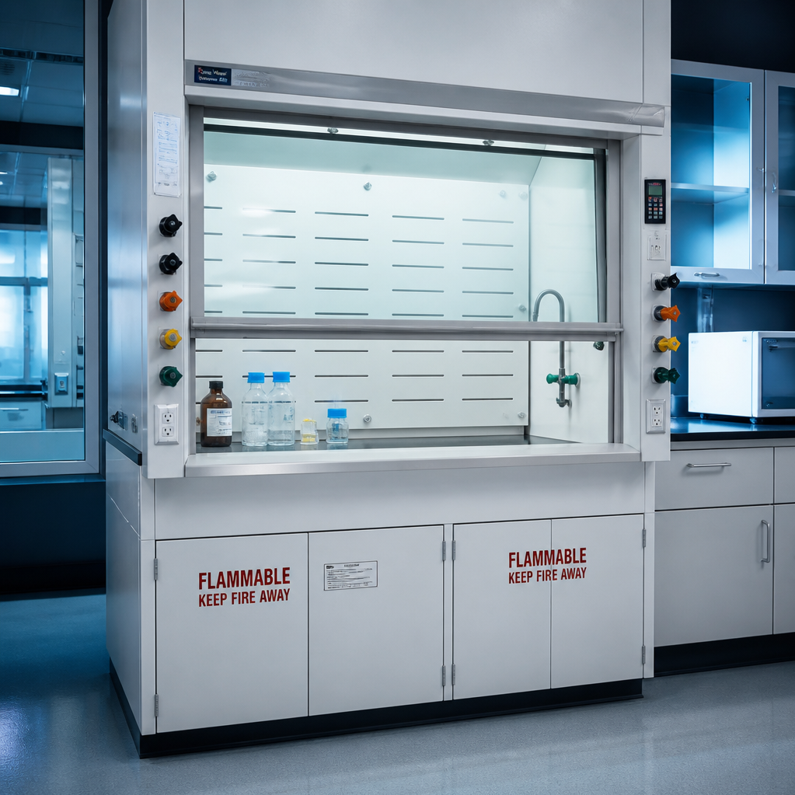
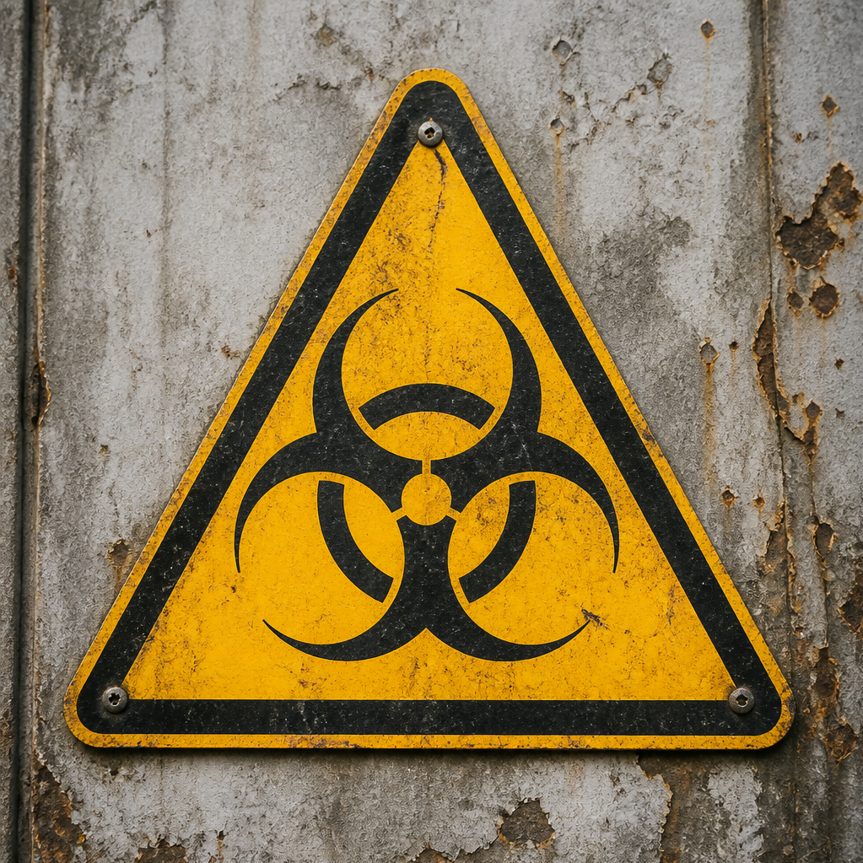
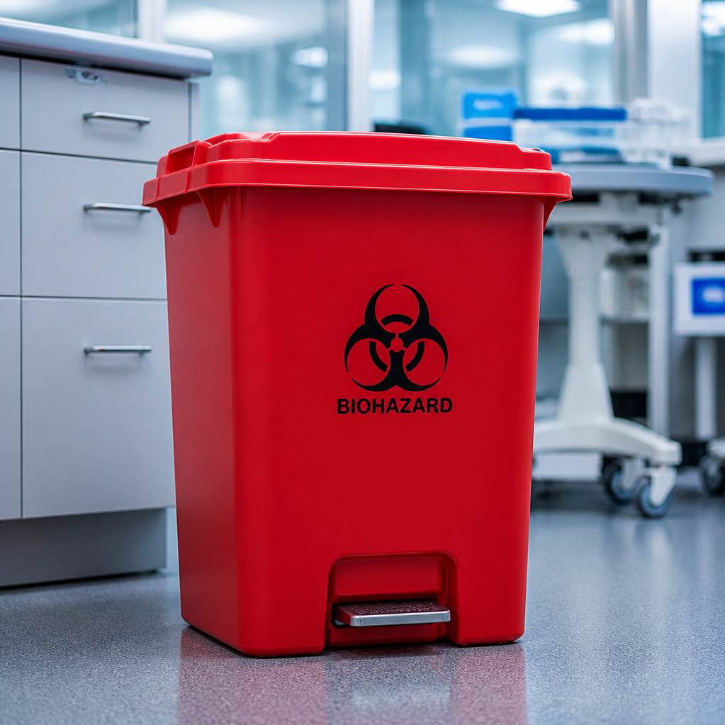
Chemical Safety
Vapors and Air
Hazardous chemical substances
  Risks include formaldehyde (carcinogen), xylene (nervous system depressant), organic solvents (flammability), and acids/bases (corrosive).
Airborne hazards
  Common sources including histology reagents, solvents, and fixatives that require controlled handling.
Waste
Biological Safety
Human and animal specimens
  Tissue samples, biopsies, cellular materials, blood and bodily fluids.
  Major waste sources
  Biological, chemical, pharmaceutical, radioactive, electronic, animal, sharps, plastic and mixed waste.
Laboratory risks examples

Slide 7

Summary of Major Regulatory Requirements
Essential EU Legislation for
Biomedical Research Laboratories
Tier 1: Foundation & General Safety
REACH (EC No 1907/2006): Chemical registration, SDS compliance, and risk management.
Waste Framework Directive (2008/98/EC): Waste hierarchy and hazardous waste tracking.
OSH Framework Directive (89/391/EEC): Employer-led risk assessment and training.
Tier 2: Specialized Research & Ethical Compliance
Biological Agents (2000/54/EC): Containment for human tissue and cell culture.
GMO Legislation (2009/41/EC & 2001/18/EC): Protocols for viral vectors and CRISPR-organisms.
Animal Protection (2010/63/EU): The 3Rs principle and ethical oversight.
Tier 3: Environmental Protection
Water Framework Directive (2000/60/EC): Prohibition of chemical discharge.
Biocidal Products Regulation (EU 528/2012): Authorization for disinfectants.
Industrial Emissions (2010/75/EU): Compliance for large-scale operations.
Maintaining compliance across these three tiers is essential for legal operation, safety, and ethical research standards.

Slide 8
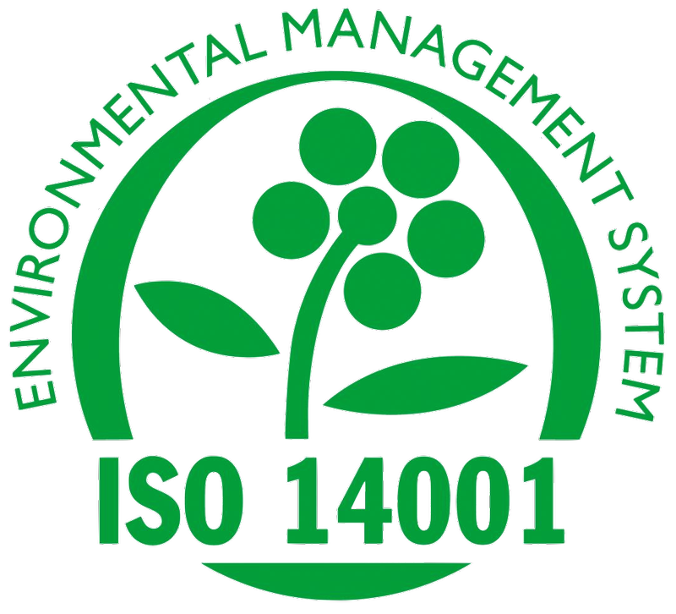
International Sustainability Frameworks
My Green Lab
  The global leader in laboratory certification, focusing on energy, water, waste, and green chemistry for academic and industry sectors.
LEAF (Laboratory Efficiency Assessment Framework)
  Developed by UCL, this framework focuses on efficiency, equipment management, and procurement, widely adopted across European research institutions.
Global standard establishing an overall, top-down Environmental Management System (EMS).
Key certification and assessment programs for laboratory sustainability

Slide 9



Measuring Quantifiable Key
Performance Indicators (KPIs)
Energy Metrics
Water & Utility
Procurement & Storage
Monitor kWh/year, kWh/m²,
kWh/FTE, and publication-
based intensity; prioritize
freezer efficiency.
Audit consumption from
inefficient autoclave and
water purification systems.
Assess sustainable product
spend and optimize freezer
occupancy/biobanking
efficiency.
Carbon Footprint
Waste & Plastics
Measure Scope 1 (Direct),
Scope 2 (Purchased
electricity), and Scope 3
(Supply chain/travel)
emissions.
Data & Culture
Track total generation
(kg/year), hazardous waste
categories, recycling rates,
and high-volume
consumable usage.
Track server energy
consumption, data storage
TBs, staff training, and
scientific reproducibility
gains.
Leveraging frameworks like My Green Lab, LEAF, and ISO 14001 to drive lab sustainability

Slide 10
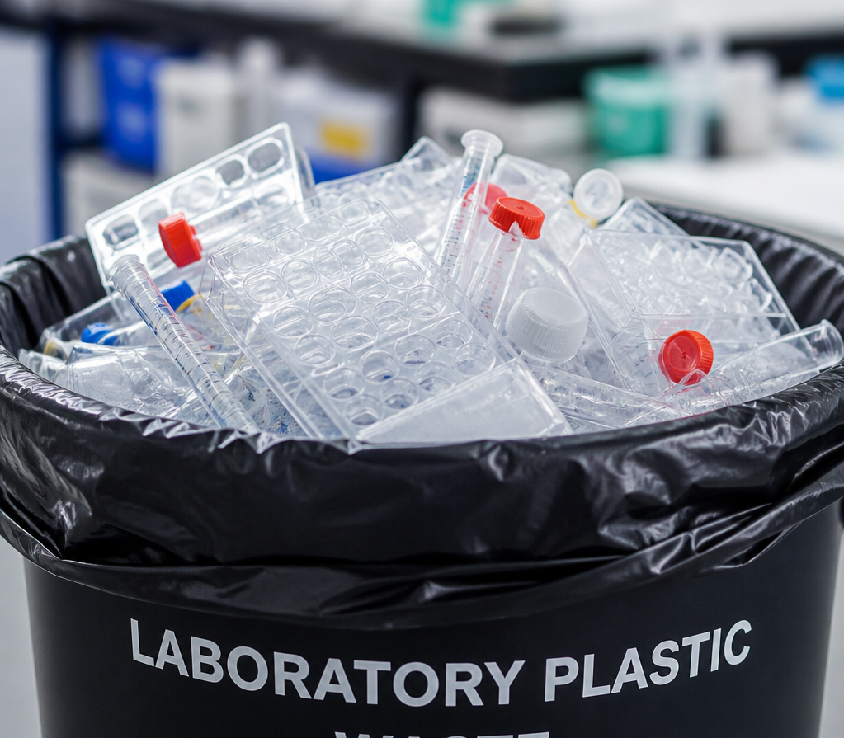
Reducing Plastic Pollution
Better experimental planning
  Enhance research and operational protocols to reduce unnecessary material waste at the source.
Bulk purchasing
  Minimize packaging waste by procuring supplies in larger quantities to reduce single-use plastic consumption.
Recycling initiatives
  Improve waste management systems to ensure plastics are properly processed and diverted from landfills.
Shift to reusable alternatives
  Actively replace single-use plastic items with durable, long-term reusable solutions.
Examples of key strategies for mitigation

Slide 11

~50%
of environmental footprint
is tied directly to
lack of scientific reproducibility

Slide 12


Robust Science is Inherently Green Science
Power Calculations
Randomization
Blinding
Eliminate selection bias to ensure the
integrity and reliability of experimental
results.
Implement rigorous masking protocols to prevent observer bias and maintain experimental objectivity.
Optimize sample sizes to achieve statistical power while minimizing resource consumption.
Data Sharing
Shared Controls
Promote transparency and scientific progress by making datasets accessible to the broader community.
Leverage centralized control groups to reduce the total number of subjects required across multiple studies.
Core Principles for Reproducible and Efficient Research

Slide 13
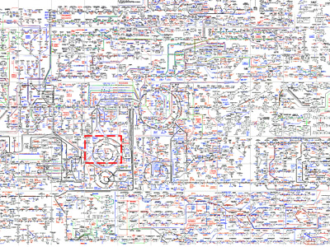
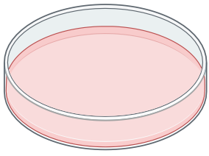


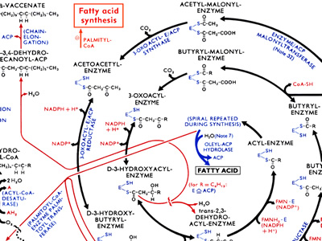
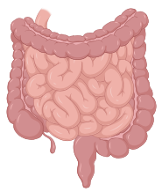
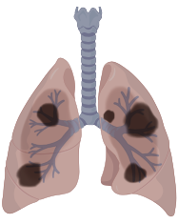
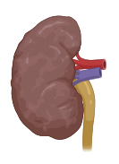

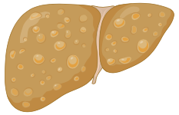

From Reductionist to Systems Biology Approach
Focus on a single gene, protein, RNA, pathway, metabolite (or cell type).
Identify direct cause-and-effect relationships.
Highly controlled experiments.
Mechanistic depth.

Slide 14
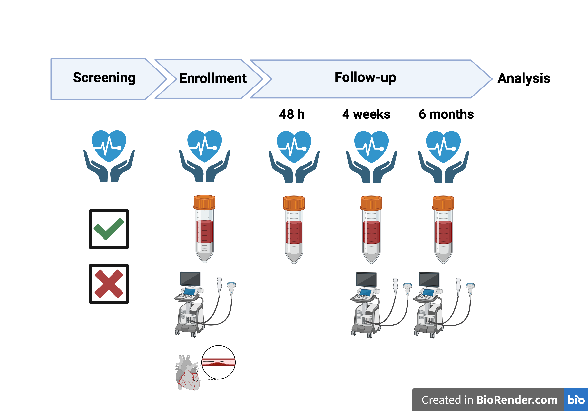

Precision Medicine Environmental Dilemma
Precision Medicine Paradigm
Electronic health records, imaging data, and multi-omics analysis.
The high-throughput data
Biobanking
High-capacity computing
Artificial Intelligence modeling
Cardiovascular
Imaging
Clinical
Evaluation
Balancing clinical impact vs. environmental cost

Slide 15
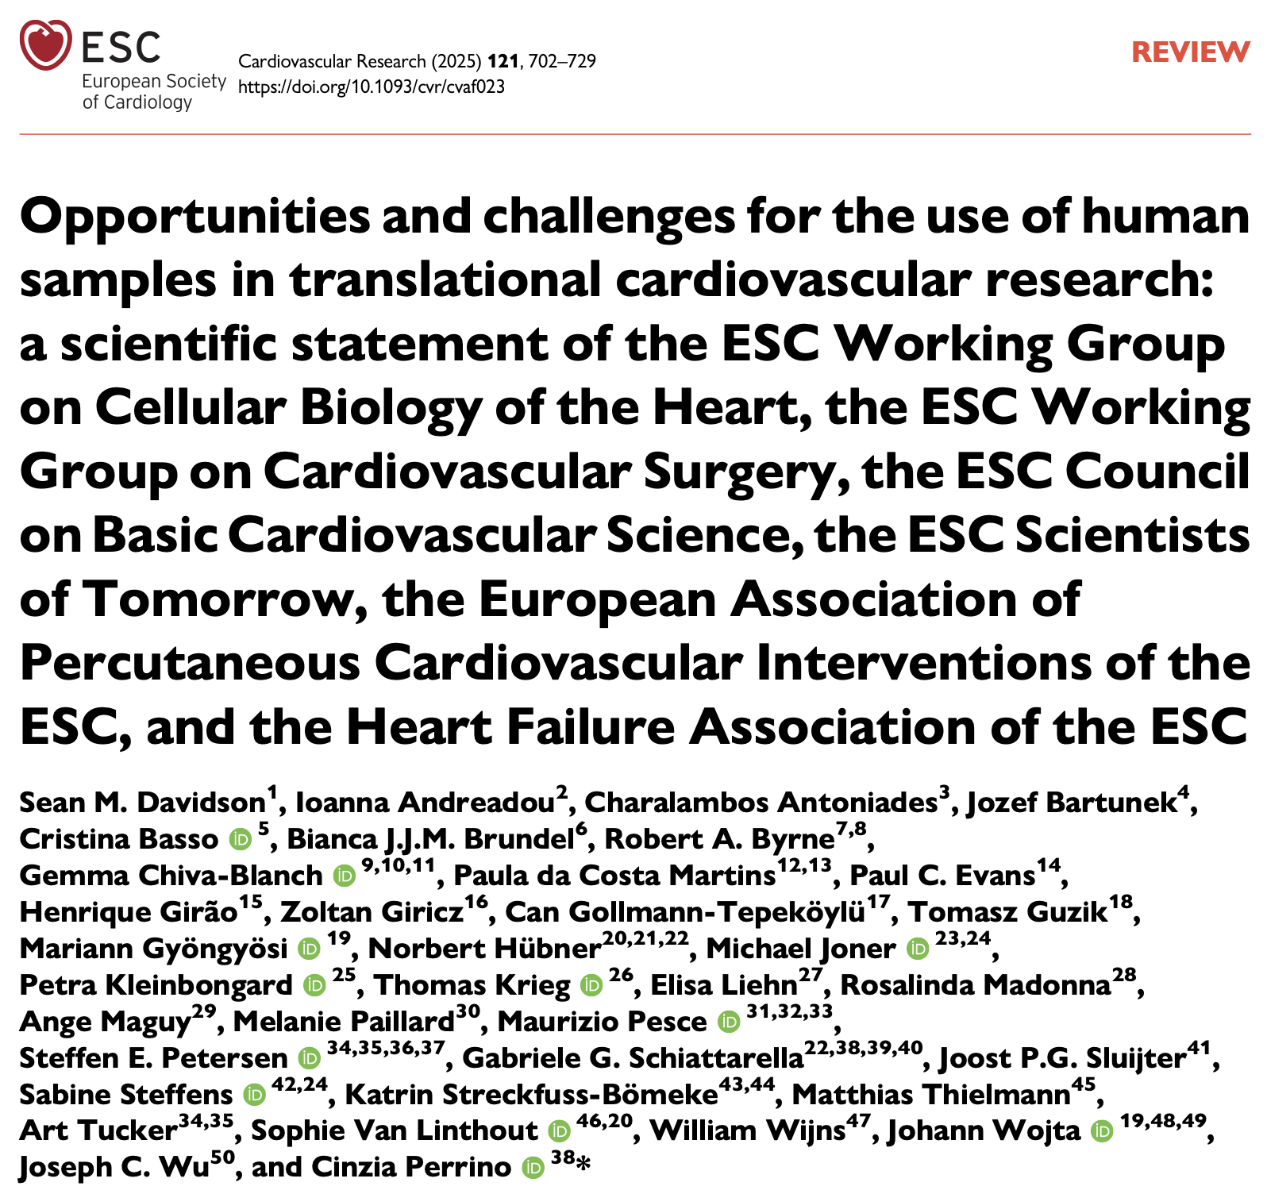
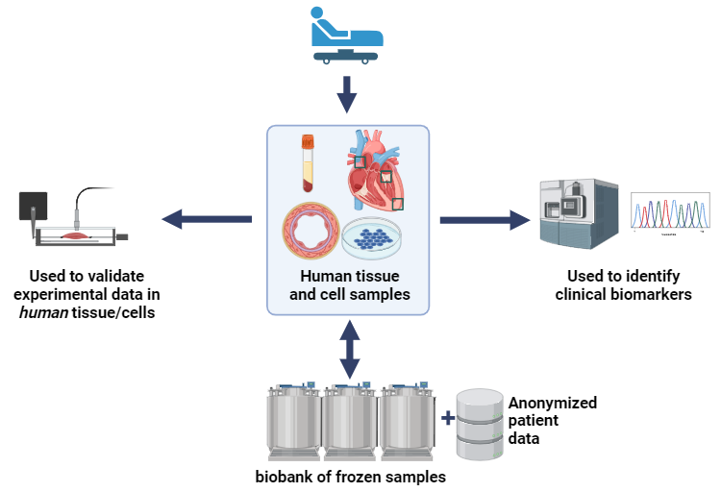

Slide 16
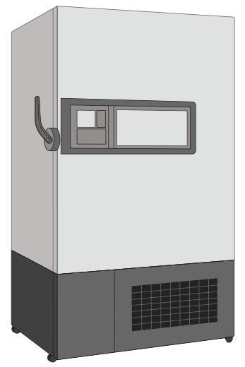

Cold Storage Optimization
Strategic Initiatives for Energy Efficiency and Space Management
Temperature adjustment
  Transition long-term storage from -80°C to -70°C to lower energy consumption.
Consolidation
  Optimize space by grouping samples and retiring underutilize freezer units.
Inventory purging
  Implement rigorous cycles to remove obsolete or expired samples.
Digital tracking
  Improve visibility through modernized inventory management systems.
A single standard -80°C ultra-low temperature freezer consumes as much energy as an entire average domestic household every single day (~20 kWh).
=
Inefficient freezer and sample management
Overfilled freezer
Storage of obsolete samples
Duplicate sample collections
Poor inventory tracking

Slide 17




Sustainable Biobanking
Centralized Storage
Barcode Tracking
Apply FAIR principles
Shared Biobanks
Implement standardized
LIMS-based tracking for
high-fidelity inventory
management.
Ensure data is Findable, Accessible, Interoperable, and Reusable to
prevent redundant data generation.
Promote collaborative
infrastructure to reduce
redundancy and resource
depletion.
Consolidate assets to
optimize energy usage and
management efficiency.
Objective: Maximize biobank value while minimizing operational and environmental waste.

Slide 18
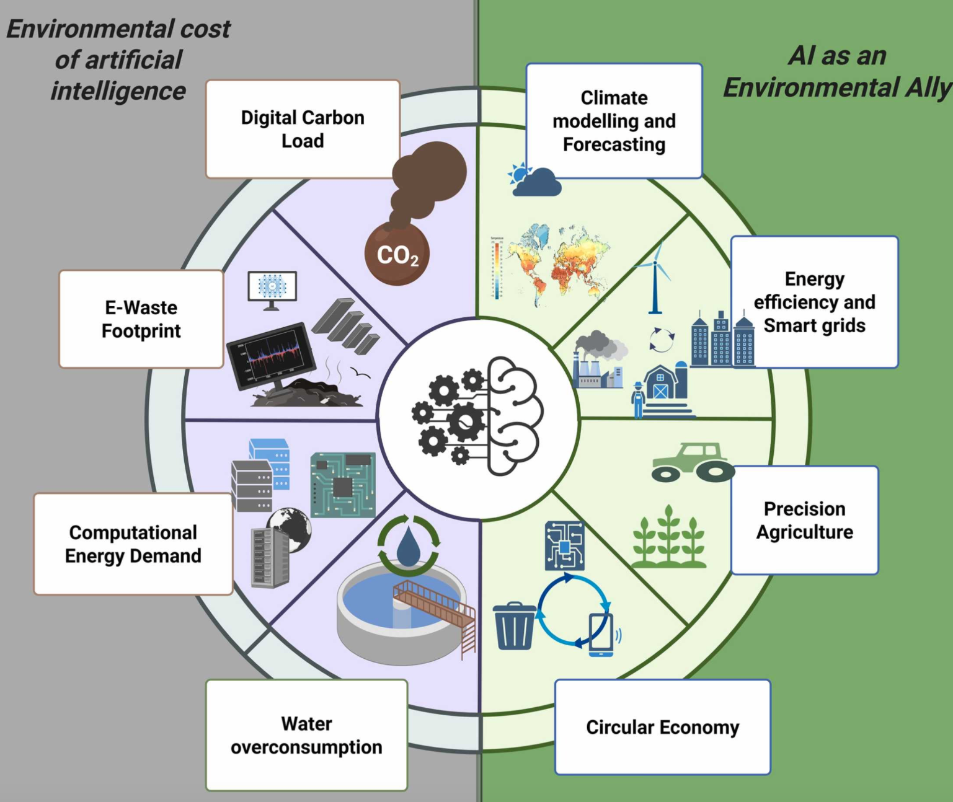
Environmental AI Checklist
Ask whether AI is needed
Use the smallest effective model
Reuse existing models
Use efficient hardware and green data centers
Optimize inference and storage
Measure and report emissions
Global Environmental Change Advances 6 (2026)

Slide 19


Precision Medicine vs. Sustainability: Key Tensions
Balancing innovation with environmental responsibility
Precision Medicine Requirement
Sustainability Challenge
Large biobanks
Continuous freezer energy consumption
Multi-omics analyses
High plastic/reagent waste
AI & Bioinformatics
Intense computational energy demand
Sample/Data Retention
Storage footprint & resource intensity
Global Collaborations
Increased Scope 3 emissions
Precision medicine must maximize insight while minimizing environmental cost
through optimized workflows, greener procurement, and clear environmental KPIs.

Slide 20



The Solution: Sustainable Precision Medicine
Smarter Biobanking
Sustainable Cloud Computing
Optimizing storage temperatures and
sample management to reduce energy
consumption.
Leveraging energy-efficient data centers and
optimized computing algorithms.
Greener Procurement
Data Retention Policies
Prioritizing ACT-labelled products to ensure
environmental accountability in the supply
chain.
Implementing lifecycle management to
reduce the carbon footprint of unnecessary
long-term cloud storage.
Efficient Omics Workflows
Dual KPI Framework
Streamlining high-throughput sequencing
and analysis to minimize reagent waste and
energy intensity.
Tracking environmental sustainability
metrics in parallel with traditional scientific
performance indicators.
Transitioning to a high-impact, low-footprint clinical research model

Slide 21
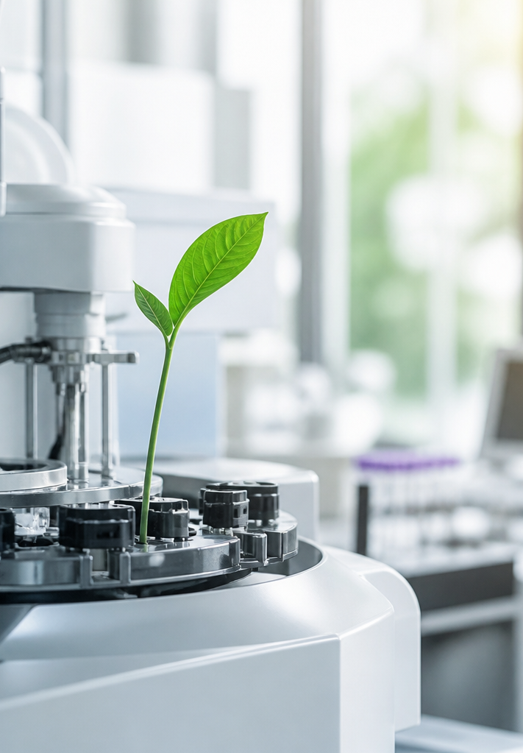
The Future of Sustainable
Cardiovascular Research
The environmental determinants of cardiovascular disease make sustainability in the research lab an integral part of our scientific mission.
Environmental safety and scientific excellence go hand in hand.
Sustainability must never compromise research quality.
The best cardiovascular laboratory is not defined solely by the impact of its discoveries, but also by its ability to generate those discoveries safely, ethically, reproducibly, and sustainably.
Reducing our research footprint is vital for both medical progress and planetary health.

