Slide 1
CRT Sustainability
How should the ESC include sustainability in its guideline recommendations
Stefan James
Professor Cardiology, Dept. of Medical Sciences Uppsala University
Scientific director Uppsala Clinical research center, Uppsala University
Senior Interventional Cardiologist Uppsala University Hospital

Slide 2
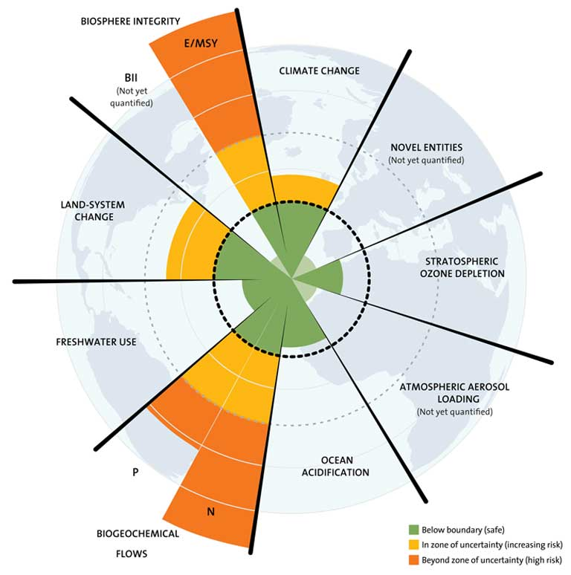
What type of sustainability is appropriate for guidelines
Environmental Sustainability and Planetary Health:
The ability to improve, maintain, or restore health while minimizing negative impacts on the environment and leveraging opportunities to restore it (WHO).
Planetary health, stands for achieving the highest possible standard of human health, well-being, and equity within "planetary boundaries" (the nine biophysical limits within which humanity can safely operate).
Planetary boundaries

Slide 3
What type of sustainability is appropriate for guidelines
Environmental Sustainability and Planetary Health:
The ability to improve, maintain, or restore health while minimizing negative impacts on the environment and leveraging opportunities to restore it (WHO).
Planetary health - achieving the highest possible standard of human health, well-being, and equity within "planetary boundaries" (the nine biophysical limits within which humanity can safely operate).
Sustainable Value:
Aims to maximize positive health outcomes while minimizing negative environmental, social, and financial impacts. The Centre for Sustainable Healthcare (CSH) defines "sustainable healthcare" as meeting the needs of current populations without damaging the health or ability of future or vulnerable populations to meet their own healthcare needs.
Sustainability of Clinical Adherence (Implementation Science):
Defined as the extent to which healthcare providers successfully maintain their adherence to evidence-based clinical practice guidelines as a part of their routine clinical workflow over a long period, typically measured more than one year after active implementation support has ceased
Planetary boundaries

Slide 4
1. Current Gaps and Needs
Historically, environmental sustainability considerations have been largely absent or addressed inconsistently in international clinical practice guidelines
While the ESC is increasingly incorporating sustainability into its strategic priorities and advocacy, clinical practice guidelines are primarily designed to maximize patient safety and clinical efficacy (and not any form of sustainability)
Is it time to include recommendations of ecologically friendly practices to explicitly stating their environmental impact in guidelines?

Slide 5
2. Institutional and Organizational Initiatives
Several leading healthcare evaluation and guideline-producing bodies are actively formulating strategies to incorporate environmental data into their processes
National Institute for Health and Care Excellence (NICE) has committed to leading globally on integrating environmental impact data (such as carbon footprint, freshwater consumption, and waste generation) directly into its guidance products and health technology evaluations.
The French National Authority for Health (HAS) has launched an environmental health roadmap that aims to encourage greater consideration of environmental criteria in both health technology assessments and the development of clinical practice guidelines

Slide 6
3. Clinical Examples and Targeted Areas
Integration of sustainability is particularly advanced in clinical areas that are high-volume or highly carbon-intensive:
Clinical asthma and COPD guidelines (such as those from NICE and the British Thoracic Society) increasingly recommend propellant-free dry powder inhalers (DPIs) or soft mist inhalers (SMIs) over high-global-warming-potential metered-d
Operating Rooms (ORs) and Anesthesia: Systematic reviews have established frameworks for integrating sustainability into OR guidelines. Key areas of focus include substituting high-impact volatile anesthetic gases, evaluating disposable versus reusable surgical instruments, utilizing low-impact surgical techniques, and managing OR ventilation energy consumption
Dentistry: Guidelines for environmental sustainability in dentistry address the broader clinic footprint, including recommendations regarding patient/staff travel, green procurement of supplies, waste segregation, and energy efficiency.

Slide 7

4. New Methodological and Decision-Making Frameworks
Guideline development groups are utilizing structured frameworks to make the integration of sustainability objective and evidence-based:
GRADE Guidance 46 (Planetary Health): has developed formal guidance to help panels systematically consider planetary health. It provides signaling questions across nine "planetary boundaries" (e.g., climate change, biosphere integrity, and freshwater change) to guide scoping and question-formulation.
PICO : Methodologists recommend introducing environmental criteria at the earliest stages of guideline scoping. This involves integrating environmental outcomes directly into the PICO (Patient, Intervention, Comparison, Outcome) framework and utilizing the GRADE Evidence-to-Decision (EtD) framework to weigh environmental costs alongside traditional clinical and economic outcomes.
Life Cycle Assessments (LCAs) and Circular Economy: Guidelines are beginning to incorporate LCAs, which quantify environmental impacts across a product's entire life cycle.
Raw Material Extraction
Manufacturing & Processing
Distribution & Transportation
Use Phase: Energy consumption, maintenance
End of Life: Recycling, repurposing, or landfill disposal

Slide 8
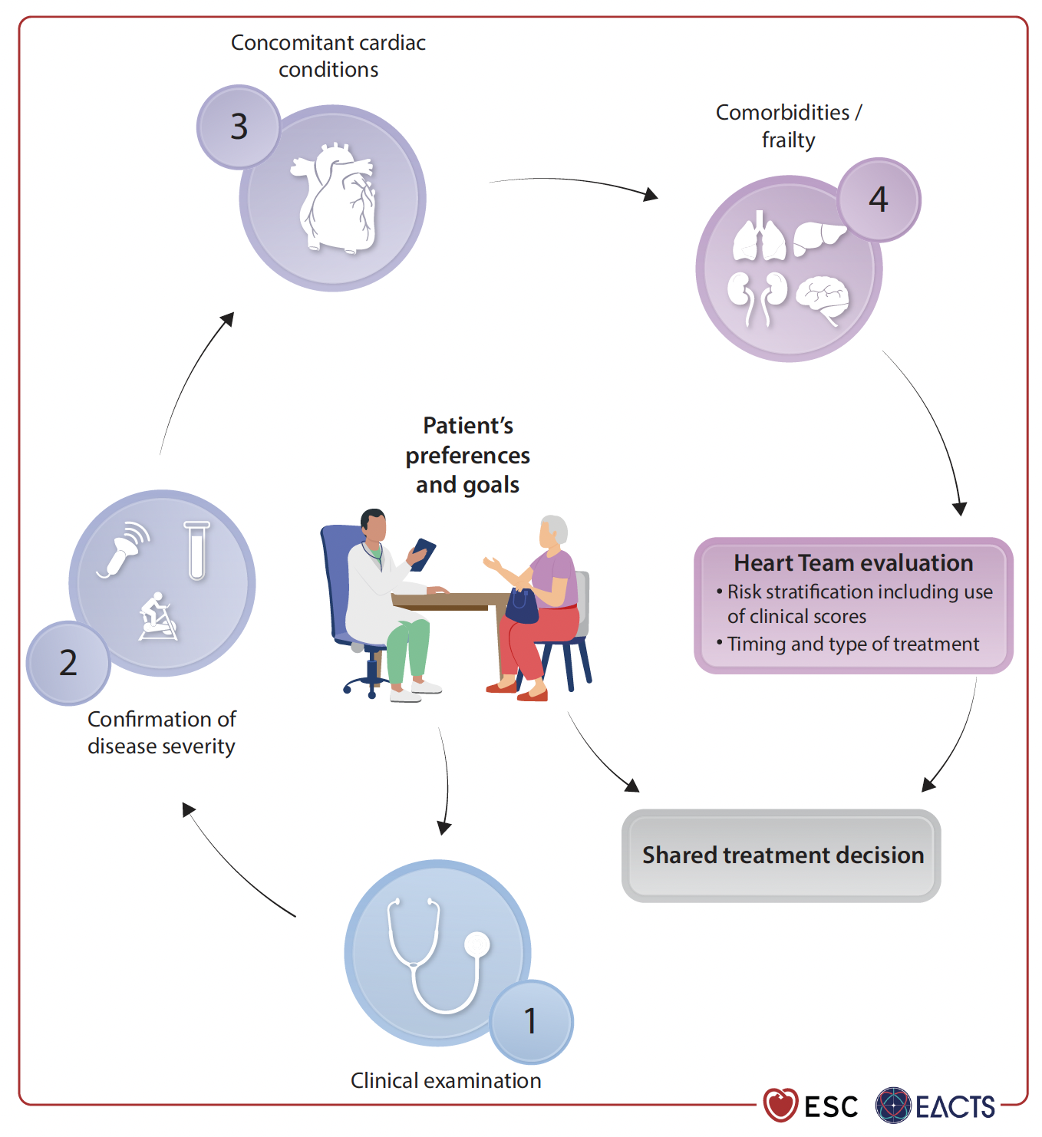
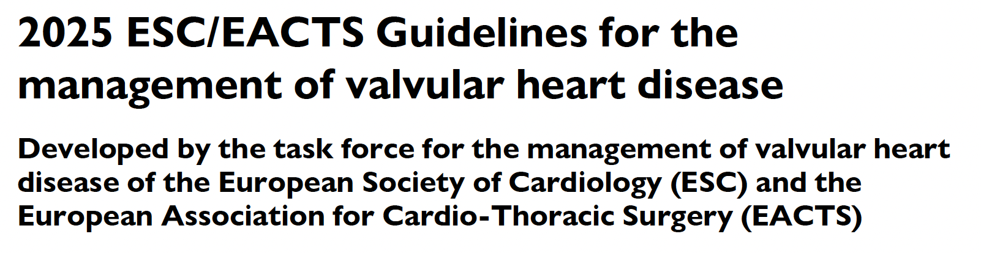
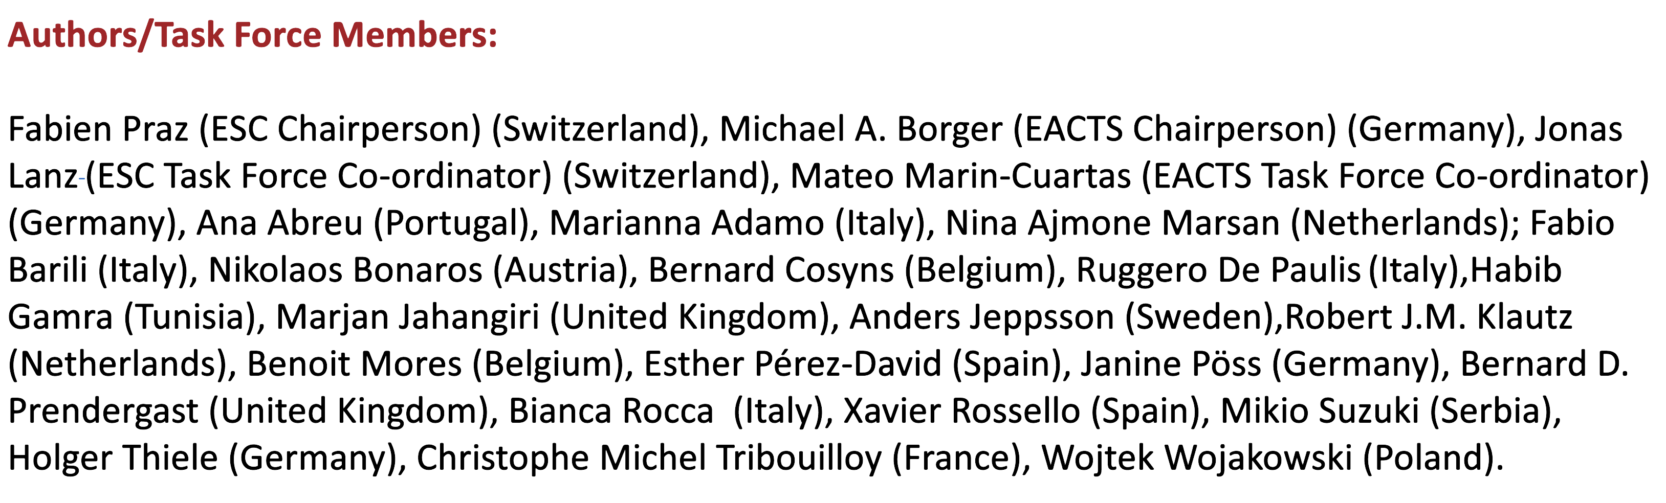
Our patients are in the centre!

Slide 9

Sustainibility is in the centre!

Slide 10
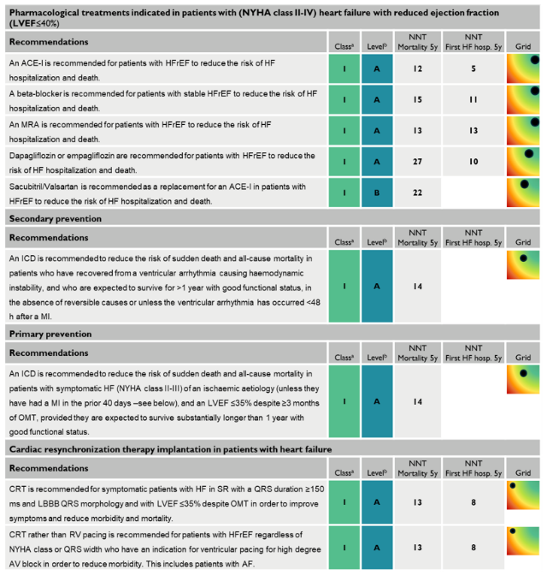
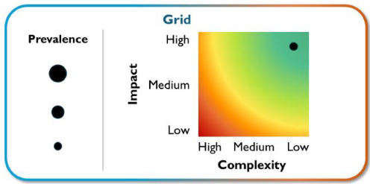
Resulting Overview of Recommendations, NNT and Grid

Slide 11
High-Intensity Imaging
Guidelines often prioritize advanced imaging for diagnostic accuracy. While clinically sound, these recommendations have a significant environmental impact:
High-Energy Modalities: Recommendations that favor CMR or CT over simpler, lower-impact alternatives like transthoracic echocardiography (TTE) for initial investigations. Research indicates that the carbon footprint of CMR and SPECT scanning is significantly higher (sometimes 5–100 times) than that of a standard echocardiogram.
Frequent Follow-up Imaging: Protocols that mandate routine "surveillance" imaging for asymptomatic patients can lead to high cumulative energy consumption and manufacturing waste associated with imaging hardware and cooling systems

Slide 12
High Consumption of Single-Use Medical Devices
Interventional cardiology, such as percutaneous coronary intervention (PCI) or electrophysiology studies, is guided by requirements for absolute sterility to prevent infection.
Disposable material: Guidelines necessitate the use of single-use catheters, guidewires, sterile drapes, and gowns. The sheer volume of non-recyclable, medical-grade plastic and metal waste generated per procedure is a major sustainability challenge.
"Kit" Culture: Clinical practice often relies on pre-packaged "procedure kits" to maintain efficiency. These kits often include items that are not used in every specific case but must be disposed of as medical waste anyway, regardless of whether they were removed from their sterile packaging

Slide 13
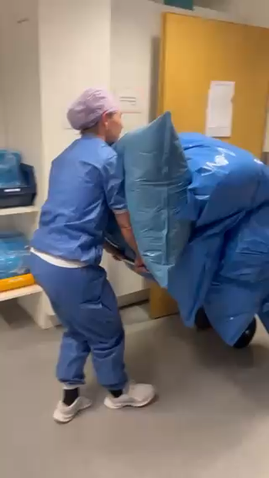
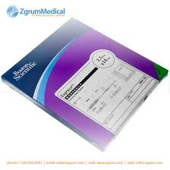

After one day in the cath lab

Slide 14
Intensive Monitoring and Digital Hardware
Recent guidelines for the management of heart failure and atrial fibrillation emphasize proactive, continuous monitoring.
Travelling: Multiple outpatient visits for investigation or follow-up may necessitate extensive travelling
Electronic Waste: Remote monitoring may necessitate the widespread distribution of proprietary digital devices, sensors, and batteries. The life cycle of this hardware—from rare earth mineral extraction to end-of-life disposal—contributes to a growing "e-waste" footprint in cardiovascular care.
Data Center Load: The shift toward digital health and AI-integrated care requires massive computational power for cloud storage and analysis, contributing to the energy consumption of large-scale healthcare data infrastructure

Slide 15
Pharmacological Persistence
While modern polypharmacy (e.g., lipid-lowering agents, anti-platelets, ACE inhibitors) for cardiovascular prevention is key for CV health, it has a downstream environmental effect, particularly if wasted.
Waterways Pollution: Cardiovascular drugs are frequently detected in municipal wastewater and surface waters because human bodies excrete these compounds, and standard wastewater treatment plants are often not equipped to remove complex pharmaceutical molecules.

Slide 16
Conclusions
Sustainability
Should be considered to be included in guidelines in order to complement scientific evidence similar to health economy, and availability of therapies

