Slide 1

Climate and Cardiovascular Health: Turning Environmental Health into Opportunities
Sanjay Rajagopalan, MD, MBA.
Disclosures Relevant to this Presentation: Grant Funding from the NIH

Slide 2
‘Food comes first, then morality’.
Bertolt Brecht

Slide 3

Direct emissions reductions
Strict target achievement
Tight renewable energy accounting
Best-efforts framework
Greater implementation flexibility
Expanded use of certificates and market instruments

Slide 4
Who is the Largest Employer of US Physicians?

Slide 5







>50,000 Physicians.
#42 on Fortune 500
# 5 Fortune 500
>40,000 Physicians.
#63 on Fortune 500
# 9 Fortune 500
>90,000 Physicians. 10% of US MDs
2025: >$448 Billion Revenue
#5 Fortune 500
4 Businesses:
Optum Care, Optum Financial,
Optum Rx and Optum Health.
# 14 Fortune 500
>40,000 Physicians.
#66 on Fortune 500

Slide 6



Volatile and Uncertain Healthcare Costs/Situations
2022: -$781 million loss
2023: >$1B Income. 6% margin
2022:$ 436m loss -1.6% margin
2023: 0.5% margin
2022: $432 million loss
2023: $48 million loss
4 million patient encounters in 2023 Highest in 102-year history
Data from Fierce and Becker Healthcare. Accessed December 26, 2023, and February 27, 2024

Slide 7
Making the strategic case for firm prosperity may involve reframing complex social problems as untapped possibilities for strategic innovation
Why Sustainability Is A Strategic Imperative, Not An Option. Forbes Magazine. August 21, 2023
Notes:
Gen-Z are expected to account for 40% of U.S. consumers once they come of age. Their motivations are drastically different from previous generations—they’re less brand loyal, they’re the first digitally-immersed cohort in history and they currently command a whopping $360 billion in purchasing power.

Slide 8
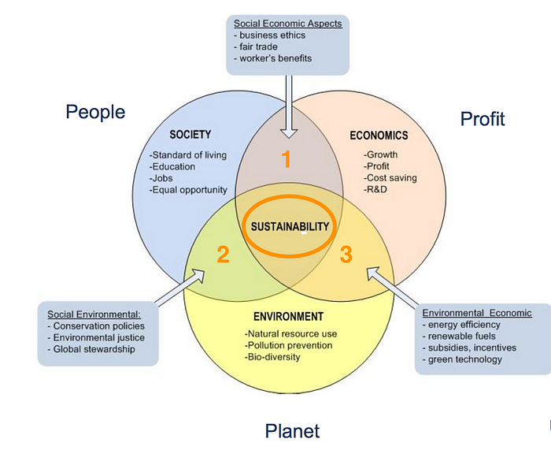
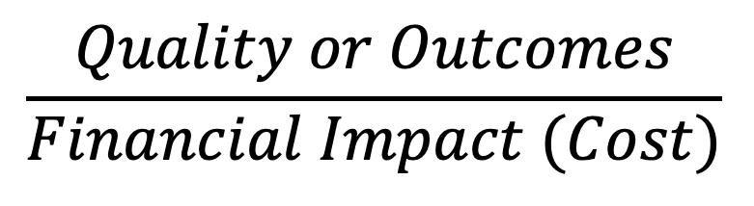
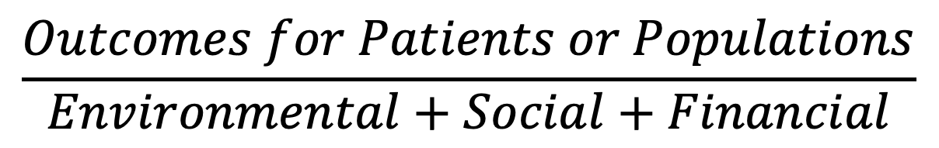
Bottom Line and Triple Bottom line
$$\frac{Quality or Outcomes}{Financial Impact (Cost)}$$
Porter ME. What is value in health care? N Engl J Med 2010;363:2477–81
$$\frac{Outcomes for Patients or Populations}{Environmental+Social+Financial}$$
> Patient level outcomes
> Financial impacts.
> Population health outcomes
> Environmental impacts
> Social impacts

Slide 9
Sustainability as a Competitive Differentiator
Lonely Frontier
Efficient Frontier
Differentiation
High
COST
Low

Slide 10
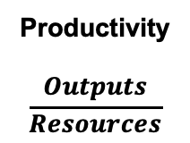

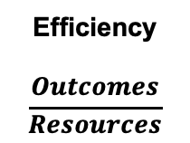
How is Sustainability Linked to Other Domains of Value Based Care?
Quality
Bottomline
Stretching the Value Frontier
Financial
Effectiveness
Timeliness
Efficiency
Productivity
$$\frac{Outputs}{Resources}$$
Efficiency
$$\frac{Outcomes}{Resources}$$
Technical Value
$$Right Paient$$
at the right time for the right reason
QUALITY
DOMAINS
Environmental
Safety
Sustainability
Patient
Experience
Equity
Social
Productivity, efficiency and technical value (Adapted with permission of Muir Gray et al. How to get ­better value healthcare. Oxford Press).

Slide 11
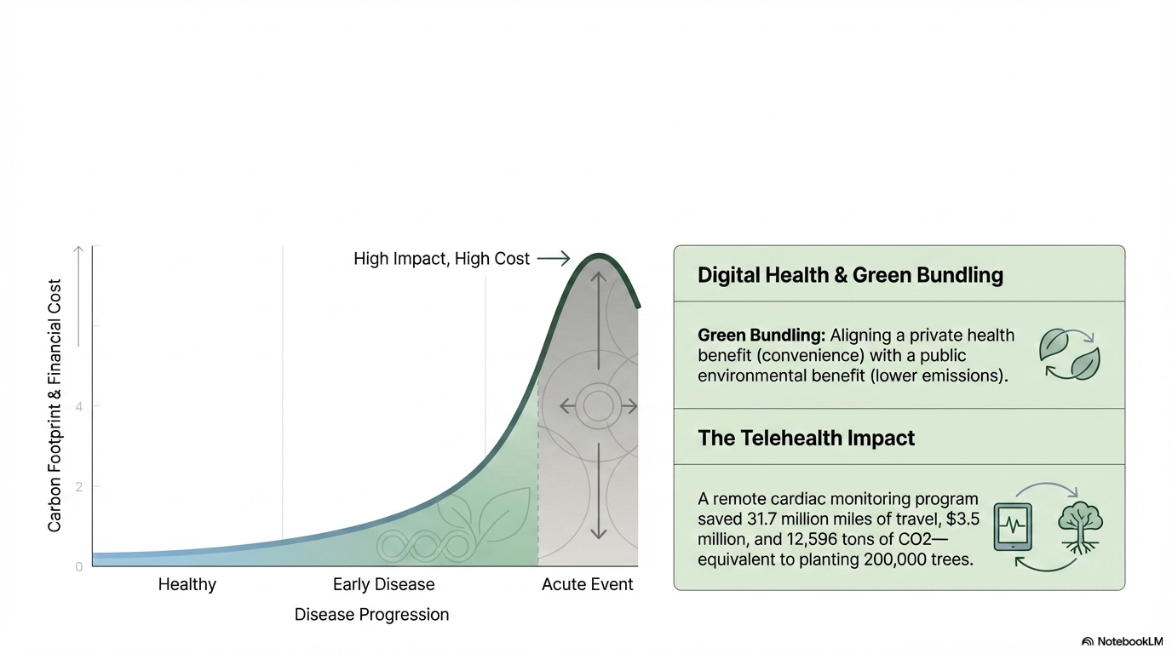
Promordial Prevention as the Ultimate Sustainability Tool
The Lowest Emission Procedure/Test/ is the one that Never Happens
Shifting the Paradigm to Early Prevention Yields the Highest Environmental/Financial ROI

Slide 12
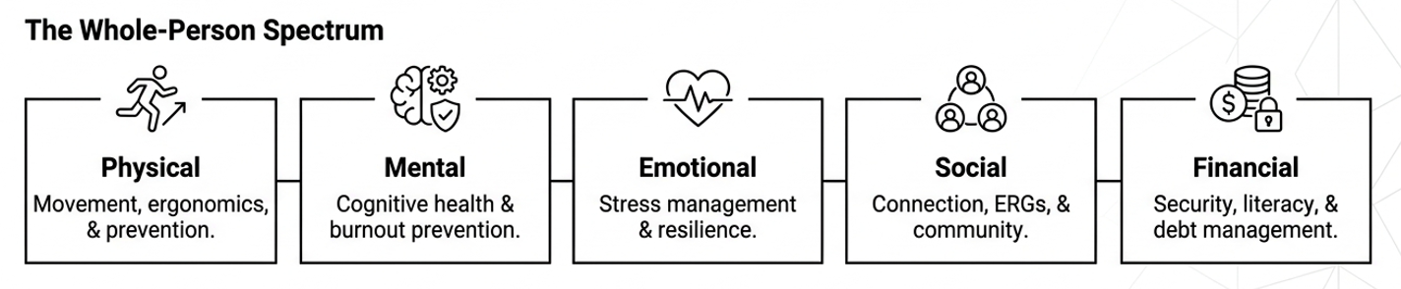
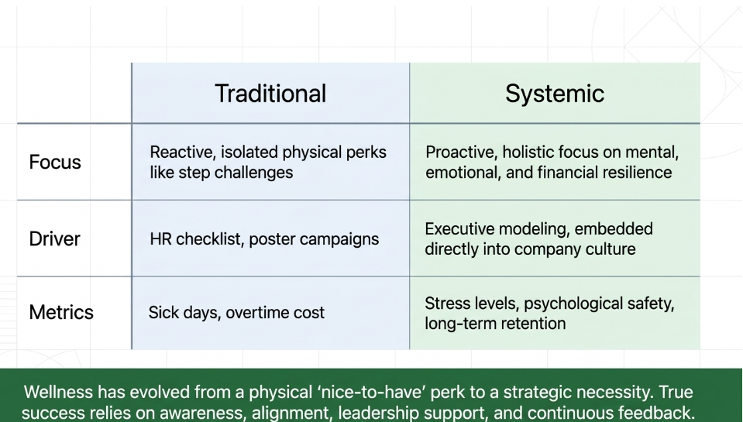
Promordial Prevention as the Ultimate Sustainability Tool

Slide 13




Building A Sustainability into a Movement and Measuring Intended Benefits
Measuring
Impact and Return
on Investment
KPI’s
Analytics
Communication
Studying the
System
Players
Opportunities
Friction Points
Setting
Goals
Problem Statement
Financial Analysis
Culture Change
Designing
the Improvement
Effort
Mapping terrain
Culture Change
Strategy

Slide 14















Energy
Medical
HCO Sustainability
Food
Climate
Health Care and Climate Change: Challenges and Pathways to Sustainable Health Care. Ganatra, Rajagopalan S et al. Ann Intern Med. 2022. Nov;175(11):1598-1600
Implementing a Sustainability Framework in Healthcare: A Three-Lens Framework.
Rajagopalan S, Pronovost P et al. Healthcare (Basel). 2023 Jun 27;11(13):1867.

Slide 15
Building A Sustainability into a Movement and Measuring Intended Benefits
Measuring
Impact and Return
on Investment
KPI’s
Analytics
Communication
Studying the
System
Players
Opportunities
Friction Points
Setting
Goals
Problem Statement
Financial Analysis
Culture Change
Designing
the Improvement
Effort
Mapping terrain
Culture Change
Strategy

Slide 16
Company and Patient Clarification Around Sustainability
Making Sustainable Living a Business Strategy
Business model should embed sustainability at all levels.
Meet changing consumer preferences and a VUCA world.
KEY INPUTS
People Process and Technology
Process: Sustainable food, supply chain, assets, logistics and partnerships
People: People should drive this effort
Technology: Innovation and Technology important
Sustainable
Living
Technology
People
Sustainable
Living
Process
Sustainable
Living
Notes:
A company and customer-centric clarification of value around sustainability

Slide 17
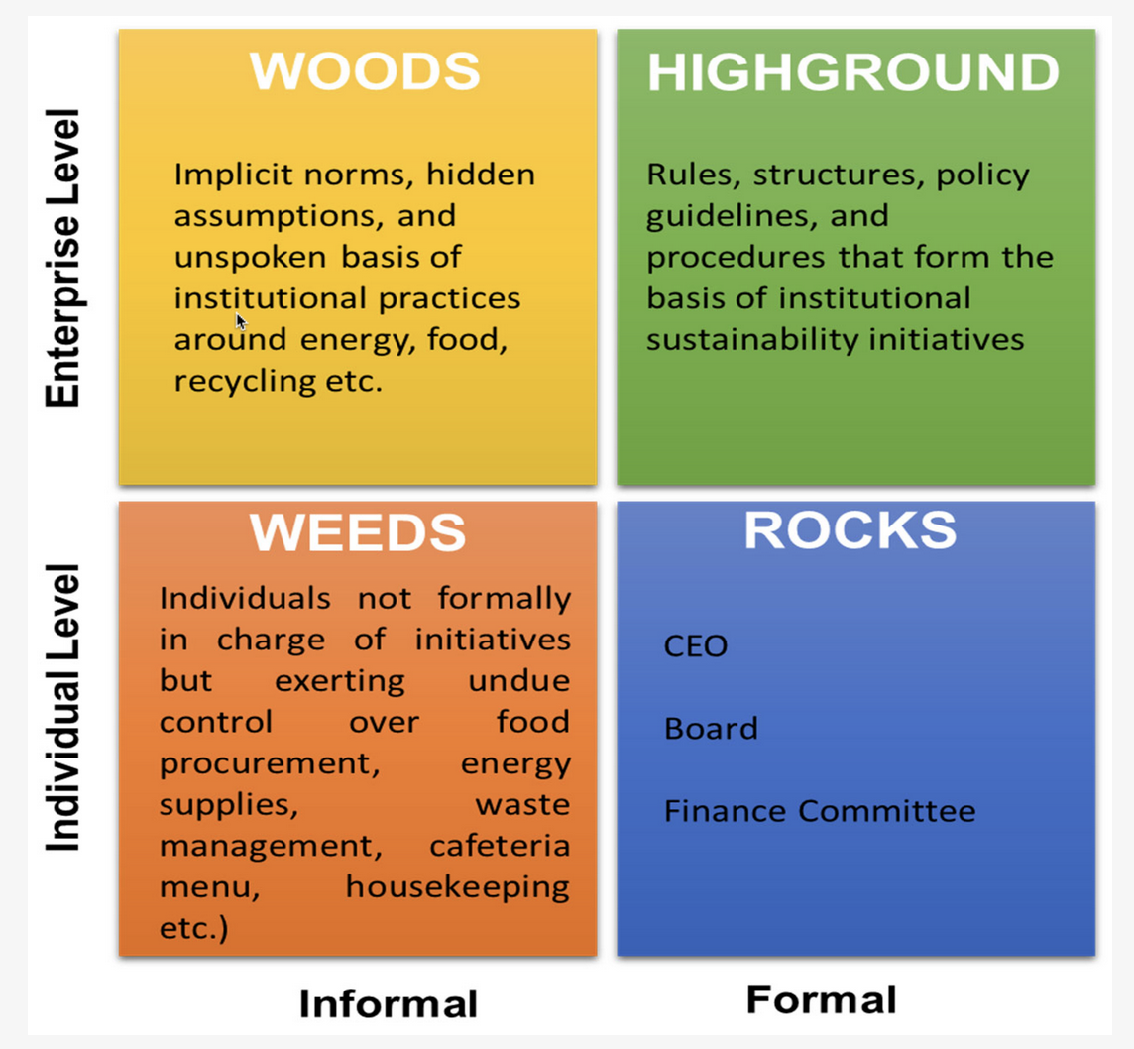
Implementing a Sustainability Framework in Healthcare: A Three-Lens Framework
The 4 Types of Organizational Politics
In Rajagopalan S et al. Healthcare 2023, 11(13), 1867; Adapted from: Michael Jarrett. Harvard Business Review 2017)

Slide 18







Goal Setting Through High-Impact Areas
Establish greater health system effectiveness
Reduce emissions by improving system effectiveness, including eliminating inefficient and unnecessary practices, linking carbon reduction and quality of care, and bolstering resilience.
Power health care with 100% clean, renewable electricity
Ensure that health care is powered by zero emissions electricity across the
three pathways.
Invest in zero emissions buildings and infrastructure
Ensure every health care building and health product manufacturing facility and their infrastructure promote energy efficiency, zero emissions, and climate resilience.
Transition to zero emissions, sustainable travel and transport
Transition to 100% low or zero emission fleet vehicles and infrastructure, while
encouraging active travel and public transport for patients and staff wherever feasible.
Provide healthy, sustainably grown food
Provide healthy, locally, and sustainably produced fresh and seasonal food with
zero food waste.
lncentivize and produce low-carbon pharmaceuticals
Reduce unnecessary pharmaceutical use, substitute high emissions products with more climate-friendly alternatives, and incentivize the production of affordable green, climate-smart medicine.
Implement circular health care and sustainable health care waste management
Implement circular economy principles to procure supplies, deploy clean technologies, reduce the volume and toxicity of health care waste, and manage waste sustainably.
Health Care Without Harm. Global Road Map for Health Care Decarbonization—Annex C Recommended Interventions.

Slide 19
Building A Sustainability into a Movement and Measuring Intended Benefits
Measuring
Impact and Return
on Investment
KPI’s
Analytics
Communication
Studying the
System
Players
Opportunities
Friction Points
Setting
Goals
Problem Statement
Financial Analysis
Culture Change
Designing
the Improvement
Effort
Mapping terrain
Culture Change
Strategy

Slide 20




Design of Sustainable Improvement:
Lean service delivery
Services where people need them
Streamlining care to minimize low value activity
Patient Employee Empowerment and Self-care
Support patients to take a bigger role in managing their own health and healthcare
Prevention
Promoting health
Preventing disease
Reduce the need for unnecessary healthcare
Low carbon alternatives
Preferential use of effective treatment and medical technologies with lower environmental impact
Minimizing waste of medications, consumables, and energy
Notes:
An audit of leverage points for change and cost savings

Slide 21
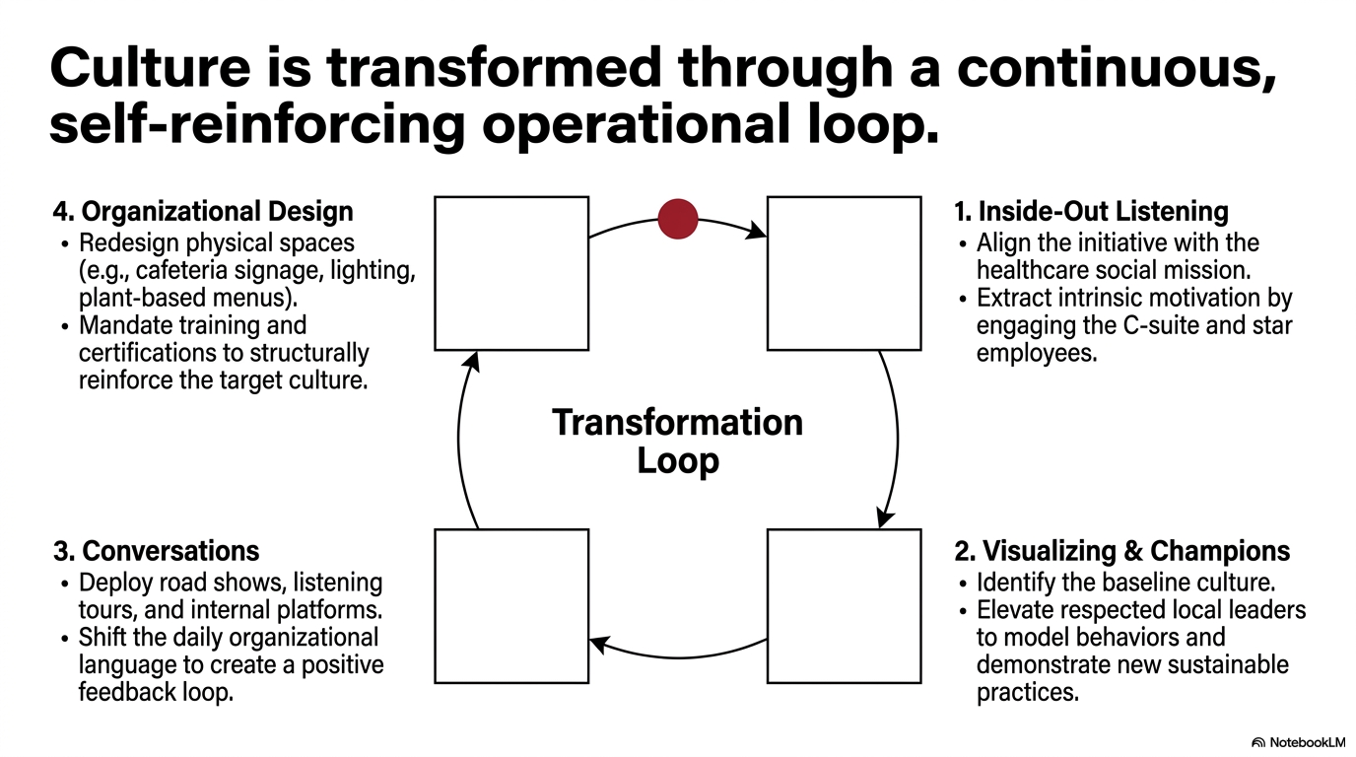
Implementing a Sustainability Framework in Healthcare: A Three-Lens Framework.Rajagopalan S et al. Healthcare 2023, 11(13), 1867

Slide 22
Short-Intermediate Cost Savings Playbook: 1
REAL ESTATE OR/MEDICAL SUPPLIES
SODEXO CONTRACT
Reduce energy costs
Reduce facility costs
Inventory Management/Lean Practices
Good for environment!

Slide 23


Intermediate Cost Savings Playbook: 2
  Scope 2 Reduction
    Leverage IRA and Governmental Funding : Swap out of Aging Assets
    Energy efficiency upgrades
    Reduced maintenance
$2 Billion OSU
$$$ Upfront Capital
  Scope 1 Reduction
    Reduce Medical Waste
    Reduce Food waste

Slide 24
ENERGY COST SAVINGS
GAS | ELECTRIC | WATER | TOTAL UTILITIES | TOTAL | 1% | 1%
$4,195,085 | $17,494,384 | $7,428,462 | $29,129,891 | $72,208,795 | $291,129 | $722,087
YEAR 1
1% UTILITY SAVINGS = $291,129
1% TOTAL SAVINGS = $722,087
UTILITY
2.5% | 5% | 1% | TOTAL
$654,569 | $1,309,138 | $1,963,707 | $26,182,760
1.0% | 2.0% | 3.0% | $72,208,795
$722,087 | $1,444,176 | $2,166,261 | $72,208,795
YEAR 2
UTILITY+ MAINT
Real Estate Consolidation with Reduction in Square Footage and savings
In Gas, Electric, Water and Maintenance
2.5% | 5% | 1% | TOTAL
$654,569 | $1,309,138 | $1,963,707 | $26,182,760
1.0% | 2.0% | 3.0% | $72,208,795
$722,087 | $1,444,176 | $2,166,261 | $72,208,795
YEAR 3
DOES NOT INCLUDE $37M in MAINTENANCE COSTS (53%) ACROSS SYSTEM. 16% of COSTS OR $19M IN MAINTENANCE AT CMC ALONE

Slide 25
OR COST SAVINGS:
Surgery Type | IP | OP | Total Surgeries
Cases | 15,771 | 47,517 | 63,288
Charges | $ 1,757,899,828 | $ 1,114,962,326 | $ 2,872,862,154
Expected Payment | $ 554,363,125 | $ 286,760,272 | $ 841,123,397
Direct Cost | $ 361,856,002 | $ 197,638,976 | $ 559,494,978
Total Cost | $ 548,890,194 | $ 271,688,587 | $ 820,578,781
Variable Direct Cost | $ 242,264,121 | $ 142,124,633 | $ 384,388,754
Labor Cost | $ 190,344,591 | $ 67,132,667 | $ 257,477,258
Fixed Labor Cost | $ 85,715,300 | $ 29,544,596 | $ 115,259,896
RN Labor Cost | $ 56,260,930 | $ 23,923,285 | $ 80,184,215
Surgical Supplies Cost | $ 42,070,717 | $ 54,653,344 | $ 96,724,061
Pharmacy Supply Cost | $ 10,581 | $ 7,303 | $ 17,884
Drug Supply Cost | $ 15,714,114 | $ 5,893,333 | $ 21,607,447
YEAR 2 COST SAVINGS
$1.2 M
*1% OF SUPPLIES, PHARMACY AND DRUG COSTS THROUGH REDUCTION IN WASTE AND INVENTORY CONTROL
YEAR 3 COST SAVINGS
$1.8 M
*1.5% OF SUPPLIES, PHARMACY AND DRUG COSTS THROUGH REDUCTION IN WASTE AND INVENTORY CONTROL AND ADDITIONAL COST SAVINGS THROUGH CULTURE CHANGE, VOLUME etc
 | IP | OP | TOTAL
Surgical Supplies Cost | $ 42,070,717 | $ 54,653,344 | $ 96,724,061
Pharmacy Supply Cost | $ 10,581 | $ 7,303 | $ 17,884
Drug Supply Cost | $ 15,714,114 | $ 5,893,333 | $ 21,607,447
Total Cost | $57,795,413 | $60,553,980 | $118,349,393
UH System Surgeries, Jan-Sept 2022
Source: EPSI

Slide 26
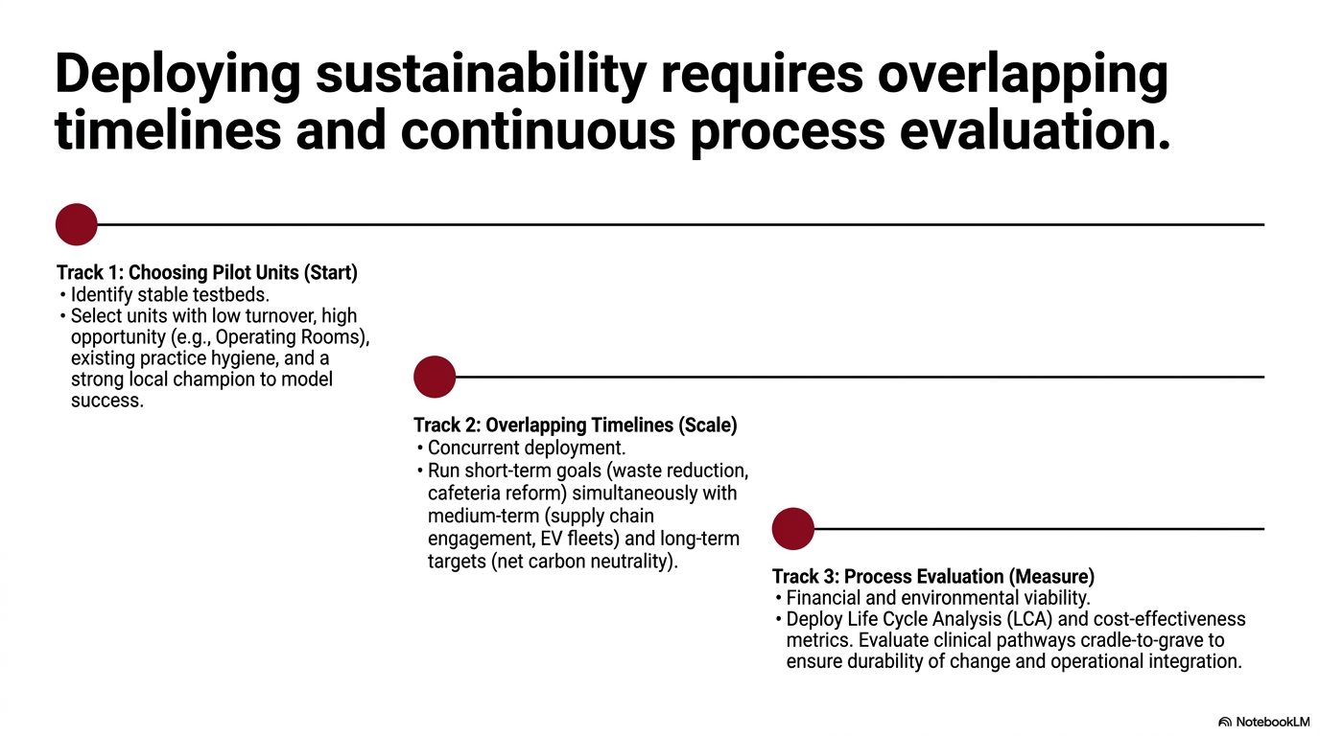

Slide 27
Building A Sustainability into a Movement and Measuring Intended Benefits
Measuring
Impact and Return
on Investment
KPI’s
Analytics
Communication
Studying the
System
Players
Opportunities
Friction Points
Setting
Goals
Problem Statement
Financial Analysis
Culture Change
Designing
the Improvement
Effort
Mapping terrain
Culture Change
Strategy

Slide 28
