Slide 1
How do I communicate environmental risk to patients?
Prof Dr Paul Dendale, Hasselt University

Slide 2

Communication aims
Raise awareness of the impact on the individual
Increase the knowledge of the mechanisms of impact
Communicate coping strategies specific to the individual (adaptation of/to the environment, changes in daily routines, sports and medication dosages,…)
Avoid inducing (more) anxiety

Slide 3
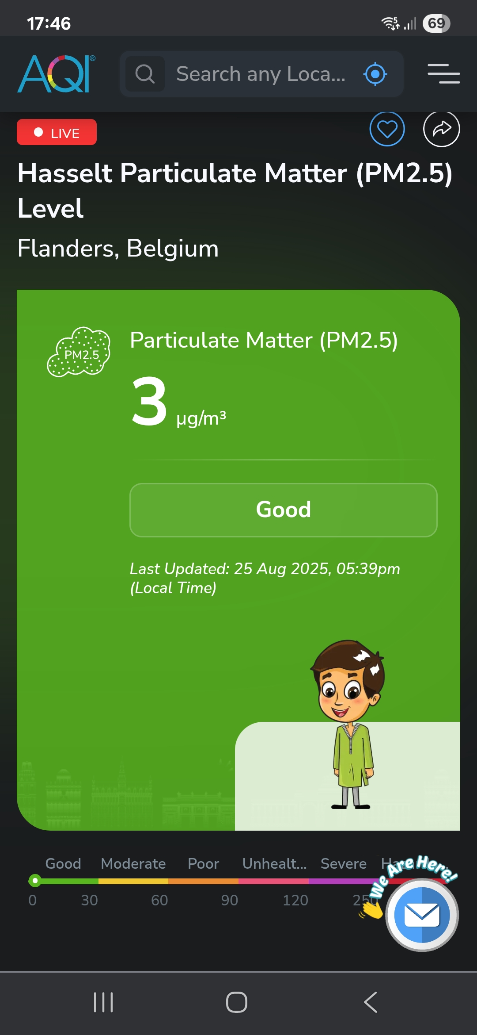
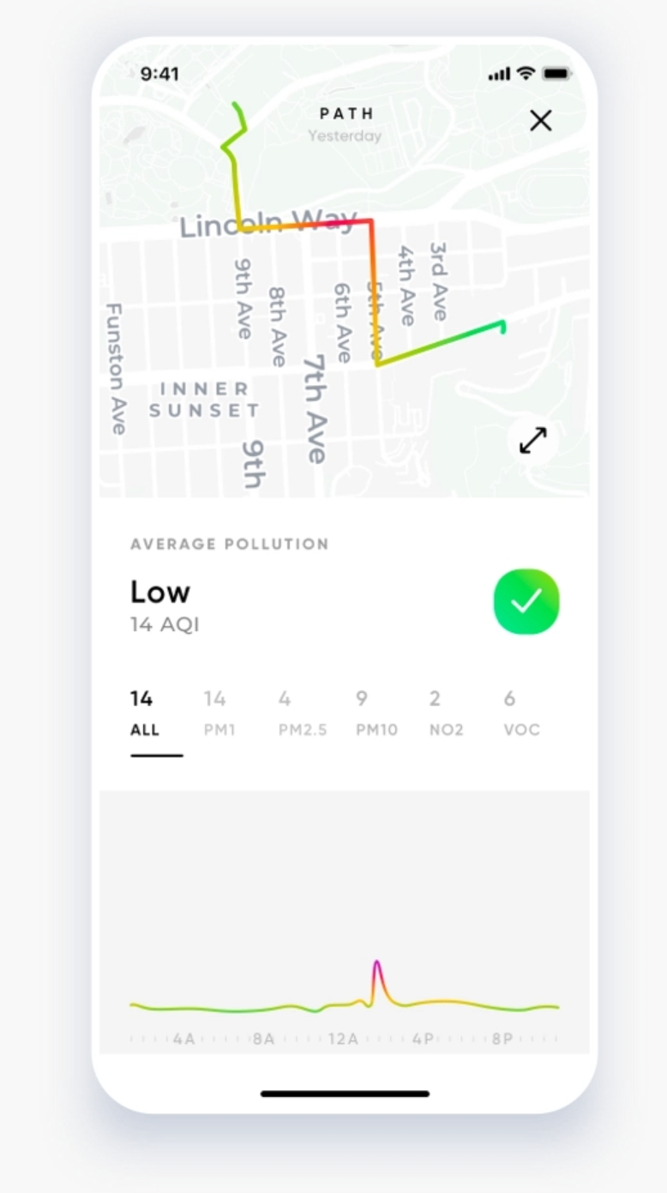
Raising awareness

Slide 4
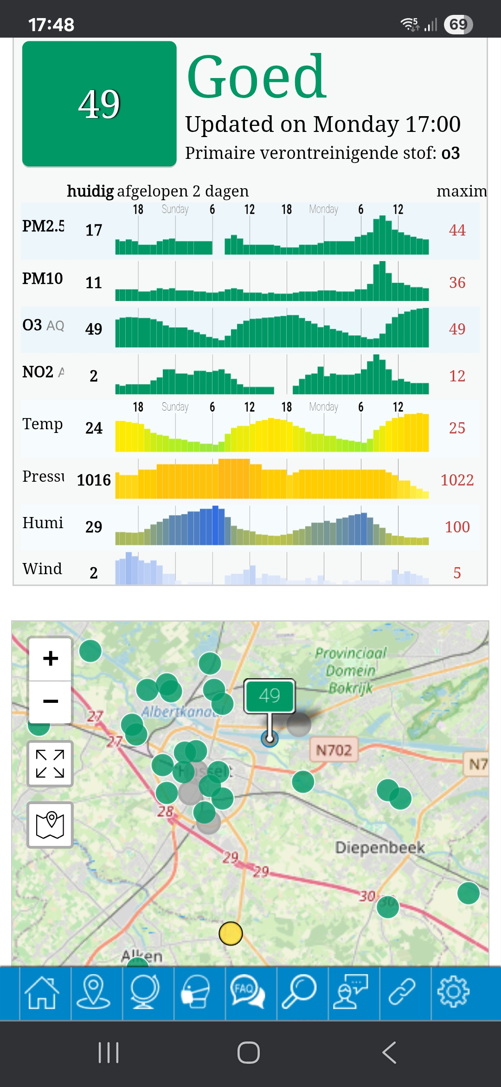
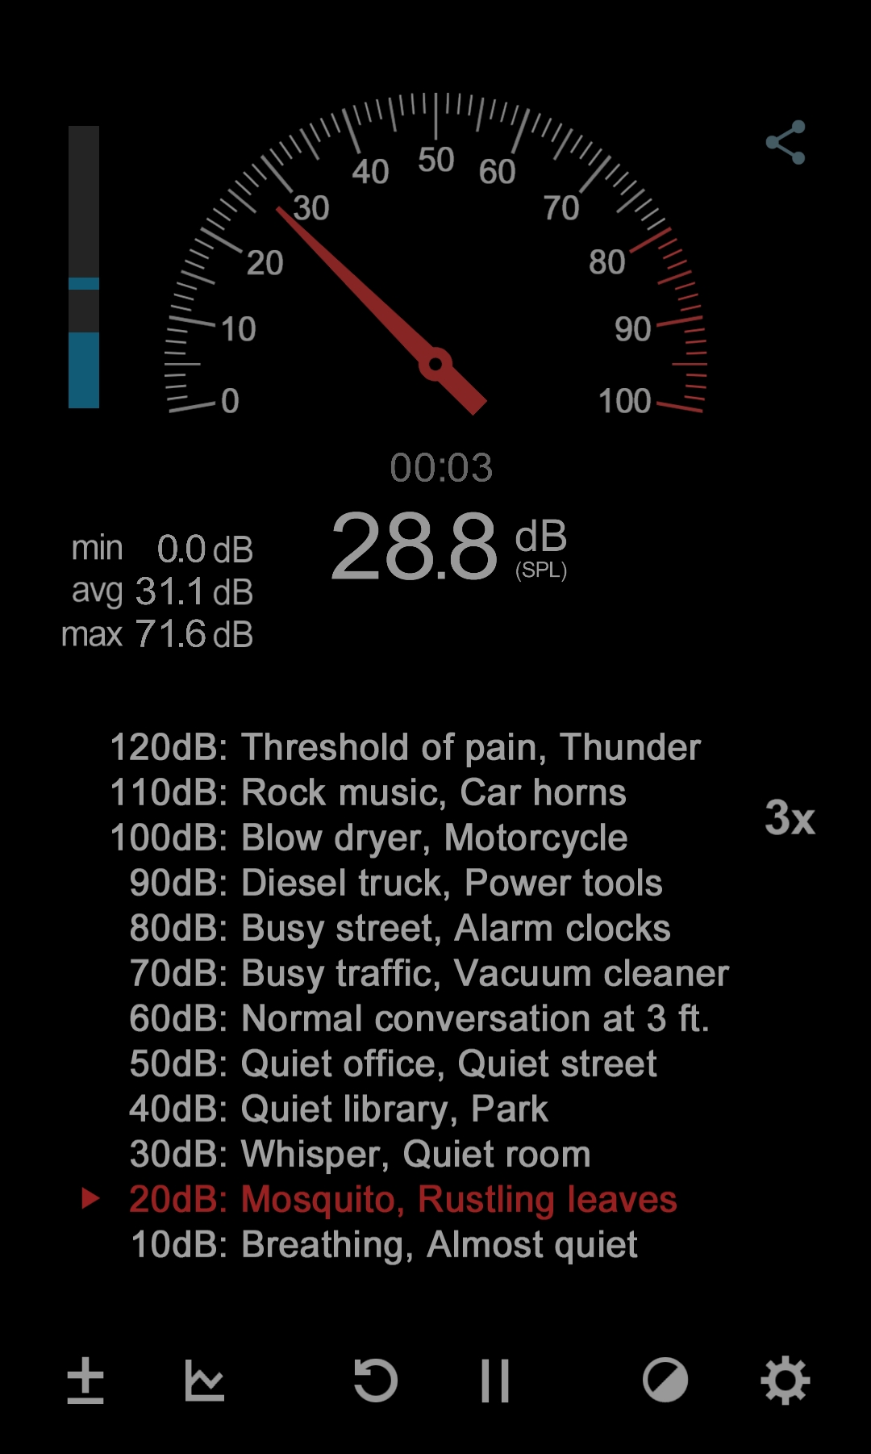
Raising awareness

Slide 5
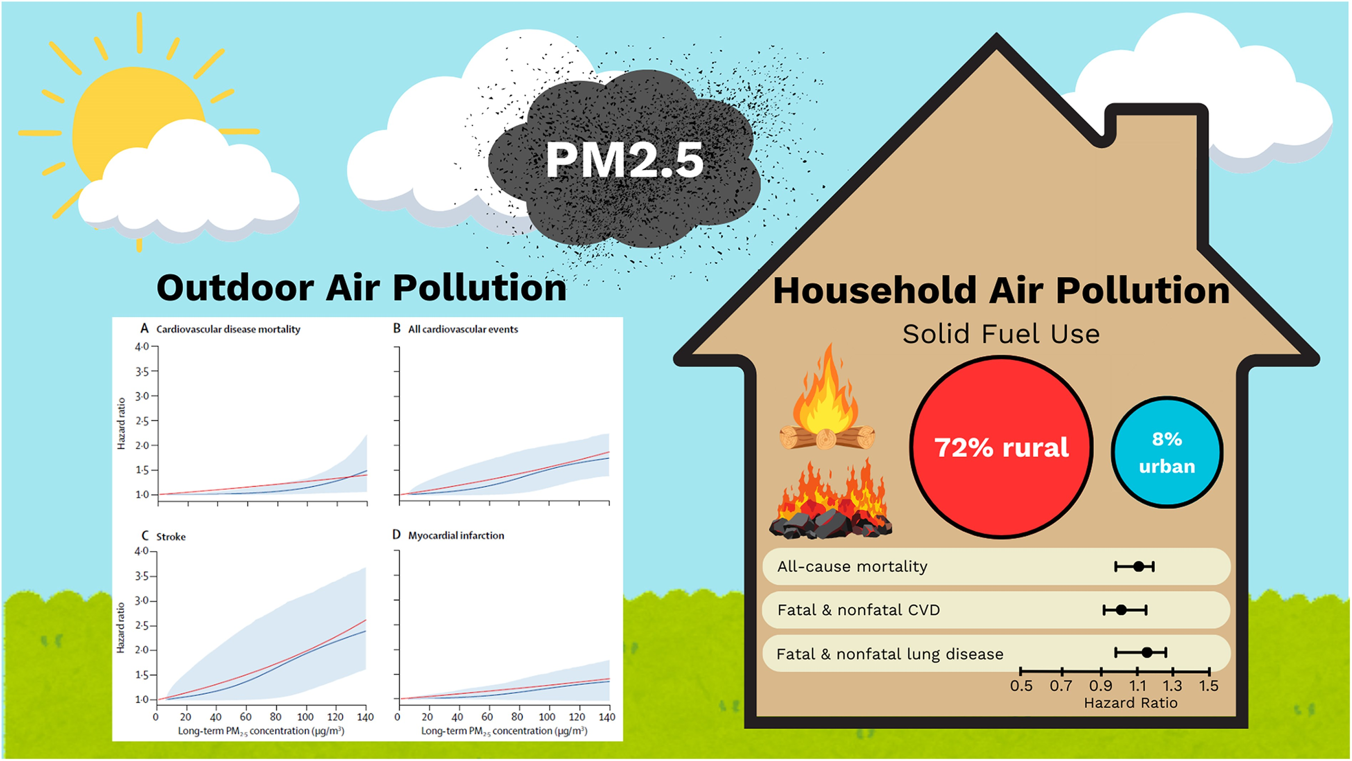
Raising awareness
Eur Heart J, Volume 46, Issue 30, 7 August 2025, Pages 2959-2973
Notes:
Effects of outdoor air pollution (left) and household air pollution (right). In the left panel, red lines show linear hazard ratios and blue lines show non-linear hazard ratios for cardiovascular disease mortality (A), all cardiovascular disease events (B), stroke (C), and myocardial infarction (D). Shaded areas represent 95% confidence intervals for the non-linear models. In the right panel, hazard ratio and 95% confidence interval for living in a household using solid fuels for cooking. Graphs on the left reprinted with permission from Hystad et al. (2020)⁹⁰ with additional modification from Hystad et al. (2019)⁹¹

Slide 6
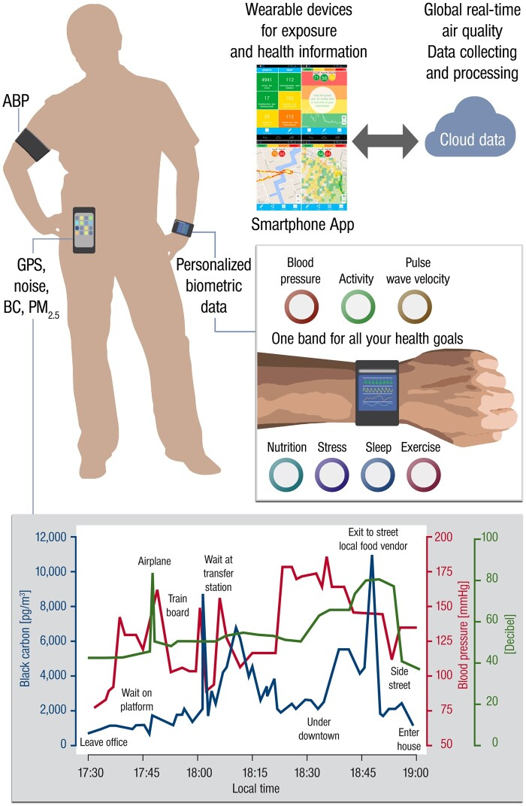
Raising awareness
Eur Heart J, Volume 42, Issue 25, 1 July 2021, Pages 2498-2500
Notes:
Hypothetical framework of investigations that combine technological innovation in biometric data with personalized exposure information in real-time to study interactive effects of environmental risk factors on cardiovascular endpoints. ABP, ambulant blood pressure monitoring; BC, black carbon; PM, particulate matter. With permission from Münzel et al.¹⁸

Slide 7
Increase the knowledge of the mechanisms of impact
Sweating
Vasodilatation (heat)
Vasoconstriction (cold)
Impact of particles and other sources of pollution
Impact of different drugs on how the body copes with temperature extremes

Slide 8
Communicate coping strategies: pollution
Promote ventilation or air purifiers for indoor pollution (e.g. after cooking!)
Avoid open fires in the house
Use face masks or stay indoors in cases of heavy particle pollution
Advocate for a healthy environment
Buy an electric car and a heat pump

Slide 9
Communicate coping strategies: heat
Install airconditioning or go to airconditioned public places
Cooling through skin wetting and fanning (depending on air temp.!)
Avoid alcohol use
Avoid strenuous exercise
Hydrate sufficiently (follow up weight)
Consider reducing diuretics and ACEI/AIIA
Beware anticholinergic/antidepressant/antiepileptics

Slide 10
Communicate coping strategies: general
Address classical risk factors
Importance of healthy lifestyle
Stimulate healthy mobility (reduce your own emissions and noise) and healthy environments
Give each person the feeling of having impact

Slide 11
In summary
Awareness
Knowledge
Coping strategies
Anxiety

Slide 12
Thanks for listening (and doing something about our environment ☺)
paul.dendale@uhasselt.be

