Slide 1
Environmental stressors as cardiovascular risk factors: from evidence to responsibility
Thomas Muenzel
16th June 2026

Slide 2
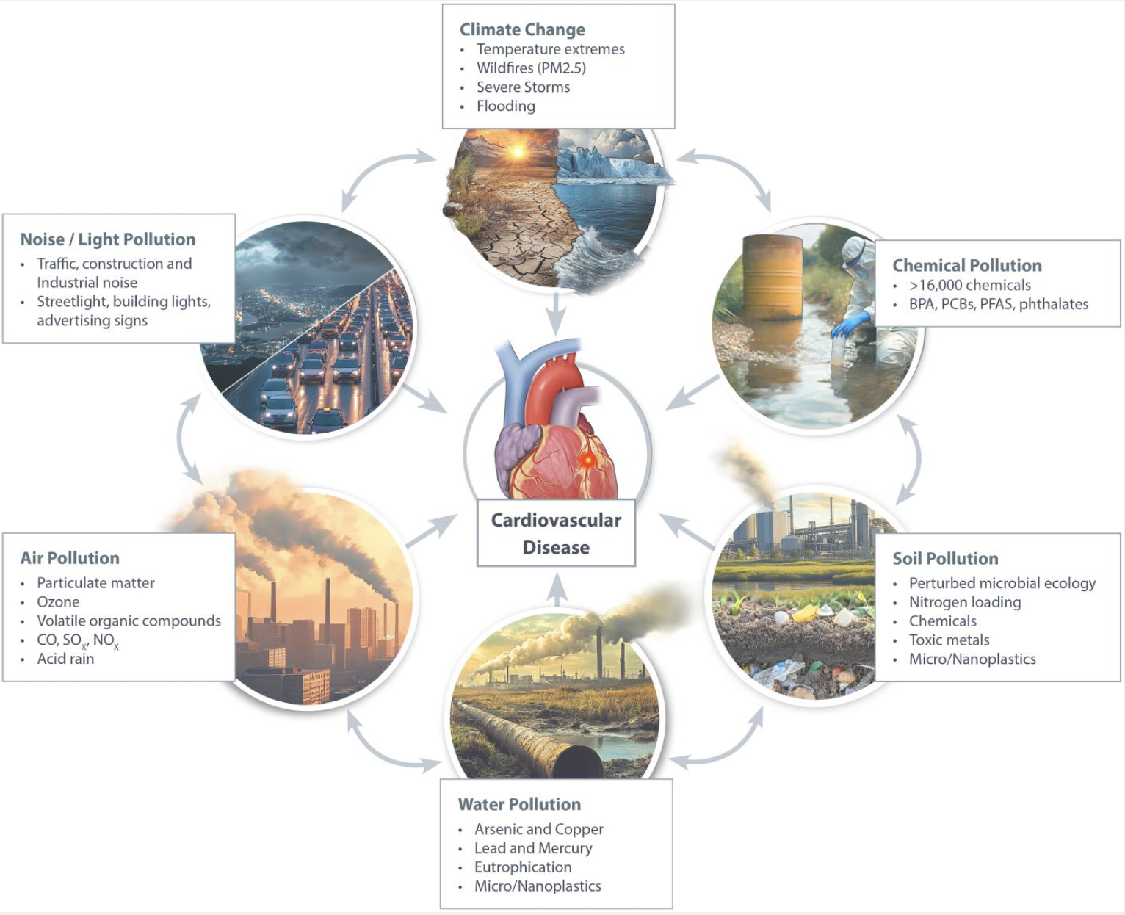
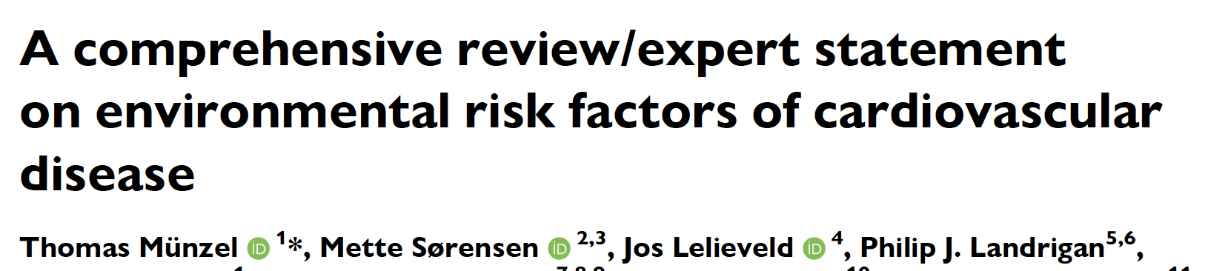

Slide 3
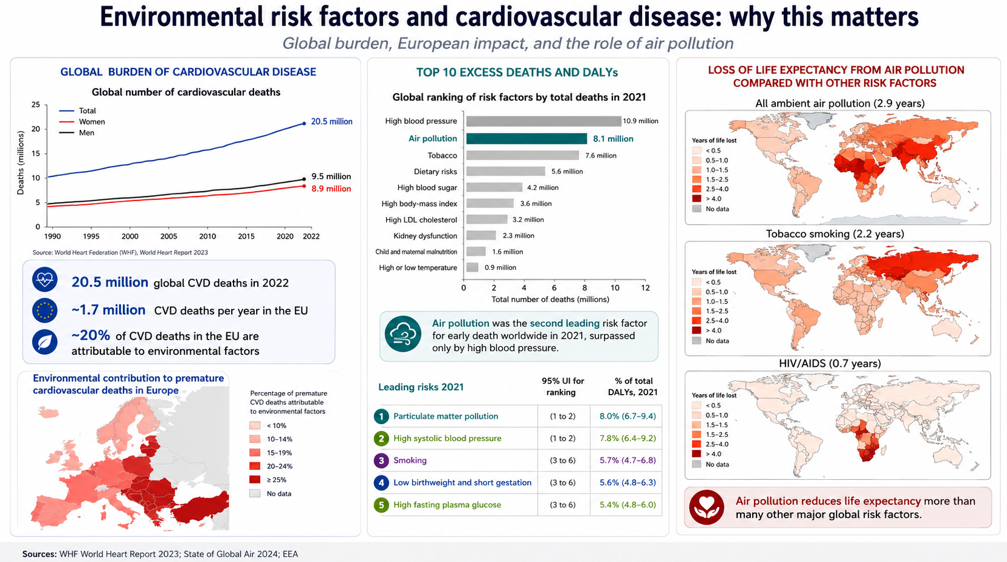
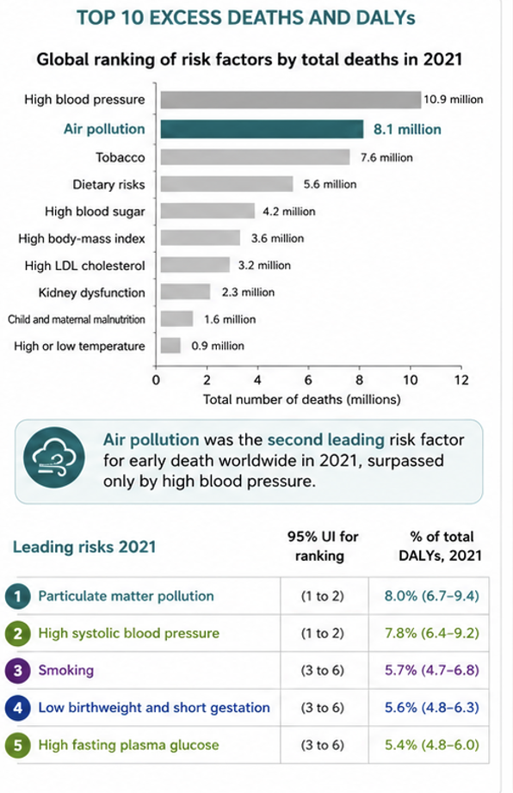
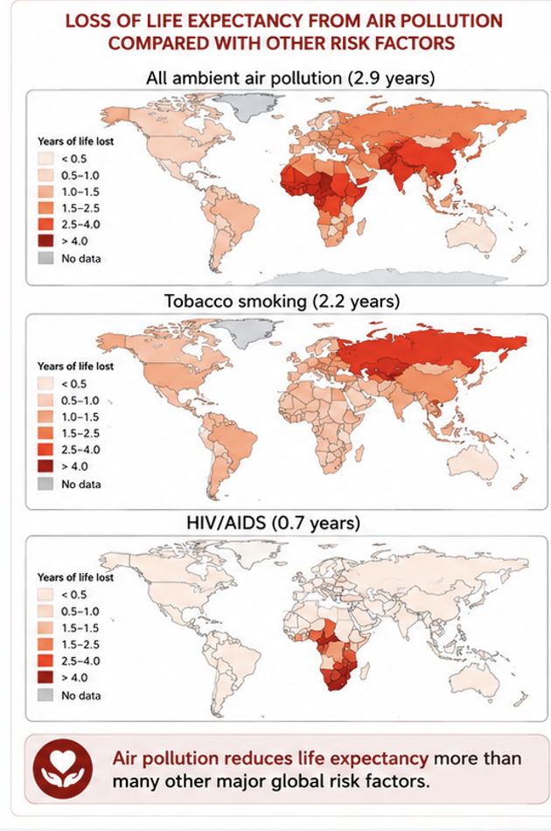

Slide 4
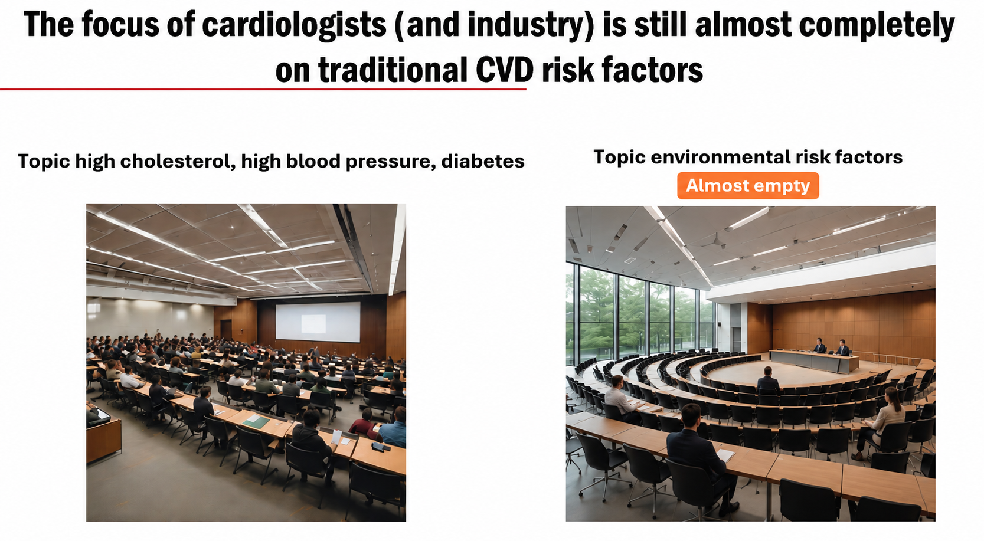

Slide 5
“Environmental cardiology is not a niche topic. It is population cardiology.”

Slide 6
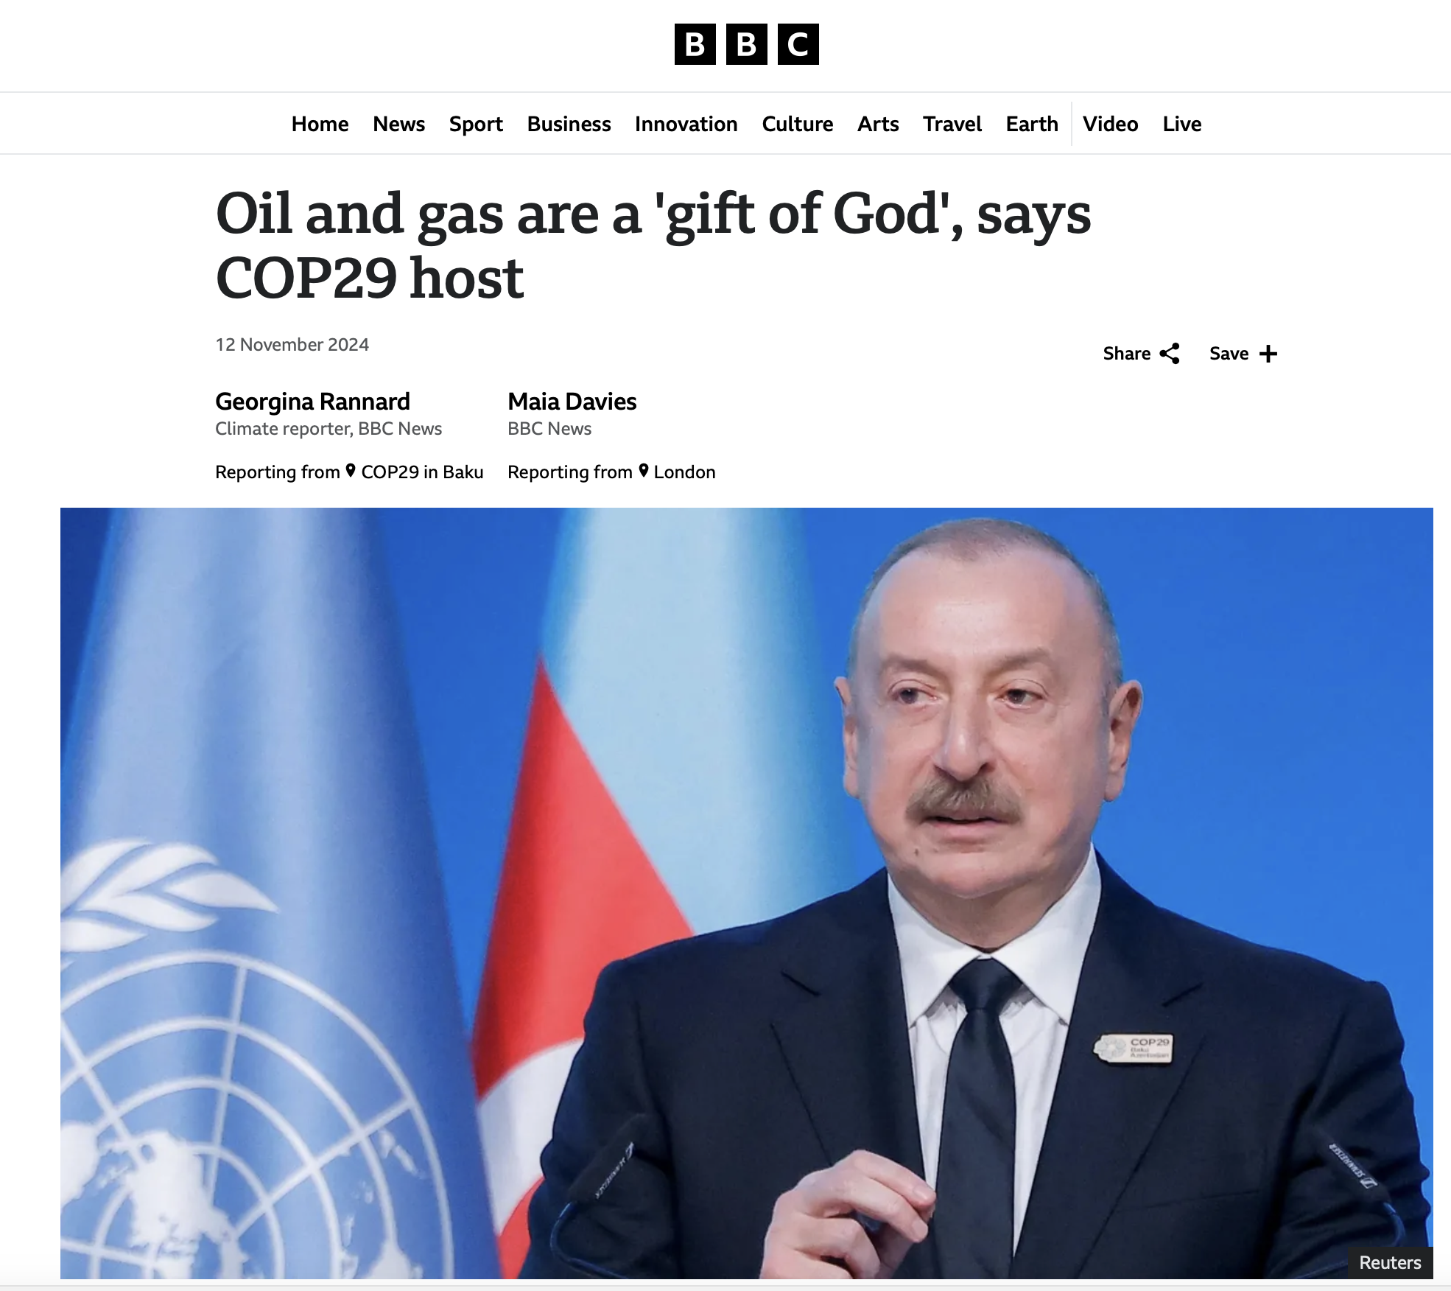
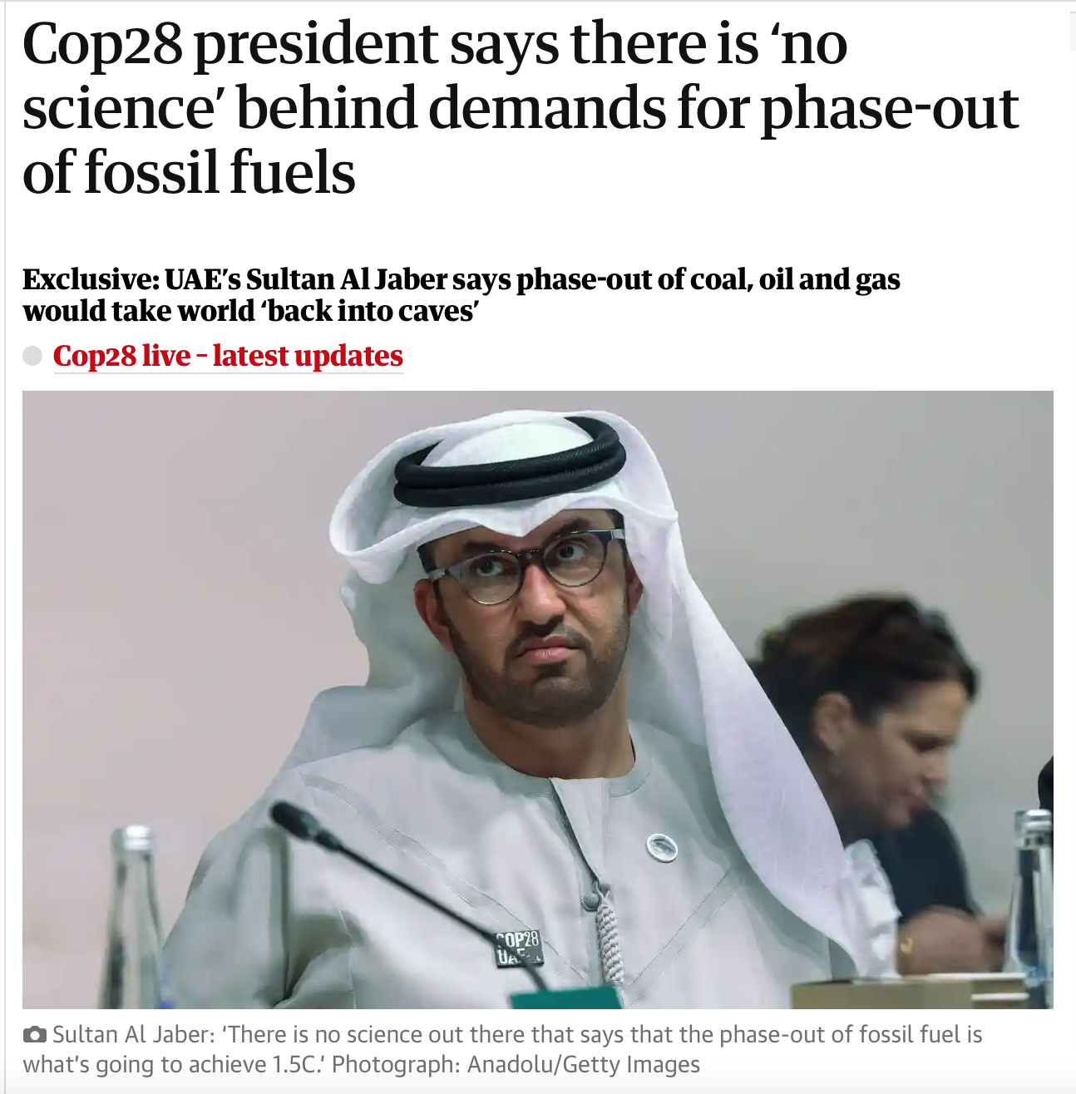
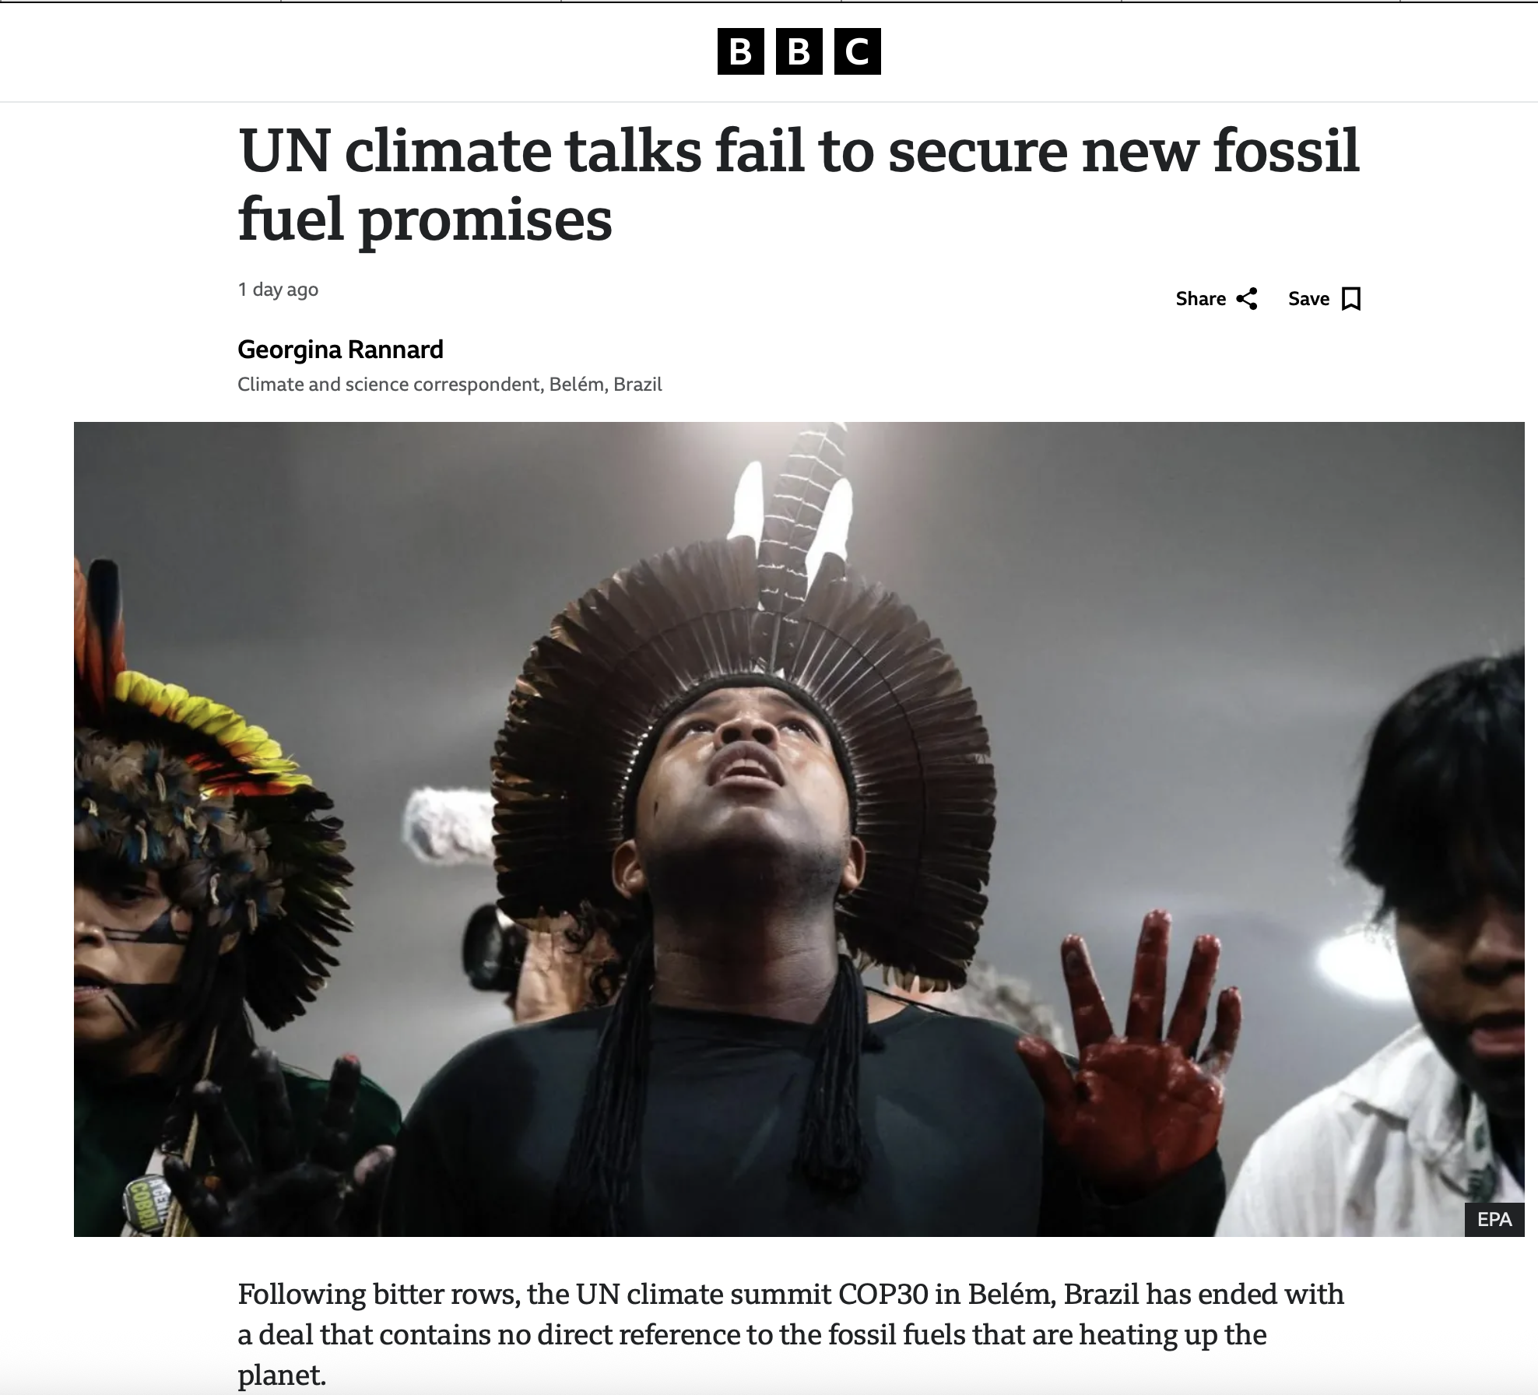

Quellenangaben

Slide 7
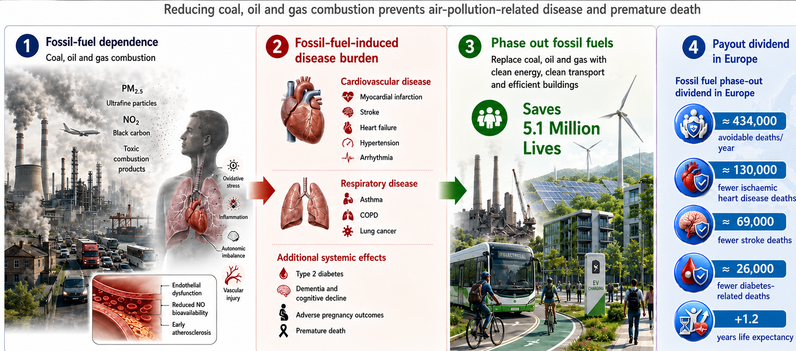
The need for a rapid fossil fuel phaseout: a cardiovascular prevention priority
Lelieveld , Münzel et al. British Medical Journal 2023, Lelieveld Münzel EHJ 2019

Slide 8
The phaseout of fossil fuel is one of the most effective strategies to protect the climate, and reduce cardiovascular disease and premature deaths

Slide 9
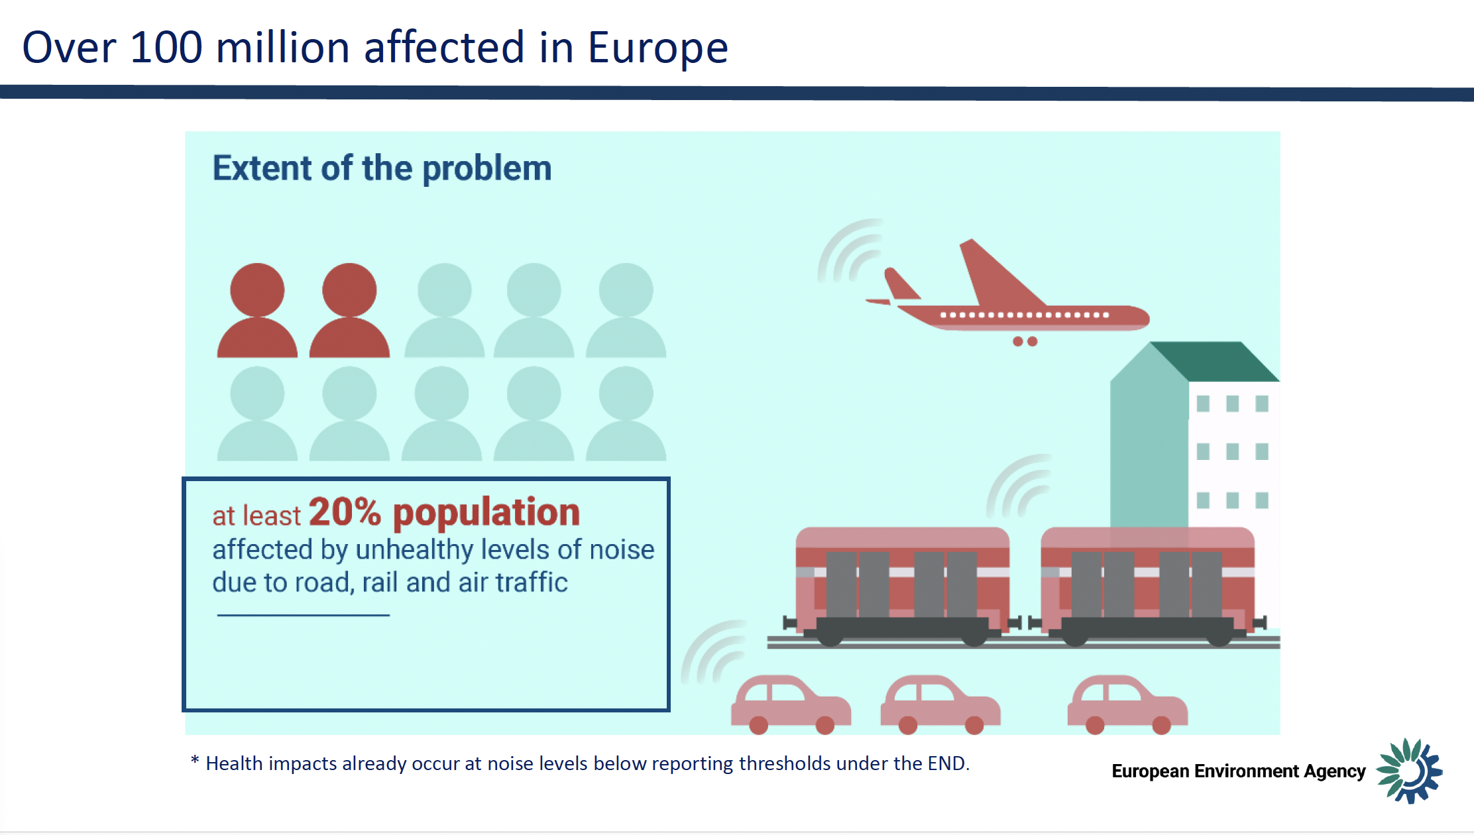

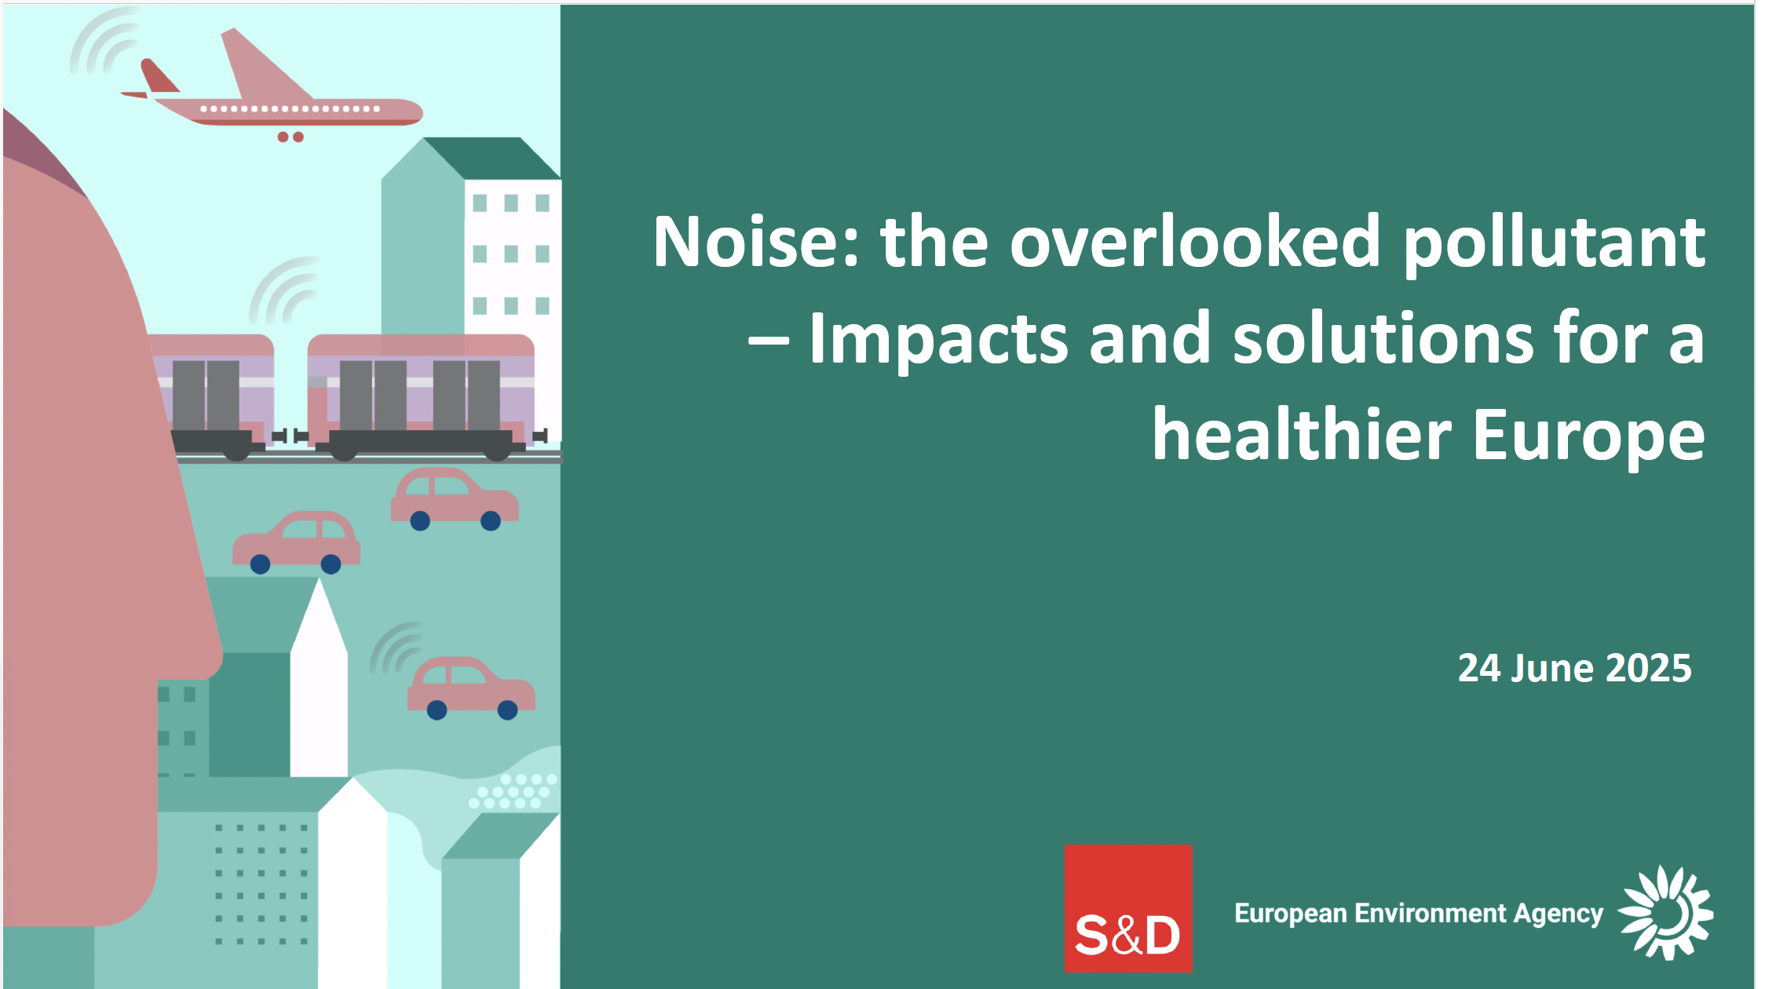
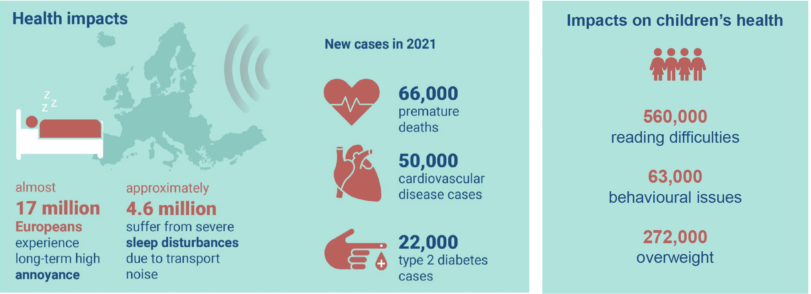
Over 130 Millio affected in Europe
At least 30% population

Slide 10
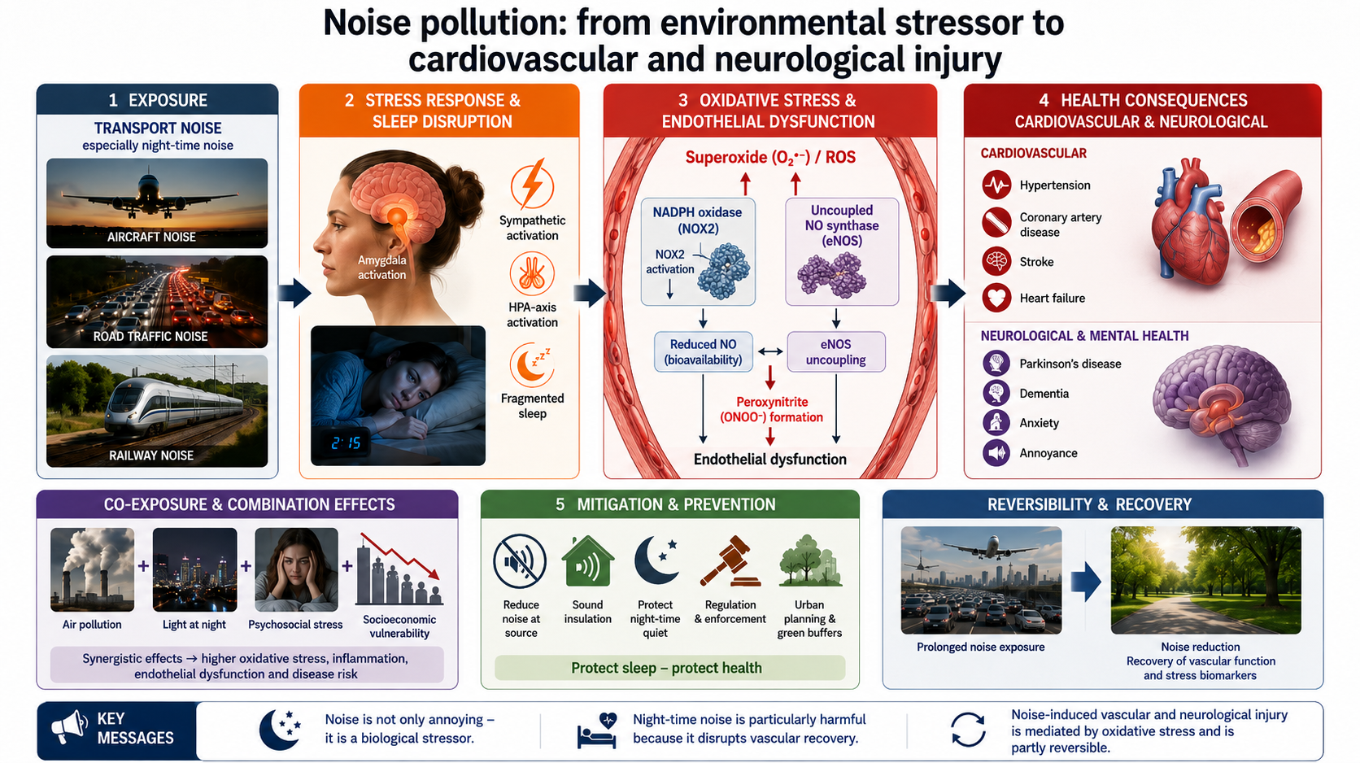
Münzel et al Nature Review Cardiology 2021, Circulation Research 2024, Lancet Planetary Health 2024, JAMA Neurology 2026

Slide 11
“Noise is a perfect example of how we underestimated an environmental exposure, because we first called it a nuisance. Today, we know it is a strong biological stressor and cardiovascular risk factor.”

Slide 12
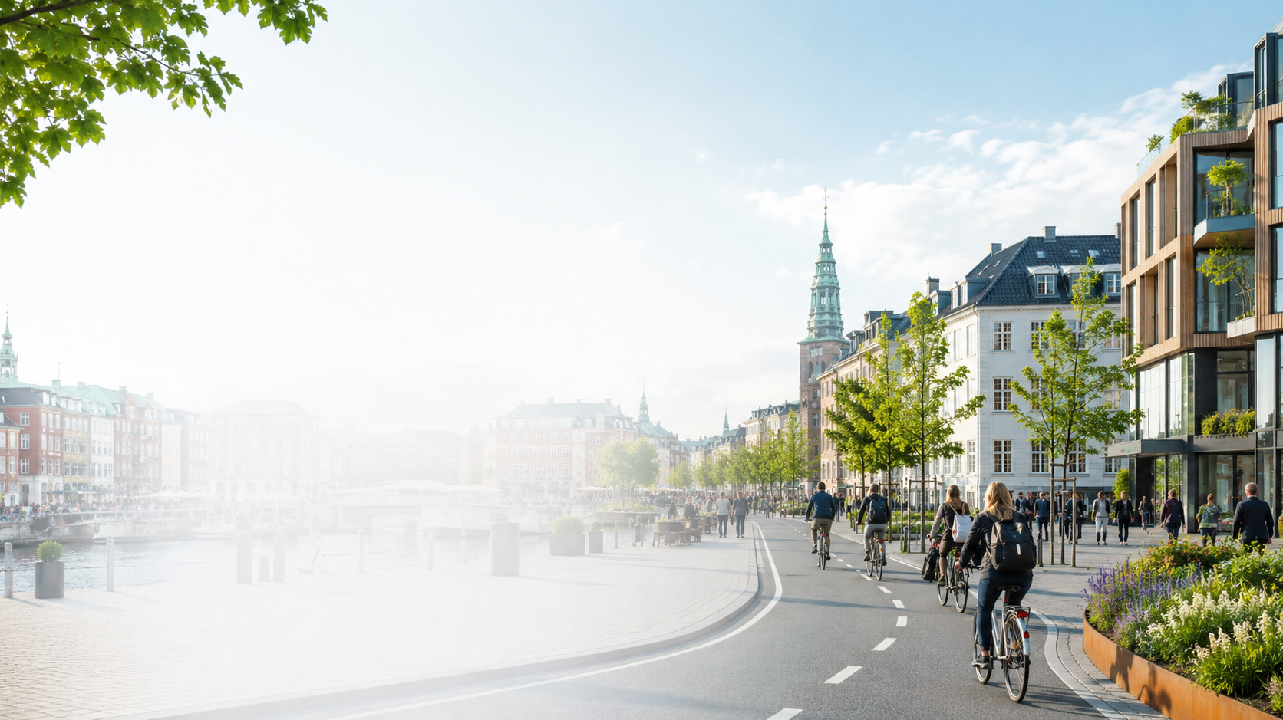
Meaning of Cities: Healthy City – Healthy Heart
Two thirds of the European population live in urban areas, and the trend is increasing
According to estimates, the world population will reach 10 billion by 2050, and 70% of them will live in cities
60–80% of global final energy consumption occurs in urban areas
70% of greenhouse gas emissions originate in cities
Environmental pollution increases significantly with further urbanization
WHO: Due to the large number of people living in cities, the urban environment and a healthy lifestyle are important for a healthy heart

Slide 13
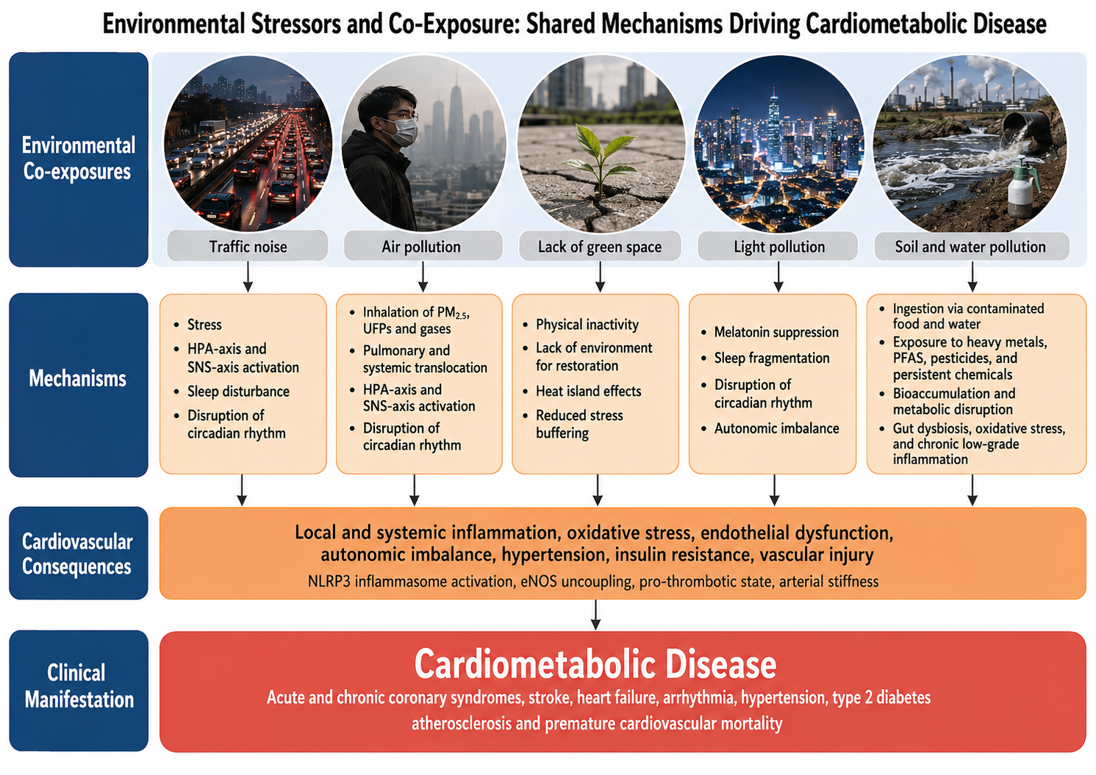
In the Urban Environment: No pollutant acts alone

Slide 14
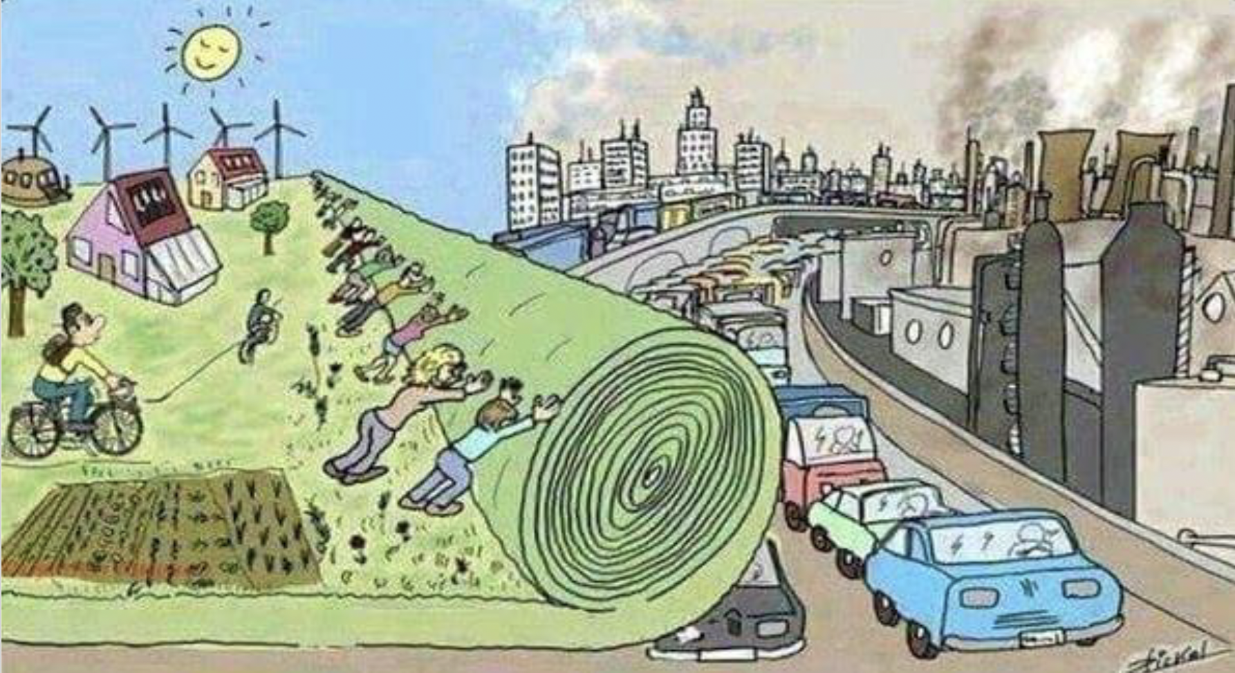
We need more greenspace and new urban models !

Slide 15
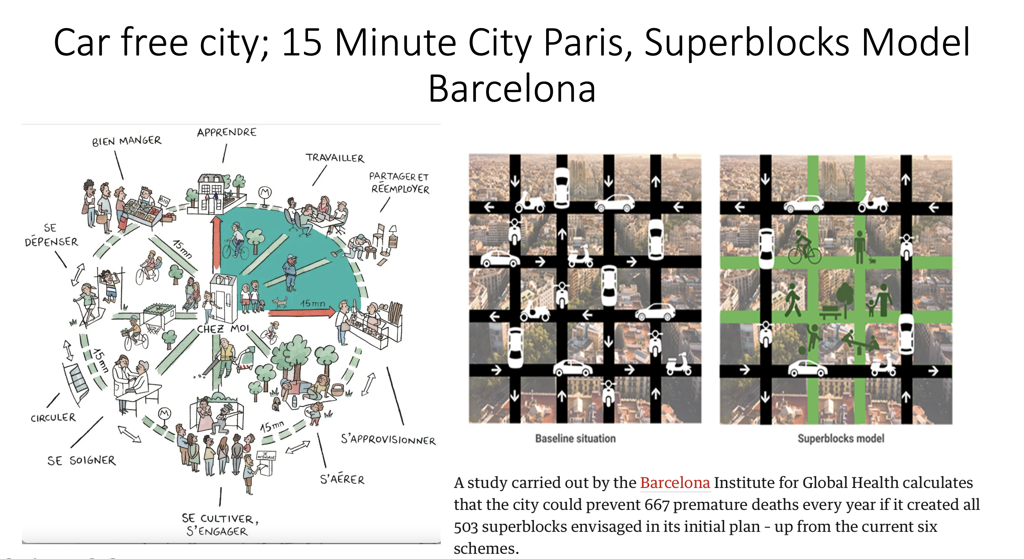
Münzel et al. European Heart Journal 2021

Slide 16
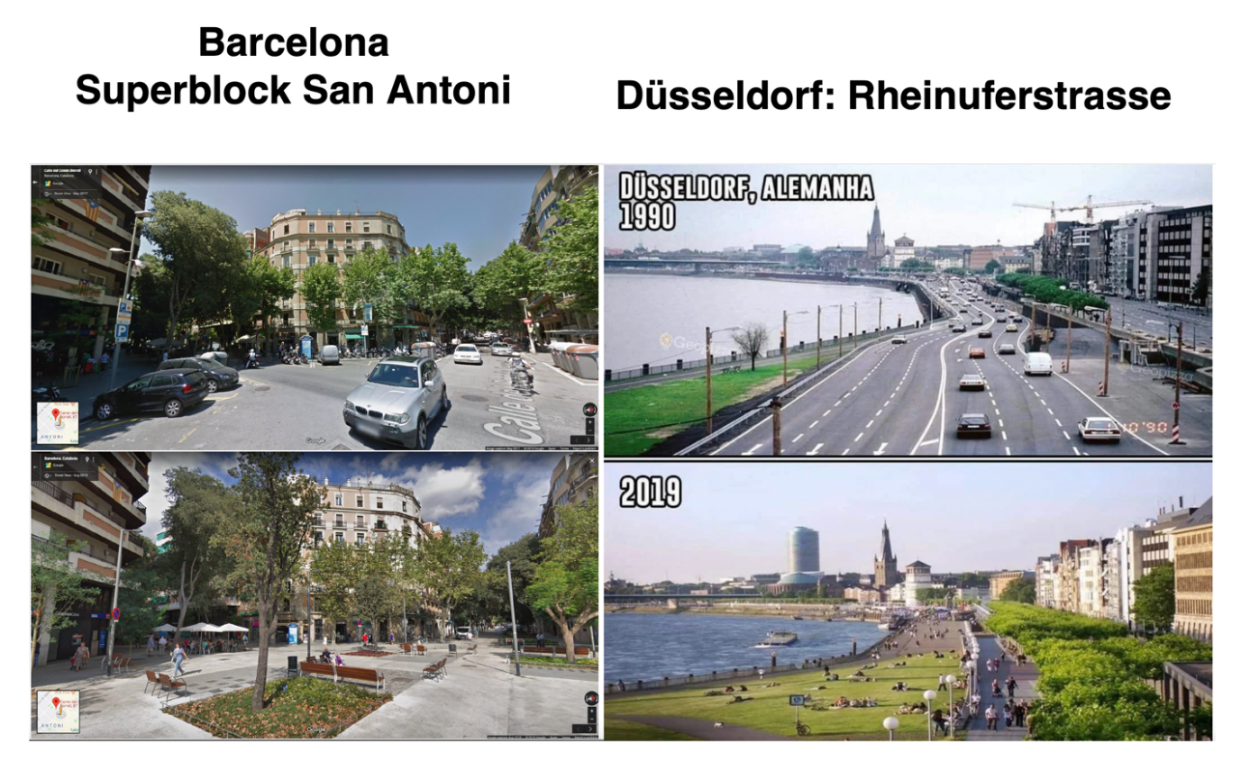

Slide 17
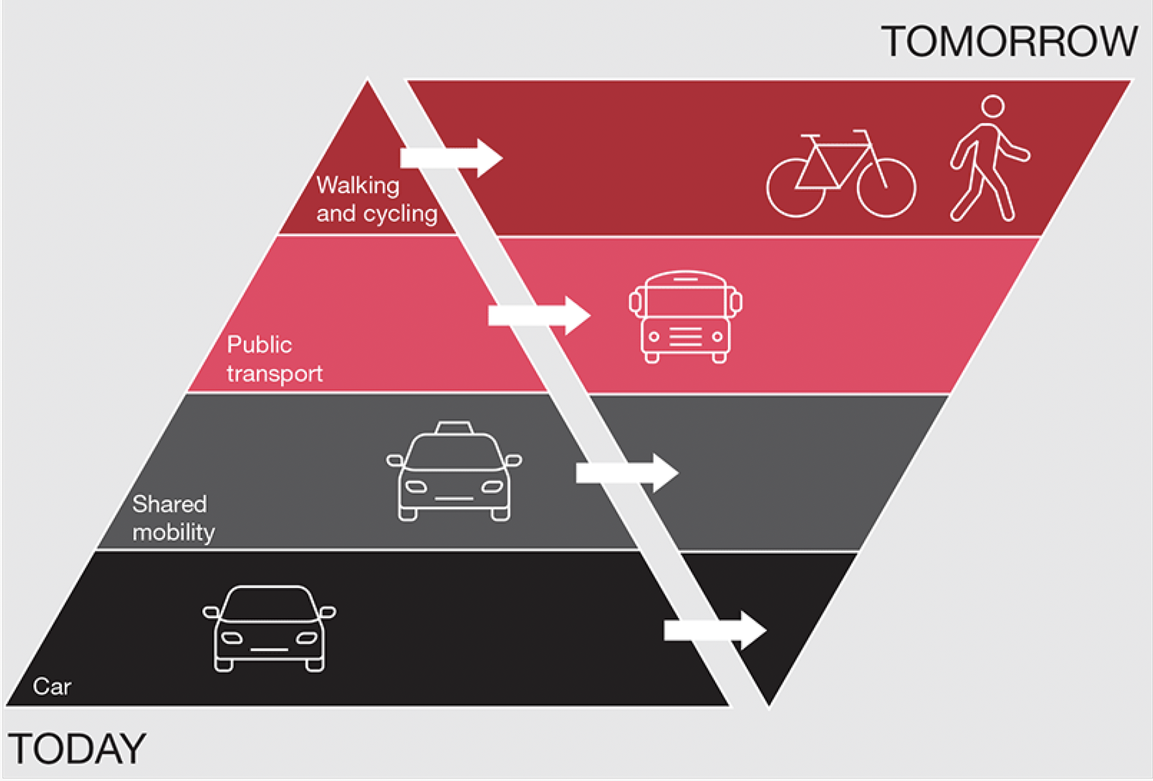

Slide 18

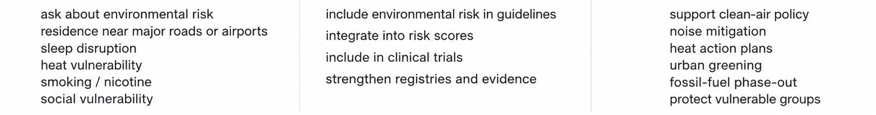

Slide 19
Environmental prevention is cardiovascular prevention, if we accept the
evidence responsibility follows
When the environment becomes a cardiovascular risk factor, sustainability becomes part of our duty of care.

