Slide 1
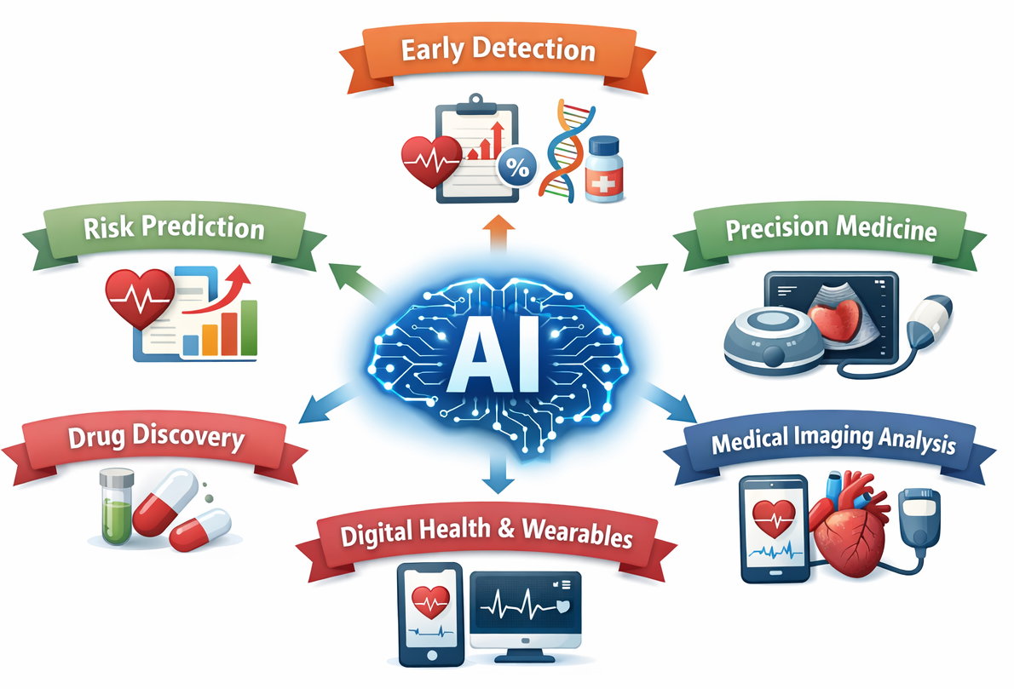
AI transforming the future of cardiometabolic disease
CRT on “Cardiometabolic disease”
Prof Ruben Casado Arroyo, ULB, Brussels, Belgium
18 & 19 March 2026

Slide 2
Conflict of interest:
Educational talks for Abbott, Zoll
EU founded Horizon Assess DHT project

Slide 3
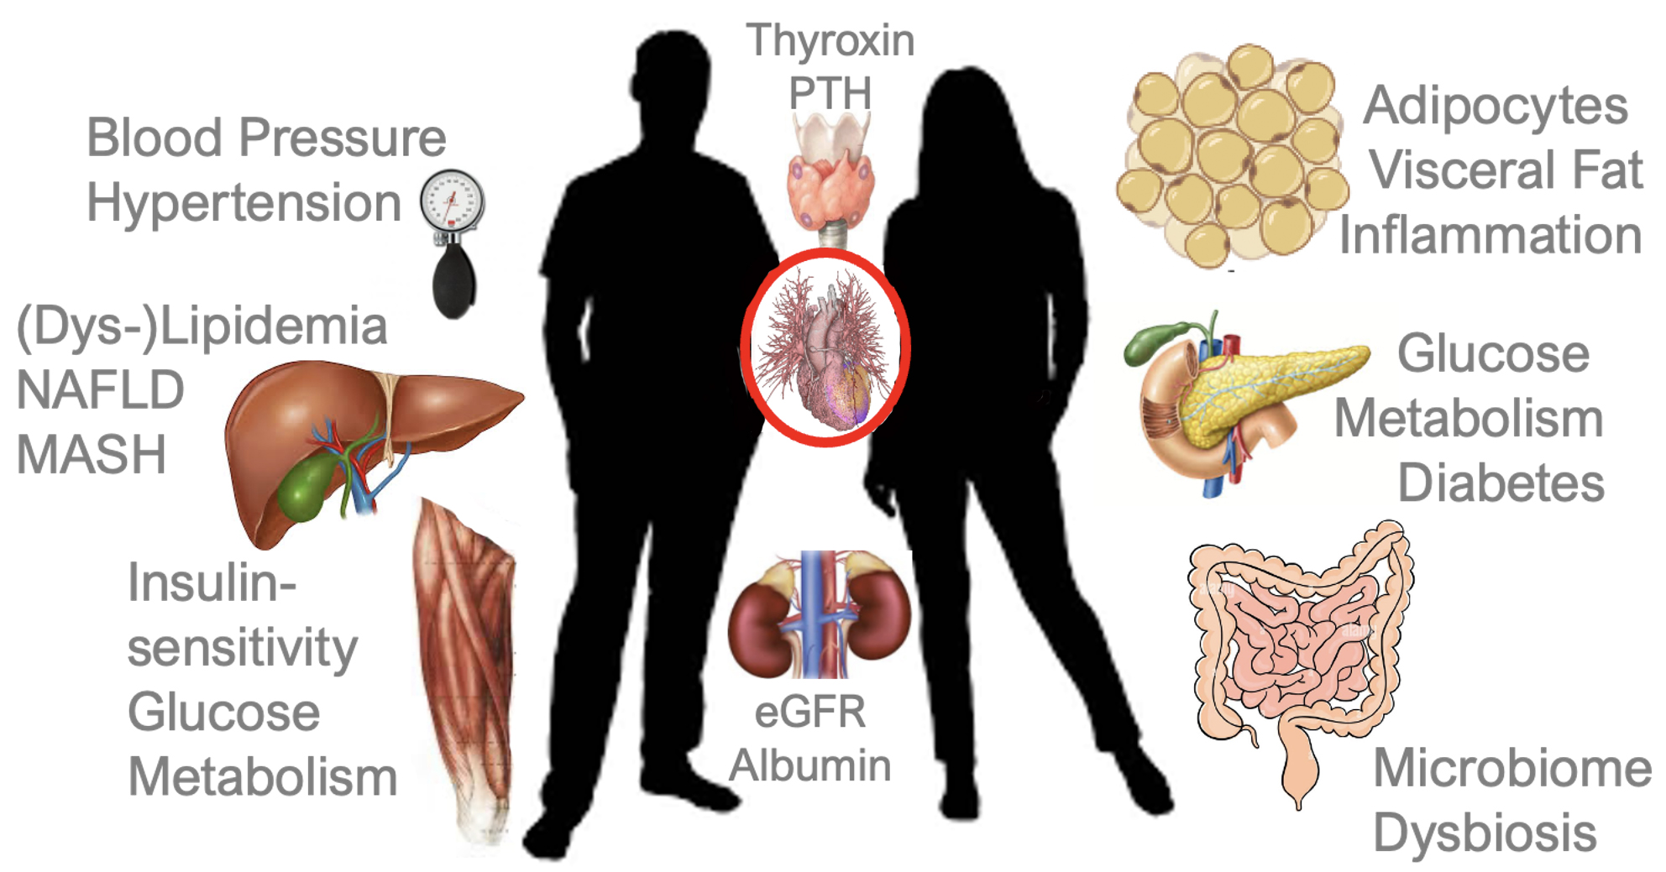
Main uses of AI in cardiometabolic disease research.
Early Disease Detection and Screening
Risk Prediction and Prognostic Modelling
Precision Medicine and Personalized Treatment
Medical Imaging Analysis
Digital Health and Remote Monitoring
Drug Discovery and Clinical Trial Optimization
Integration of Multi-Omics Data
Population Health and Public Health Research
Lüscher TF. CardioMetabolic medicine: the advent of systems cardiology and the new cardiovascular generalist? Eur Heart J. 2025 Aug 21;46(32):3147-3150.

Slide 4
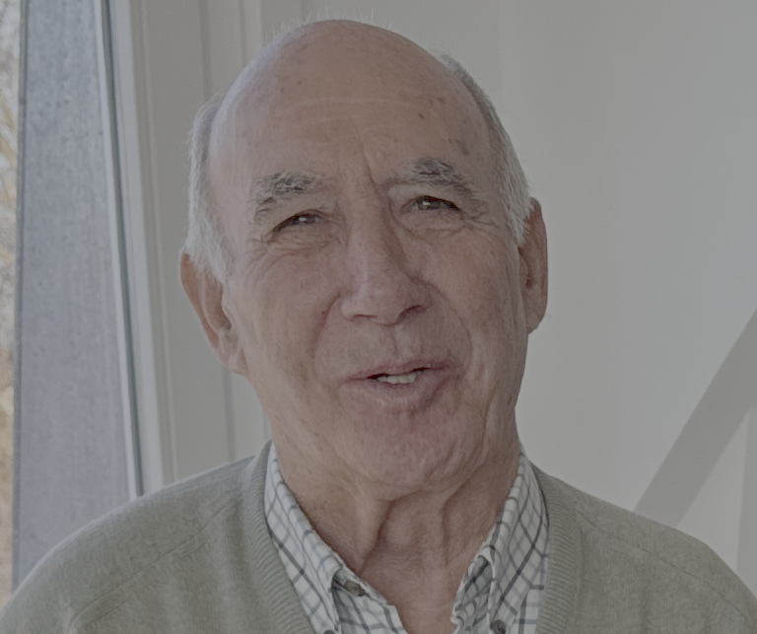
Natural History of Disease
I feel great!!!
Symptoms + Signs
Diagnostic Testing Treatment

Slide 5
Natural History of Disease
I feel great!!!
Symptoms + Signs
Diagnostic Testing Treatment
It may be too LATE!!
First event can be Heart Attract, Stroke, SCD

Slide 6
Natural History of Disease
I feel great!!!
Symptoms + Signs
Diagnostic Testing Treatment
It may be too LATE!!
First event can be Heart Attract, Stroke, SCD
Metabolic and physiologic abnormalities develop over years!
Waiting for signs and symptoms before diagnosing has been done for 2000 years
We can do better with AI!!!

Slide 7
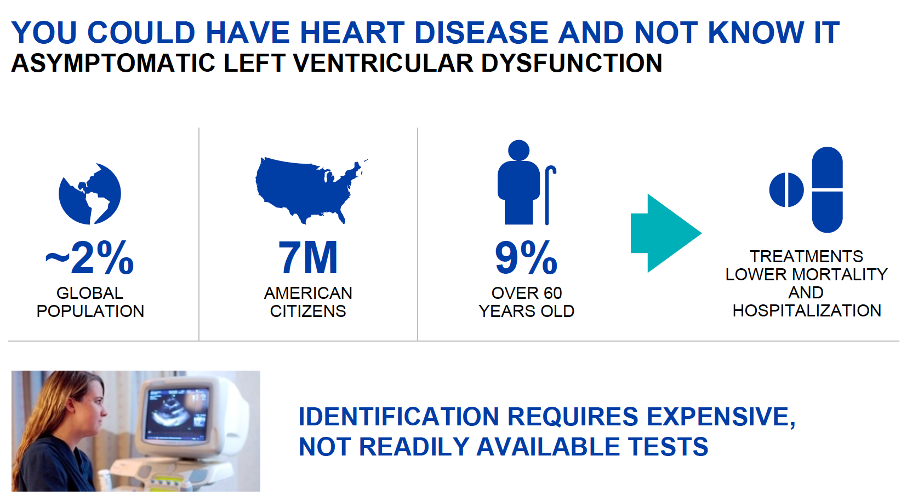
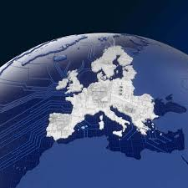

Slide 8
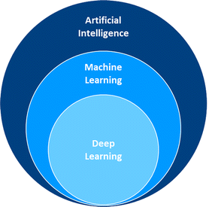
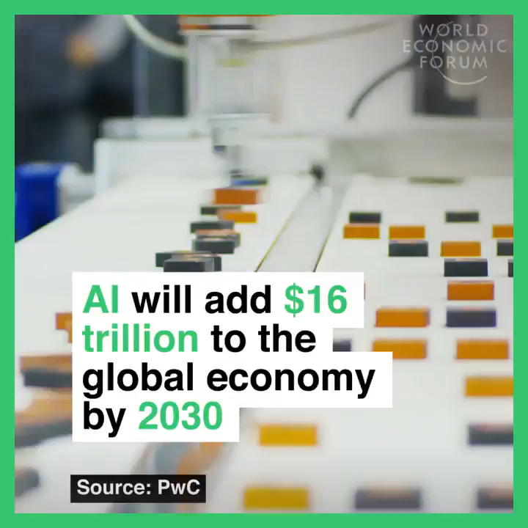

Slide 9
Early Disease Detection and Screening
Impact
  Earlier diagnosis
  Prevention of complications
  Screening of large populations
Example applications:
  Deep-learning ECG models predicting left ventricular dysfunction
  AI algorithms detecting silent myocardial infarction
  Detect heart failure from ECG signals.
  Identify diabetes risk using electronic health records.
  Detect hypertrophic cardiomyopathy from imaging.
  Predict chronic kidney disease before decline in kidney function
Typical data used
  ECG, Laboratory biomarkers, Electronic health records

Slide 10
Risk Prediction and Prognostic Modelling (Digital Twin):
AI models can analyze hundreds of variables simultaneously to estimate the risk of future disease or complications
Examples of predicted outcomes
  MI, stroke, heart failure hospitalization, chronic kidney disease progression, SCD
Data sources used
  Electronic health records, laboratory tests, genomics, wearable sensors, lifestyle data
Impact
  Better risk stratification
  Personalized preventive strategies
  Improved clinical decision-making
Examples: Prediction of
  Myocardial infarction risk. Sudden cardiac death from ECG patterns. Heart failure hospitalization.
  Progression of chronic kidney disease and Diabetes.
Typical algorithms
  Machine learning risk models, Survival prediction models, Deep learning classifiers

Slide 11
Precision Medicine and Personalized Treatment
AI helps tailor treatments based on individual patient characteristics
Applications
  Predict which patients respond best to specific medications
  Optimize insulin dosing in diabetes
  Personalize diet and lifestyle interventions
  Identify optimal therapy for heart failure patients
Impact
  More effective treatment
  Reduced side effects and improved adherence
Examples
  Predict which patients respond best to GLP-1 receptor agonists for obesity or diabetes.
  Optimize insulin therapy in diabetes.
  Identify best heart failure medication combinations.
  Predict statin response in dyslipidaemia

Slide 12
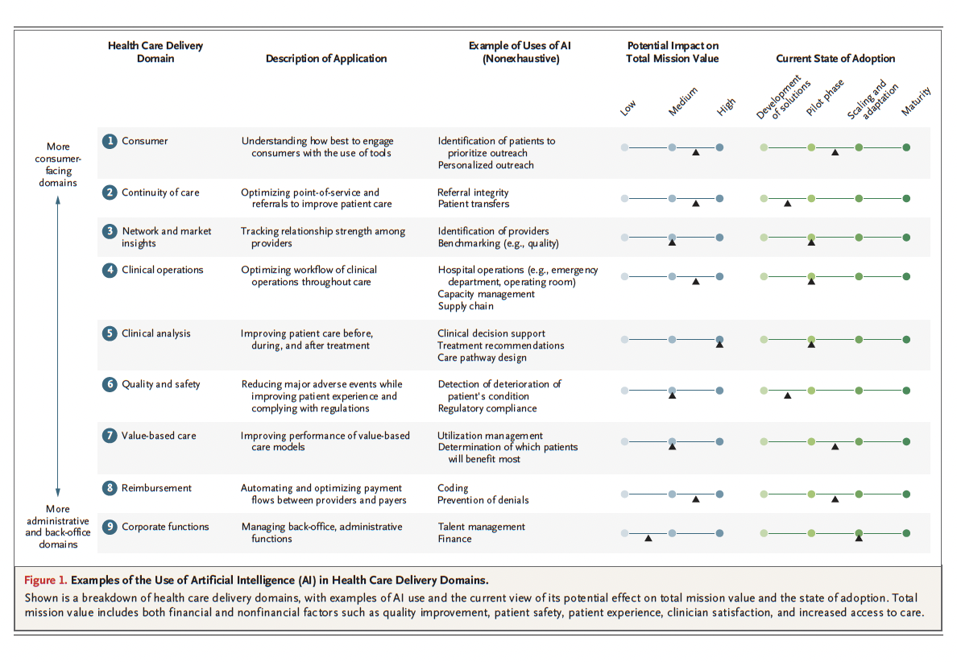
CDSS. The highest potential for impact in Healthcare
Sahni, N. R. (2023). Artificial Intelligence in U.S. Health Care Delivery. N Engl J Med

Slide 13
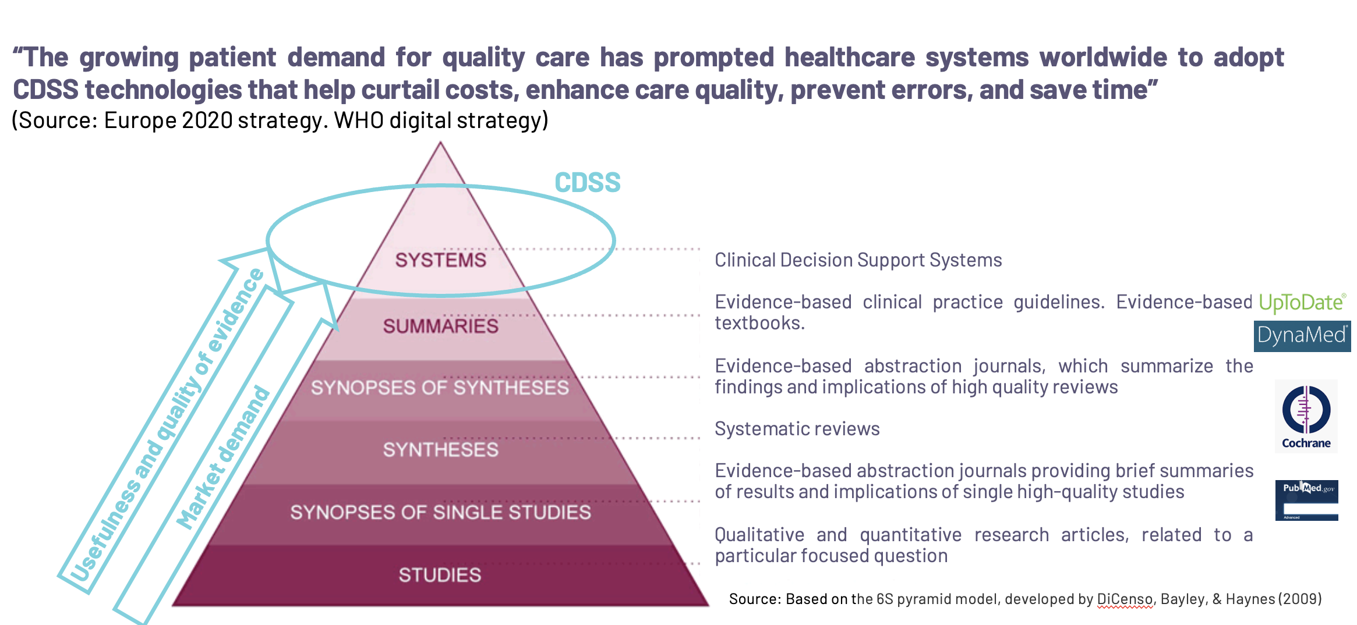

Slide 14
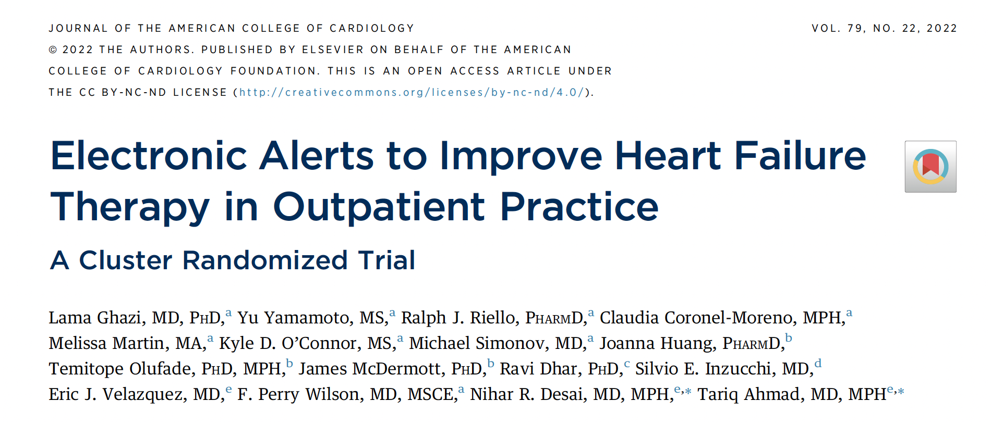
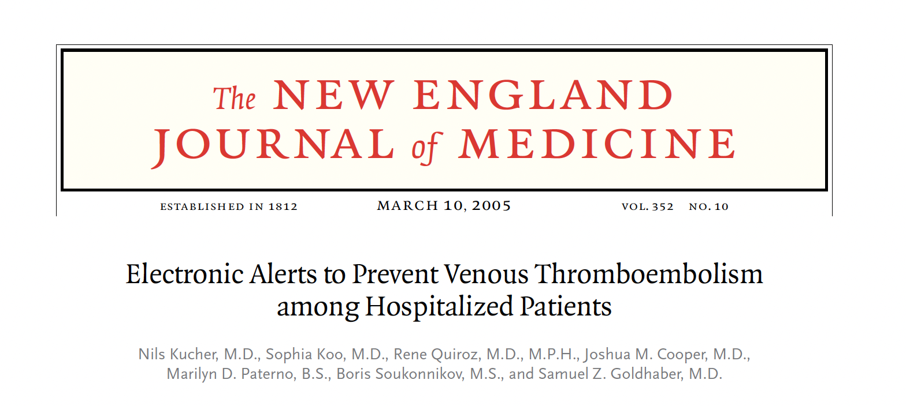
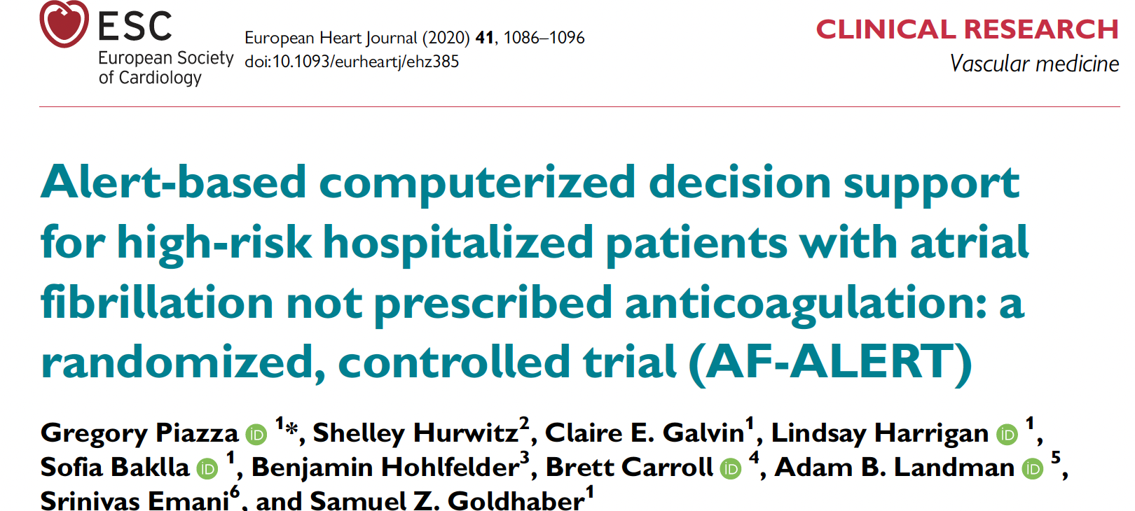
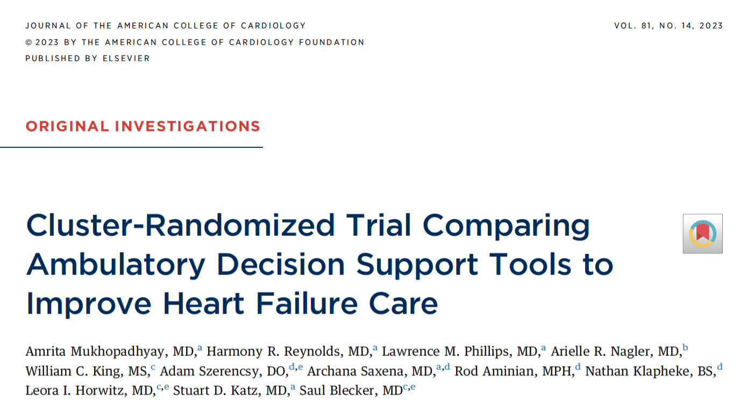

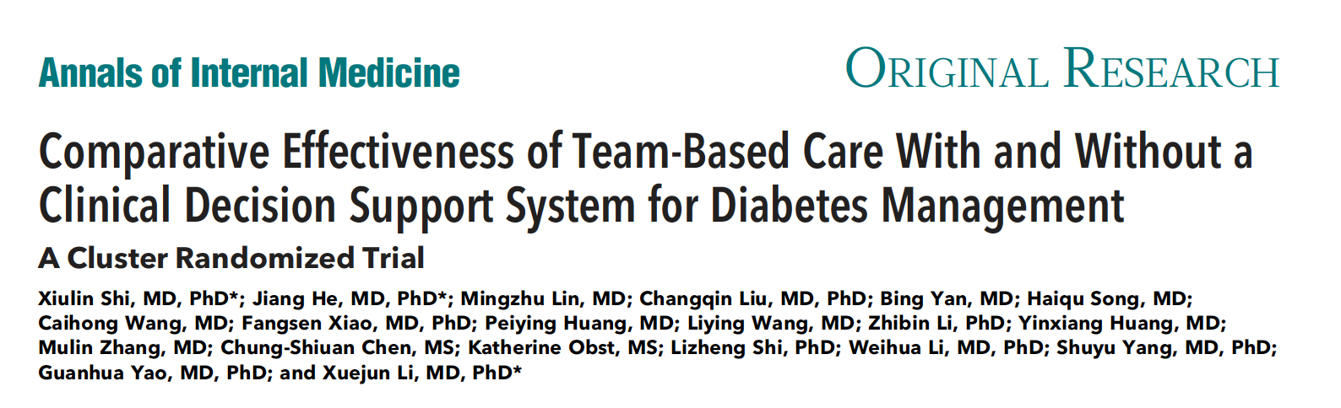
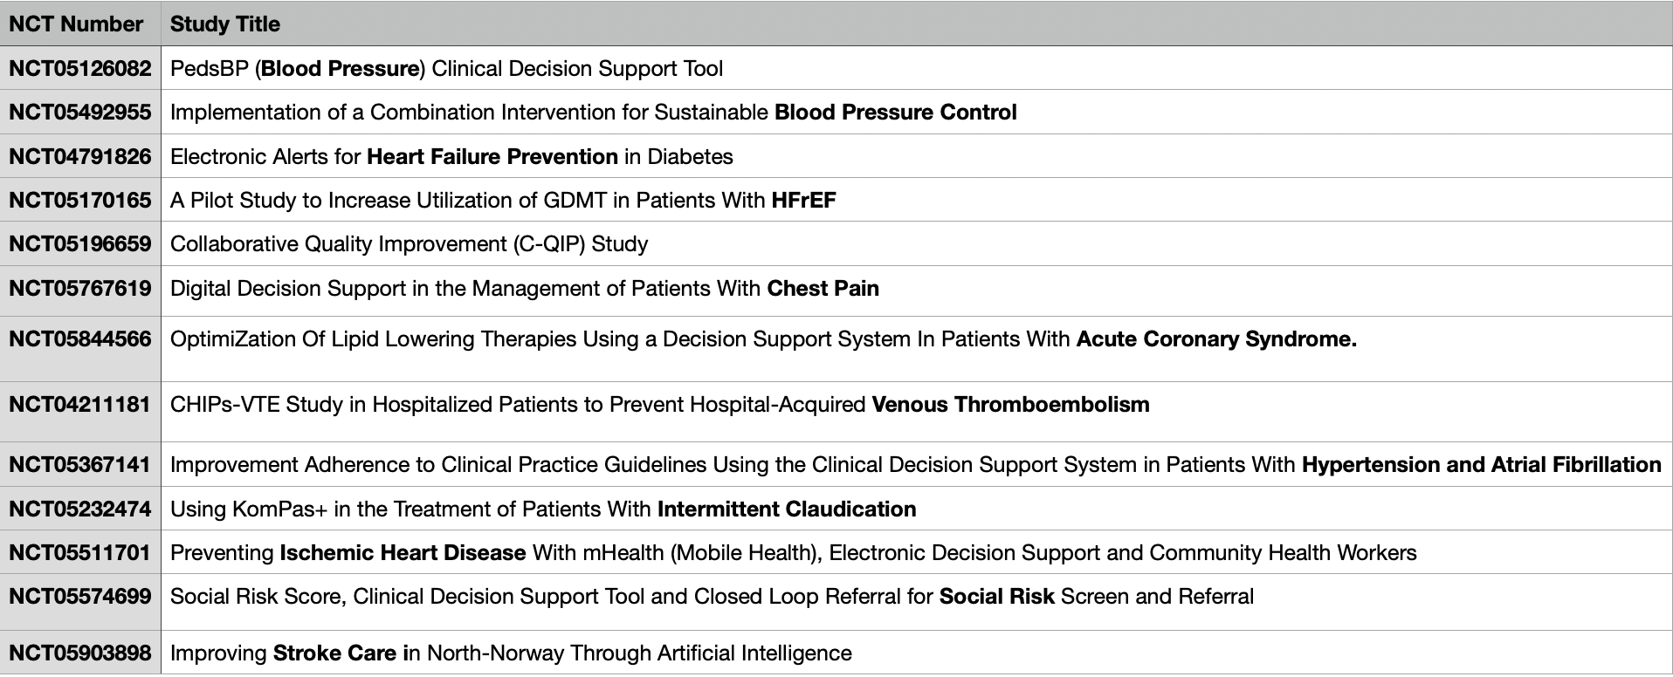
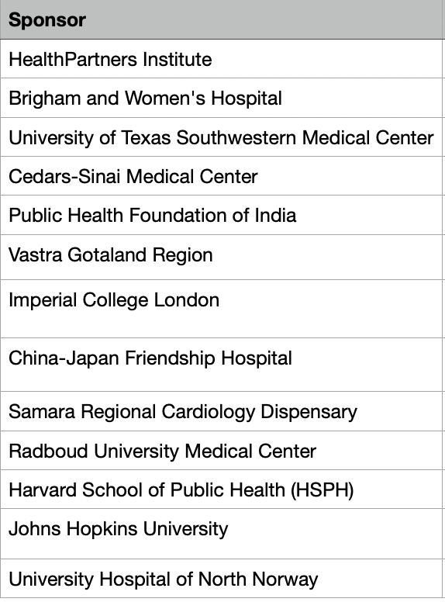
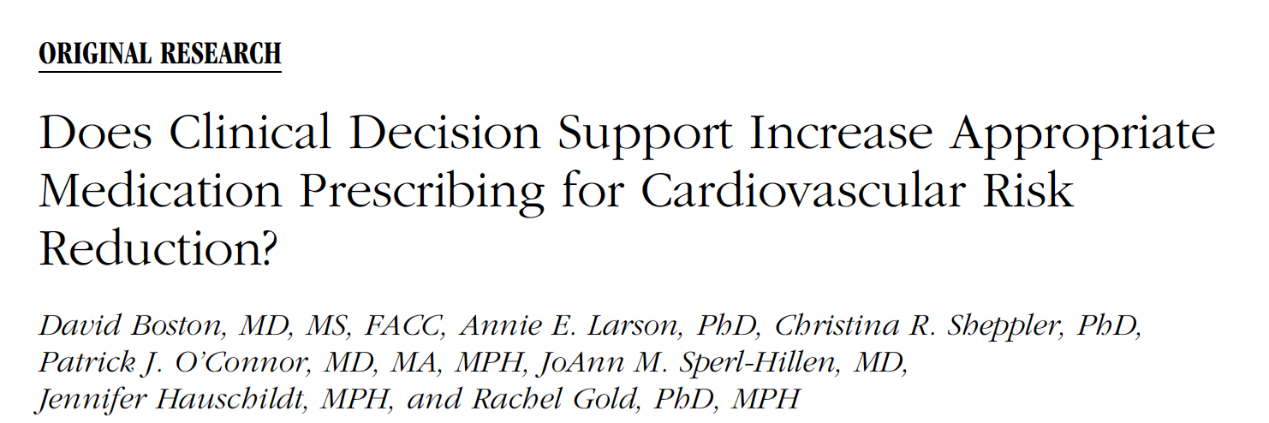
Ongoing evidences

Slide 15
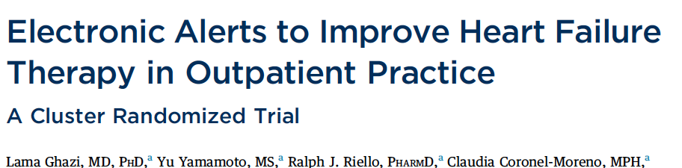
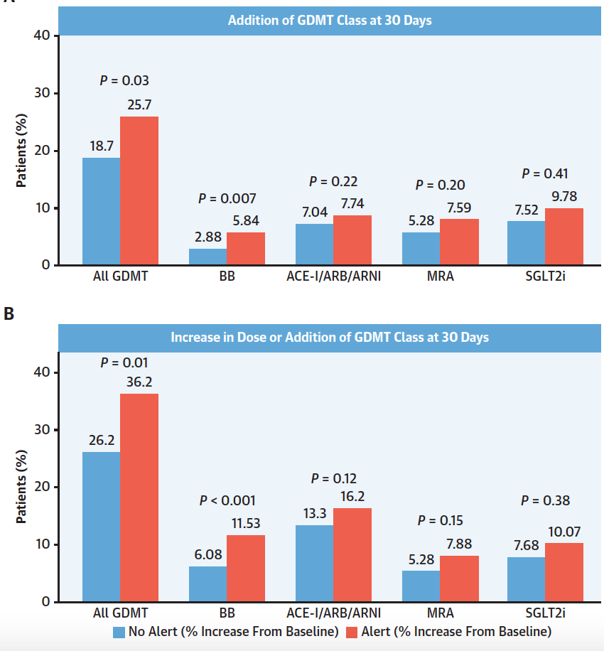
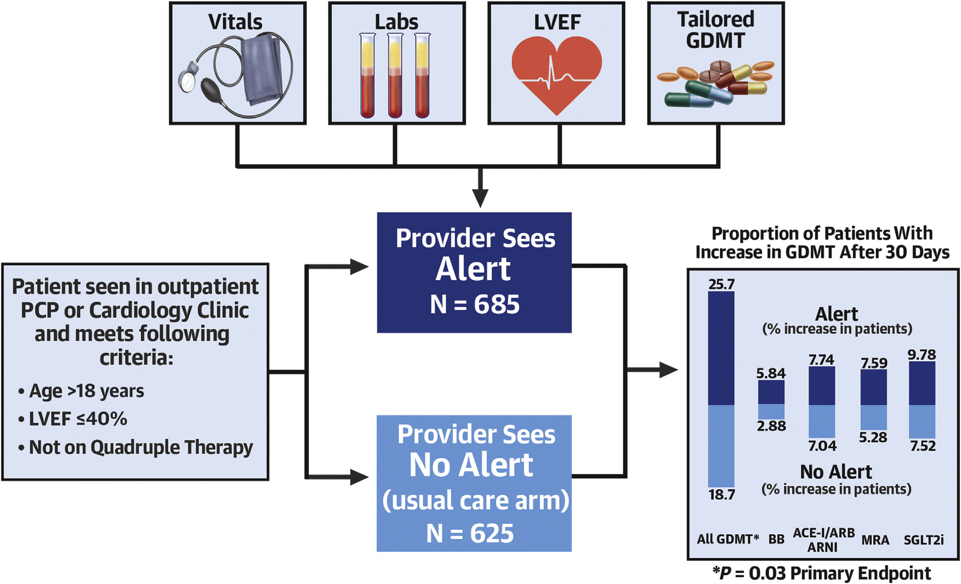

Slide 16
Medical Imaging Analysis
AI has the potential to analyze medical images more rapidly and accurately (?).
Types of imaging used
Echocardiography, cardiac MRI, CT angiography, retinal imaging
Examples
Detect coronary artery disease from CT scans
Identify cardiomyopathy from echocardiography
Quantify myocardial infarction size
Impact
Faster diagnosis
Reduced workload for clinicians
Improved diagnostic accuracy

Slide 17
Digital Health and Remote Monitoring
AI is increasingly used in digital therapeutics and remote patient monitoring
Technologies
Wearable devices, smart watches, mobile health applications, continuous glucose monitors
Applications
Detect arrhythmias, predict blood glucose fluctuations, monitor blood pressure trends
identify early signs of heart failure decompensation
Impact
Continuous monitoring
Early intervention
Reduced hospitalizations
Examples
Detect coronary artery disease in CT angiography. Measure left ventricular ejection fraction from echocardiography. Identify myocardial infarction scars in cardiac MRI. Detect diabetic retinopathy from retinal images.

Slide 18
Drug Discovery and Clinical Trial Optimization
AI is also used in pharmaceutical and translational research
Applications
  Identify new drug targets
  Predict drug interactions
  Optimize clinical trial design
  Identify eligible patients for trials
Impact
  Faster drug development
  Reduced costs
  Improved trial efficiency
Examples
  Identify molecular targets for atherosclerosis drugs.
  Predict drug candidates for obesity treatments.
  Model metabolic pathways involved in type 2 diabetes.
  Predict drug toxicity affecting the heart or kidneys.

Slide 19
Integration of Multi-Omics Data
AI can integrate different biological datasets:
Genomics, Proteomics, Metabolomics, Microbiome data
Example
AI models may identify genetic and metabolic pathways involved in cardiometabolic diseases.
Impact
Discovery of new biomarkers
Better understanding of disease mechanisms
Examples
Identify genes associated with obesity and metabolic syndrome.
Discover biomarkers predicting cardiovascular disease risk.
Integrate genomics + metabolomics in diabetes research.

Slide 20
Population Health and Public Health Research
AI can analyze large population datasets to identify epidemiological trends
Applications
Predicting obesity trends
Identifying social determinants of cardiometabolic risk
Optimizing prevention programs
Examples
Predict regional trends in obesity prevalence.
Identify populations at risk of hypertension.
Model healthcare burden of cardiovascular disease.
Predict impact of prevention strategies.

Slide 21
Main goals:
Early disease detection
Risk prediction
Treatment decision support
Remote monitoring and digital coaching

Slide 22
Gaps in knowledge / barriers to implementation / Key Challenges
Lack of awareness and confidence
Accessibility
Better delivery of
health care
?
Reduce workload
?
Cost-efficiency
?
Exceptionality vs meet the evidence based medicine current practices
Lack of implication of
stakeholders
Randomised controlled
Trials
?
Meet safety,
Privacy, safety, reliability
and transparency
standards
Algorithm bias
Reimbursement
?
Lack of inter-operability and standardization
Quality Control
?
Ethics

Slide 23
AI in Cardiometabolic Disease Research
1. AI will help to enable earlier detection of cardiometabolic diseases
Artificial intelligence can detect diseases before clinical symptoms appear by analyzing large datasets such as ECG signals, medical imaging, laboratory tests, and electronic health records.
2. AI will help to improve risk prediction and disease stratification
Machine-learning models can analyze hundreds of variables simultaneously to estimate the future risk of cardiovascular and metabolic events.
3. AI will support precision medicine and personalized treatment
AI can identify which therapy works best for each patient, enabling more personalized healthcare.
4. AI will integrate multiple health data sources
enables more comprehensive understanding of cardiometabolic diseases.
Main implication: AI facilitates discovery of new biomarkers and disease mechanisms.
5. AI will transform prevention, monitoring and clinical research (drug discovery and development, population data analysis)
These advances have the potential to significantly reduce the global burden of cardiovascular and metabolic diseases.

Slide 24
