Slide 1


Novel therapies & integrated care models in clinical management of diabetes, hypertension, dyslipidemia & obesity
Professor John Deanfield, CBE
ESC-CRT on Cardiometabolic disease |
Bratislava Mar 2026
MEMBER OF STEERING COMMITTEE FOR SELECT & SOUL TRIALS

Slide 2
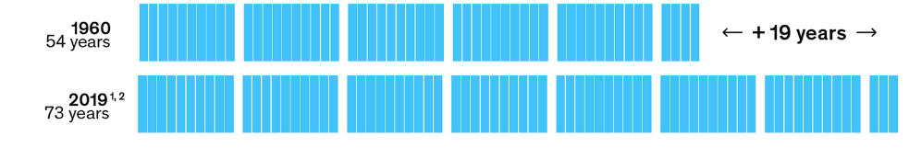
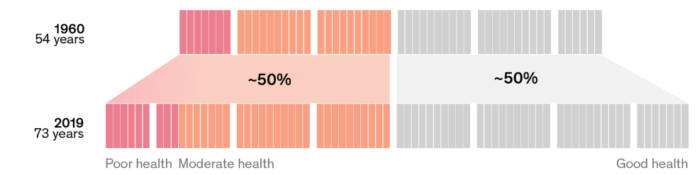
Globally lives have gotten longer but not healthier!
The past 60 years have seen massive improvements in global life expectancy…
…but the proportion of life spent in poor or moderate health has not changed!
Managing established clinical disease, despite advances, is not enough to tackle the health and economic impact of NCDs – Need to prevent disease!
Source: McKinsey Health Institute, ‘Adding years to life and life to years’ Mar ‘22

Slide 3
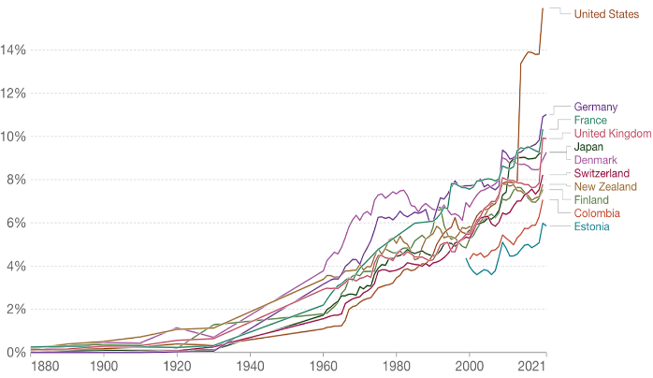
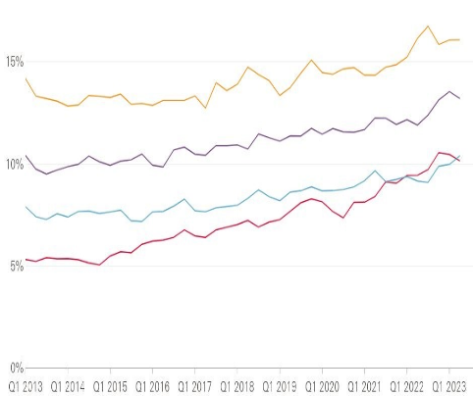

Can we afford not to adopt a prevention approach?
The ESC-EU Safe Hearts Programme is timely
Gov Health Expenditure as share of GDP | % Employed with work-limiting health conditions
CVD alone cost the E​​uropean ​​U​nion​ economy ~€282BN annually…
…Treat health as a wealth creation opportunity, not simply as an expense
MARCH 17, 2026 5:00 AM CET
Source: (L) Our World Data / (R) Health Foundation Report ‘What we know about the UK’s working-age health challenge’ Nov 2023

Slide 4



Healthcare systems not set up to deliver this!
Cardiologist
Oncologist
Diabetologist
Neurologist
Rheumatologist
Gastroenterologist
Influences throughout life
Psychologist
… Other ‘ists’…

Slide 5




The malignant triad changing the face of medicine
Pharmacological innovation
New drugs which target not just RFs but outcomes
Implementation innovation
Novel system to:
  start early
  treat broadly &
  sustain the benefit
CVD
T2DM
OBESITY
CKD

Slide 6
CVD | Investing in your arteries for future gain
Cumulative exposure drives arterial disease
Causal RF’s are known – Effective treatments available – Compound interest from early sustained lowering of each RF
9 RFs accounted for 90% of MI in men and 94% in women
Clinical Events
Foetus
0
10
20
30
40
50
60
Age (yrs)
Source: Yusuf, S et al, Lancet (364);9438,11–17 September 2004, 937-952
Notes:
accumulative damage to biology
driven by lifelong exposures
modified by choices and environments
measurable and malleable with modern tools

Slide 7
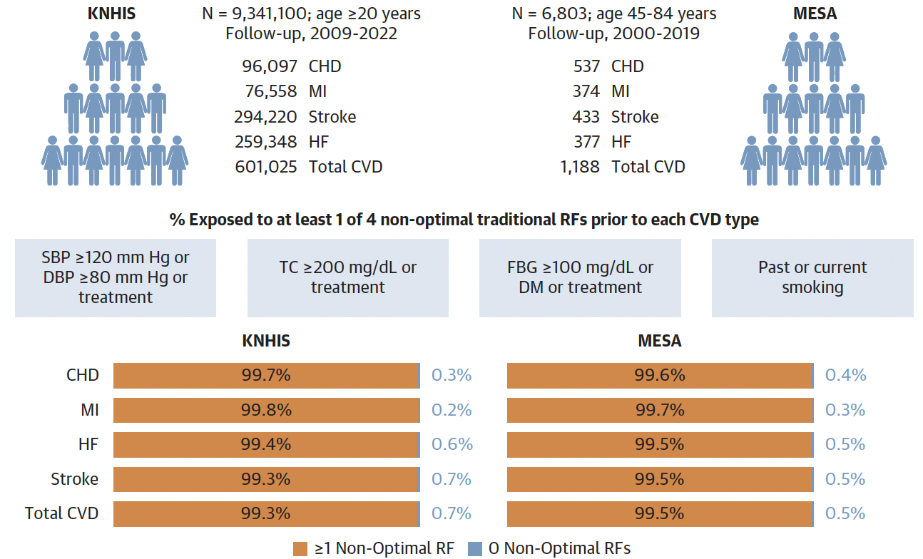
Very High Prevalence of Nonoptimal Traditional Risk Factors Prior to Cardiovascular Disease Events
Does CVD frequently occur without preceding non-optimal traditional risk factors?
 | Given the near-universal presence of ≧1 non-optimal traditional RF prior to any CVD, CVD events rarely occur in the absence of antecedent non-optimal traditional RFs, highlighting the importance of greater and earlier lowering of modifiable RFs
Korean National Health Insurance Service
Multi-Ethnic Study of Atherosclerosis
Source: Lee H,et al.JACC.2025;86(14):1017–1029

Slide 8
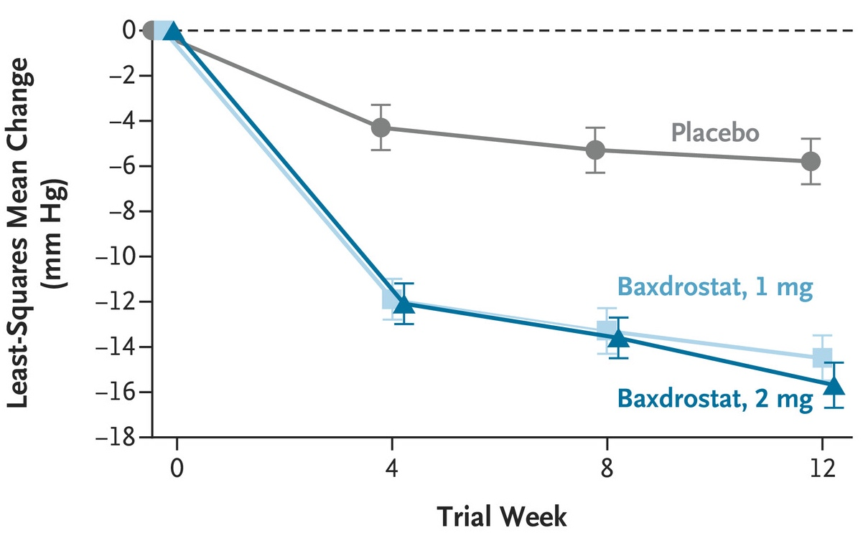
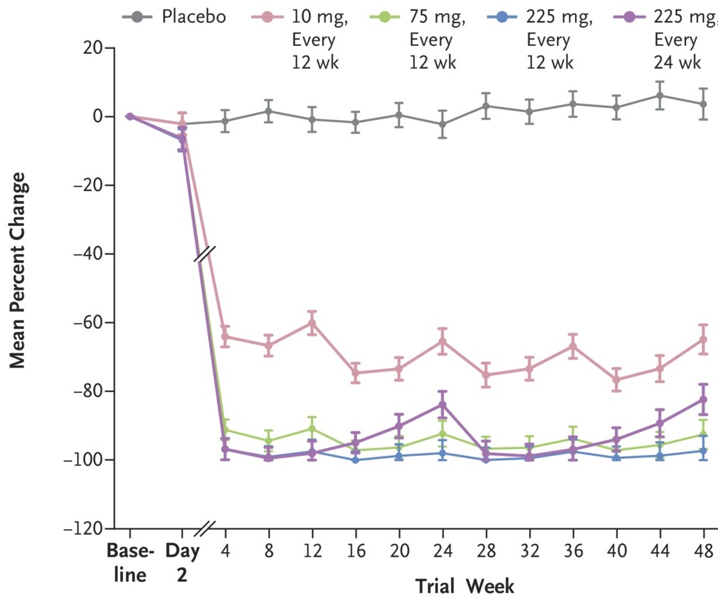
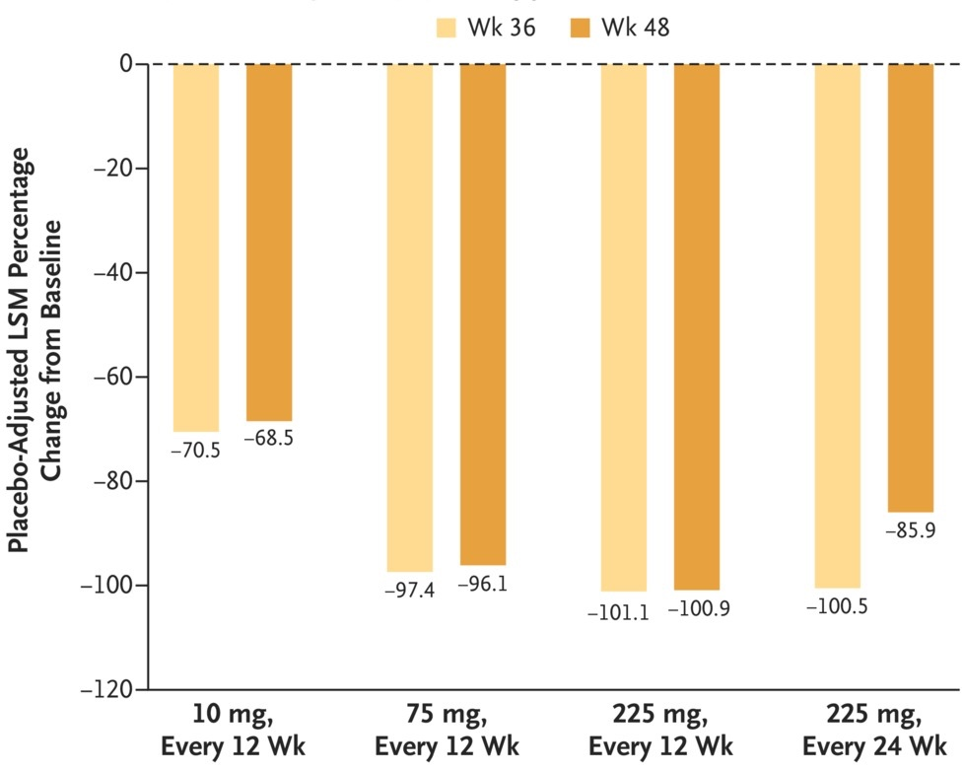
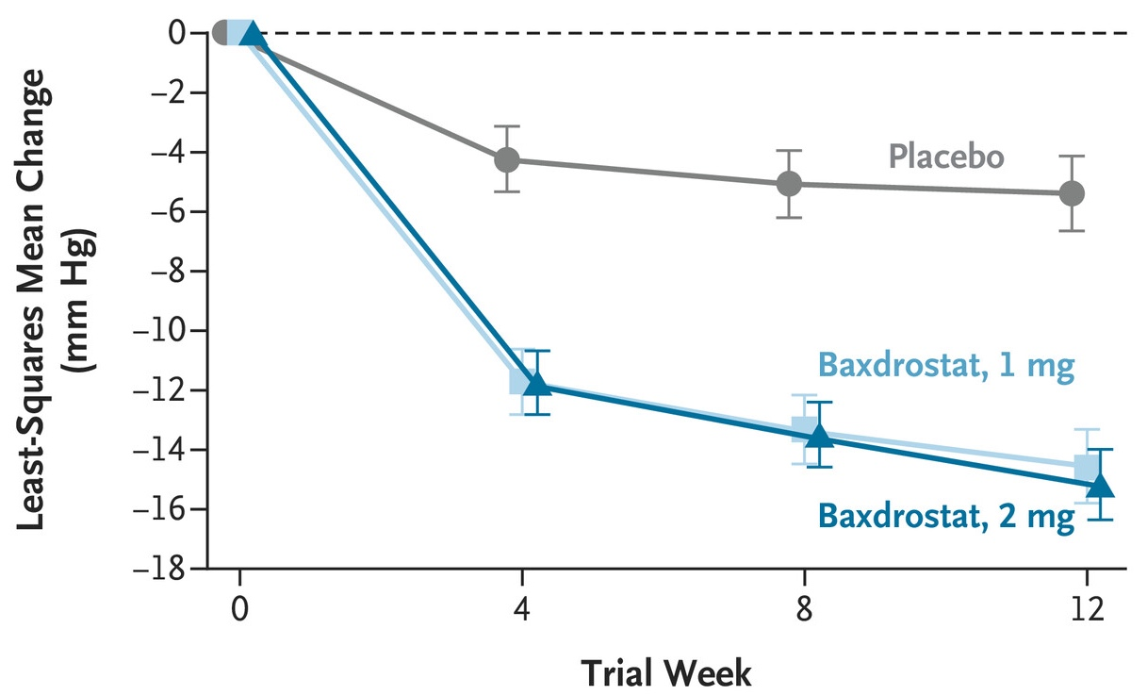
Advancing Novel Therapies for Cardiovascular Risk Factors
BrigHTN (Baxdrostat) | Uncontrolled and resistant hypertension |  | OCEAN(a)-DOSE (Olpasiran) | Established ASCVD + elevated Lp(a)
794 pts, mean 61yrs, men 62%, ≥3 drugs
281 pts, mean 61yrs, men 68%, Lp(a) ≥150 nmol/L
Change in seated systolic blood pressure from baseline to wk 12
% Change in LP(a) concentration
Change in seated systolic blood pressure from baseline to wk 12
in resistant-hypertension subpopulation
Placebo-adjusted change in LP(a) concentration
Source: Flack, J et al, N Engl J Med 2025;393:1363-1374 / O’Donoghue ML et al. N Engl J Med2022;387:1855-1864

Slide 9
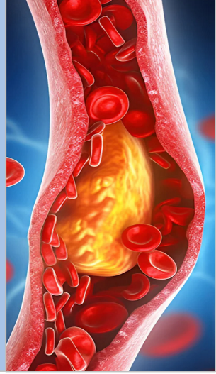
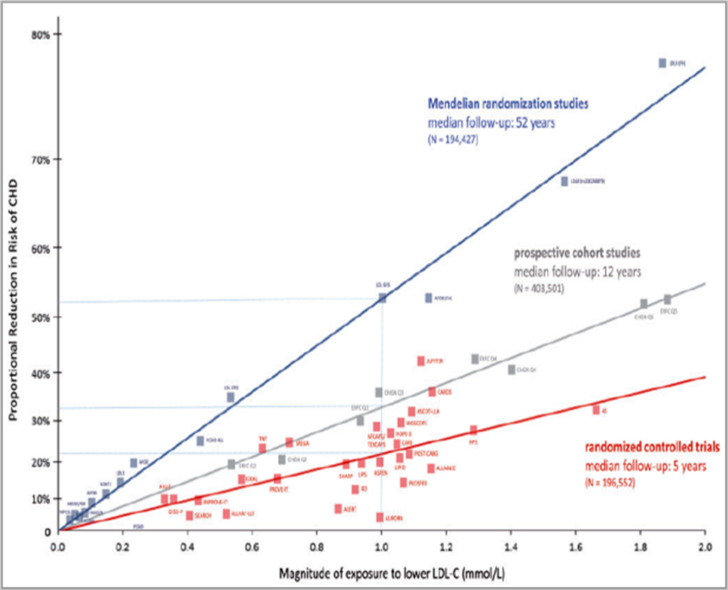
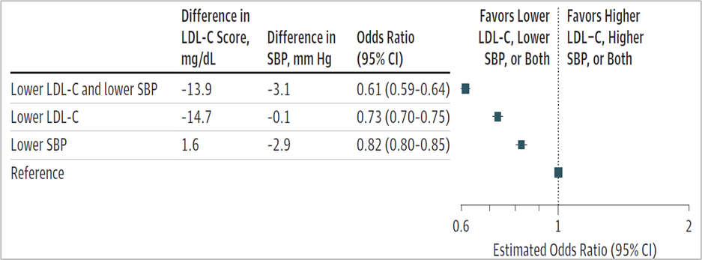
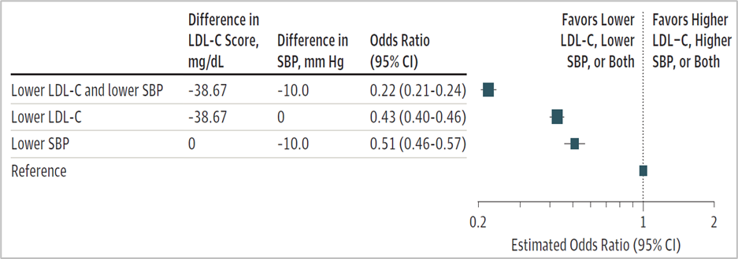
Cumulative Exposure to LDL-C and Risk of Coronary Disease
Associations of exposure to lower LDL-C, lower SBP, or both with risk of major coronary events
2M participants > 20M person-yrs of F/U > 150K CV events
438,952 pts / 24,980 experienced a first major coronary event
Arterial disease causing heart attacks and strokes may be largely preventable by sustained early RF reduction!
Measure risk and benefit earlier
right people, right time, right intervention
alter disease trajectories
Observed odds ratios for major coronary events vs reference group
Observed odds ratios for major coronary events vs reference group
Odds ratios scaled for 1mmol lower LDL-C, 10-mm Hg lower SBP, or both vs reference group
Source: (L) Ference et al, Eur Heart J, 2017 Aug 21;38(32):2459-2472 / (R) Ference et al, JAMA 2019 Oct 8;322(14):1381-1391

Slide 10
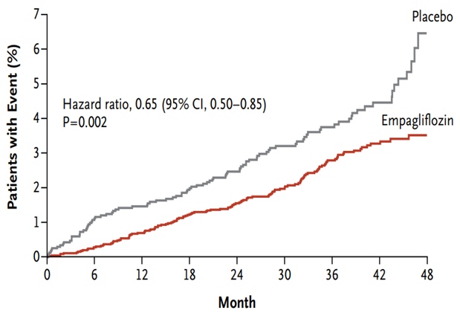
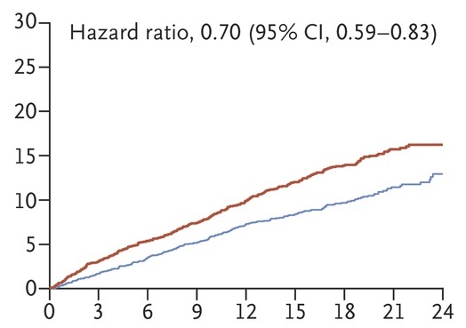


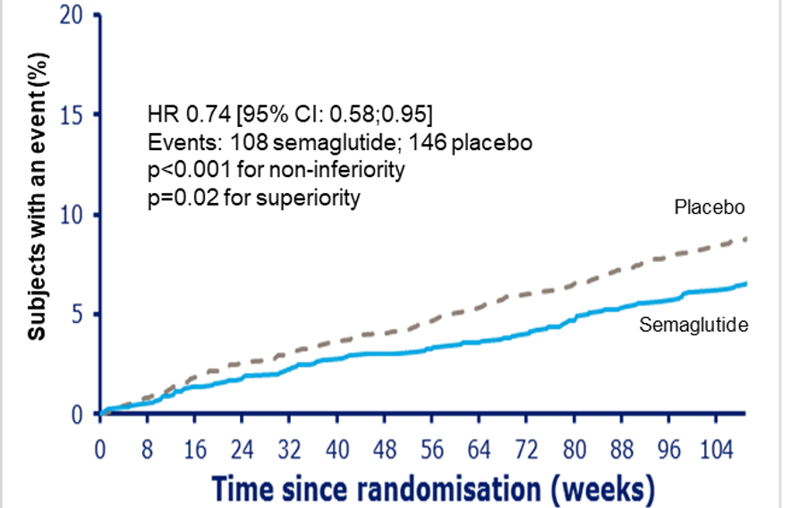
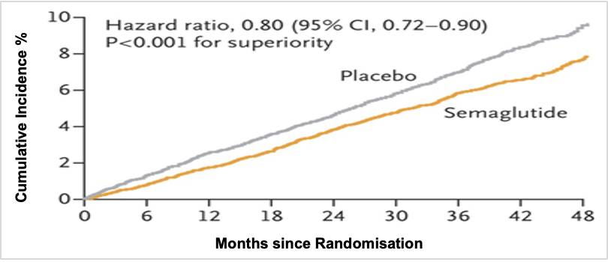
Drug trials being assessed against hard outcomes
SGLT2i and GLP-1 RA CV Outcome Trials
In patients with T2D | In patients w/out T2D
EMPA-REG (empagliflozin) - Hospitalization for heart failure
DAPA-HF (dapagliflozin) - Hospitalization for heart failure
SUSTAIN-6 (semaglutide) - 3-point MACE
SELECT (semaglutide) - 3-point MACE
Source: Zinman B, et al; N Engl J Med. 2015;373:2117-2128 / Marso SP, et al; N Engl J Med. 2016;375:1834-1844.
McMurry J et al, N Engl J Med 2019;381:1995-2008 / Lincoff AM et al, N Engl J Med 2023;389: 2221-2232

Slide 11
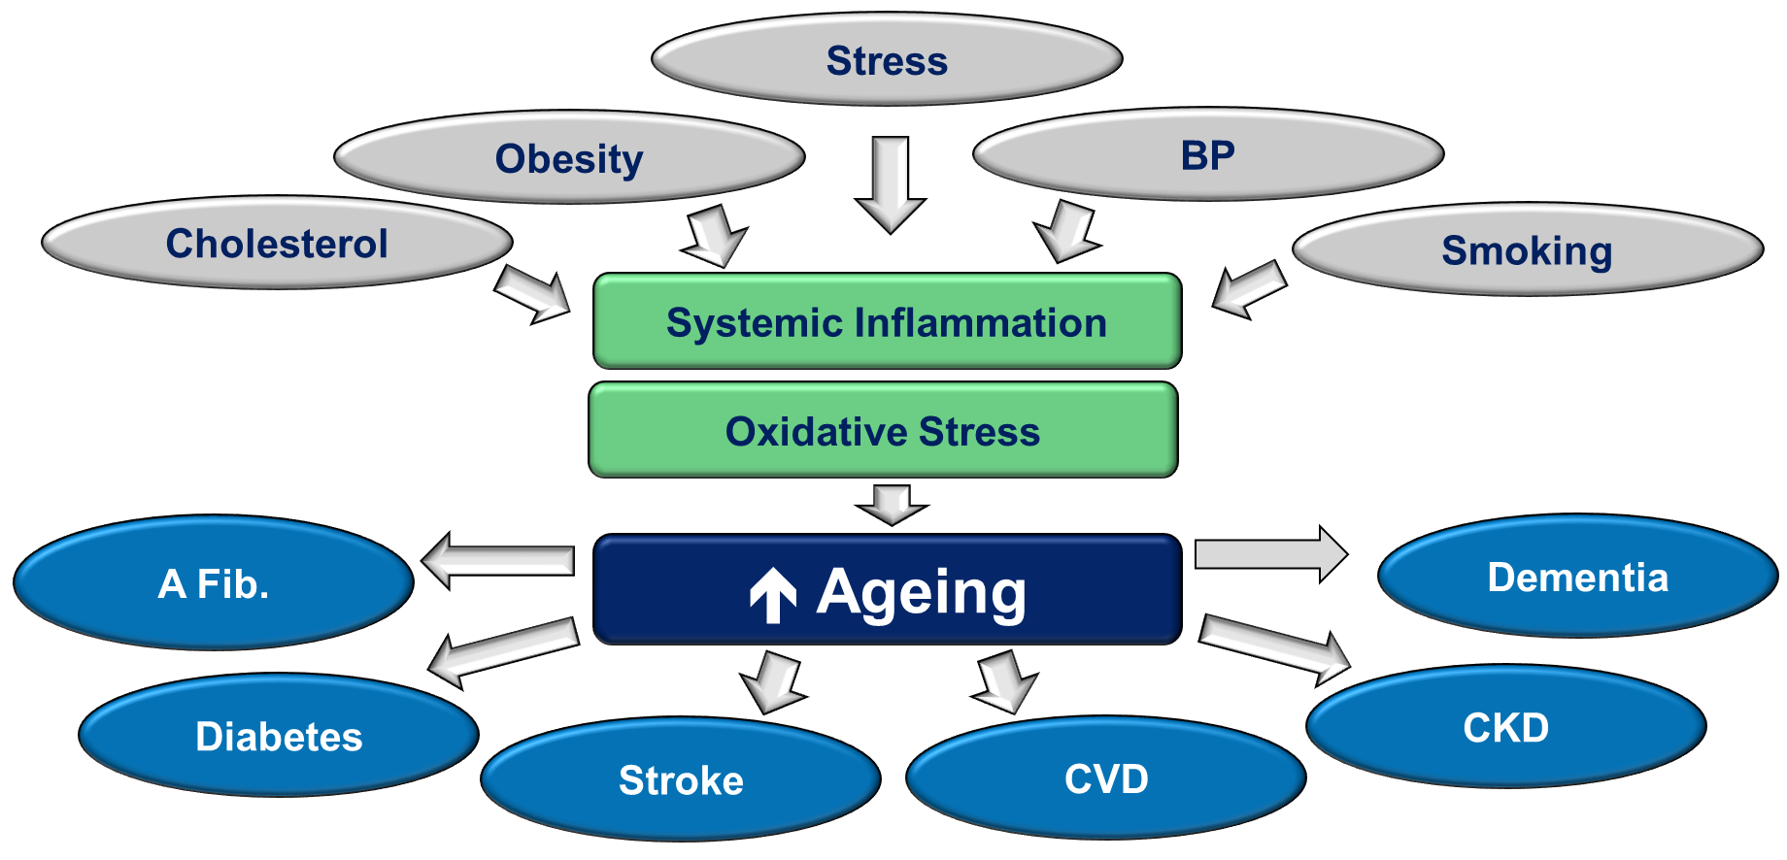
Modifiable risk factors drive multiple diseases of ageing
New treatments for Common biology e.g. GLP-1RA
Leveraged gain from treatment with health and economic benefits

Slide 12



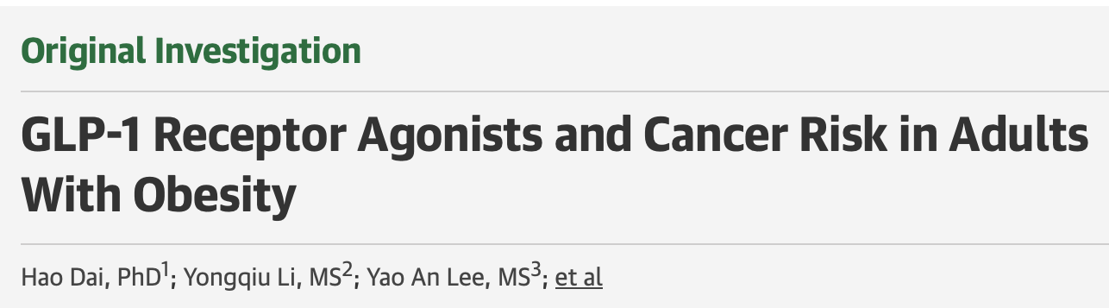

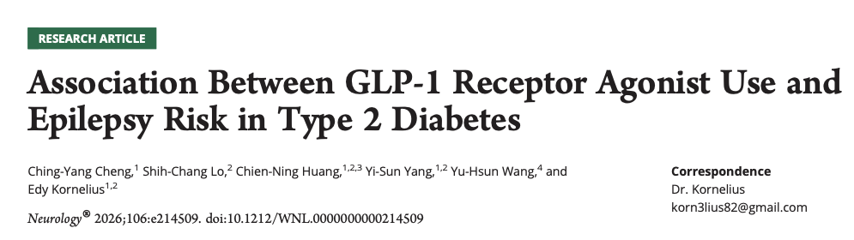
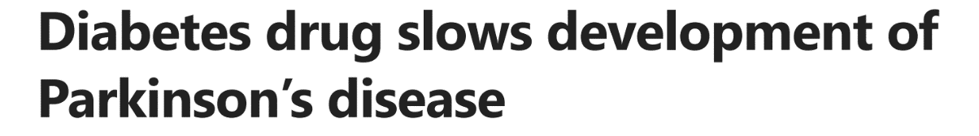

Evidence emerging of broader clinical benefits…
Heart Failure (Aug’24) | Kidney (May ‘24)
Liver (Jun’24) | Cancer (Aug’25)
Parkinson’s Disease (Apr’24) | Epilepsy (Jan’26)

Slide 13
Challenge is to be able to deliver personalised prevention at scale
2024 UK Government Taskforce Report
Age
Innovation
Learning System to test and incorporate innovation: OFH
Evaluation
Citizen
Digital platform for longitudinal health
Incl. risk and benefit calculator & AI for communication
Actionable
information
Healthcare Professional/System
EHR
New Social Contract - Inform, Empower & Reward
Source: Deanfield, J “Making prevention everyone’s business: a transformational approach to personalised prevention in England” Independent report May 2024

Slide 14

Our Future Health | Dynamic learning system driven by big data to enable rapid adoption of innovations into practice
A unique funding model between UK Government and Life Sciences Industry
5 Million Recruitment Target!
Identify a consented, genotyped cohort at high risk of potentially modifiable diseases to power clinical trials of both novel treatment & prevention therapies
5M
3.5M
Recruitment target
volunteers
20%
10%
Non-British white ethnicity
Poorest societal bracket
Source: Our Future Health Data June 2024

Slide 15
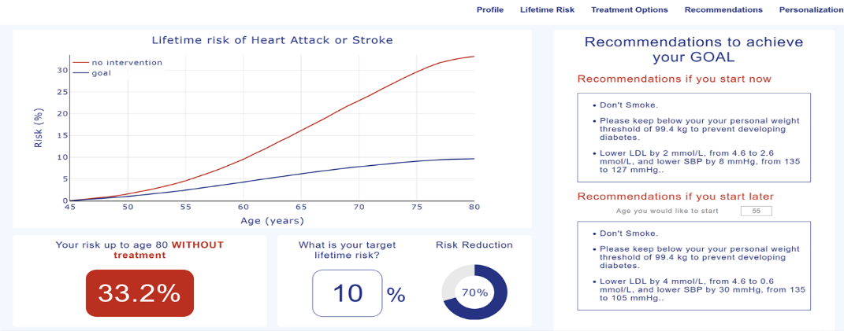
Personalised lifetime risk & benefit goals & recommendations to achieve it
Risk & Benefit Calculator powered by deep-learning algorithms to quantify causal effect of RFs to estimate benefit beginning at any age and any duration
Source: Ference, BA et al Nat Rev Cardiol 2024 Oct; 21(10):701-716 / 1DeepCausalAI Institute for Clinical Translation

Slide 16
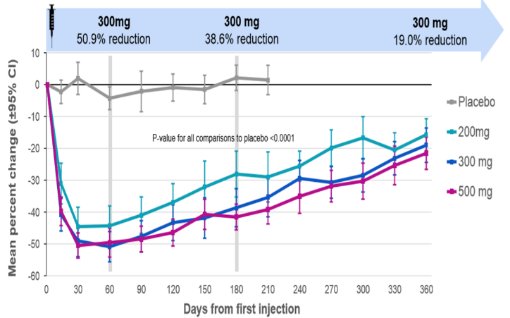
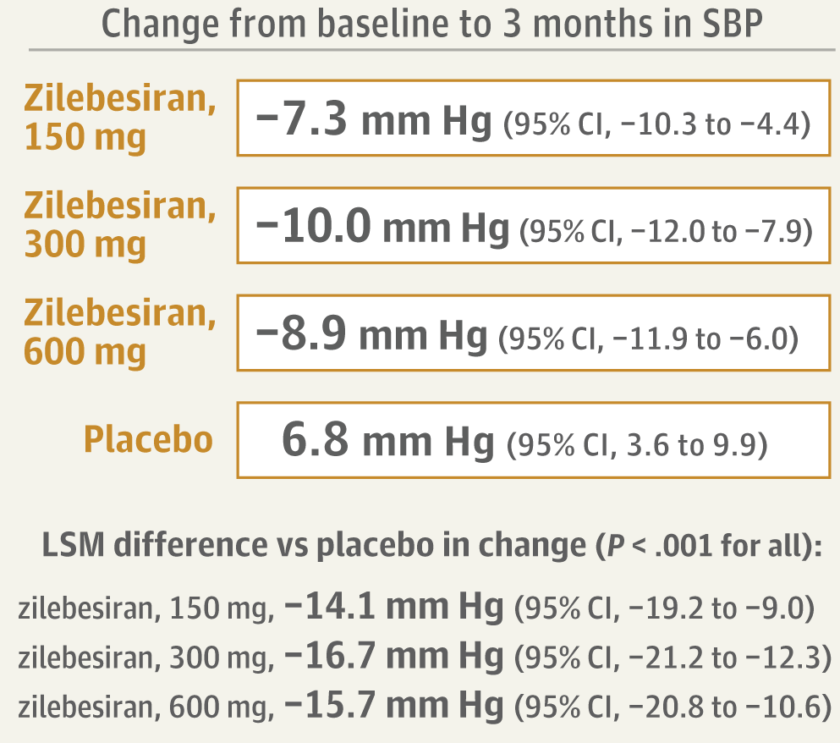
Solving the compliance issue with long-acting treatments
ORION-1 (Inclisiran) | LDL-C reduction w. one dose
KARDIA-1 (Zilebesiran) | Sustained BP reduction w. one dose
501 pts, mean 63yrs, men 65%, ASCVD or high CV risk, LDL-C ≥70 mg/dL
394 pts, mean 57yrs, men 56%, SBP: 140 to <180 mmHg
Source: (L) Ray K et al., N Engl J Med (2017); 376:1430-1440 / (R) Bakris GL et al, JAMA 2024;331;(9):740-749 /

Slide 17
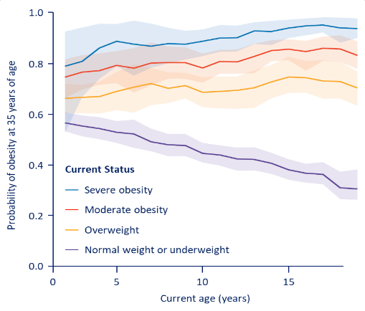
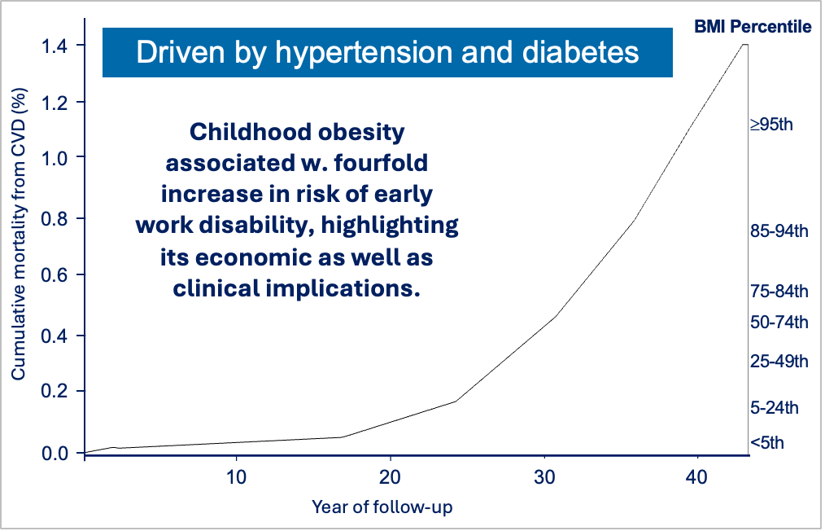
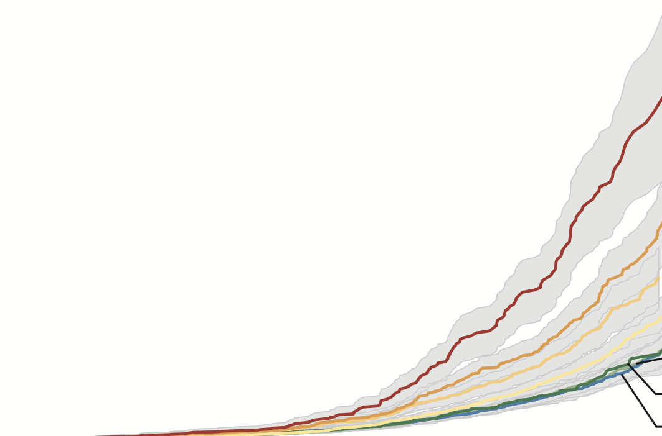

How Early Should Prevention Start?
Probability by current BMI category and age | Probability by current BMI category and age
57% of today’s children will be living with obesity at 35 yrs Never too late…but actually never too early!
Driven by hypertension & diabetes
Source: (L) Ward et al, N Engl J Med 2017;377:2145-53 / (R) Twig G et al, NEJM 2016;374:2430-40 /
(B) WHO projection (C) Fox CK et al. N Engl J Med 2025;392:555-565

Slide 18
Novel therapies & integrated care models in clinical management of diabetes, hypertension, dyslipidemia & obesity
Disruptive moment in health care, away from defining and managing health merely in terms of the presence or absence of disease
Based on scientific understanding of disease progression, availability of novel treatments producing sustained impact and technology advances to reach & assist individuals…but must start early!
Healthy ageing requires a prevention mindset: reducing lifelong exposure to major risk factors and harmful behaviours, with delivery through an integrated, scalable approach
Need to empower the population to take ownership of their ‘wellness’ in order to unburden the ‘disease care system’ by giving them the tools, support and knowledge required to act
Prevention should be viewed not just as an expense to the healthcare budget but as a wealth creation opportunity !!

Slide 19
THANK YOU
John.e.deanfield@gmail.com

