Slide 1
WHAT WILL THE FUTURE BRING: A BIRD´S EYE VIEW
a patient’s perspective
Konstantina Boumaki, MD
19/03/26

Slide 2
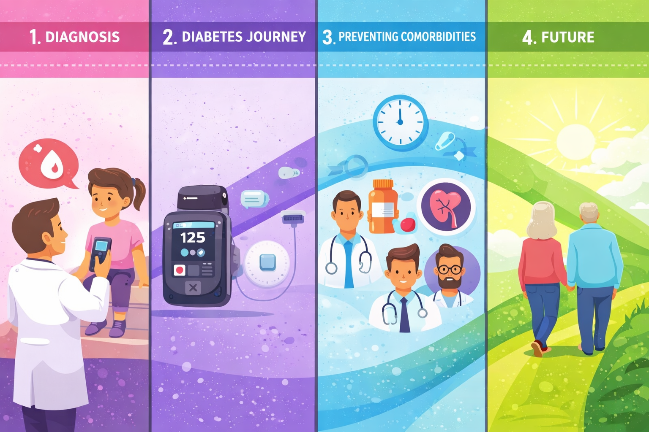
Living with lifelong cardiometabolic risk
From diagnosis to preventing complications across the patient journey

Slide 3
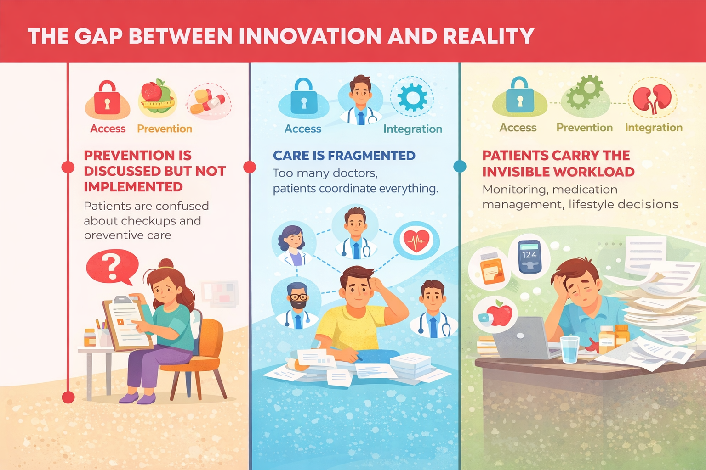
What is missing today

Slide 4
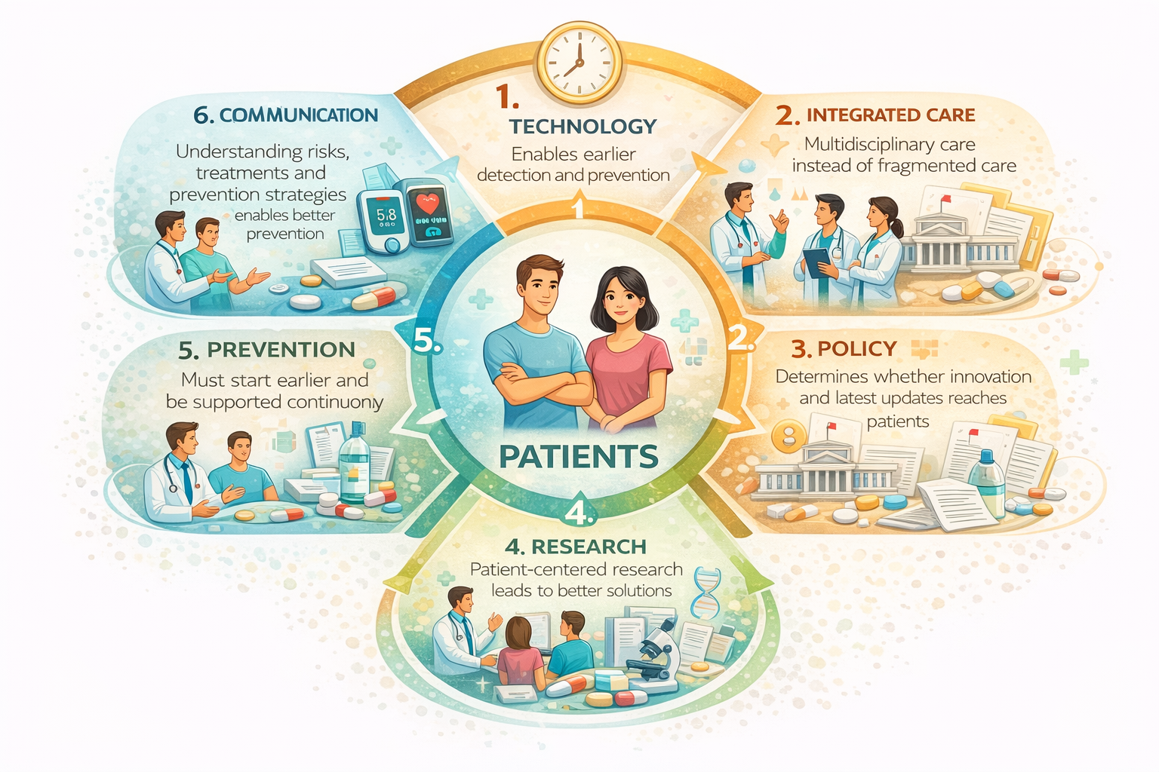
What the future should look like

Slide 5
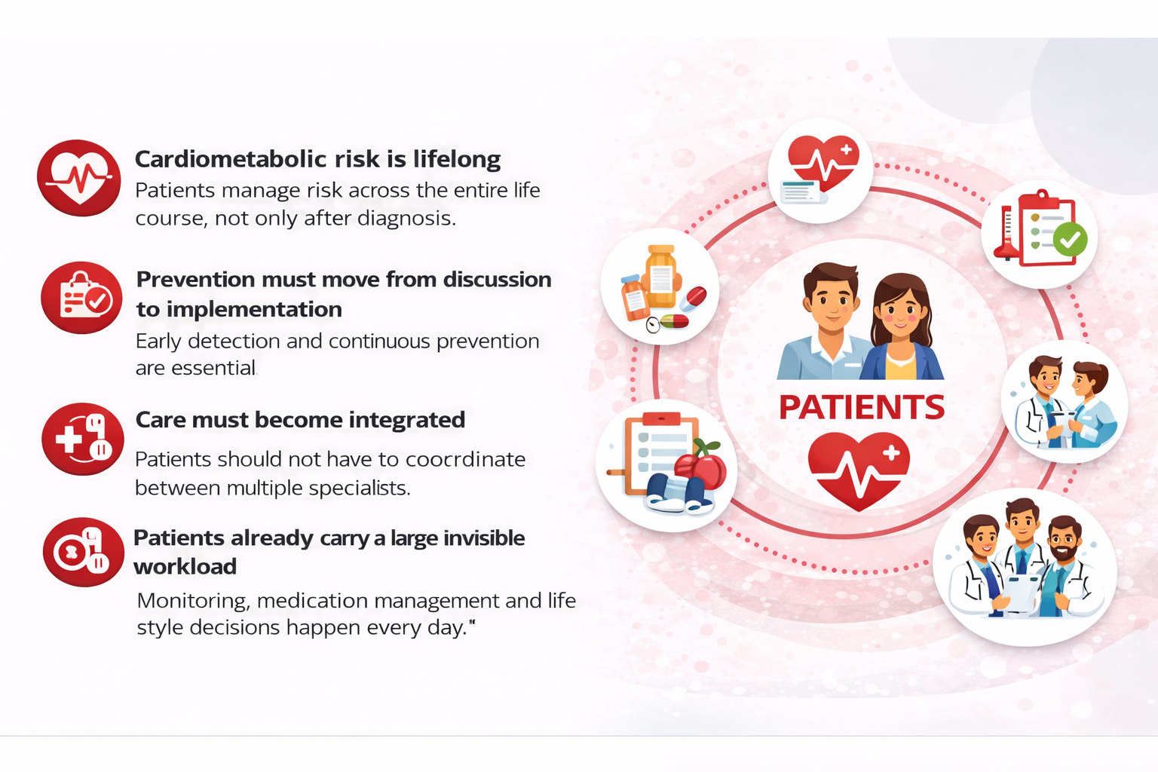
Key Takeaways

Slide 6

Konstantina Boumaki
kboumaki@hotmail.com

