Slide 1
INTERVENTION FOCUS ON CARDIOMETABOLIC DISEASE
Lifestyle changes for global prevention and implementation strategies at individual and population-level
Ana Abreu

Slide 2
STRUCTURE OF THE PRESENTATION
Cardiometabolic Risk and Lifestyle Behaviours
Challenges in Prevention Implementation
Implementation of Preventive Strategies
Implementation of Preventive Strategies at Populational level
Implementation od Preventive Strategies at Individual level
Future Directions and Key Messages

Slide 3
Cardiometabolic Risk and Lifestyle Behaviours
Challenges in Prevention Implementation
Implementation of Preventive Strategies
Implementation of Preventive Strategies at Populational level
Implementation od Preventive Strategies at Individual level
Future Directions and Key Messages

Slide 4

Why Does Lifestyle Matter in CMD?
Reduce CMD Risk
Improve quality of life
Reduce healthcare costs
Increase life expectancy
Promote mental well-being

Slide 5
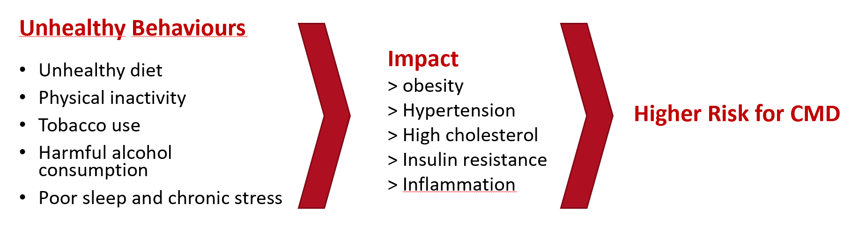
Lifestyle Behaviour Modifiable Risk Factors
Society has changed: higher incomes, urbanization, technological advances, mass media, marketing, goods and services global trade, have promoted ultra-processed food diets, physical inactivity, sedentary behaviour, poor sleep and chronic stress.

Slide 6
CMD Risk
Unhealthy Diet
Several meta-analyses (numerous prospective cohort studies) have investigated the contribution of specific lifestyle behaviours to CMD burden, showing unhealthy diets (high sodium, saturated fat, added sugars, low consumption of fruit and vegetables) are key contributors to CMD-related premature mortality.
Unhealthy dietary factors together account for 15–35% of CVD-related deaths, and are common in both high-income and low-income countries, with > 40% non-adherence to national food-based dietary guidelines.
Global Burden of Disease Diet Collaboration. Lancet 393, 1958–1972 (2019); Global Burden of Disease Risk Factor Collaboration. Lancet 388, 1659–1724 (2016); Chareonrungrueangchai, K et al. Nutrients 12, 1088 (2020); Juul F, et al. Adv. Nutr. 12, 1673–1680 (2021); Meier T. et al. Eur. J. Epidemiol. 34, 37–55 (2019); Vaduganathan M. et al. J. Am. Coll. Cardiol. 80, 2361–2371 (2022); Leme A, et al. Nutrients 13, 1038 (2021).

Slide 7
CMD RISK
Physical Inactivity and Sedentarism
Sedentary behaviour is increasingly prevalent worldwide and increases CMD risk in a dose-dependent fashion.
The association between physical activity and CMD, probably nonlinear, shows the greatest relative benefits when moving from inactive state to a more active state. Physical inactivity has a major impact on the development of CMD, contributing to estimated 6% of the CVD burden and 7% of T2DM.
Warburton, D. E. R. & Bredin, S. S. D. Curr. Opin. Cardiol. 32, 541–556 (2017).
Blodgett, J. M. et al. Eur. Heart J. 45, 458–471 (2024).
Eijsvogels, T. M., George, K. P. & Thompson, P. D. Cardiovascular benefits and risks across the physical activity continuum. Curr. Opin. Cardiol. 31, 566–571 (2016).

Slide 8
CMD Risk
Sleep deprivation and Chronic Stress
Sleep deprivation and chronic stress, as well as other behaviours, are associated with increased CMD risk in prospective studies, although their contribution to the global burden of CMD relative to other lifestyle behaviours is uncertain.
Itani O,. Et al. Sleep. Med. 32, 246–256 (2017).
Kivimaki, M. & Steptoe, A. Nat. Rev. Cardiol. 15, 215–229 (2018).

Slide 9
CMD Risk
Lifestyle behaviours cluster
Each of these behaviours poses a metabolic risk, with clear interdependencies between them: unhealthy lifestyle behaviours often cluster and synergistically contribute to premature mortality, particularly in socioeconomically disadvantaged people.
These risks synergism highlights the importance of addressing multiple lifestyle behaviours simultaneously in interventions aimed at improving cardiometabolic health.
Ding D., et al. PLoS Med. 12, e1001917 (2015).
Fransen H. P., et al. Eur. J. Public Health 27, 274–278 (2017).

Slide 10
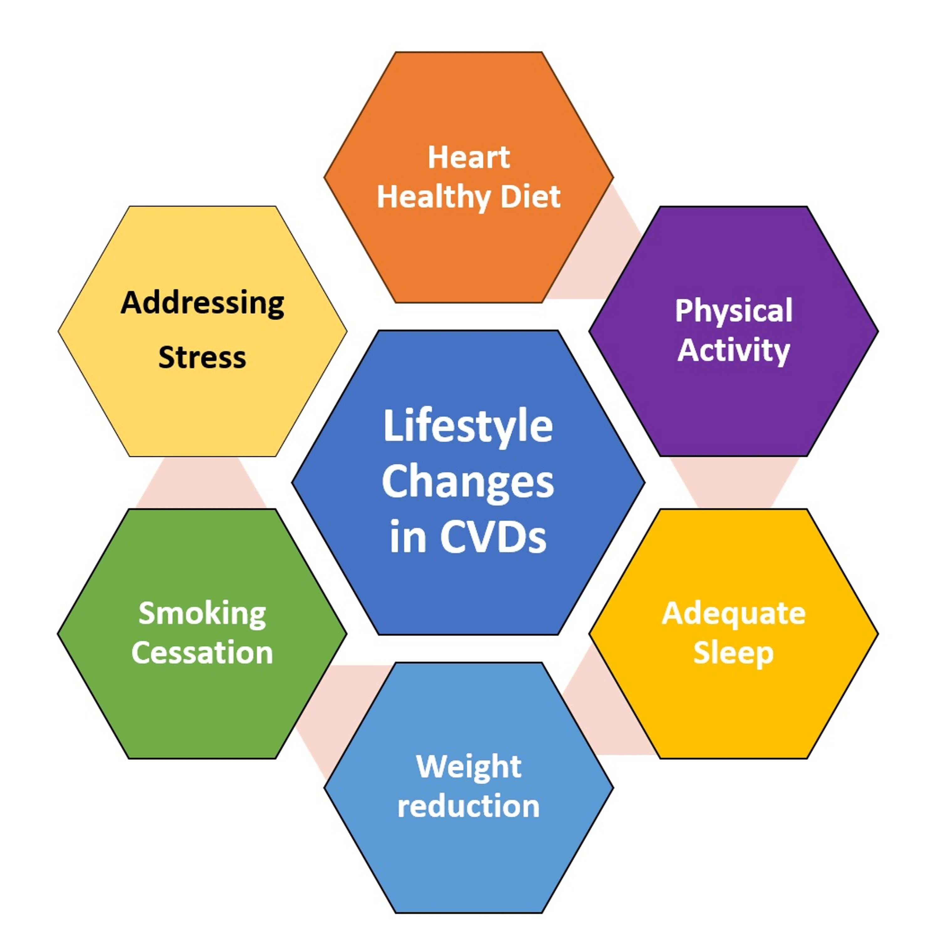
What are the targets of a healthy lifestyle ?
https://www.cureus.com/articles/172900-impact-of-lifestyle-modifications-on-cardiovascular-health-a-narrative-review

Slide 11
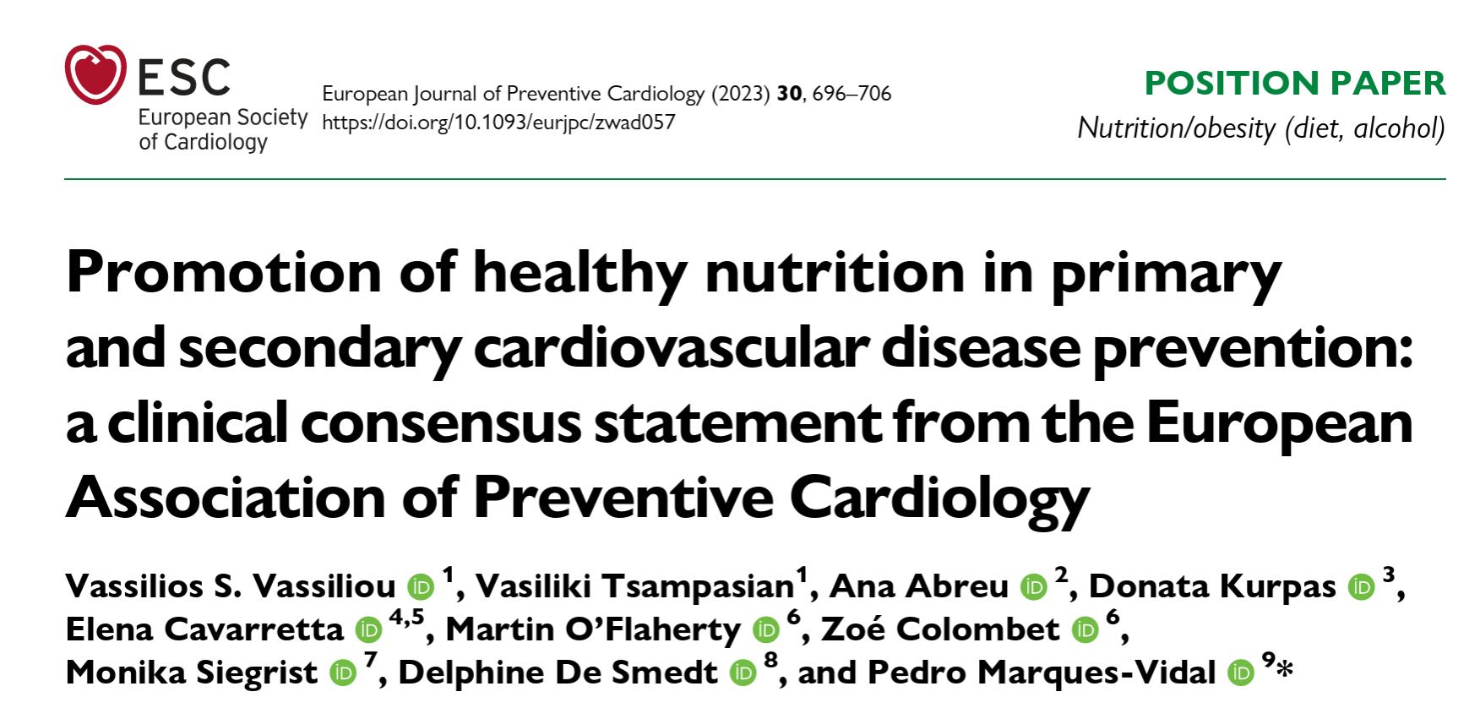
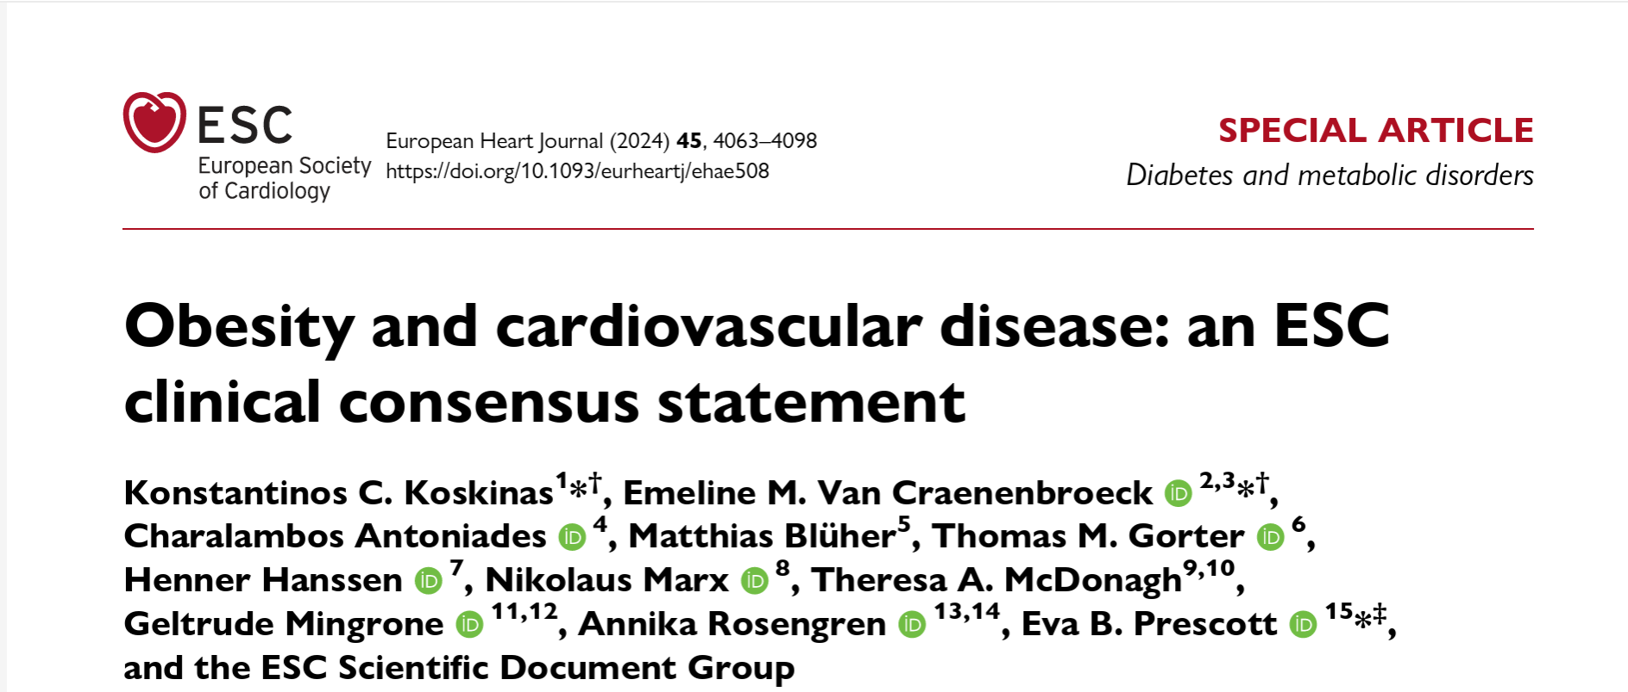
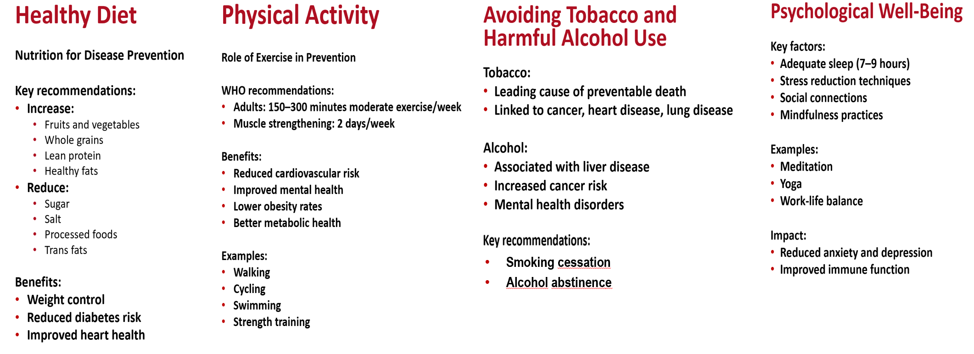
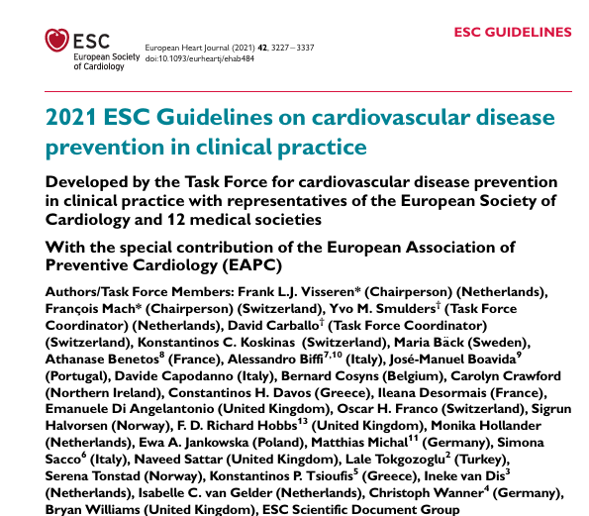
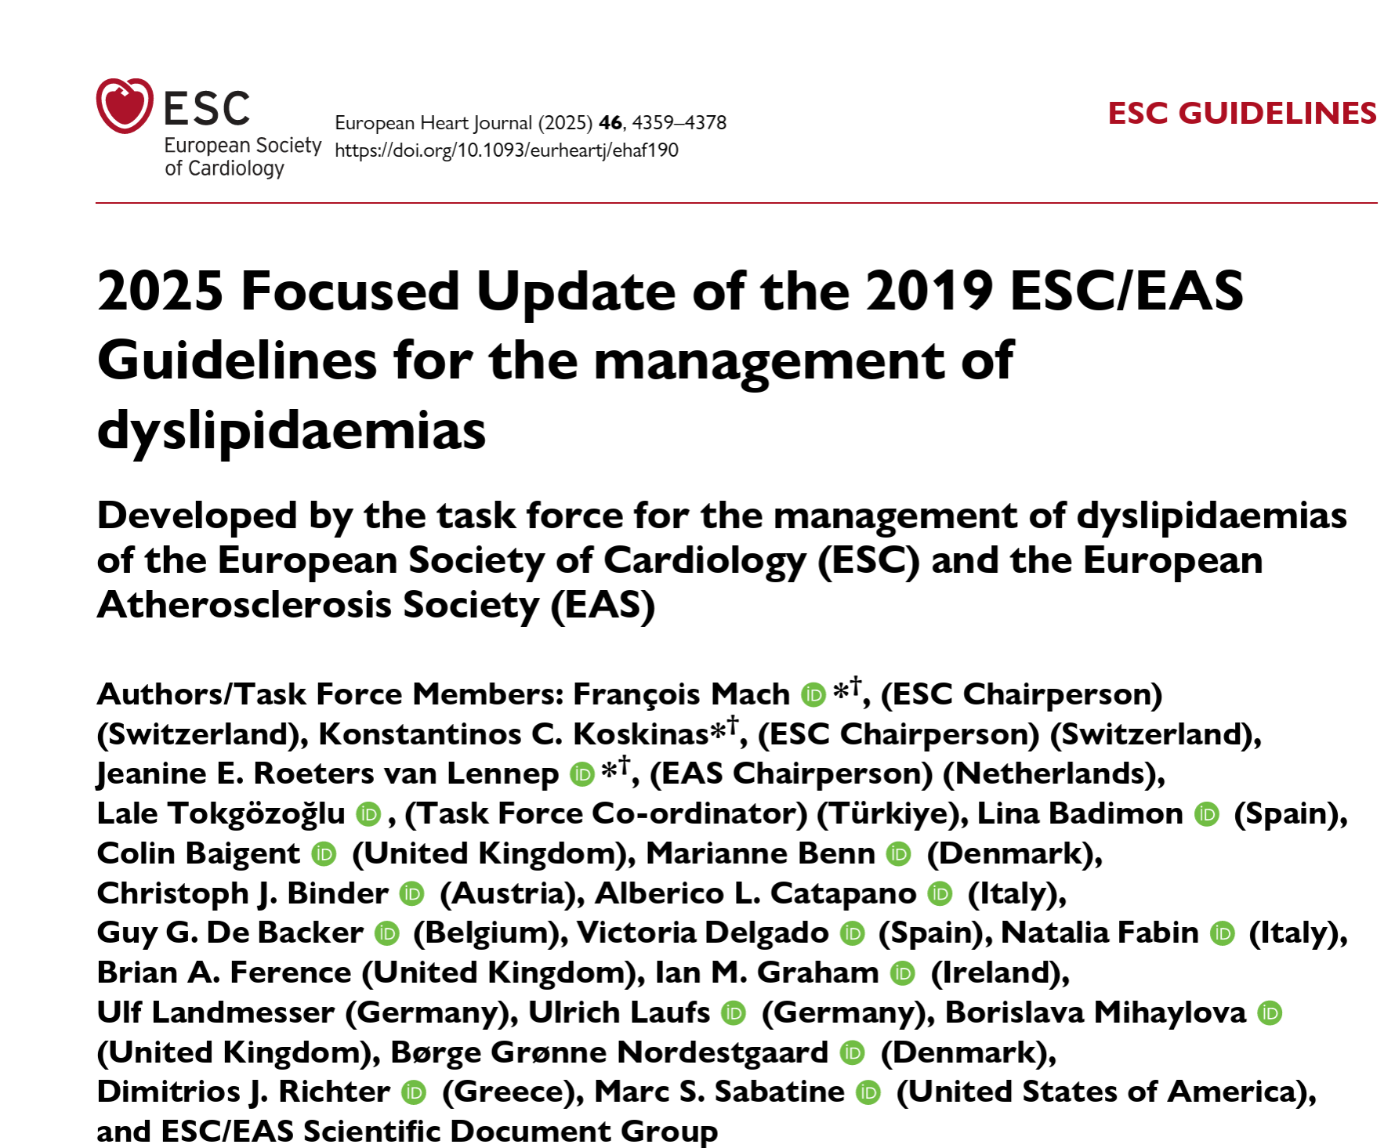
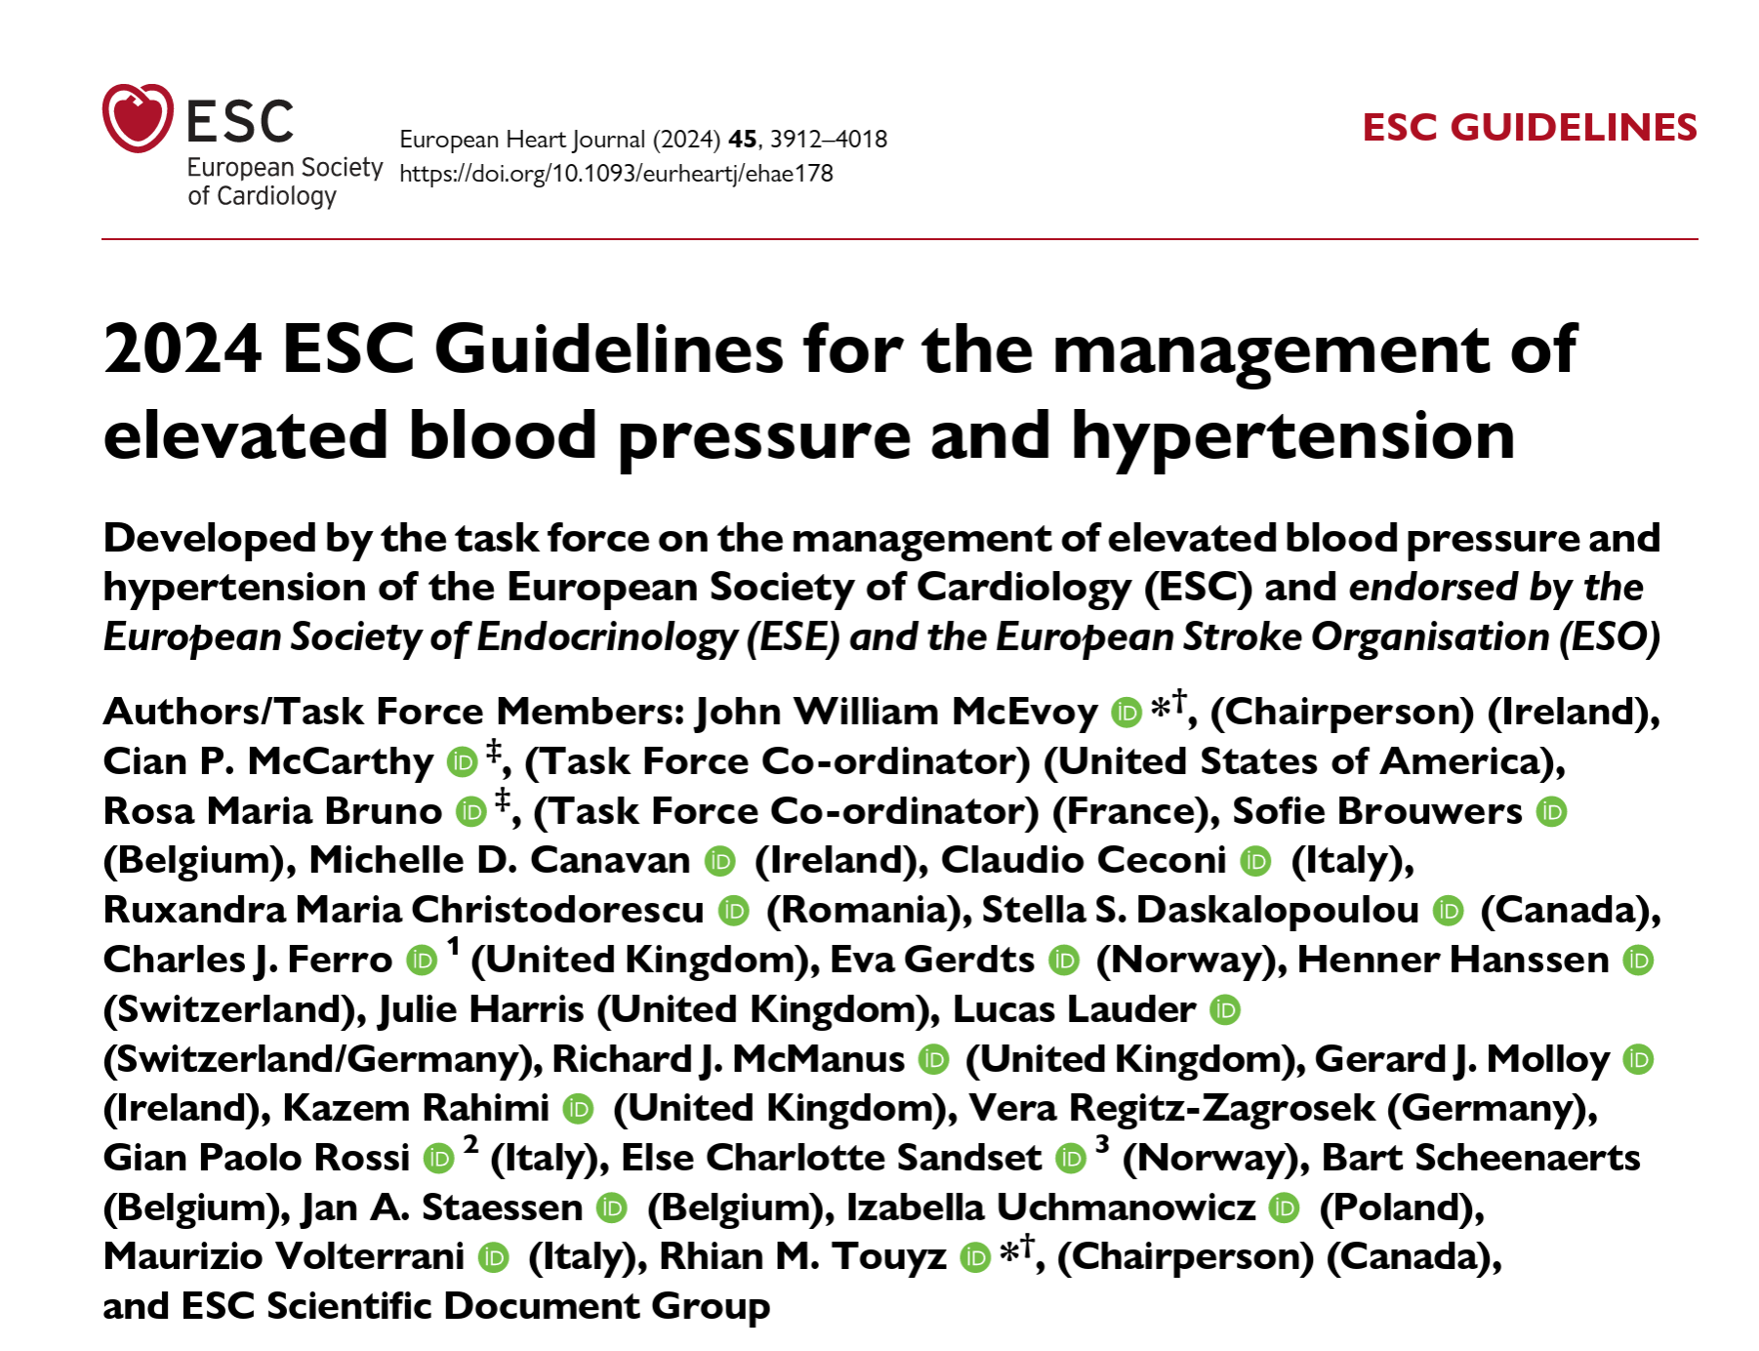
Healthy Lifestyle Recommendations
We know What to Do, but How to Implement?

Slide 12
Cardiometabolic Risk and Lifestyle Behaviours
Challenges in Prevention Implementation
Implementation of Preventive Strategies
Implementation of Preventive Strategies at Populational level
Implementation od Preventive Strategies at Individual level
Future Directions and Key Messages

Slide 13
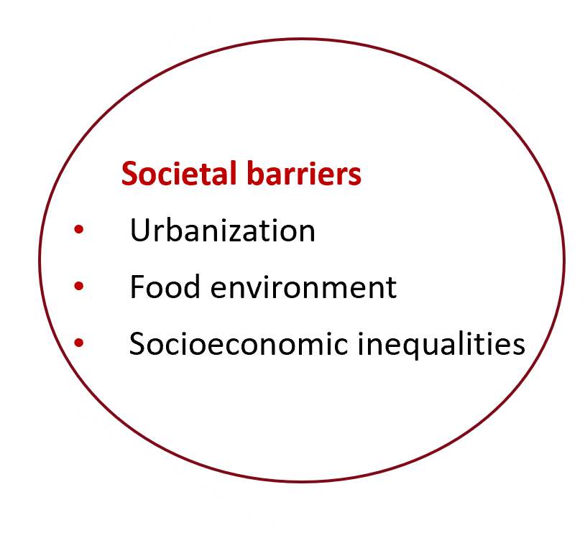
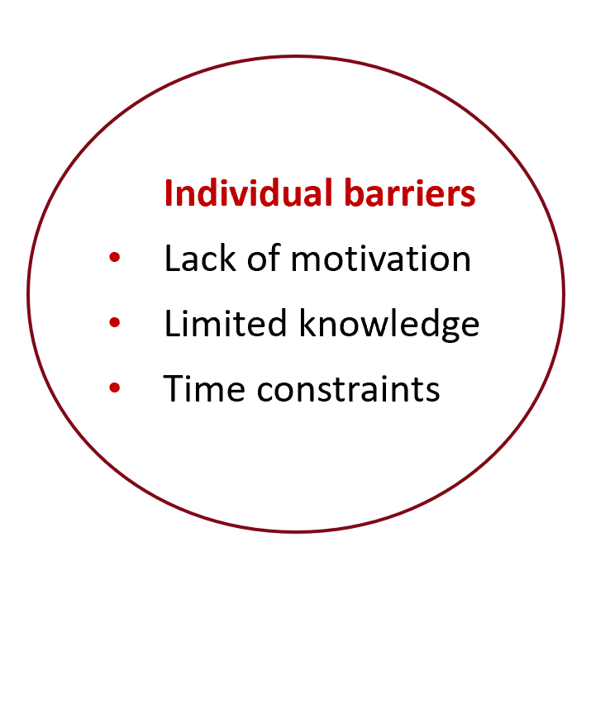
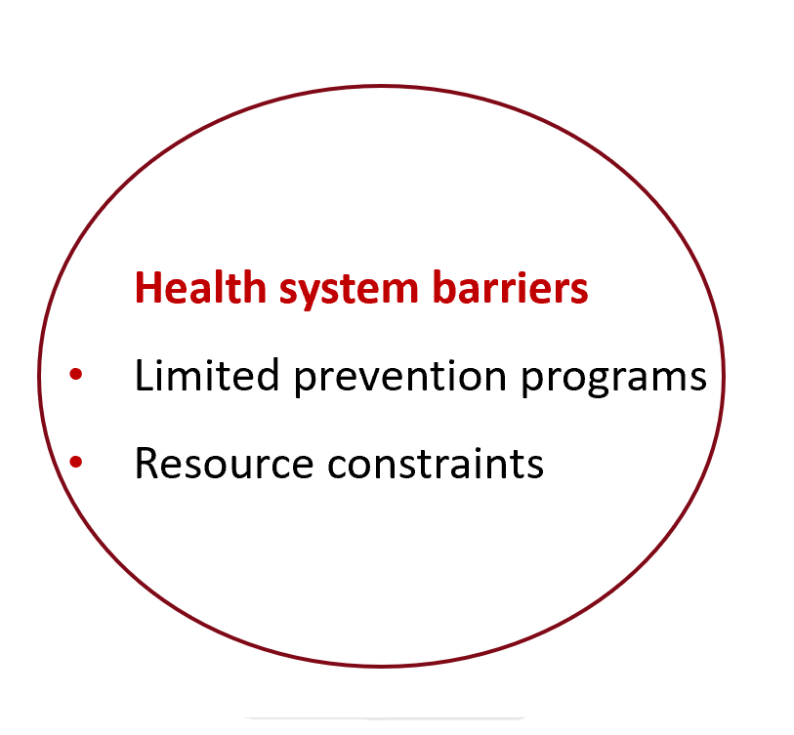
Challenges to Implementation

Slide 14
Cardiometabolic Risk and Lifestyle Behaviours
Challenges in Prevention Implementation
Implementation of Preventive Strategies
Implementation of Preventive Strategies at Populational level
Implementation od Preventive Strategies at Individual level
Future Directions and Key Messages

Slide 15
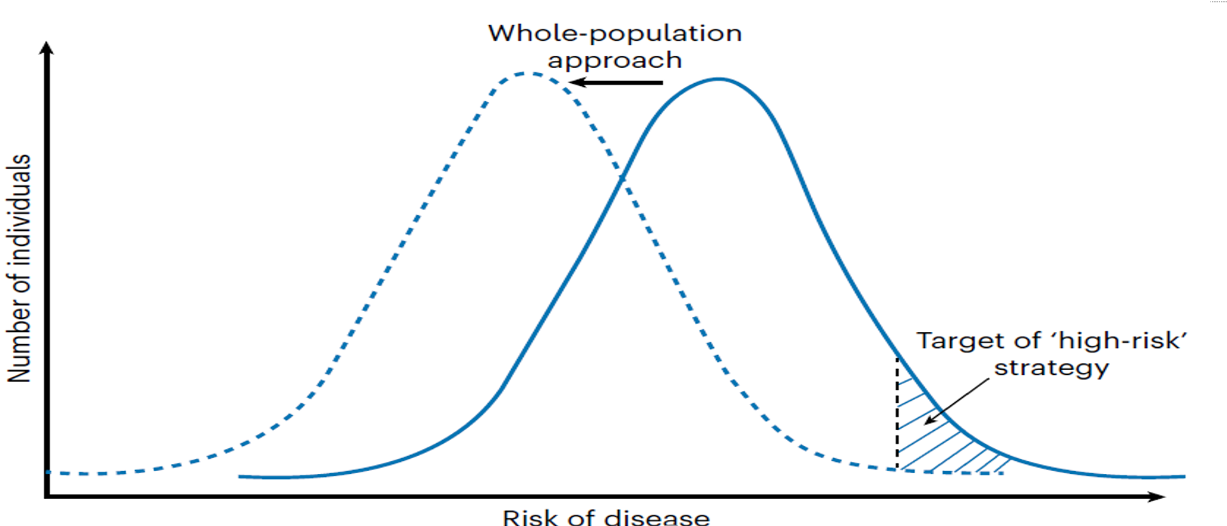
Population-based and individual high risk Prevention
CMD preventive approaches range from targeted interventions in high-risk individuals to population-wide approaches addressing the wider collective determinants of lifestyle behaviours. The two approaches are complementary.
Most disease cases in a population occur in individuals at low or moderate risk, while only a minority occur in high-risk individuals (“Prevention paradox” of Geoffrey Rose’s). This is due to the far greater number of individuals at low or moderate risk than at high risk in a population.
Population approaches aim to address the underlying causes of disease incidence at a population level, while “High-risk” approaches aim to protect more susceptible individuals at risk of developing CMD.
Rose, G. Sick individuals and sick populations. Int. J. Epidemiol. 14, 32–38 (1985).

Slide 16
Population-based and individual high risk Prevention
Lifestyle behaviours are shaped not just at the individual level, but within broader contexts that act as upstream drivers. including the physical, economic, political and sociocultural surroundings, and associated opportunities and conditions that influence people’s lifestyle behaviours.
Policy upstream measures that target the entire population are needed and tend to align or overlap with strategies to reduce carbon emissions and improve the health of the planet offering co-benefits.
Only targeting high-risk individuals is insufficient to decrease the prevalence of metabolic disease at a population level.
Lakerveld, J. & Mackenbach, J. The upstream determinants of adult obesity. Obes. Facts 10, 216–222 (2017).

Slide 17
Population-based and individual high risk Prevention
Population-based approaches seek to address unhealthy living environments and their social, political and commercial drivers. Investments in cycling and walking infrastructure, food taxes and subsidies, and in reducing poverty can contribute to reduction in the burden of CMD at population-level. These approaches tend to have greater impact in more vulnerable populations, hence reducing inequalities.
Combined Lifestyle Interventions (CLIs) targeting high-risk individuals will still be needed to substantially reduce disease burden, even in environments more supportive of healthier lifestyles.
Bland, M., et al. Int. J. Sustain. Transp. 18, 201–220 (2024).
Blakely, T. et al. Lancet Public Health 5, e404–e413 (2020).
Ludwig, J. et al. N. Engl. J. Med 365, 1509–1519 (2011)

Slide 18
Cardiometabolic Risk and Lifestyle Behaviours
Challenges in Prevention Implementation
Implementation of Preventive Strategies
Implementation of Preventive Strategies at Populational level
Implementation od Preventive Strategies at Individual level
Future Directions and Key Messages

Slide 19
Population-based approaches
Healthy Diet
Population-based approaches to improve diet quality include pricing policies, sales and marketing restrictions, product placement and labelling.
In general, the largest effects can be expected from multicomponent or complementary policy actions. Evidence from countries that implemented sugar taxes or industry levies suggests that increased prices of sugar-sweetened beverages are associated with lower sales, while fruit and vegetable subsidies are associated with increased fruit and vegetable sales among low-income consumers.
Limited data are available for the population health effects of such pricing policies, although sugar-sweetened beverage taxes are estimated to reduce obesity prevalence in high-income countries by 1–3%. Modelling studies suggest substantial health gains and savings of such policies.
Marketing restrictions to date have only targeted children. Evidence suggests that policies that restrict children’s exposure to unhealthy food marketing are associated with reduced purchases of unhealthy foods, but there is very little evidence for the health effects of such policies.
Front-of-pack labelling seems an effective approach to promote healthier product purchases, but effects on dietary intake or other outcomes are rarely reported.
Finally, only very few studies in the USA and the UK evaluated restrictions of fast-food outlets, with mixed results.
Hyseni, L. et al. Eur. J. Clin. Nutr. 71, 694–711 (2017). ; Andreyeva, T. et al. JAMA Netw. Open 5, e2215276 (2022) ;Andreyeva, T. wt al. JAMA Netw. Open 5, e2214371 (2022); Itria A., et al. Public Health Nutr. 24, 5550–5560 (2021); Lee, Y. et al. Circulation 142, 523–534 (2020); Boyland, E. et al. Obes. Rev. 23, e13447 (2022); Song, J. et al. PLoS Med. 18, e1003765 (2021); Croker, H., et al. J. Hum. Nutr. Diet. 33, 518–537 (2020) ;Brown, H. et al. Soc. Sci. Med. 306, 115126 (2022); Sturm, R. & Hattori, A. Soc. Sci. Med. 133, 205–211 (2015).
Policies that go beyond the food environment and physical activity are needed, to reduce the burden of CMD

Slide 20
Population-based approaches
City Planning
Urban or city planning can promote physical activity through designing compact, green, high-density, walkable and cyclable cities. City-planning policies focus on residential density, investment in transport infrastructure, design, destination accessibility, employment distribution, air pollution, demand management and distance to public transport.
Estimates suggest that increasing density and diversity of land use and reducing distances to public transport options may result in a gain of 420 to 826 disability-adjusted life years per 100,000 individuals, attributable to reductions in T2D, respiratory diseases and CVD.
Observational studies suggest that greater neighbourhood walkability, more green space and lower drivability is associated with a 10–50% lower T2D risk, and lower risk of CVD events.
Quantitative effects of such policies are difficult to obtain, but evidence is strongest for new infrastructure for walking, cycling and public transport, increased accessibility, improvement of parks and playground and street connectivity. A meta-analysis with evidence grading demonstrated convincing evidence for the associations between green spaces and cardiovascular mortality, and highly suggestive evidence for associations with T2D and all-cause mortality.
Intervening on social determinants can have positive effects.
Policies tackling unhealthy physical activity environments, unhealthy food environments, unhealthy neighbourhoods and structural causes of disease such as poverty should be combined to maximize their impact.
Nieuwenhuijsen, M. J. et al. Environ. Int. 140, 105661 (2020); Giles-Corti, B. et al. Lancet 388, 2912–2924 (2016); Lowe, M. et al. Lancet Glob. Health 10, e882–e894 (2022); Karmeniemi, M., et al. Ann. Behav. Med. 52, 239–251(2018); Xie, Y. et al. EBioMedicine 106, 105261 (2024); Liu, M. et al. Eur. J. Prev. Cardiol. 30, 1801–1827 (2023); Marteau, T. M., BMJ 372, n332 (2021).

Slide 21
Population-based approaches
Cost-Effectiveness
Cost-effectiveness evaluation of population-based approaches is challenging.
Some population studies indicated that taxing sugar-sweetened beverages was costs saving, while policies such as modifications to the built environment showed inconsistent results.
Caution is needed in policies involving taxes, which may have favourable effects, such as sugar reduction from sugar-sweetened-beverage in response to proposed sugar tax or less favourable results, such as addicted smokers eating less healthy cheaper foods in response to increased tobacco taxes.
Lorenc, T. & Oliver, K. J. Epidemiol. Community Health 68, 288–290 (2014).
Zhou, X. et al. Diabetes Care 43, 1593–1616 (2020).

Slide 22
How to evaluate Population level policies?
Due to the challenges and limitations of conducting randomized experiments when it concerns population-level policies, other types of evidence need to be generated.
A systems science approach may address the challenges of evaluating dynamic, nonlinear and unexpected policy effects. This may be combined with well-conceived natural experiments and modelling studies with the aim to triangulate different sources of evidence.
Hammerton, G. & Munafo, M. R. Psychol. Med. 51, 563–578 (2021).
Lawlor, D. A., et al. Int. J. Epidemiol. 45, 1866–1886 (2016).

Slide 23

Implementation of Preventive Strategies at Population level
Key Public Health Approaches
Health promotion campaigns
School health programs
Urban planning for active living
Food labelling policies
Taxation on unhealthy products
Examples
Sugar taxes
Smoke-free policies
Public exercise spaces

Slide 24
Role of Governments and Organizations
Policy and Global Initiatives Major stakeholders
Governments
Public health agencies
Healthcare systems
Non-government organizations
Examples
World Health Organization global NCD prevention strategies
National health promotion programs
Community interventions
EU Health Committee
Goal: Create environments
that support healthy choices.

Slide 25
Cardiometabolic Risk and Lifestyle Behaviours
Challenges in Prevention Implementation
Implementation of Preventive Strategies
Implementation of Preventive Strategies at Populational level
Implementation of Preventive Strategies at Individual level
Future Directions and Key Messages

Slide 26
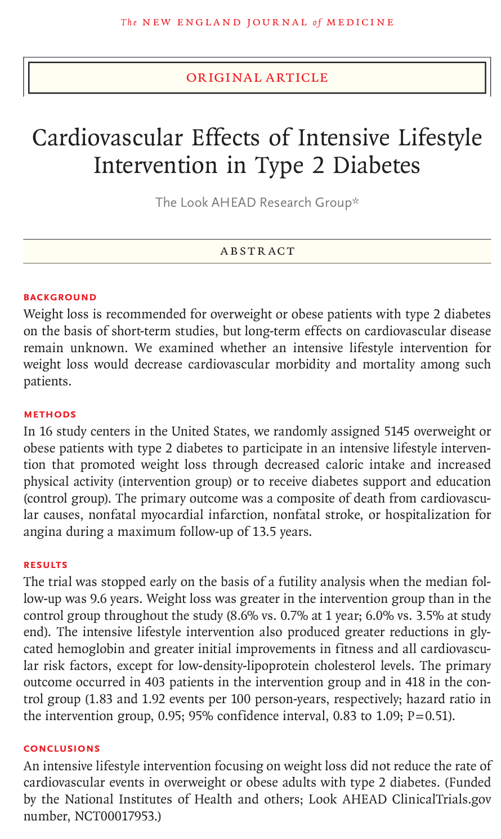
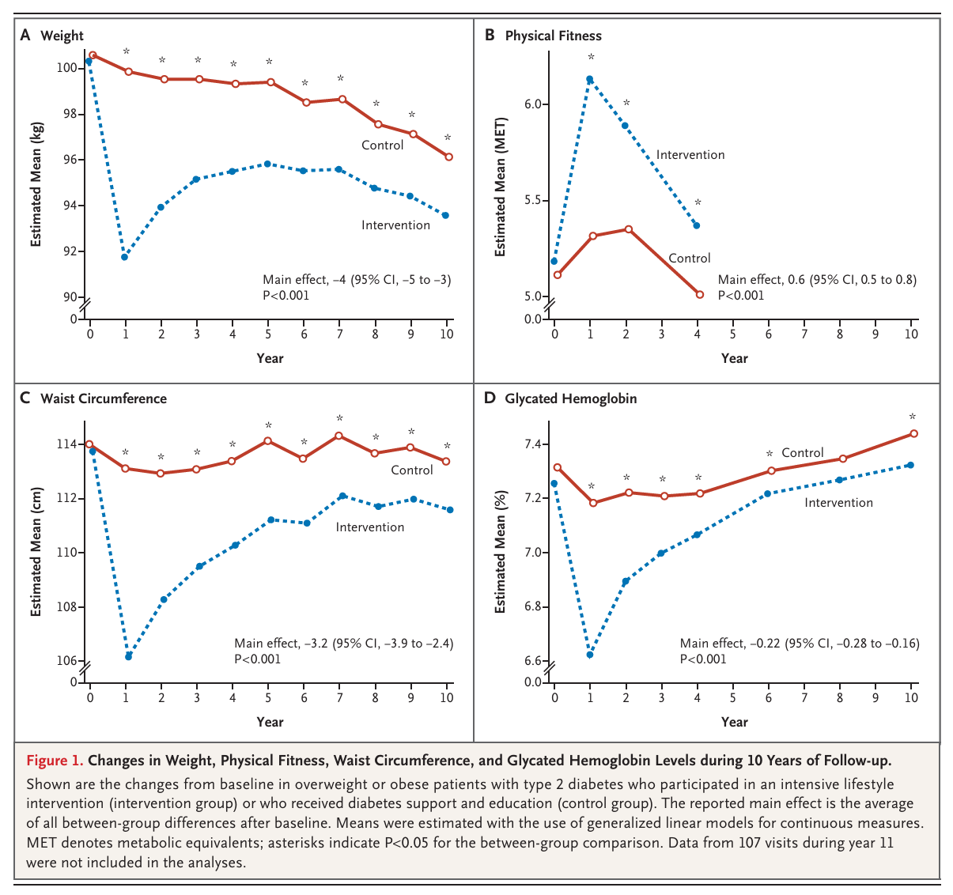
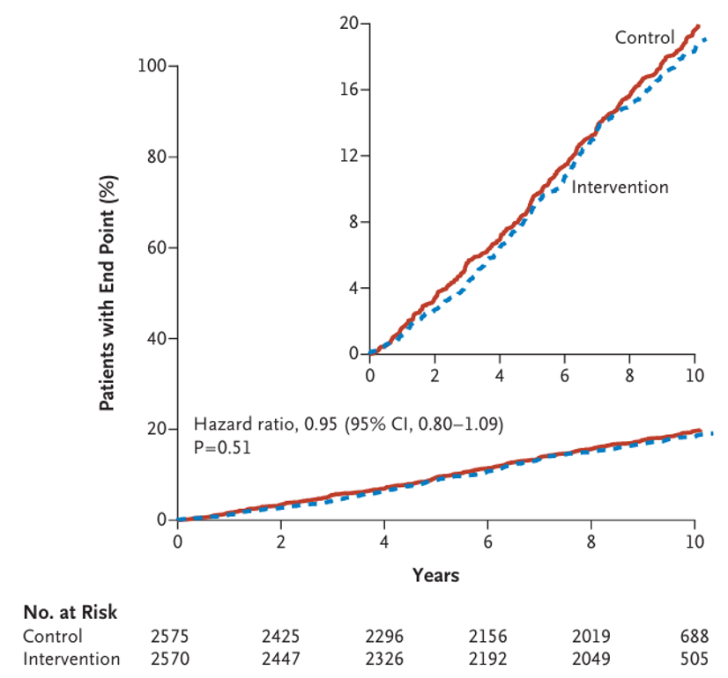
Lifestyle trials
Lifestyle trials, as Look AHEAD did not reduce the rate of CV events, but show, as LIFT, that structured, intensive lifestyle interventions are as effective or superior to standard care in treating chronic conditions like obesity, type 2 diabetes, METS, with significant improvements in health markers like weight, glucose levels, and blood pressure, often proving cost-effective and scalable.
Behavioural Adherence: Success in these trials often hinges on consistent tracking of food intake and attendance of structured, often group-based, sessions.

Slide 27
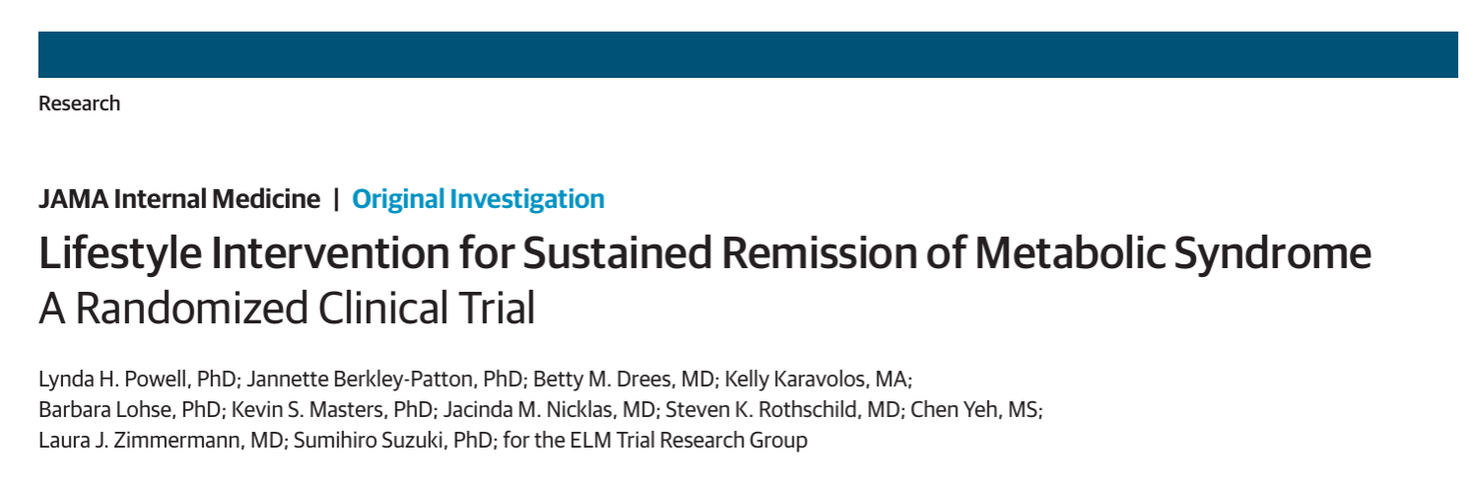
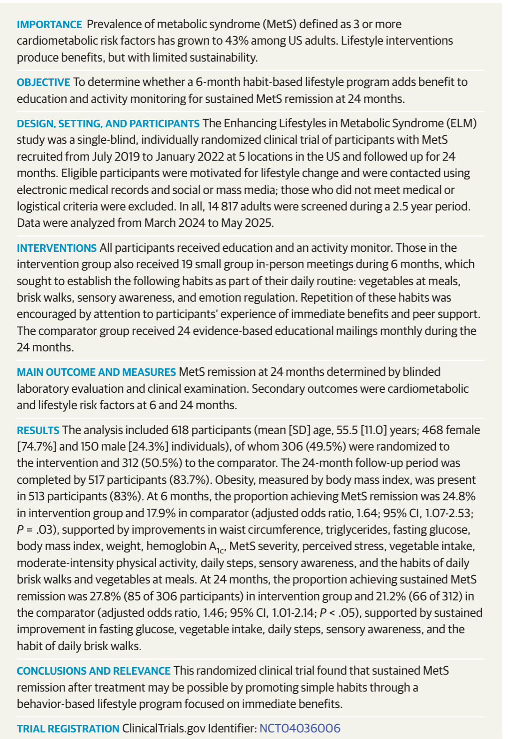
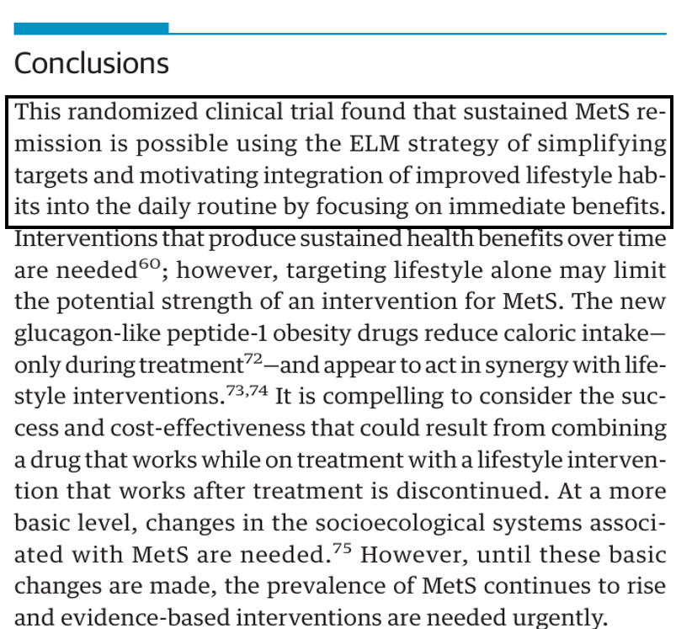
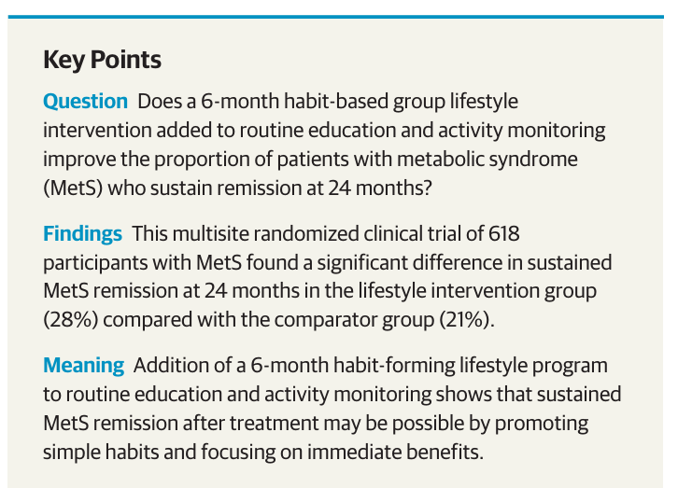
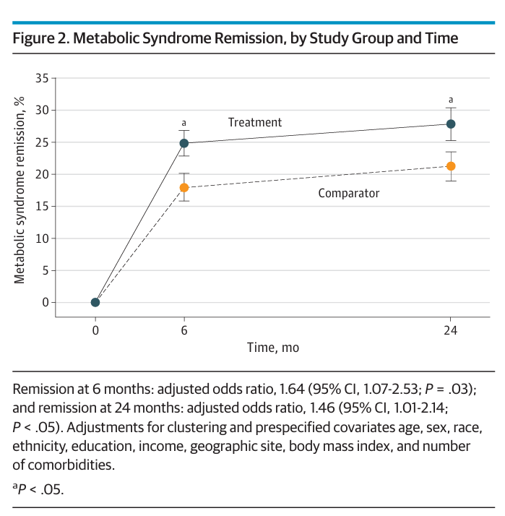
JAMAInternMed.2026;186(1):67-77. doi:10.1001/jamainternmed.2025.5900
Remission MetS:
- 6M: 25% VS 18%
- 24M: 28% VS 21%
*
ELM - Elaboration Likelihood Model
Notes:
Elaboration Likelihood Model (ELM)

Slide 28
Key Elements of Successful Lifestyle Trials
Multidomain Approach: Integrating Diet + Exercise + Behavioural Counselling.
Duration & Intensity: Weekly or highly consistent training for at least 6 months often provides the best results, with sustained weight loss plateau usually occurring at 6 months.
Community-Based Delivery: Using community health workers can make programs for, such as the LIFT Diabetes study, more accessible.

Slide 29
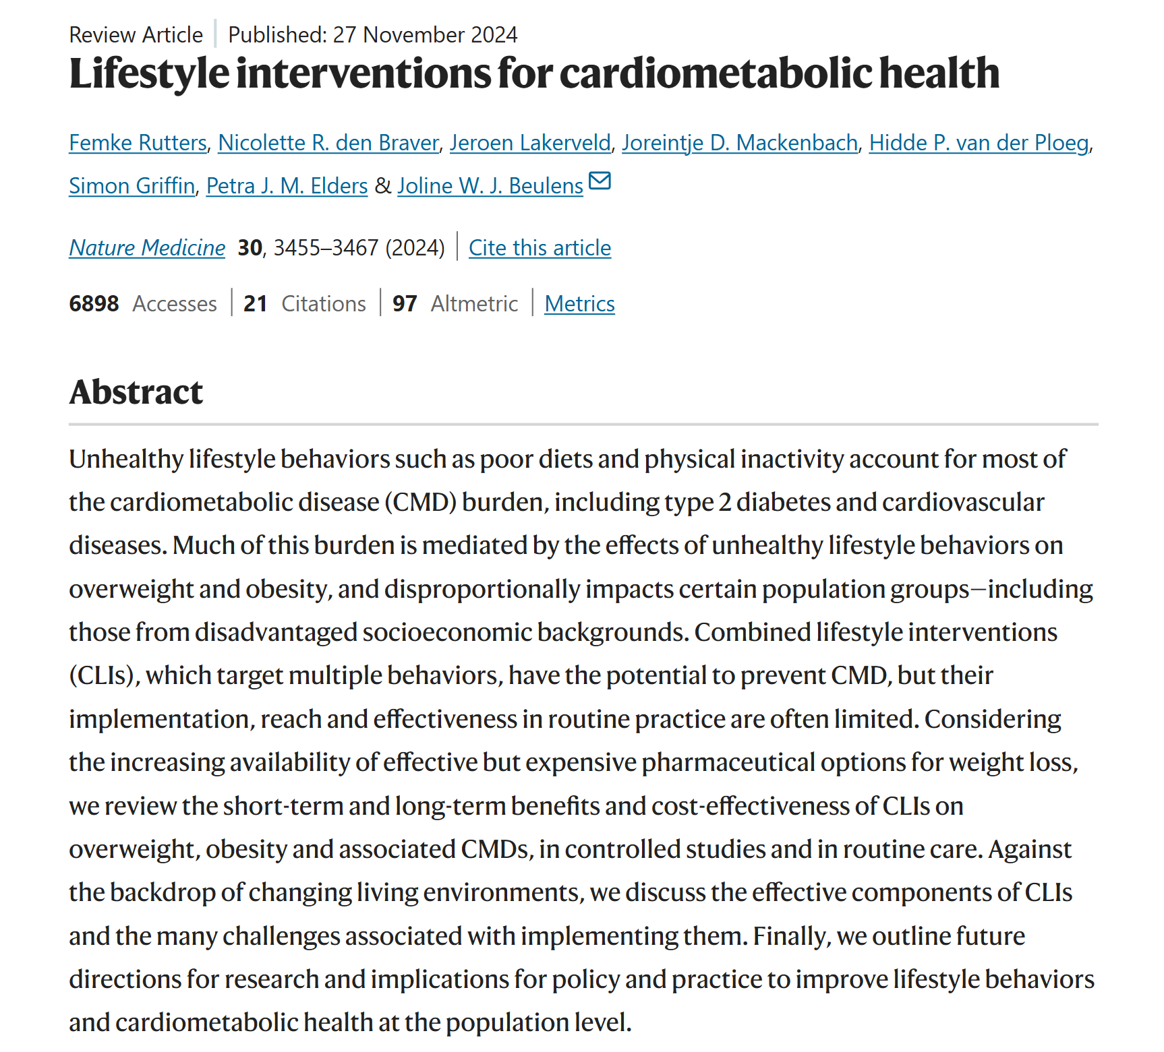
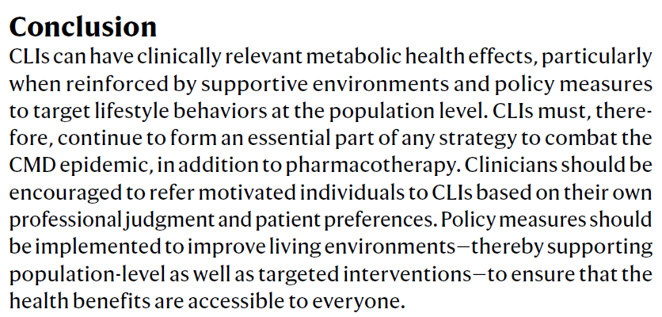

Slide 30
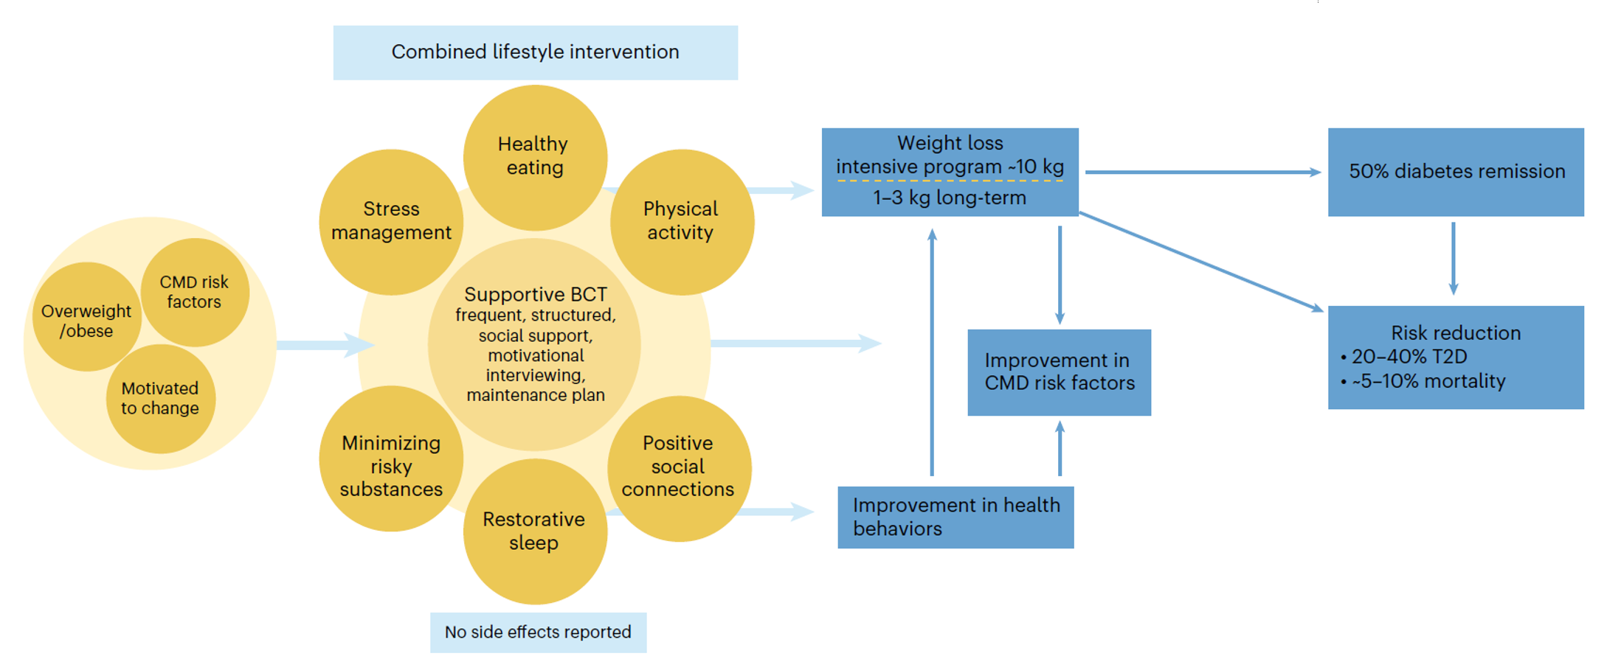
Individual Combined Lifestyle Intervention (CLI)
Components of CLIs and their effects on cardiometabolic health
Rutters F, et al. Lifestyle interventions for cardiometabolic health. Nat Med. 2024 Dec;30(12):3455-3467

Slide 31
Implementation and cost-effectiveness of CLIs
Based on the promising effects of CLIs on T2-DM risk in some RCTs, other studies were performed to implement and evaluate the effects of CLIs in routine practice.
A meta-analysis (25 RCTs and other studies), showed approximately 33-50% of the effectiveness reported in the original RCTs.
Overall, there is a scarce evidence of cost-effectiveness of CLIs in routine practice. Long-term evaluations or modelling studies are needed to compare cost-effectiveness of CLIs with usual care and other treatment options such as medication and surgery.
Dunkley, A. J. et al. Diabetes Care 37, 922–933 (2014).
Galaviz, K. I. et al. Diabetes Care 41, 1526–1534 (2018).

Slide 32
Why are CLIs less effective in routine practice?
There is only limited evidence to explain the reduced effectiveness of CLIs in routine practice compared with controlled research settings. Reasons for less effectiness in practice:
Selection of participants included in RCTs versus those referred in clinical practice.
Reduced adherence to the intervention or deviations from the intervention content.
Implementation challenges.
Physiological mechanisms might reduce long-term effectiveness.
Wareham, N. J. Lancet Diabetes Endocrinol. 3, 160–161 (2015); Aziz, Z., et al. Implement. Sci. 10, 172 (2015); Deslippe, A. L. et al. Int. J. Behav. Nutr. Phys. Act. 20, 14 (2023); Ali, M. K., et al. Health Aff. 31, 67–75 (2012); Pronk, N. P., et al. Ann. Intern. Med. 163,465–468 (2015); Dunbar, J. A. Diabetes prevention in Australia: 10 years results and experience. Diabetes Metab. J. 41, 160–167 (2017); Machado, A. M. et al. Clin. Nutr. ESPEN 49, 138–153 (2022); van Baak, M. A. & Mariman, E. C. M. Nat. Rev. Endocrinol. 19, 655–670 (2023).

Slide 33
Implementation of Prevention at Individual level
Approaches
Health education
Goal setting
Self-monitoring (apps)
Counselling and coaching
Digital health interventions
Examples
Fitness tracking apps
Personalized diet plans
Online health programs
Combined Lifestyle Interventions

Slide 34
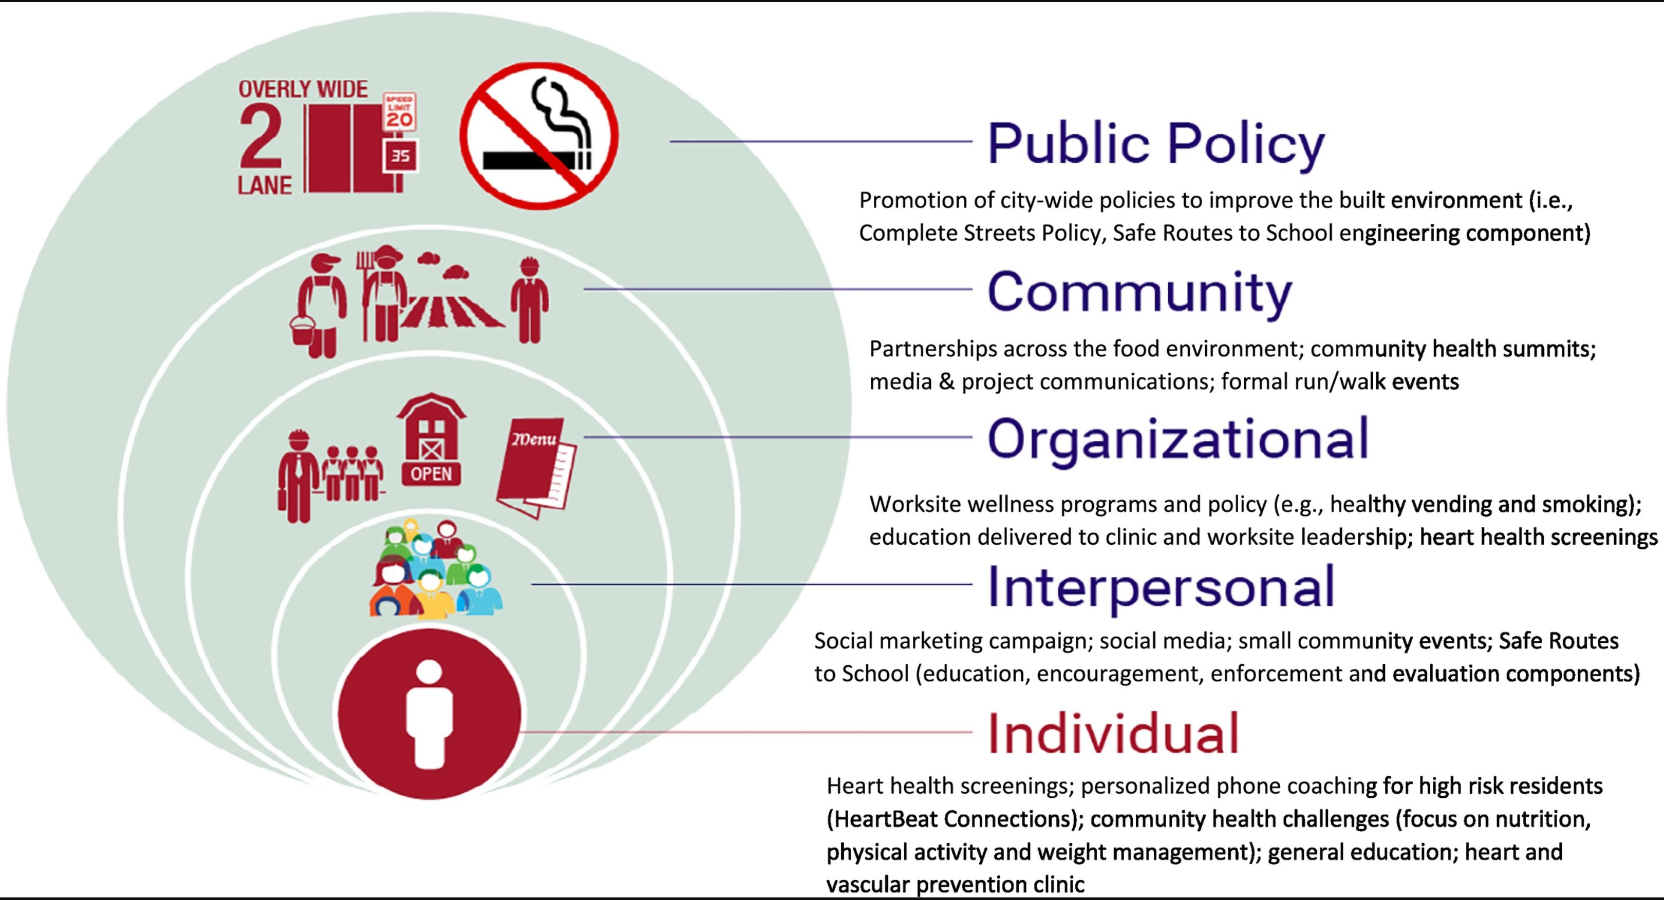
Heart of New Ulm (HONU) Interventions
It focuses on transforming the community environment and individual lifestyles to reduce heart attack
Gretchen Benson, Abbey C. Sidebottom, Arthur Sillah, David M. Vock, Marc C. Vacquier, Michael D. Miedema, Jeffrey J. VanWormer,Population-level changes in lifestyle risk factors for cardiovascular disease in the Heart of New Ulm Project, Preventive Medicine Reports 2019; Volume 13, Pages 332-340, ISSN 2211-3355, https://doi.org/10.1016/j.pmedr.2019.01.018.

Slide 35
Cardiometabolic Risk and Lifestyle Behaviours
Challenges in Prevention Implementation
Implementation of Preventive Strategies
Implementation of Preventive Strategies at Populational level
Implementation of Preventive Strategies at Individual level
Future Directions and Key Messages

Slide 36
Future Directions
Improving Global Prevention
Key strategies
Digital health technologies
Community-based programs
Combined Individual Interventions
Combined Policy Interventions
Cross-sector collaboration
Focus on
Early prevention
Health equity
Sustainable health systems
Quality Research involving all determinants of CM risk
Advocacy for prevention

Slide 37
Key Messages
Lifestyle modification is undoubtedly a cornerstone of CMD prevention: the highest priority should be given to healthy lifestyle implementation and adherence for the general population and for high-risk individuals to reduce the burden of CMD.
Individual combined lifestyle behavioural changes are essential but insufficient alone; population-level policies are critical for large-scale impact; combined individual + policy approach offers the best results.
Education and awareness on CMD Risk need to be increased, with centered communication and shared decision-making for motivation and commitment to effective lifestyle interventions adherence.
Multi and transdisciplinary involvement of all the actors in prevention is needed: physicians, other healthcare professionals, politicians, pharmacists, teachers, researchers, media experts, marketing professionals…

Slide 38


Prevention through healthy lifestyles is one of the most powerful tools for improving global health, including CMD.

