Slide 1



Sustainable Healthcare Systems & Carbon-Intensive Cardiology
A Singapore Perspective
Jeffrey Lau, M.D., Ph.D., FACC, FAMS
Institutional Sustainability Officer, National Heart Centre Singapore
Sernior Cardiologist, National Heart Centre Singapore
Pro-tem Head of Department, Eastern General Hospital
World’s Best Specialised Hospital for 7 years!
June 16, 2026

Slide 2
Declaration of Interest
Medical advisor and investor — Medclarity
Did not receive honorarium

Slide 3
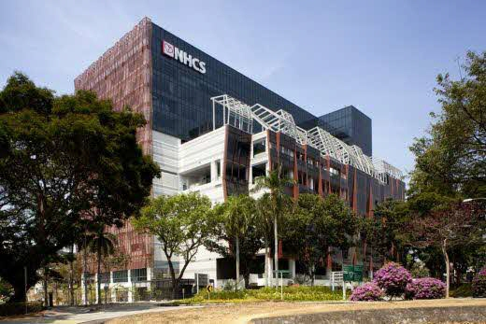

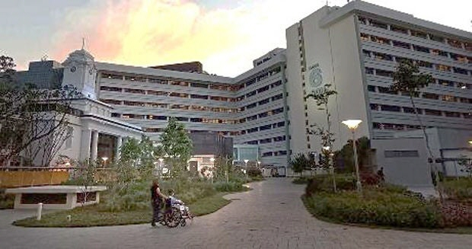


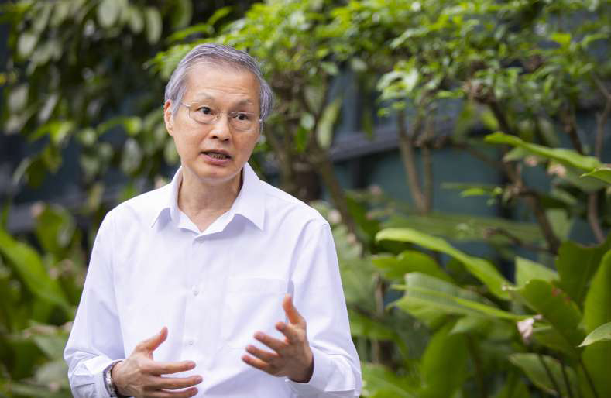

National Heart Centre Singapore (NHCS)
Largest cardiac specialty center in Singapore
Services ~50% of Singapore’s five million population
Part of the Singhealth cluster
Committee of Sustainability since 2024
NHCS, Singhealth .
Singapore General Hospital, Singhealth
Prof Yeo Khung Keong, CEO
Prof Terrance Chua
Prof Koh Tian Hai
Prof Jack Tan

Slide 4
NHCS Was Built With Sustainability In Mind
Purposefully built in 2013 for environmental sustainability
Heat-deflecting building scaffolds
Rain-harvesting fixtures
Regenerative lifts which generate energy when moving
Air corridor to reduce solar heat
Energy-efficient air-conditioning
BCA Green Mark Platinum Award 2012
Prof Koh Tian Hai

Slide 5

Eastern General Hospital (EGH) Sustainable Designs
In construction, planned opening in 2029
Biophilic designs for function
“Phygital” (physical + digital) integration
Natural therapeutic spaces via partnership with national park (Mandai X)
Minimum carbon footprint construction (Obayashi-Santarli Joint Venture)
Future-proof, pandemic-ready design
BCA Green Mark certification
Easten General Hospital, Est. 2029 Completion

Slide 6
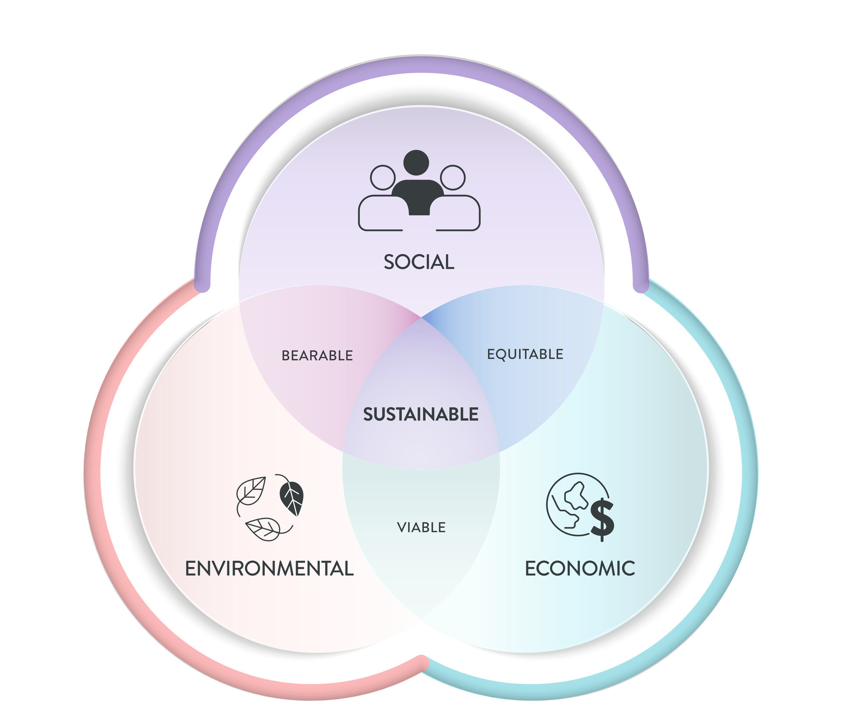
Healthcare Sustainability is a Pressing Issue In Singapore
92% of Healthcare workers reports stressed at work³
AHP’s amongst most vulnerable to burnout
Singapore Healthcare GHG emission at 7%¹
(Global average ~ 4.4%)
Healthcare expenditure outpaces GDP
Projected to nearly triple from $22 billion in 2018 to $59 billion by 2030²
Sources: ¹greengov.sg; ²moh.gov.sg; ³Tan et al., Ann Acad Med Singap (2022); static.vecteezy.com;

Slide 7
Three Key Messages
“Whole-of-System” Approach
Sustainability as a value-driver, not cost center
Embedding sustainability into culture and everyday life

Slide 8
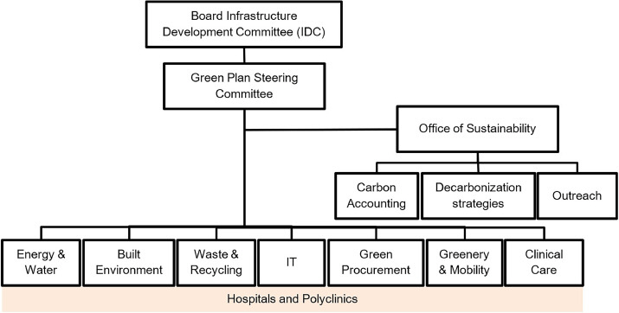
1. A “Whole-Of-System” Approach to Healthcare Sustainability
Dedidated office
Structured governance
Accountability
Management
Internal capability to decarbonize healthcare
National Univeristy Hospital System Sustainability Governance Chart
Lum et al., J Clim Chang Health (2025)

Slide 9
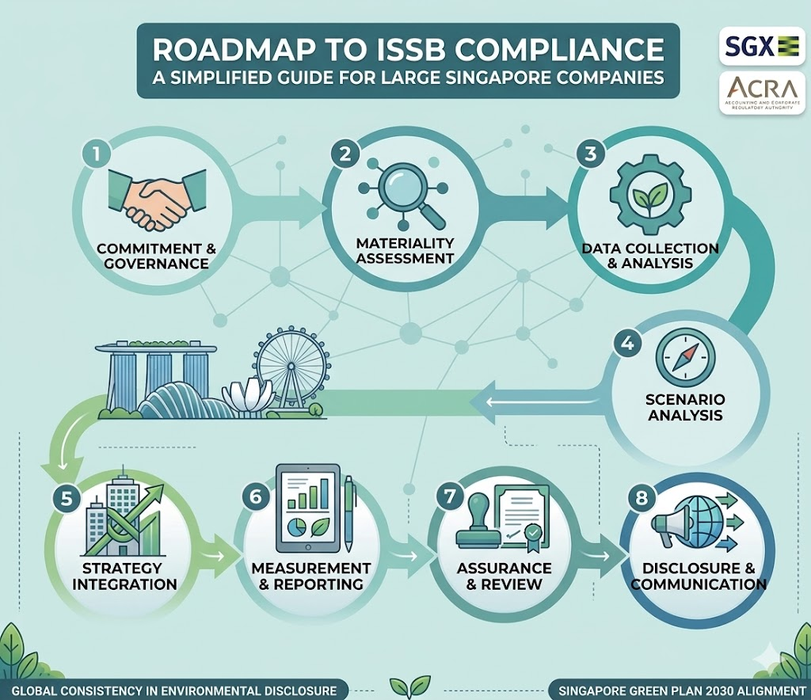
Singapore Government as Enabler in Public Hospital Green Transformation
“Sticks”
Mandate for ISSB reporting
Mandate for energy, water, and waste improvements
Carbox tax
“Carrots”
Various grants available

Slide 10
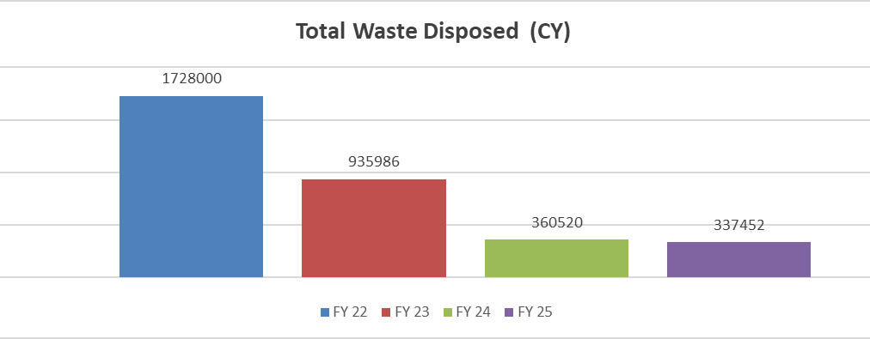
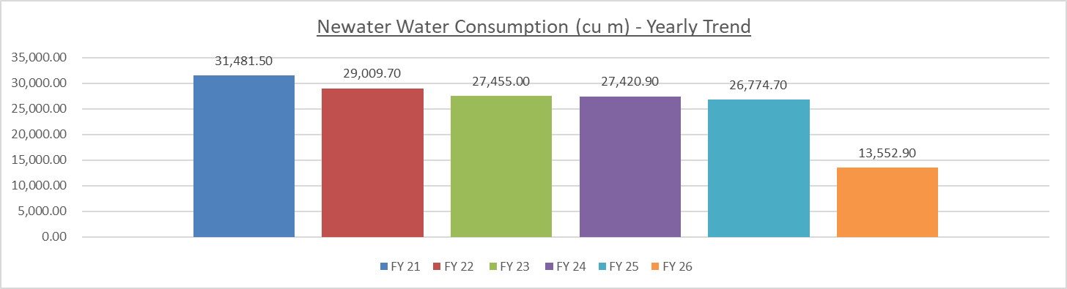
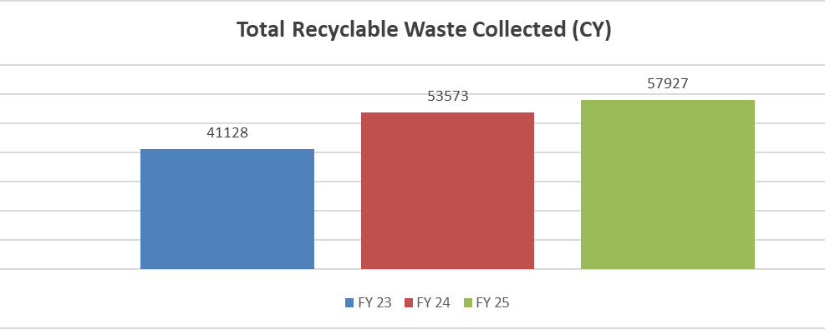
NHCS Sustainability Improvements
Electricity Consumption (KWH)
Total Waste Disposed (CY)
Newater Water Consumption (cu m)
Total Recyclable Waste Collected (CY)
Paper Metal Plastic Glass

Slide 11


2. Sustainability as a Value-driver, not Cost Center
Many of the changes we implemented were also financially beneficial
Some Examples:
Elimination of desflurane gas
Replacement with energy-saving LEDs
Installation of solar panels
Paper-less patient journey
Adjusting ambient temp to 25ᵒC

Slide 12

2. Sustainability as a Value-driver, not Cost Center
Creation of QVAL Workgroup
Quality
Value
Appropriateness
Learning System
Evidence-based improvement of work processes
Examples:
  Chest Pain protocol eliminates unnecessary testing in low pre-test probability patients
QVAL
Testing modality | Protocol (N=353) | Usual Practice (N=371)
Stress echo | 43 (12.2%) | 153 (41.2%)
MIBI | 9 (2.5%) | 35 (9.4%)
CTCA | 13 (3.7%) | 39 (10.5%)
CT calcium | 13 (3.7%) | 18 (4.9%)
Dr. James Cai

Slide 13









3. Fostering the Culture of Sustainability
Generates buy-in from all segments of workforce
Doctor
Finance
Nurse
Recent cluster-wide survey (n=7268) reveals areas for improvements
Procurement
Patient
AHP
STRENGTHS
Good Awareness
Personal practice
WEAKNESSES
Knowledge gap on initiatives
Human Resource
Nursing
Surgeon
OPPORTUNITIES
Teleconsultation
Interest in green initiatives
THREATS
Device waste complex to recycle
Heavey workload limits behaviour change
SWOT Analysis for NHCS

Slide 14



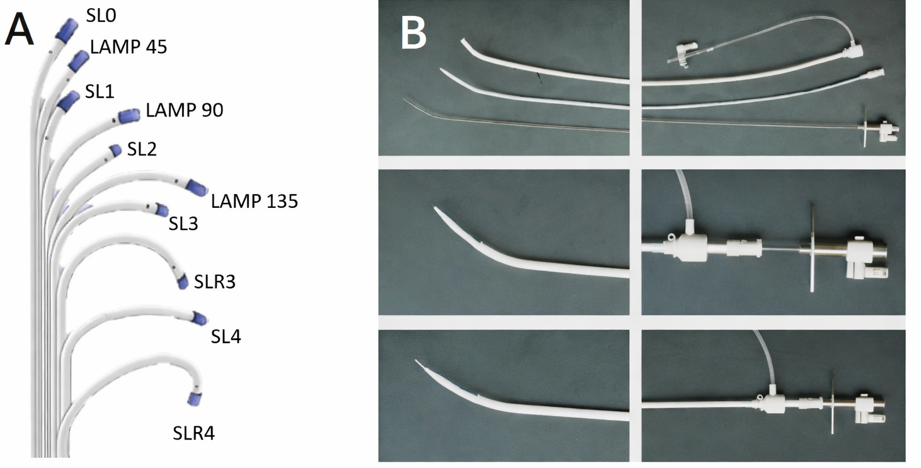
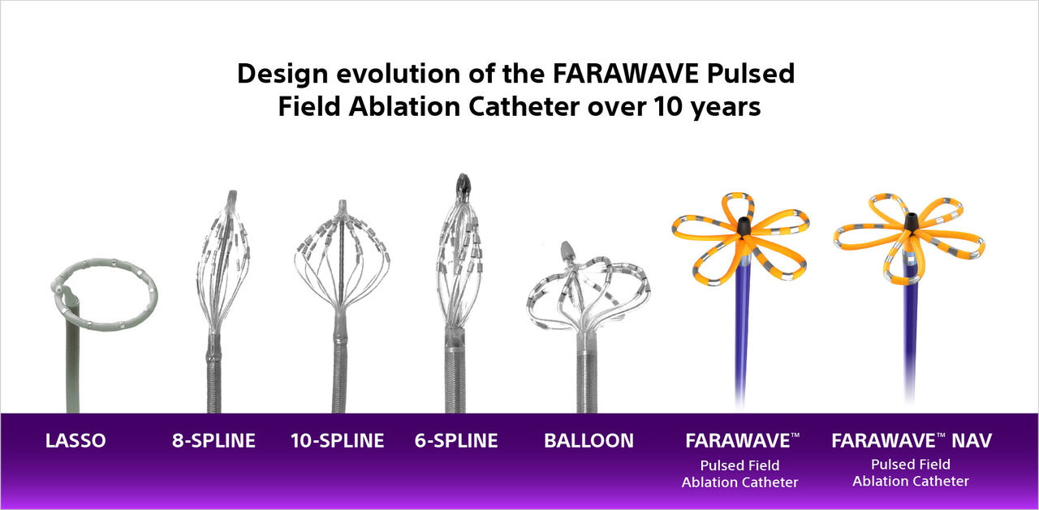
Catheter Recycling Programme in NHCS
Nursing-led Initiative
  Environmental Impact:
  40,000 kg CO₂e /kg for platinum production, vs 1,500 to 3,500 kg kg CO₂e /kg secondary platinum recovery
  ~95% reduction in carbon emission
Sister Ng SP
  Financial Benefit:
  Financial savings from rare metal recovery and cost avoidance for waste disposal

Slide 15
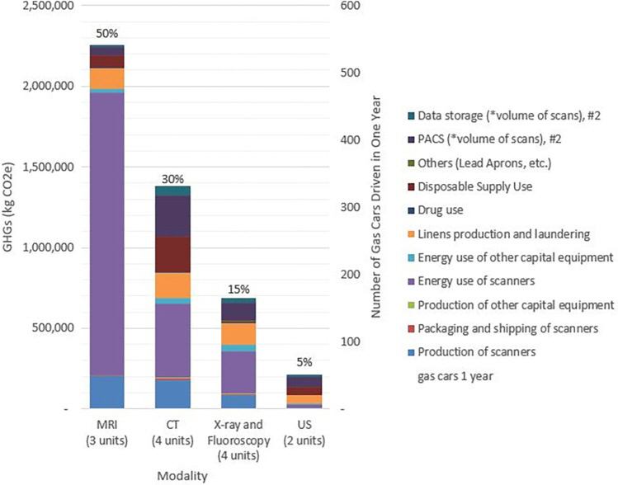
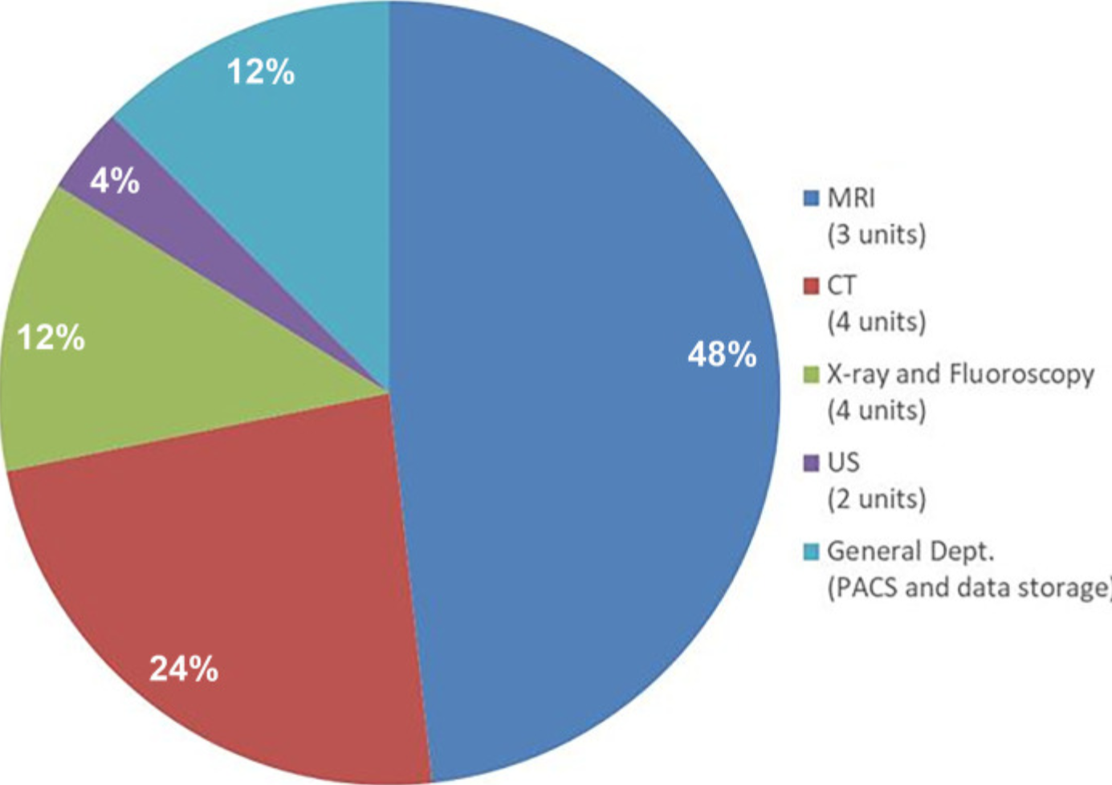
Life Cycle Analysis (LCA) in Cardiovascular Imaging
Thiel et al., Radiology (2024)
Thiel et al., Radiology (2024)

Slide 16
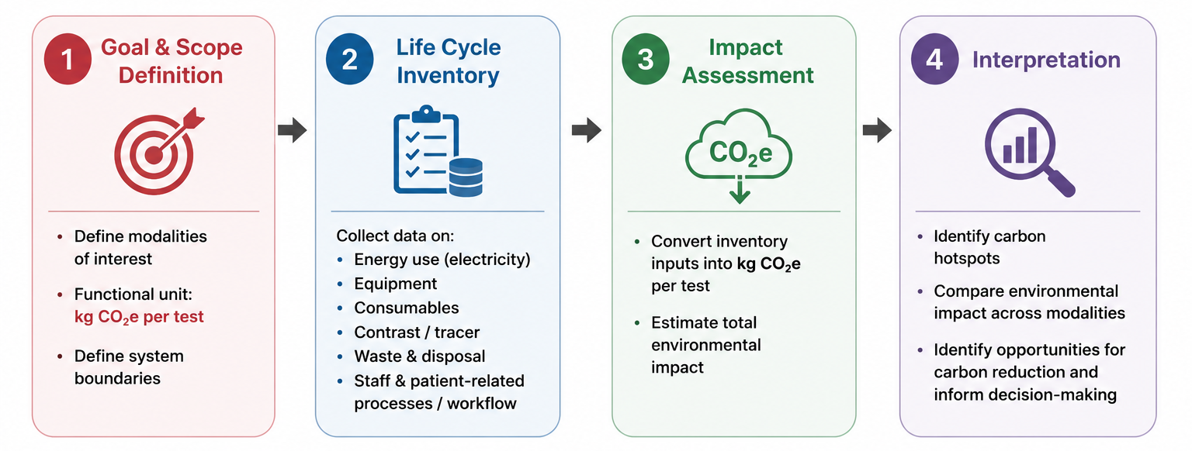


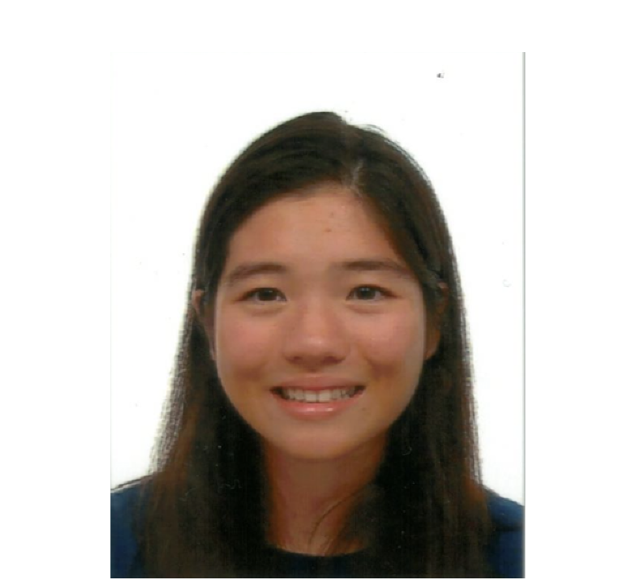






Life Cycle Analysis (LCA) Project in NHCS
Identify areas for improvement
Engaging trainees
Promote sustainability-related projects
LCA Analaysis at NHCS

Slide 17

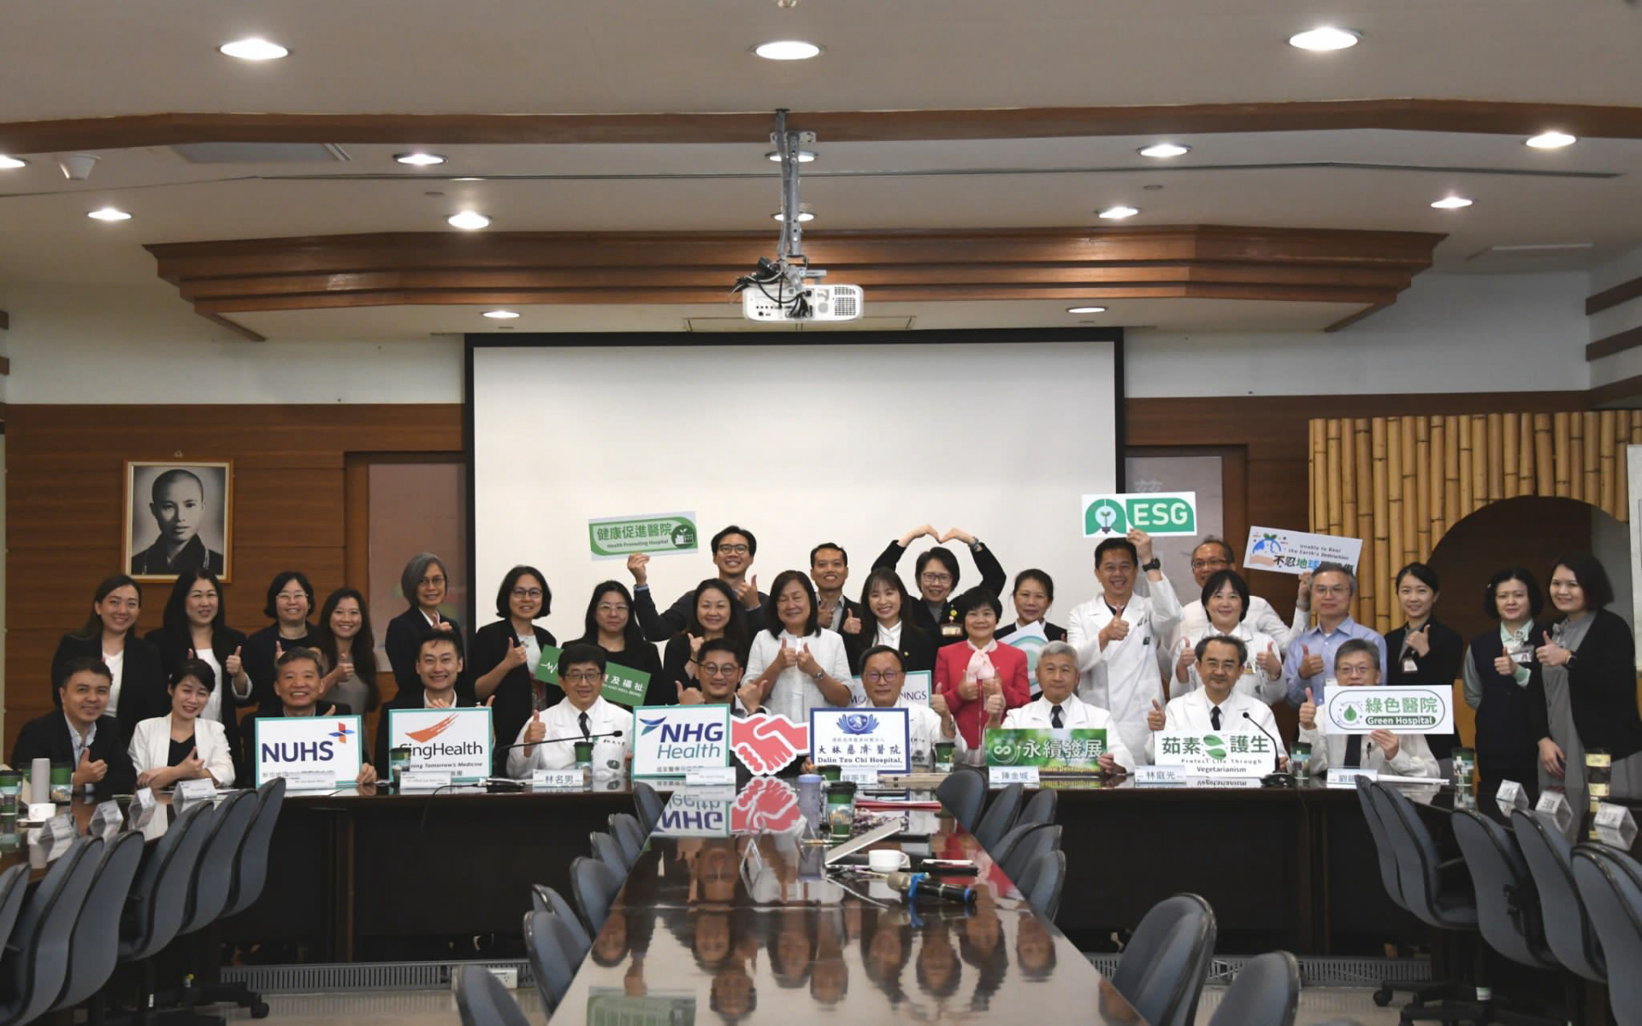
Culture Building, One Step at a Time
Culture-building and Engagement of the wider Singhealth community
Connection with other public hospital clusters
Connection with regional health systems

Slide 18

Local Engagement and Beyond
Aim to engage the Singapore Cardiac Society to create a lecture series on sustainability-related topics
If you’re kind enough to offer your expertise in future webinars, please reach out to us

Slide 19

Image copyright from quotefancy

Slide 20



Thank you
For more information on NHCS
Web: www.nhcs.com.sg
Disclaimer: Contents including images and charts used are properties of the respective copyright owners and are meant for educational purposes only.

Slide 21

For more information on NHCS
Web: www.nhcs.com.sg
General Appointment Line
6704 2000
Email: central.appt@nhcs.com.sg
Operating Hours
Mon - Fri: 8.30 am – 5.00 pm
Scan here to make an appointment:
for.sg/nhcs-appointmentform

