Slide 1
Global and precision risk prediction along life cycle: biomarkers, imaging, omics and machine learning
Professor Emanuele Di Angelantonio, FMedSci
ESC Cardiovascular Round Table 18th March 2026

Slide 2
Why do we need cardiovascular risk assessment?
To estimate, communicate, and monitor risk
Motivate adherence to lifestyle changes or therapies
Allocate preventive resources efficiently and target prevention strategies

Slide 3
Clinical guidelines on cardiovascular disease prevention
Guidelines recommend use of a risk score to predict a patient’s risk of having a CVD event over the subsequent 10 years
Resulting risk predictions influence treatment decisions e.g. prescription of statins to lower cholesterol
Risk models traditionally include: age, sex, blood pressure, smoking, lipids measurements, and diabetes status

Slide 4
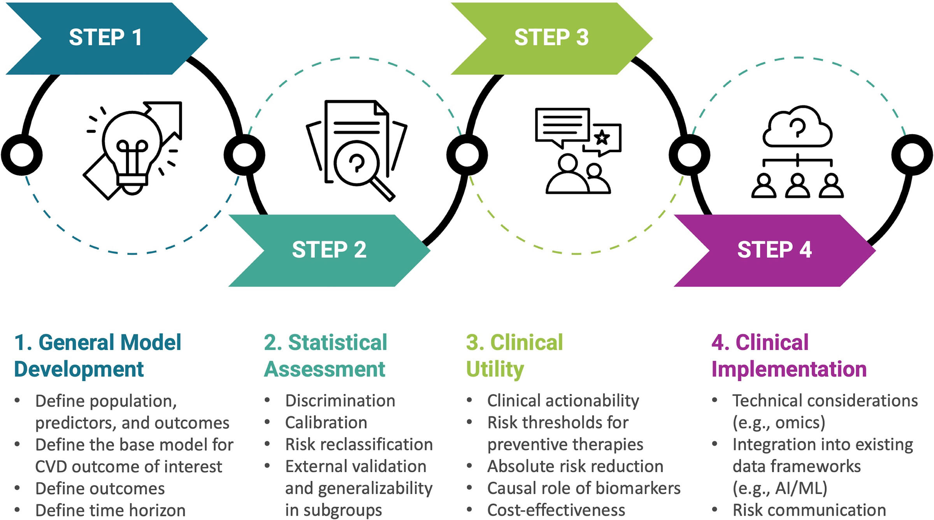
Key steps for evaluating CVD risk prediction models
Khan S. Circulation 2026

Slide 5
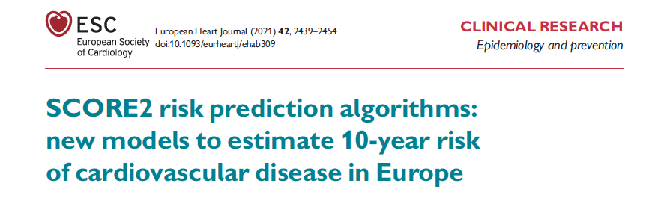
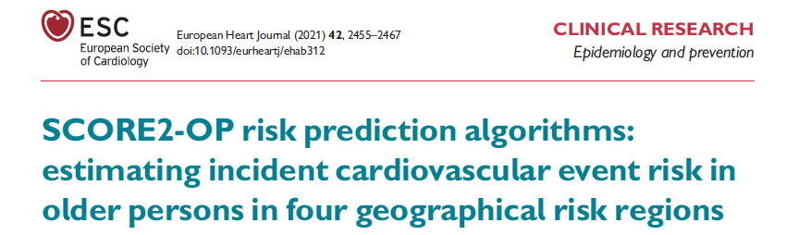
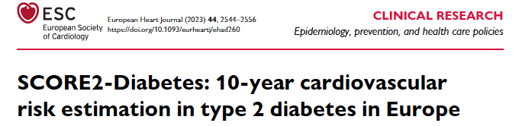
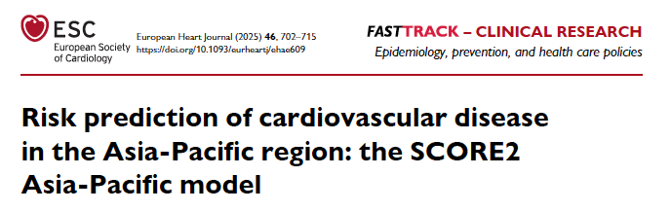
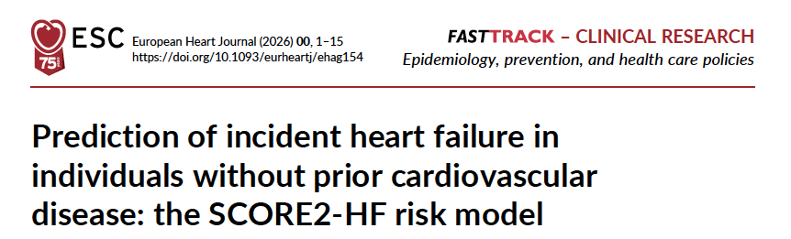
Current ESC CVD risk prediction tools

Slide 6
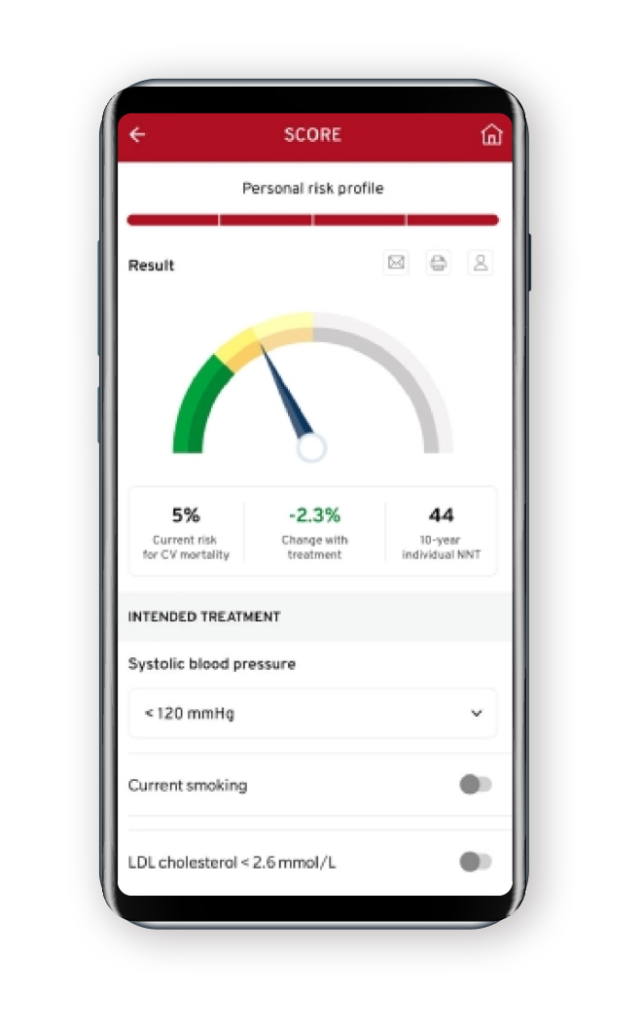

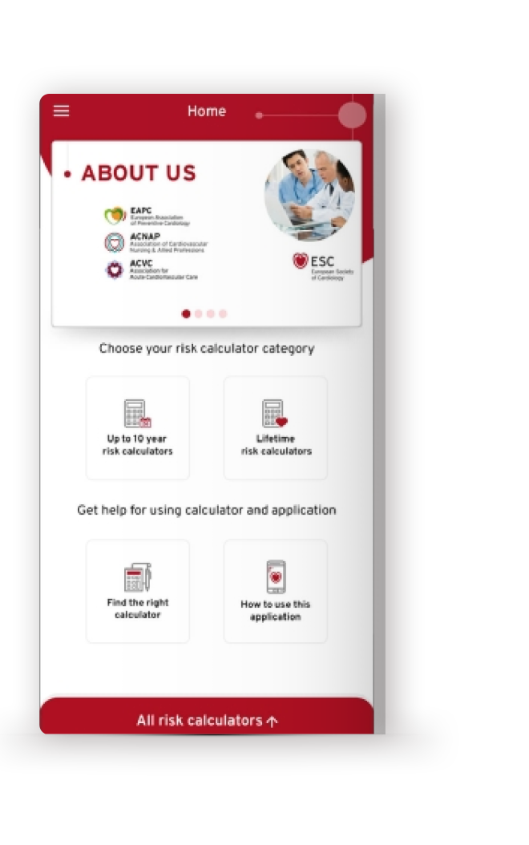
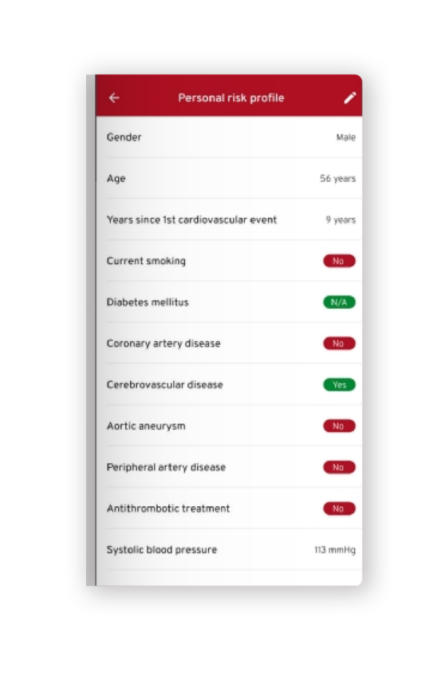

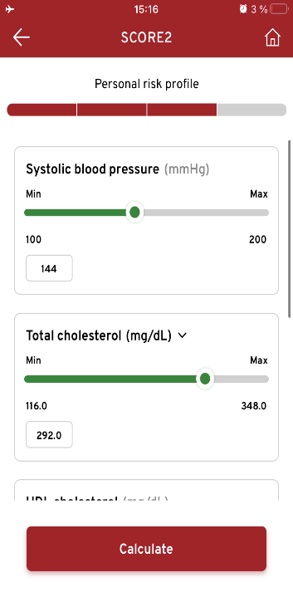
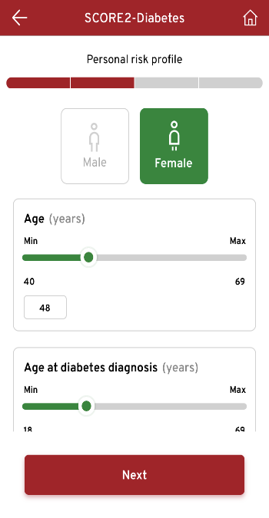



ESC CVD Risk Calculation Mobile App
Includes primary and secondary prevention risk calculators:
SCORE2
SCORE2-OP
SCORE2-Diabetes
ASCVD
SMART
SMART-REACH*
DIAL*
LIFE-CVD*

Slide 7
Can we improve cardiovascular risk prediction?
Clinical biomarkers and ‘omics
Imaging
AI and machine learning

Slide 8
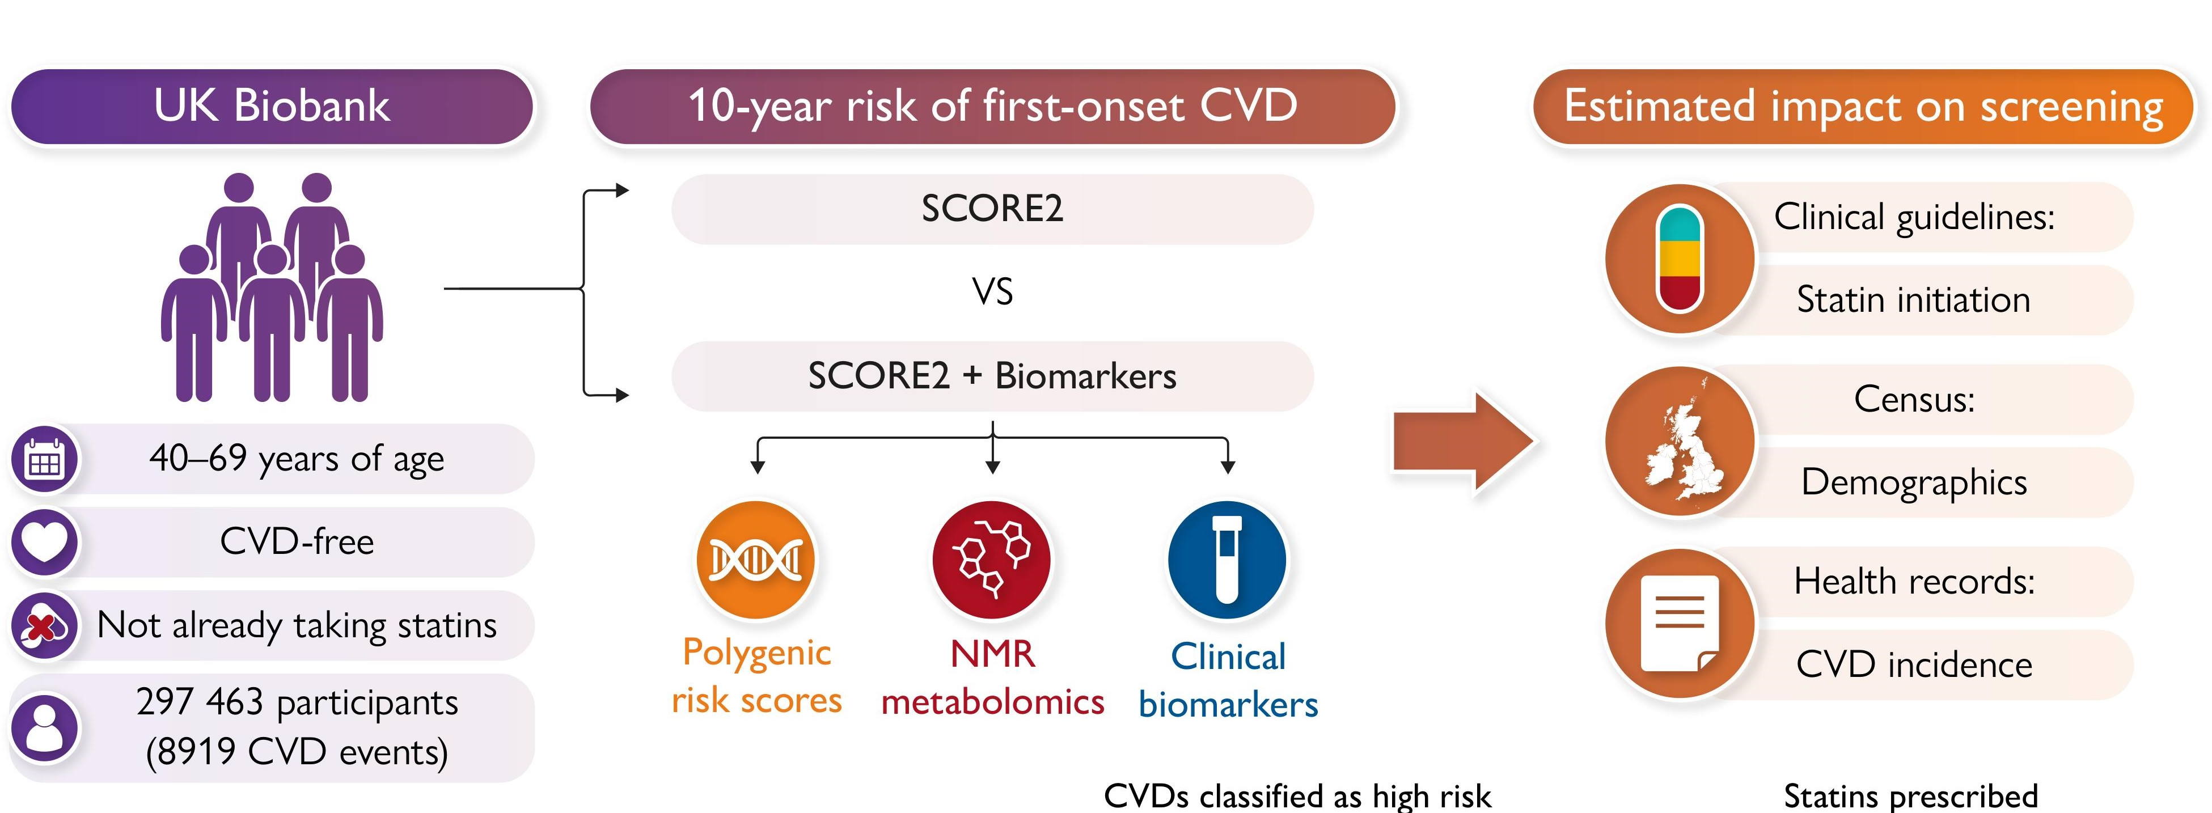
What is the value of additional biomarkers?
Ritchie SC. EHJ 2025

Slide 9
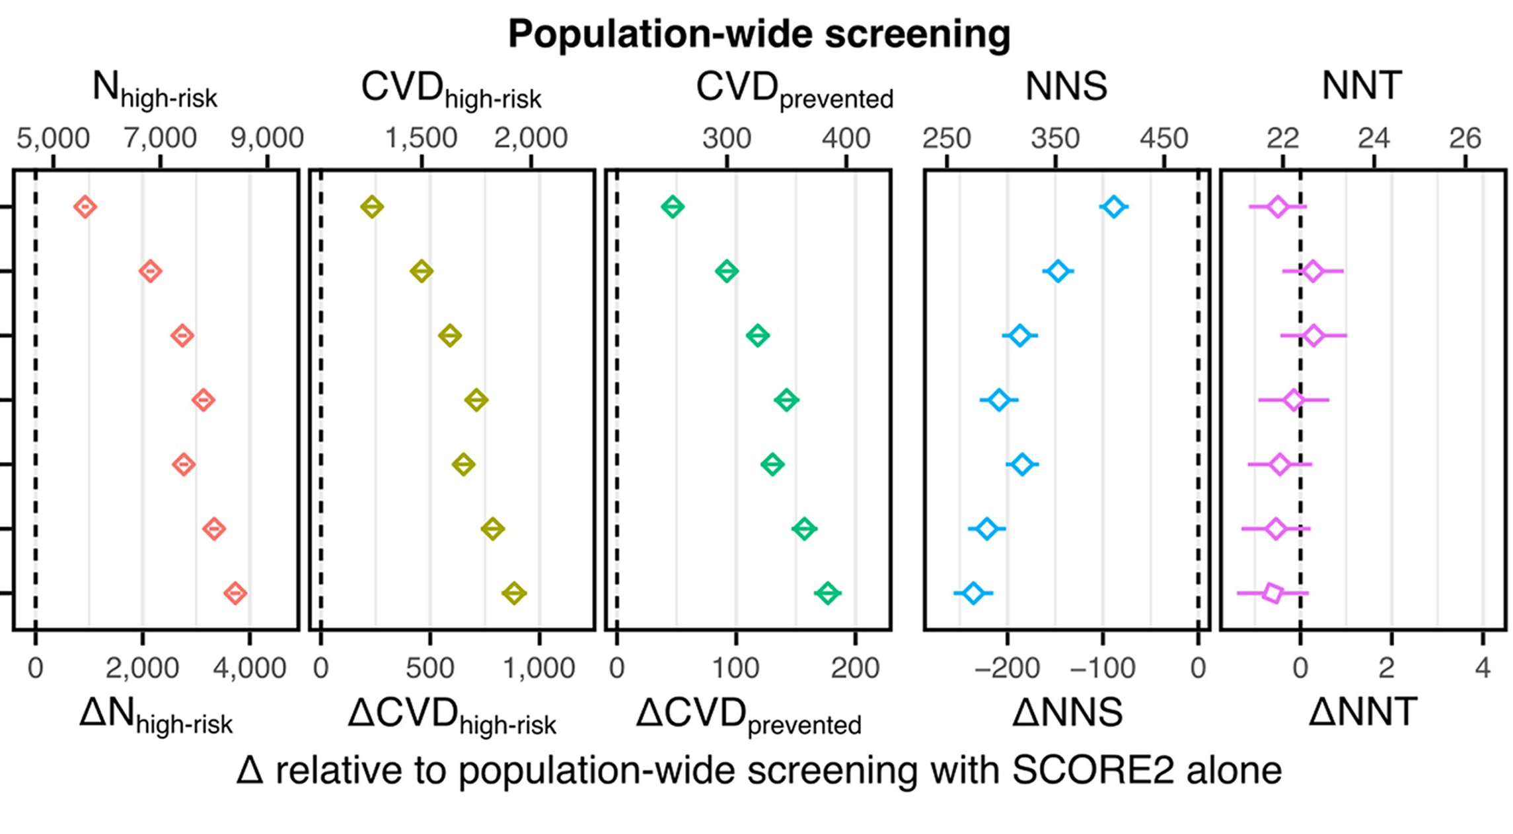
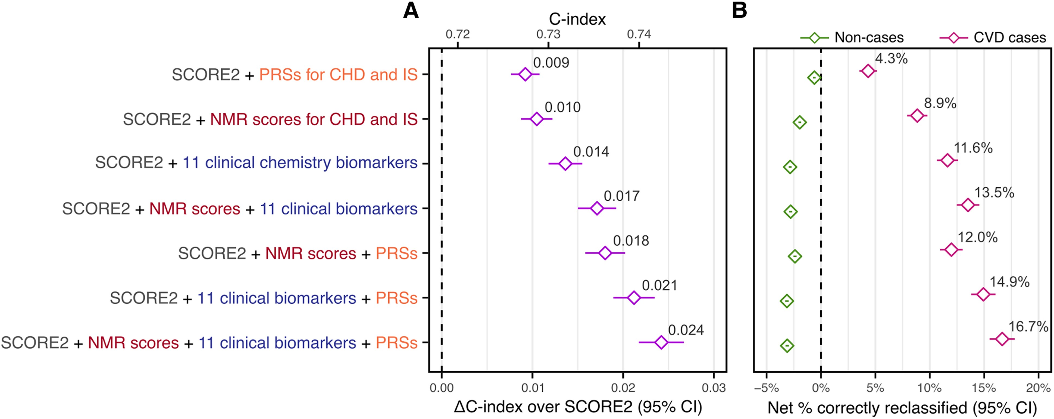
What is the value of biomarkers, PRS, and metabolomics?
Additional biomarkers may provide benefits if applied at population level
Risk discrimination and reclassification
Ritchie SC. EHJ 2025

Slide 10
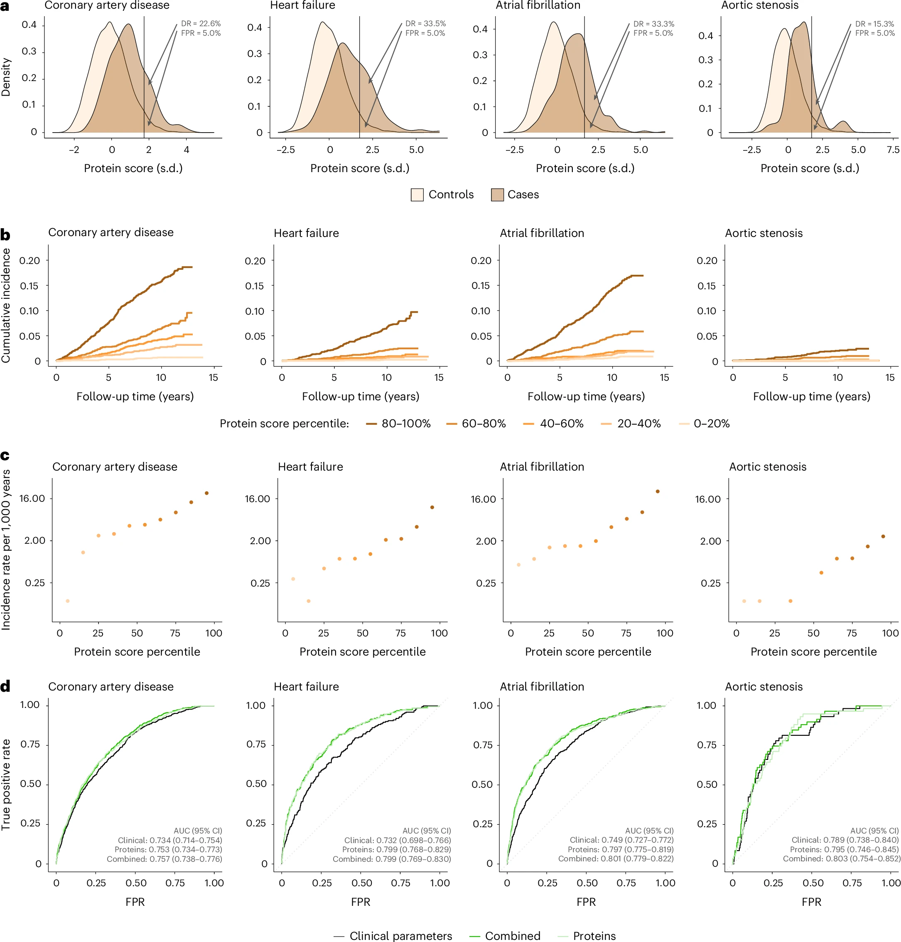
Proteomic prediction of common cardiac diseases
Improvement in predictive performance by adding proteins information
Coronary heart disease
Heart failure
Schuermans A, Nat Cardiovasc Res 2024

Slide 11
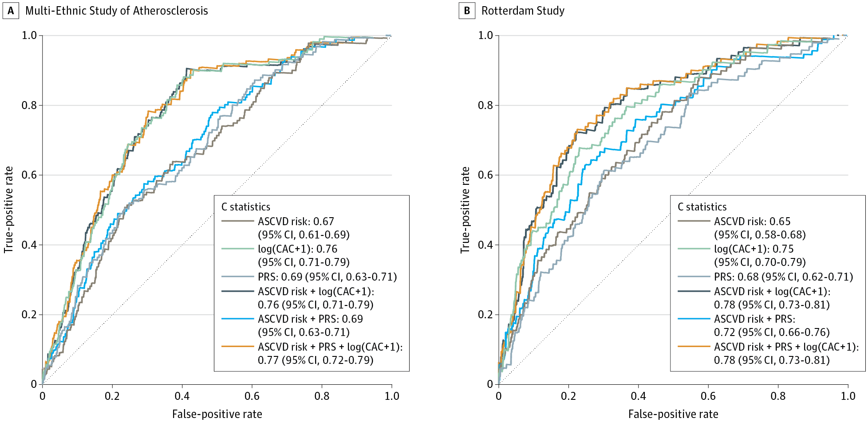
Do imaging data add useful information?
Coronary Artery Calcium Score and PRS for CHD prediction
Khan SS et al, JAMA 2023

Slide 12
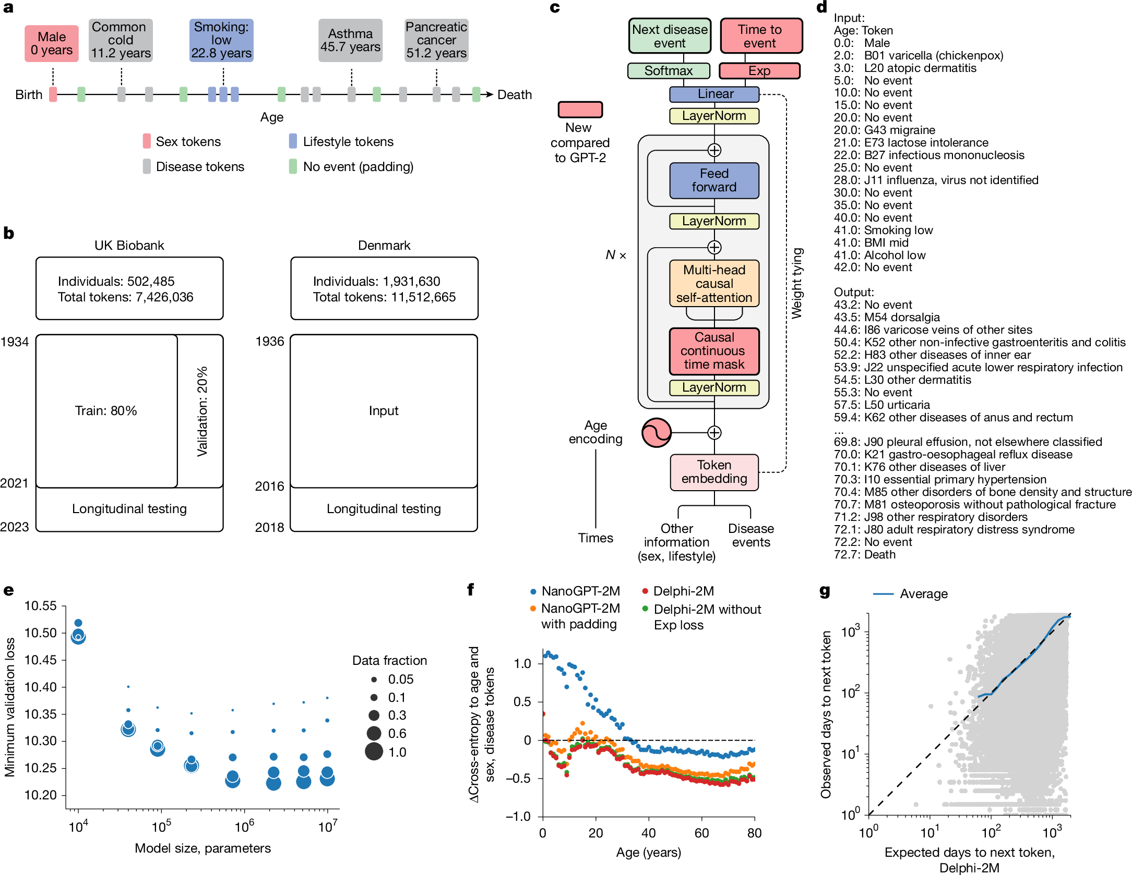
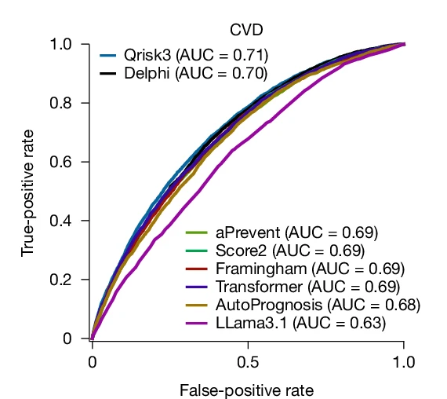
Can we leverage novel analytical approaches?
Delphi, a modified GPT architecture, models health trajectories
Shmatko A, Nature 2025

Slide 13

Can we integrate all these different features together?
Single (core) model estimating risk over any time frame (e.g., 10y and lifetime)
Recalibration to country-specific level
Treatment benefit estimation
Add-on tools for key risk enhancers
(e.g., Lp(a), renal function, genetic - and standardise the methods for future add-ons)
Estimation of each component as well as the total CVD risk

Slide 14
Summary
Current ESC CVD risk prediction tools provide a robust and pragmatic foundation for population-level risk assessment
These tools remain largely based on conventional risk factors, which provide only moderate discrimination particularly in younger individuals and those at intermediate risk.
Addition of clinical biomarkers, ‘omics, and imaging may enhance risk prediction, but current evidence is largely observational and lacks clear generalisability for routine implementation.
Artificial intelligence offers the potential to integrate complex, high-dimensional data and refine individual risk estimation, although its incremental clinical value and real-world applicability remain to be fully established.

