Slide 1
Shared pathophysiology for diverse clinical presentations: inflammation, adipose tissue biology, insulin resistance
Maria Marketou, MD, PhD, FESC
Associate Professor of Cardiology
University of Crete, School of Medicine, Heraklion, Crete
18/3/2026

Slide 2
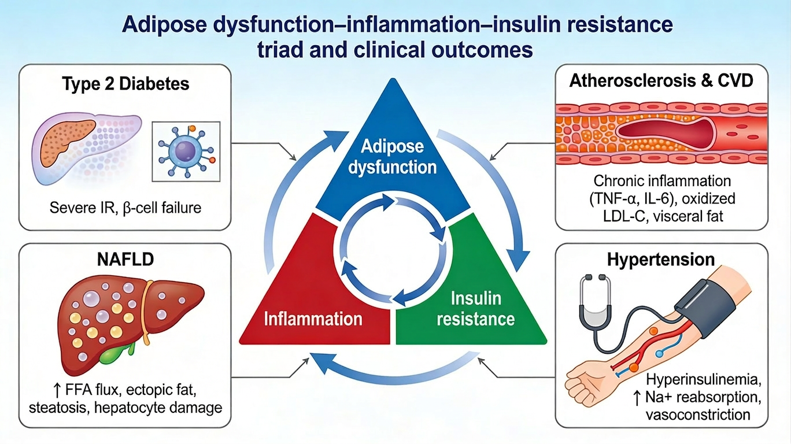
Cardiometabolic disease: a single, systemic, pro-inflammatory, insulin-resistant state

Slide 3
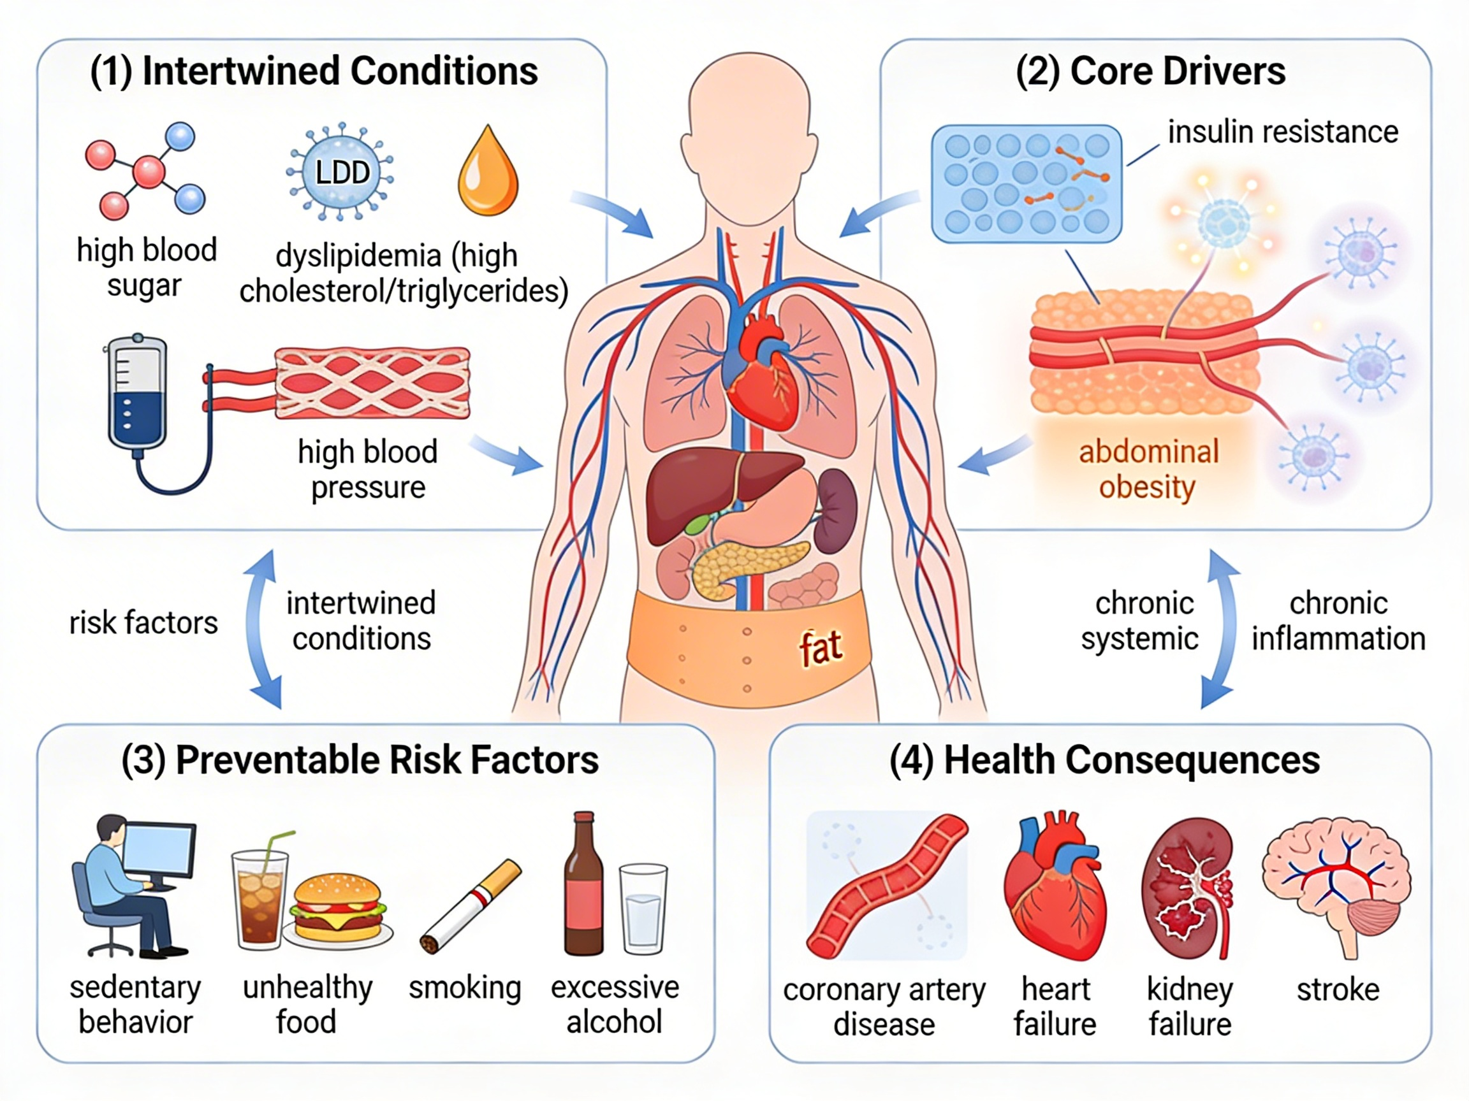
Cardiometabolic Disease: Interconnected Risks, Modifiable Drivers, and Long‑Term Organ Damage
dysfunction of endothelial cells
β-cells failure
parenchymal organs fibrosis

Slide 4
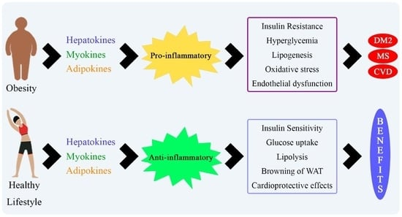
Inter-Organ Crosstalk: Hepatokines, Myokines, and Adipokines
Adipose, skeletal, and hepatic muscle tissues are the main endocrine organs that produce adipokines, myokines, and hepatokines.
Can be harmful or beneficial acting through the endocrine, paracrine, and autocrine pathways.
Lifestyle changes results in marked changes in the secretion profile of these substances
Int J Mol Sci 2021, 22(5), 2639

Slide 5
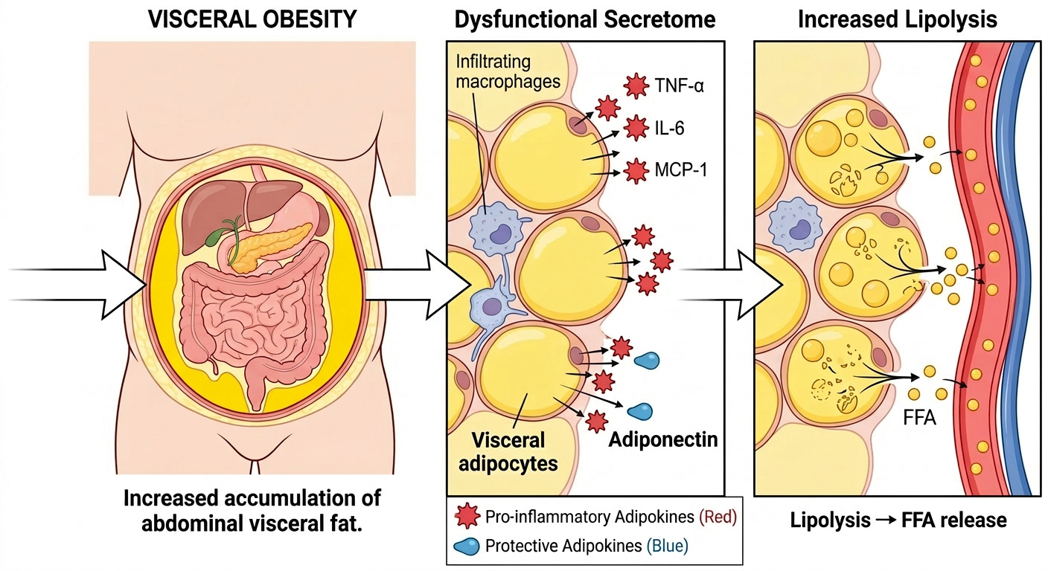
Adipose tissue dysfunction: The Epicenter
Adipocyte Hypertrophy:
Energy intake exceeds storage capacity, adipocytes expand ➔ cellular stress ➔ hypoxia
Dysfunctional Expansion:
"fat spillover" ➔ ectopic lipid accumulation in the liver, skeletal muscle, and heart ➔ organ-specific insulin resistance
Adipokine Imbalance:
↓ adiponectin and ↑ pro-inflammatory adipokines such as leptin, resistin, and IL-6
Inherited defects in mitochondrial function and FFA oxidation?????

Slide 6
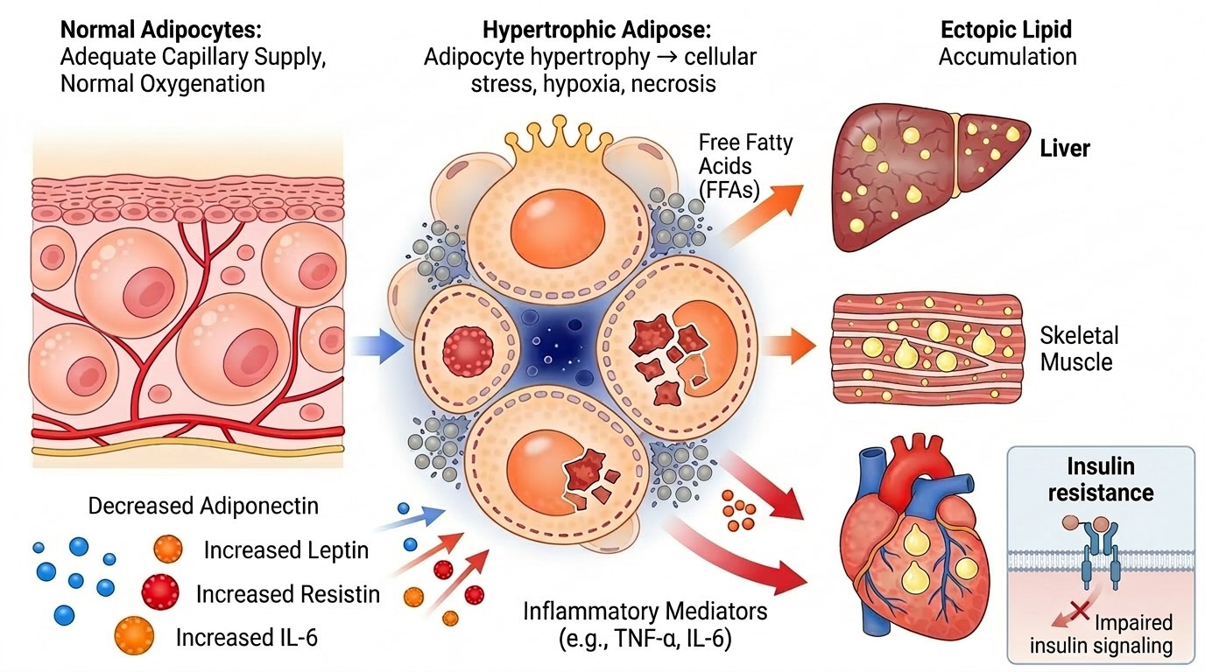
Dysfunctional adipose tissue: clinically manifest as impaired glucose tolerance or prediabetes
Ras-mitogen-
activated protein kinase (MAPK) pathway : control cell growth and differentiation
phosphatidylinositol
3-kinase (PI3K)-AK: glucose uptake, and other metabolic actions
IRS

Slide 7
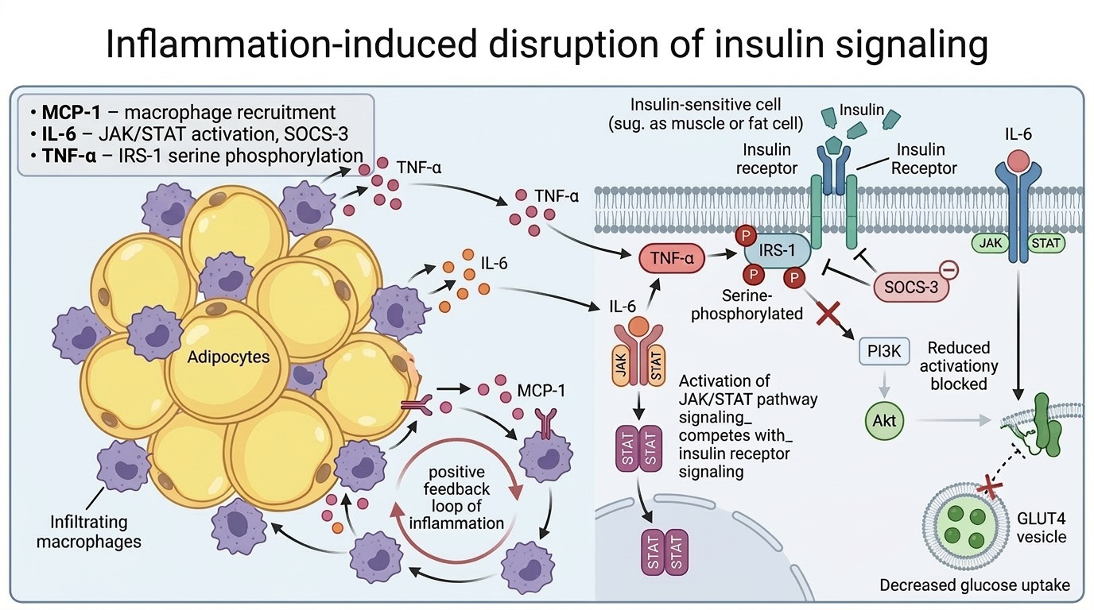
Inflammation: The Mediator
Metaflammation
Negative clinical consequences

Slide 8
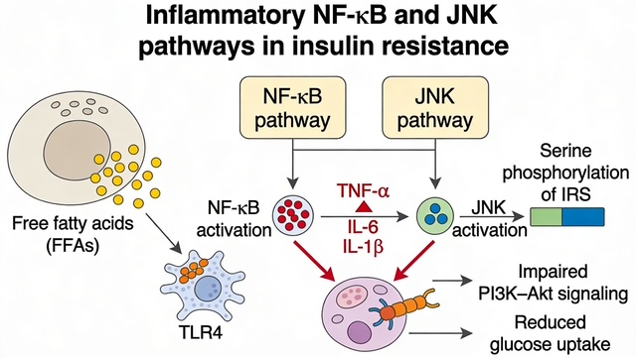
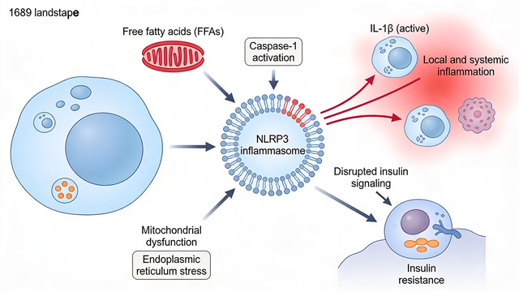
NF-κB, JNK, and NLRP3 inflammasome: The key shared pathways
• NLRP3 inflammasome: multi-protein sensor complex inside immune cells that detects “danger” signals, turns on caspase‑1, which converts inactive pro‑IL‑1β into active IL‑1β
• NF-κB pathway: transcription factor pathway that turns on many inflammatory genes.
• JNK pathway: stress-activated protein kinase, adds phosphate groups to specific serine sites on insulin receptor substrates
•

Slide 9
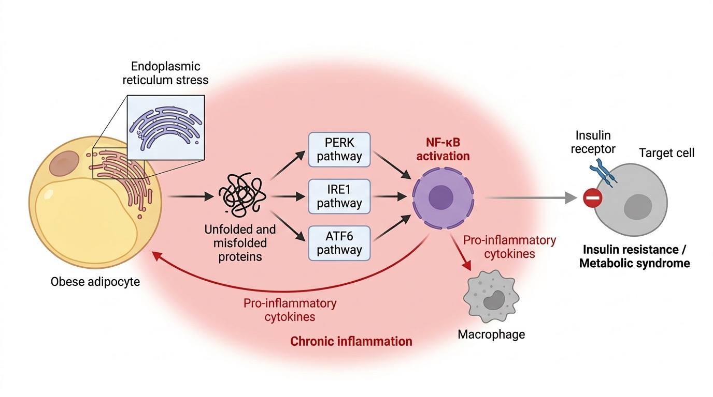
Endoplasmic Reticulum Stress

Slide 10
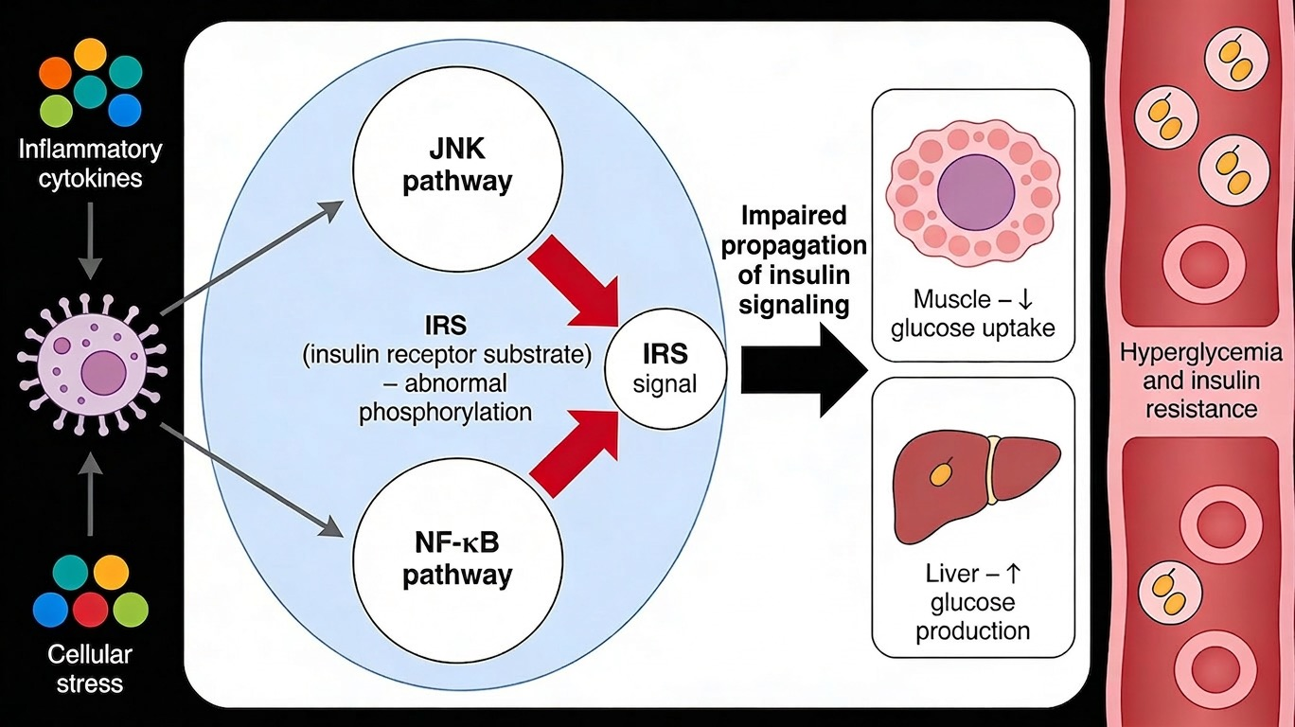
systemic insulin
resistance via endocrine cytokine signaling
Insulin Resistance: The Hallmark
Knockout of Jnk1 (Jnk1−/−) leads to amelioration of insulin resistance in high fat diet fed mice
localized insulin resistance via autocrine/paracrine cytokine signaling

Slide 11
Key message: AT dysfunction is the major cause of IR
Cardiometabolic disease = single systemic pro-inflammatory, insulin-resistant state
Adipose tissue dysfunction is the epicenter driving ectopic fat, inflammation, and organ damage

Slide 12
Challenges & Open Questions
the sequence of events???
develop specific biomarkers to identify high-risk patients before irreversible organ damage
spatio-temporal omics
prioritize therapeutic targets
personalize interventions based on individual inflammatory profiles (digital twins)
optimal timing for intervention to maximize benefit

Slide 13

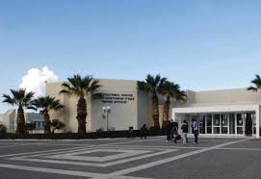
Thank you

