Slide 1
The role of human behaviour
Lis Neubeck, ESC Patient Forum Chair
18/19th March 2026

Slide 2
One size fits all?

Slide 3
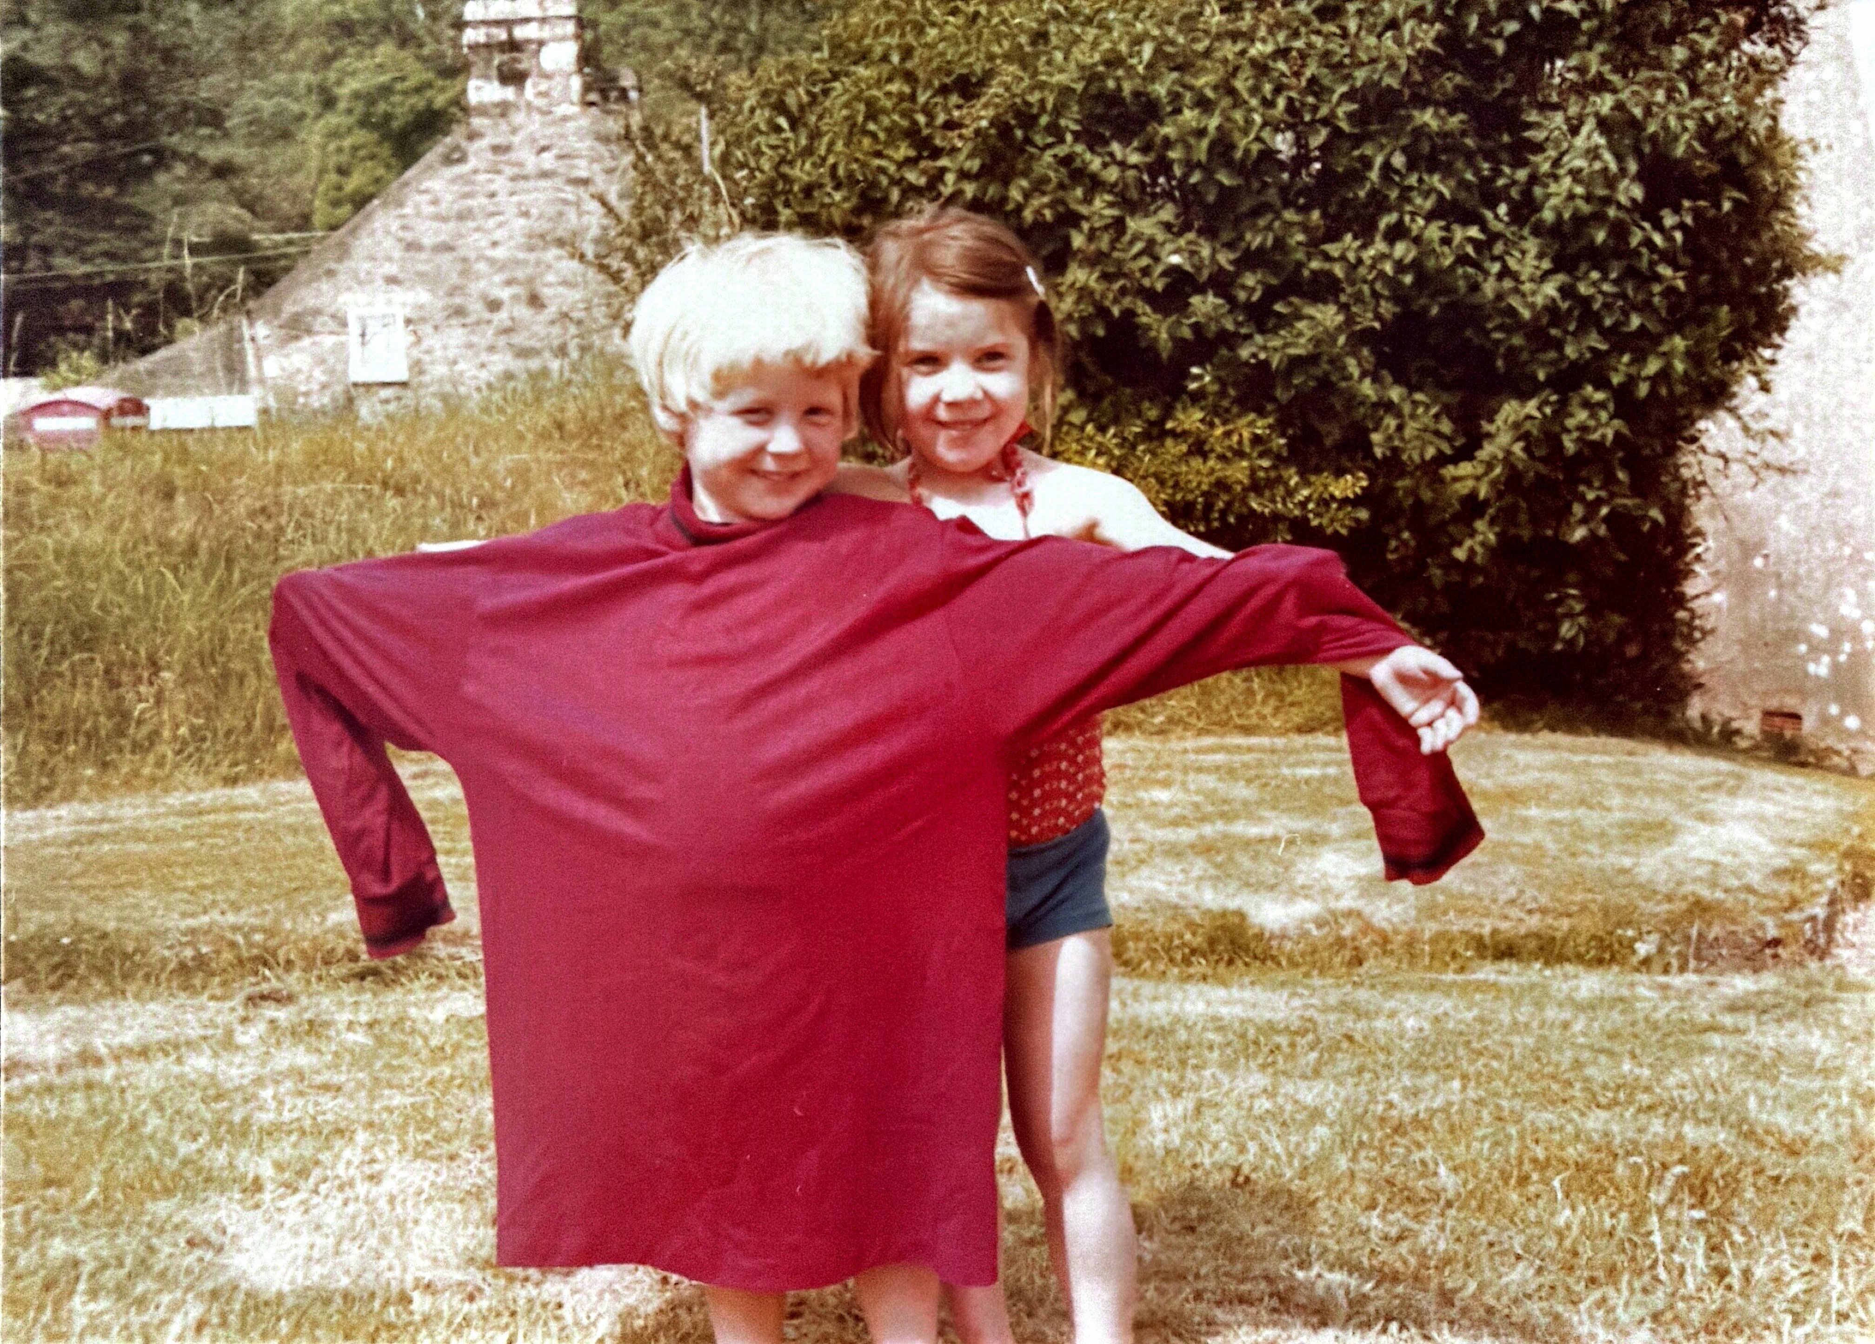
One size fits all?

Slide 4
What influences human behaviour?
Human behaviour refers to the actions, habits, decisions, and responses shaped by:
Knowledge and beliefs
Attitudes and motivations
Social and cultural norms
Environment and access to resources
Emotions and mental health
Trust in HCPs
Structure and practical barriers

Slide 5





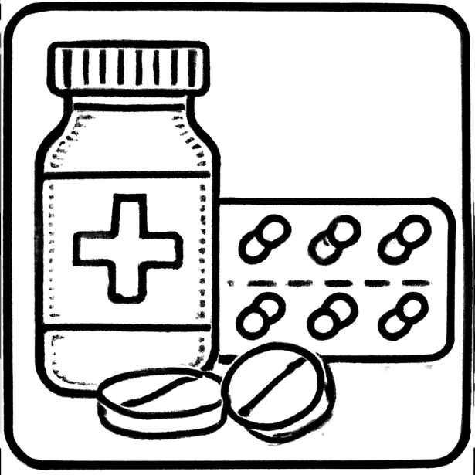
Common “adverse” behaviours

Slide 6
Behaviour through the lifecourse
Childhood: Diet, physical activity, sleep, and screen time shape lifelong habits.
Adolescence: Risk-taking, peer influence, and identity formation affect substance use and sexual health.
Adulthood: Work, family, stress, and environment influence lifestyle and self-care.
Older Age: Mobility, social connection, and health engagement affect independence and quality of life.

Slide 7
Psychology of behaviour
People do not change behaviour because they are told to
Perceived risk and benefit
Confidence and self-efficacy
Habits and routines
Emotional drivers
Social influence
Common models include the Health Belief Model, Theory of Planned Behaviour, and COM-B (Capability, Opportunity, Motivation – Behaviour)

Slide 8
Barriers to healthy behaviour
Poverty and inequality
Limited access to healthy food
Limited access to safe spaces
Low health literacy
Stress, trauma, and mental illness

Slide 9
Policy affects choices
Smoke-free public spaces
Affordable healthy food
Walkable communities
Active transport systems
Workplace wellbeing policies

Slide 10
Human behaviour affects
Whether people attend appointments (up to 33% non-attendance)¹
How they use medications (50% fail to take meds as prescribed)²
Engagement with prevention and screening³
Only 64-79% say they have trust in HCP⁴
Our behaviour matters- 1.62 times increased adherence when we communicate well⁵

Slide 11
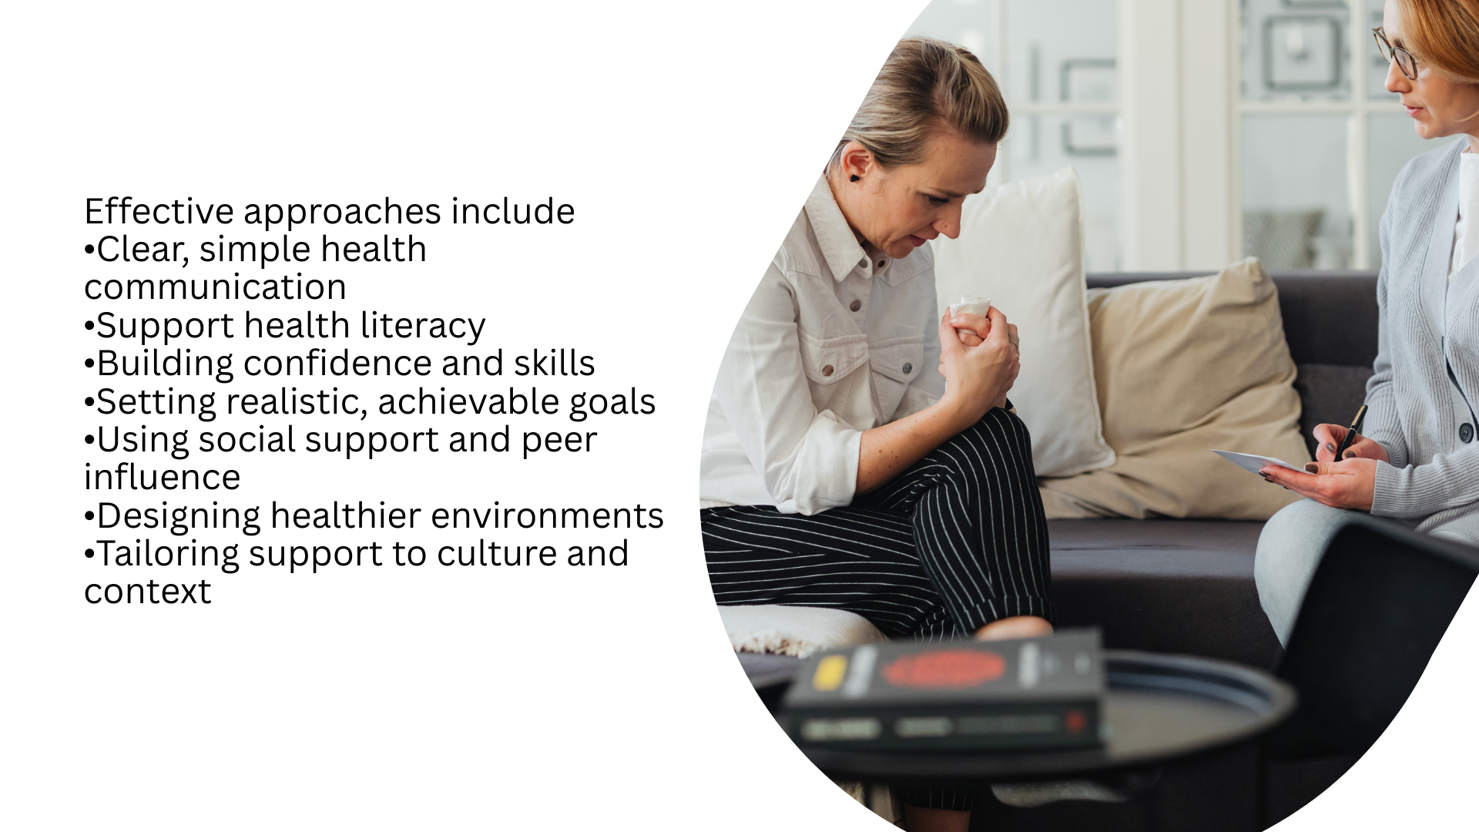
How to support behaviour change
Effective approaches include
Clear, simple health communication
Support health literacy
Building confidence and skills
Setting realistic, achievable goals
Using social support and peer influence
Designing healthier environments
Tailoring support to culture and context

Slide 12
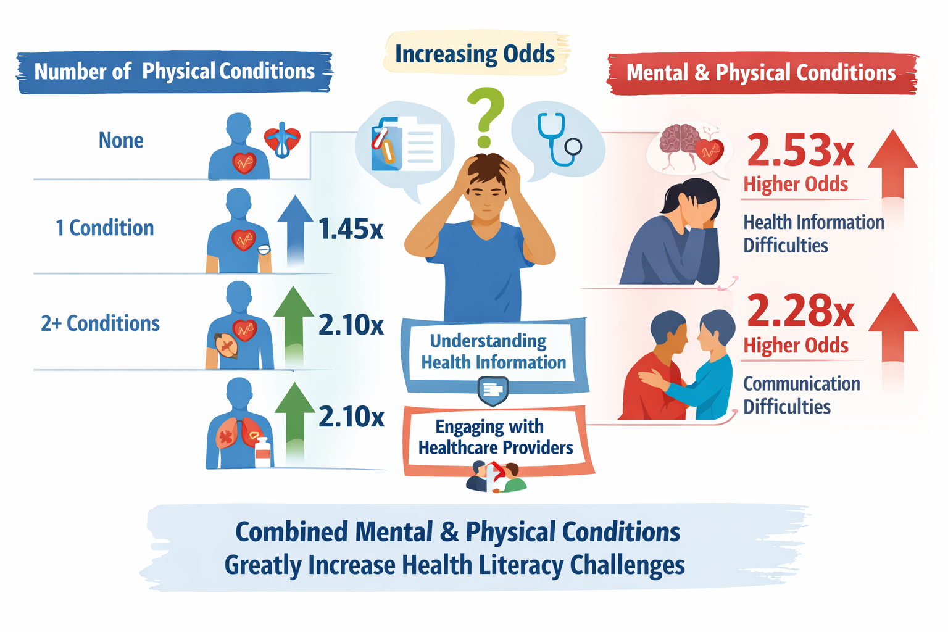
Complexity adversely affects health literacy
Pederson et al 2024

Slide 13











Improving health literacy
01
Uses plain language
04
Ask open ended questions
02
One topic at a time
05
Identify misconceptions
03
Check understanding
Closes the loop
06
Teach back

Slide 14
Human behaviour
Lis Neubeck, ESC Patient Forum Chair
18/19th March 2026

Slide 15
References
Schwalbe, Daria, Morten Sodemann, Maria Iachina, Bente Mertz Nørgård, Nina Høy Chodkiewicz, and Jette Ammentorp. "Causes of patient nonattendance at medical appointments: protocol for a mixed methods study." JMIR Research Protocols 12, no. 1 (2023): e46227.
World Health Organization (2003). Adherence to long-term therapies: evidence for action. Geneva: World Health Organisation. ISBN 978-92-4-154599-0.
Ma, Zhen-qiang, and Lisa C. Richardson. "Cancer screening prevalence and associated factors among US adults." Preventing chronic disease 19 (2022): E22.
Keating, Nancy L., et al. "Patient characteristics and experiences associated with trust in specialist physicians." Archives of internal medicine 164.9 (2004): 1015-1020.
Zolnierek, Kelly B. Haskard, and M. Robin DiMatteo. "Physician communication and patient adherence to treatment: a meta-analysis." Medical care 47.8 (2009): 826-834.
Pedersen, S. E., Aaby, A., Friis, K., & Maindal, H. T. (2023). Multimorbidity and health literacy: A population-based survey among 28,627 Danish adults. Scandinavian journal of public health, 51(2), 165-172.

