Slide 1
The role of the environment
Prof dr Paul Dendale
Hasselt University, Belgium
March 18 2026

Slide 2
What is “the environment”?
Oxford learner’s dictionary :
“the natural world in which people, animals and plants live”
Or
“the conditions in which a person, animal or plant lives or operates or in which an activity takes place”

Slide 3
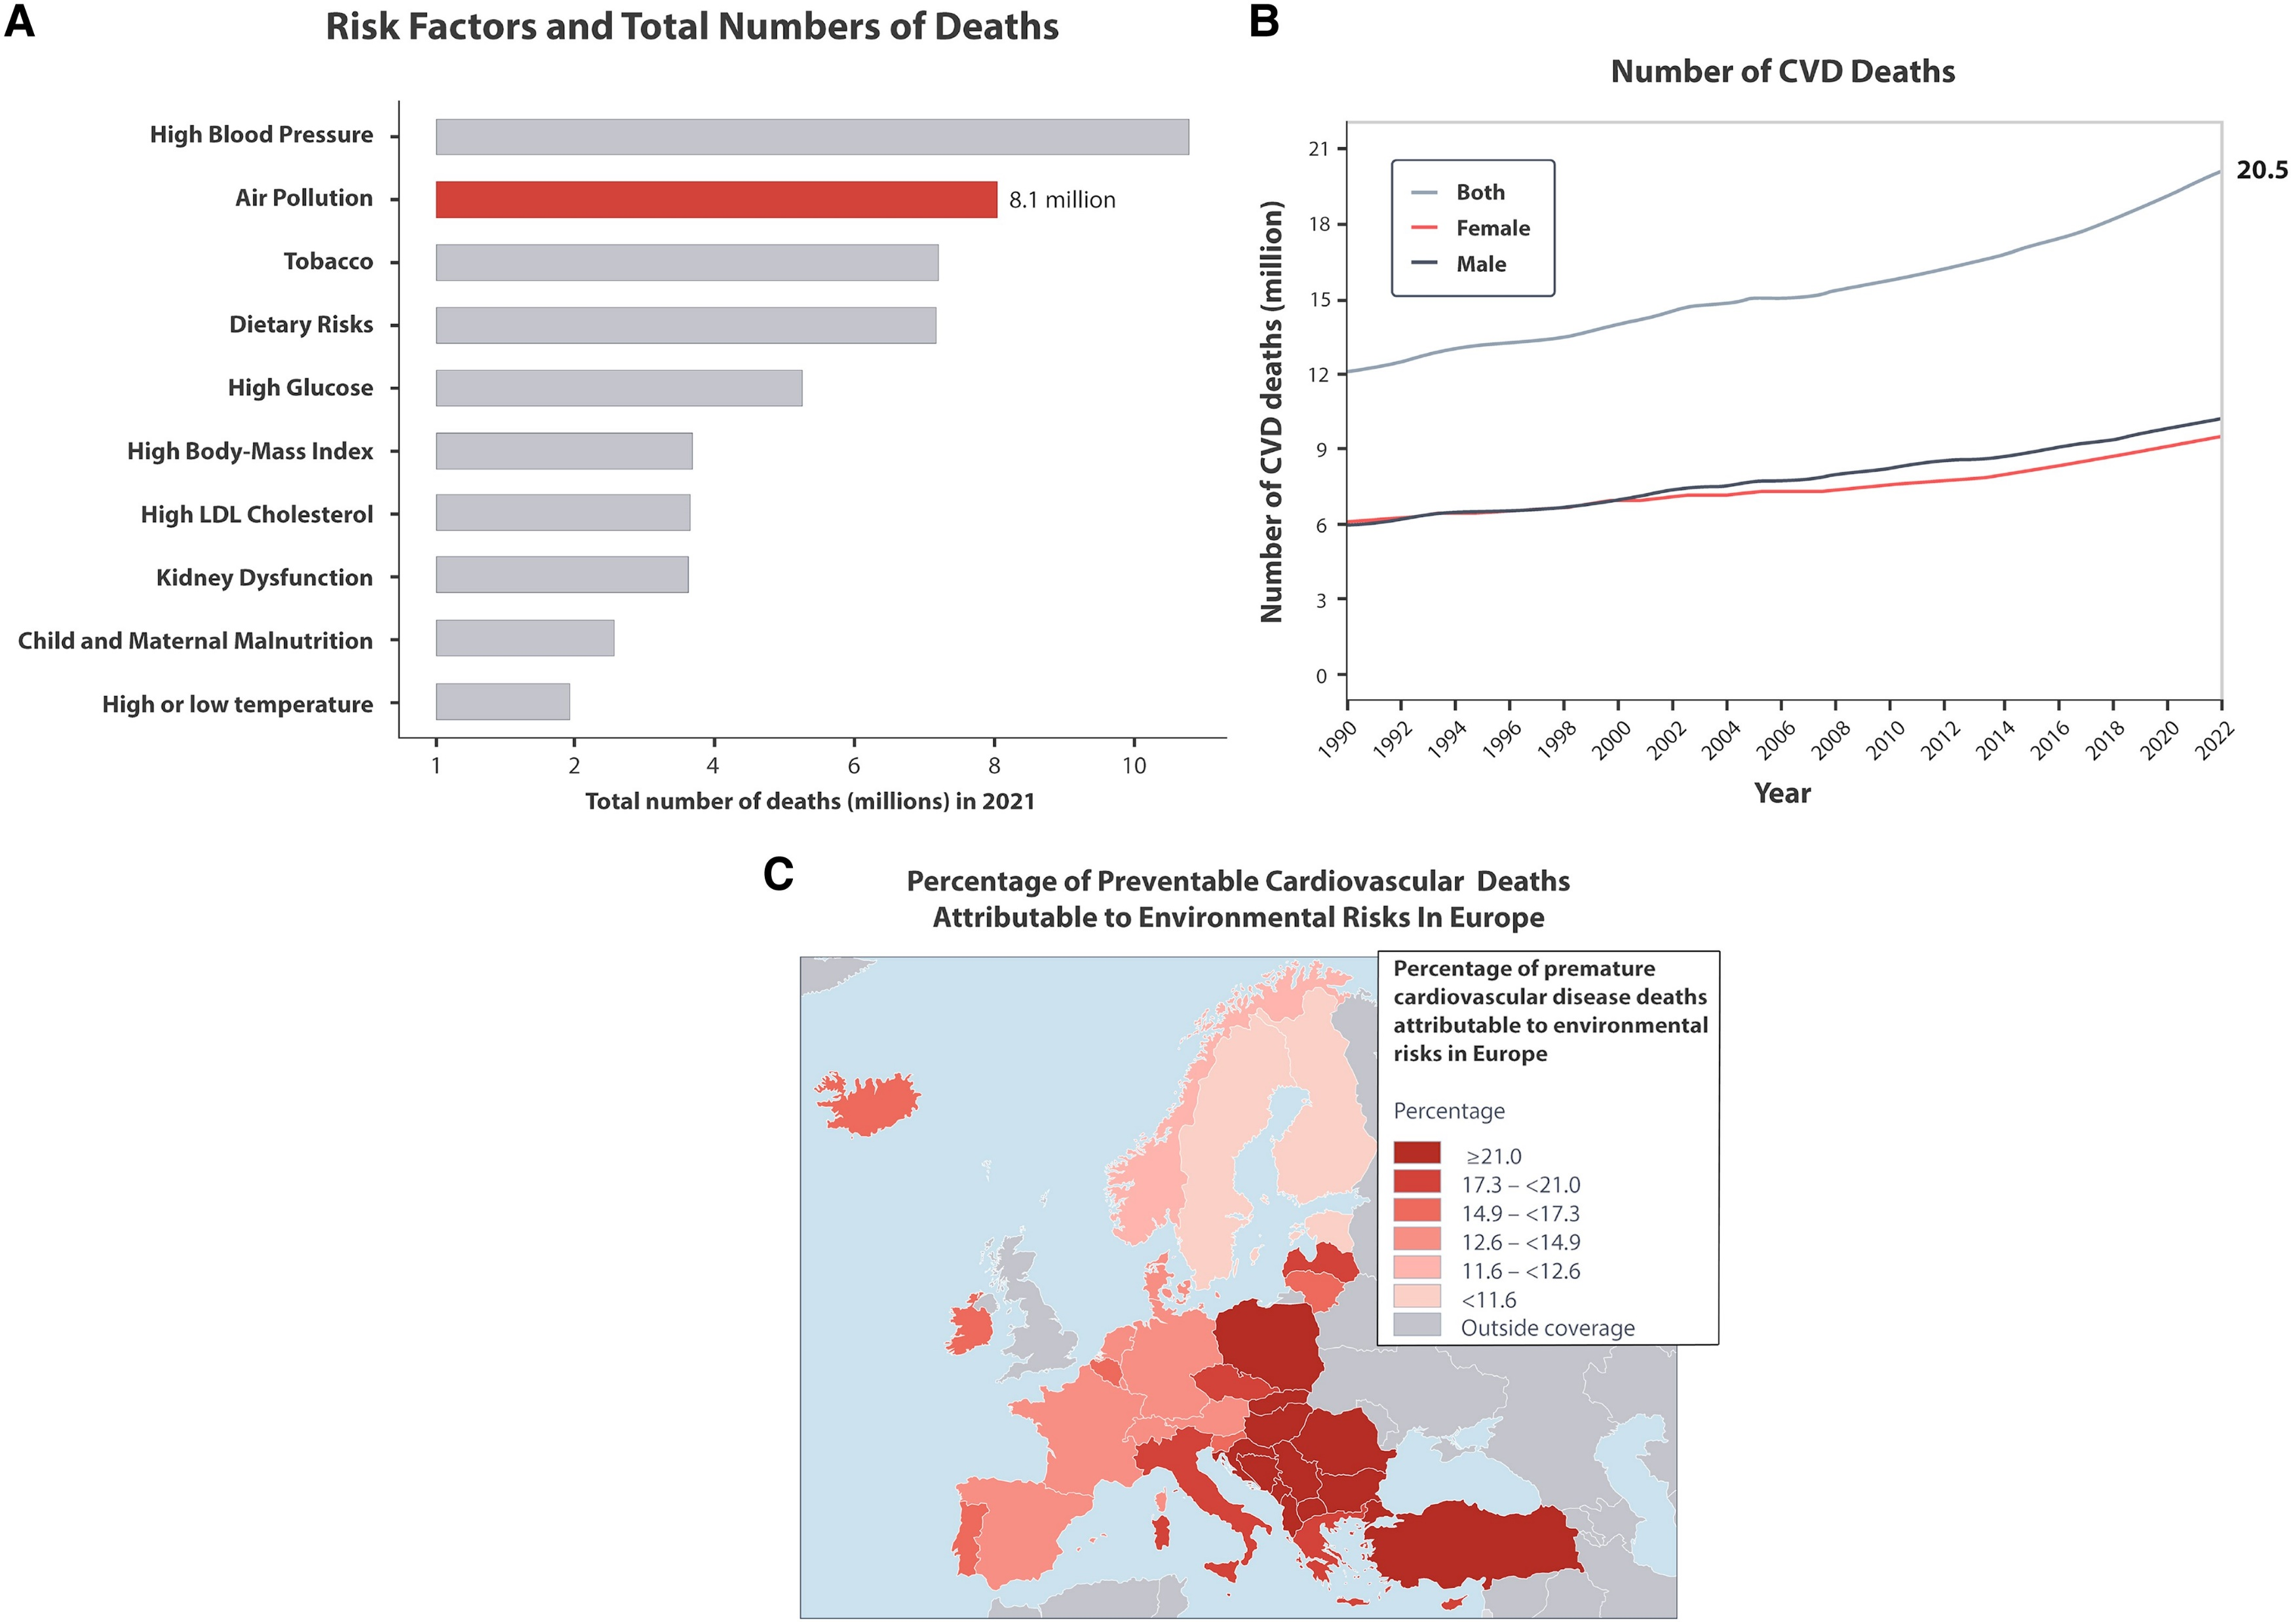
Is it really important?
Cardiovascular Research, 2025, Pages 1-26

Slide 4
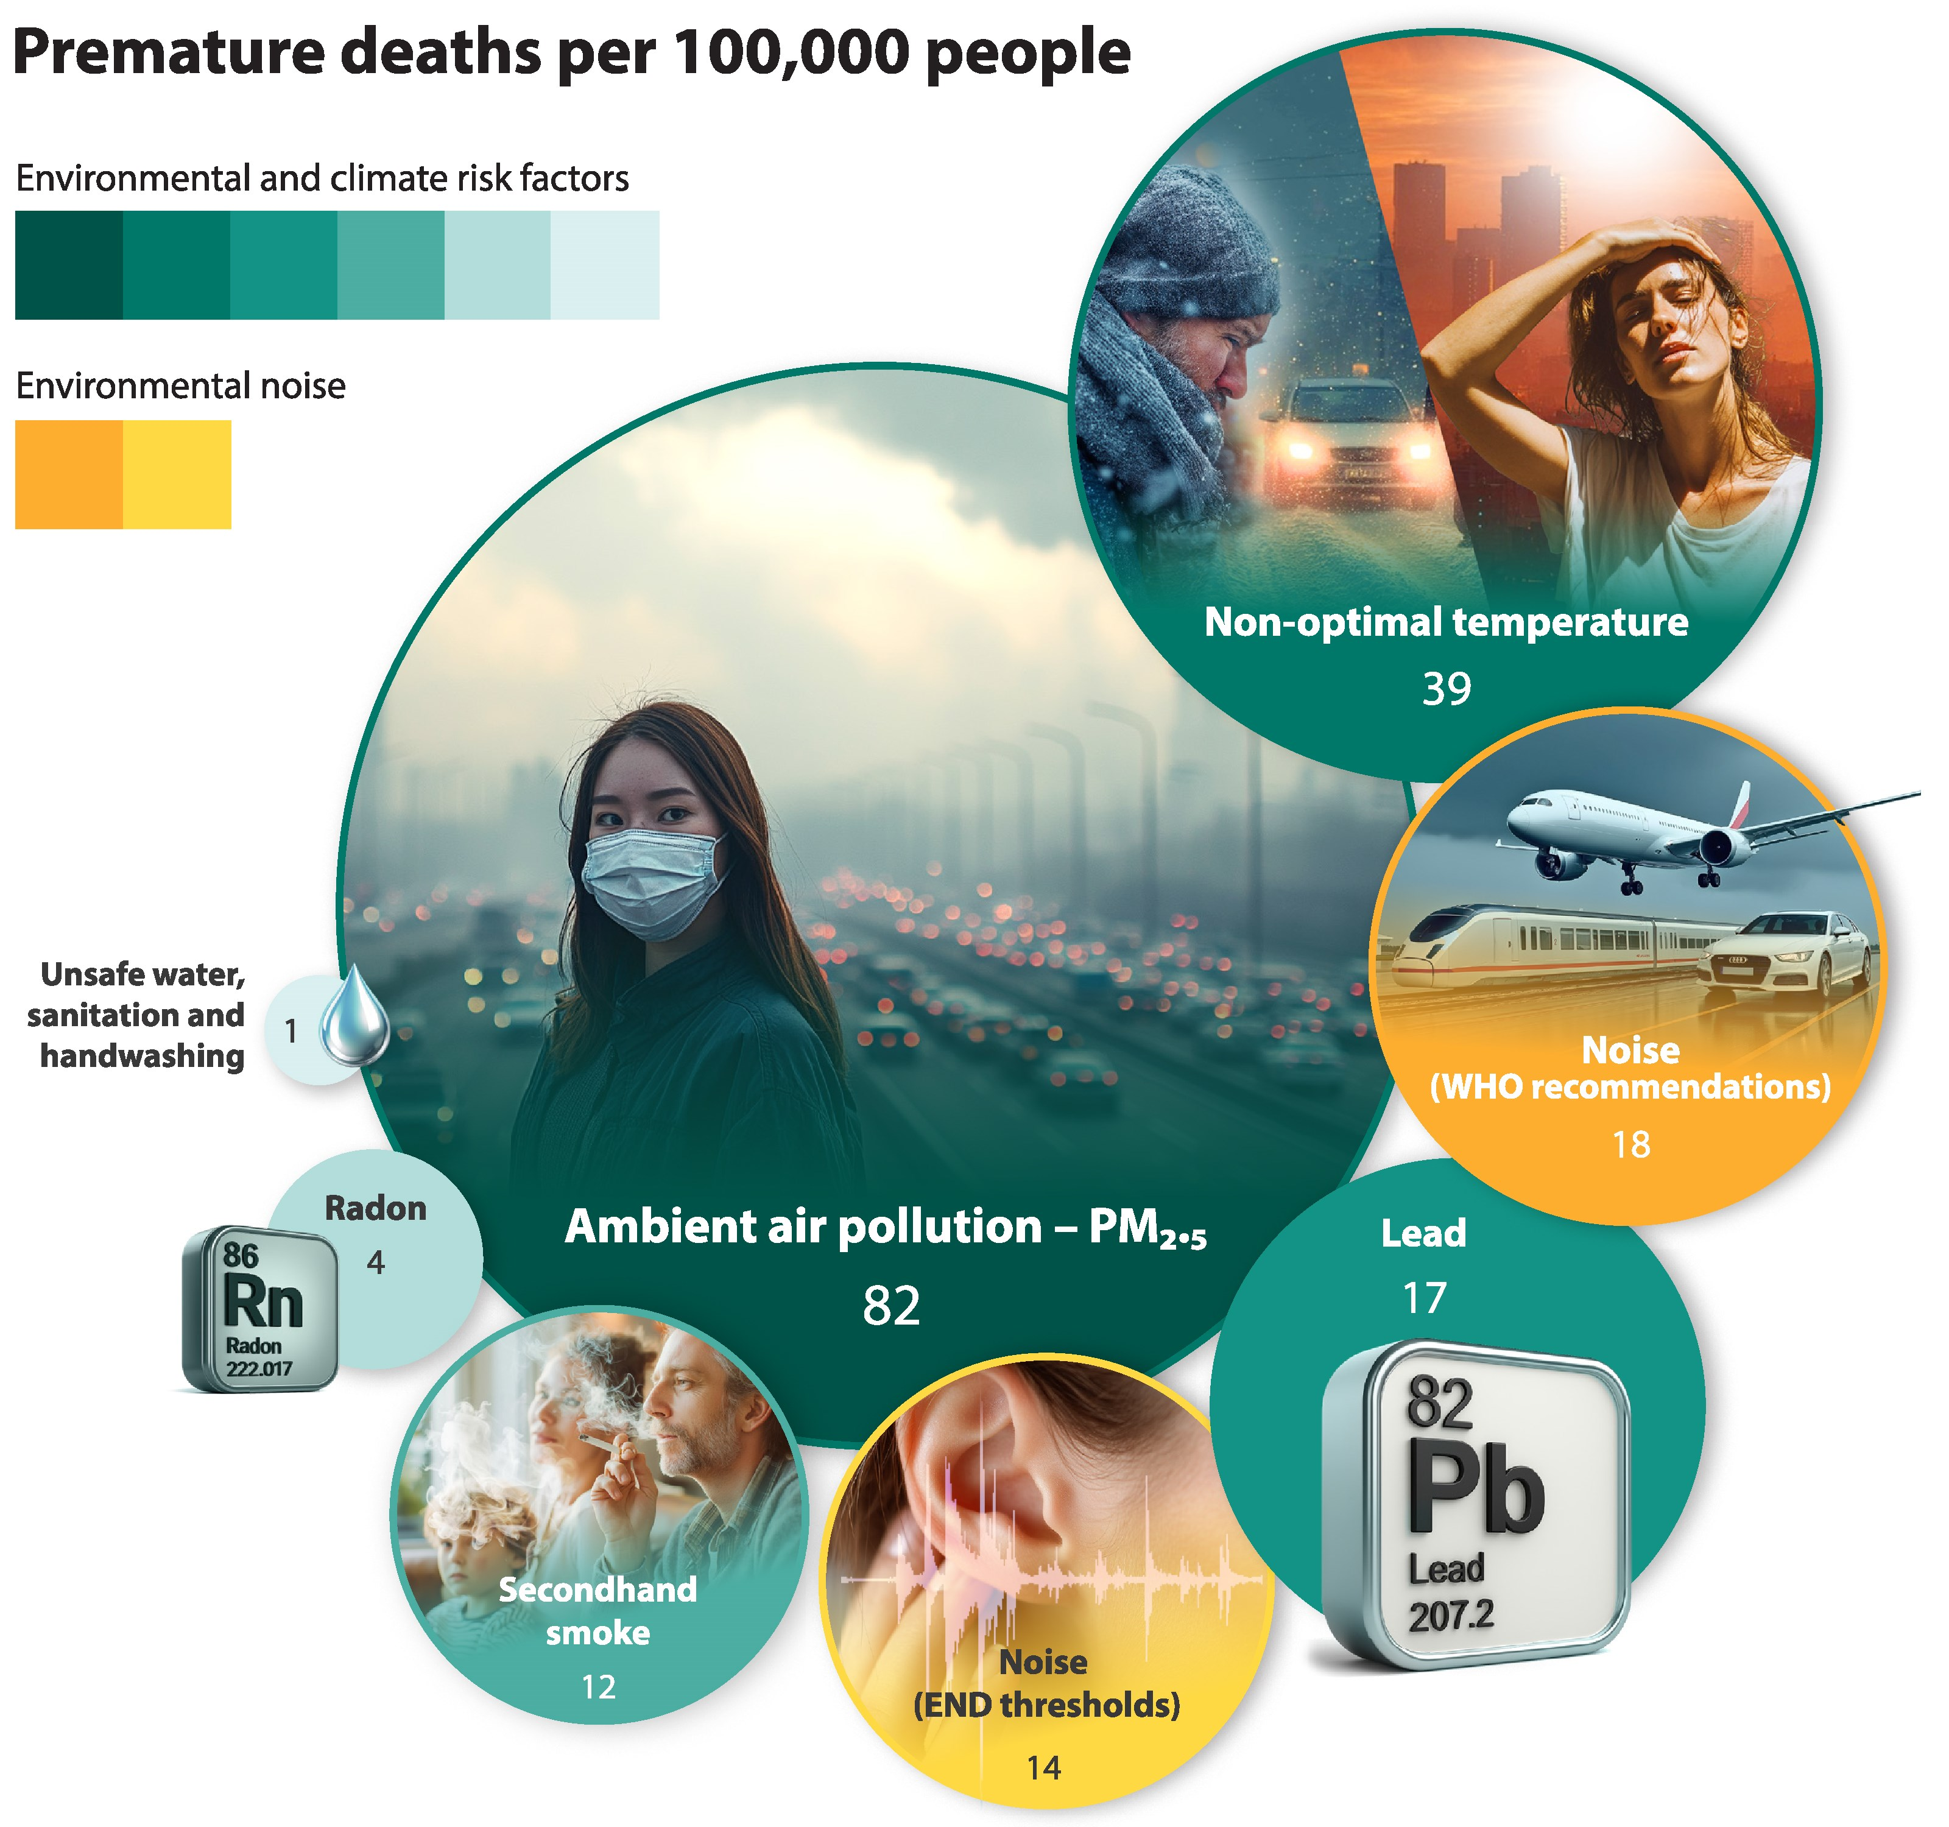
Eur Heart J, Volume 47, Issue 11, 14 March 2026, Pages 1279–1281, https://doi.org/10.1093/eurheartj/ehaf1072

Slide 5
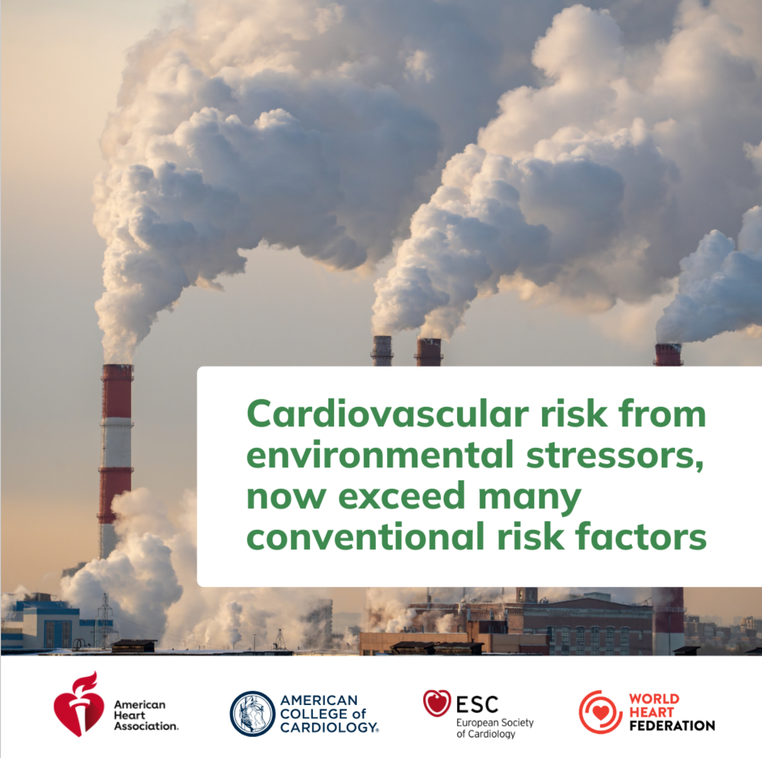

Slide 6
Where can I run to?
Cardiovascular Research, 2025, Pages 1-26

Slide 7
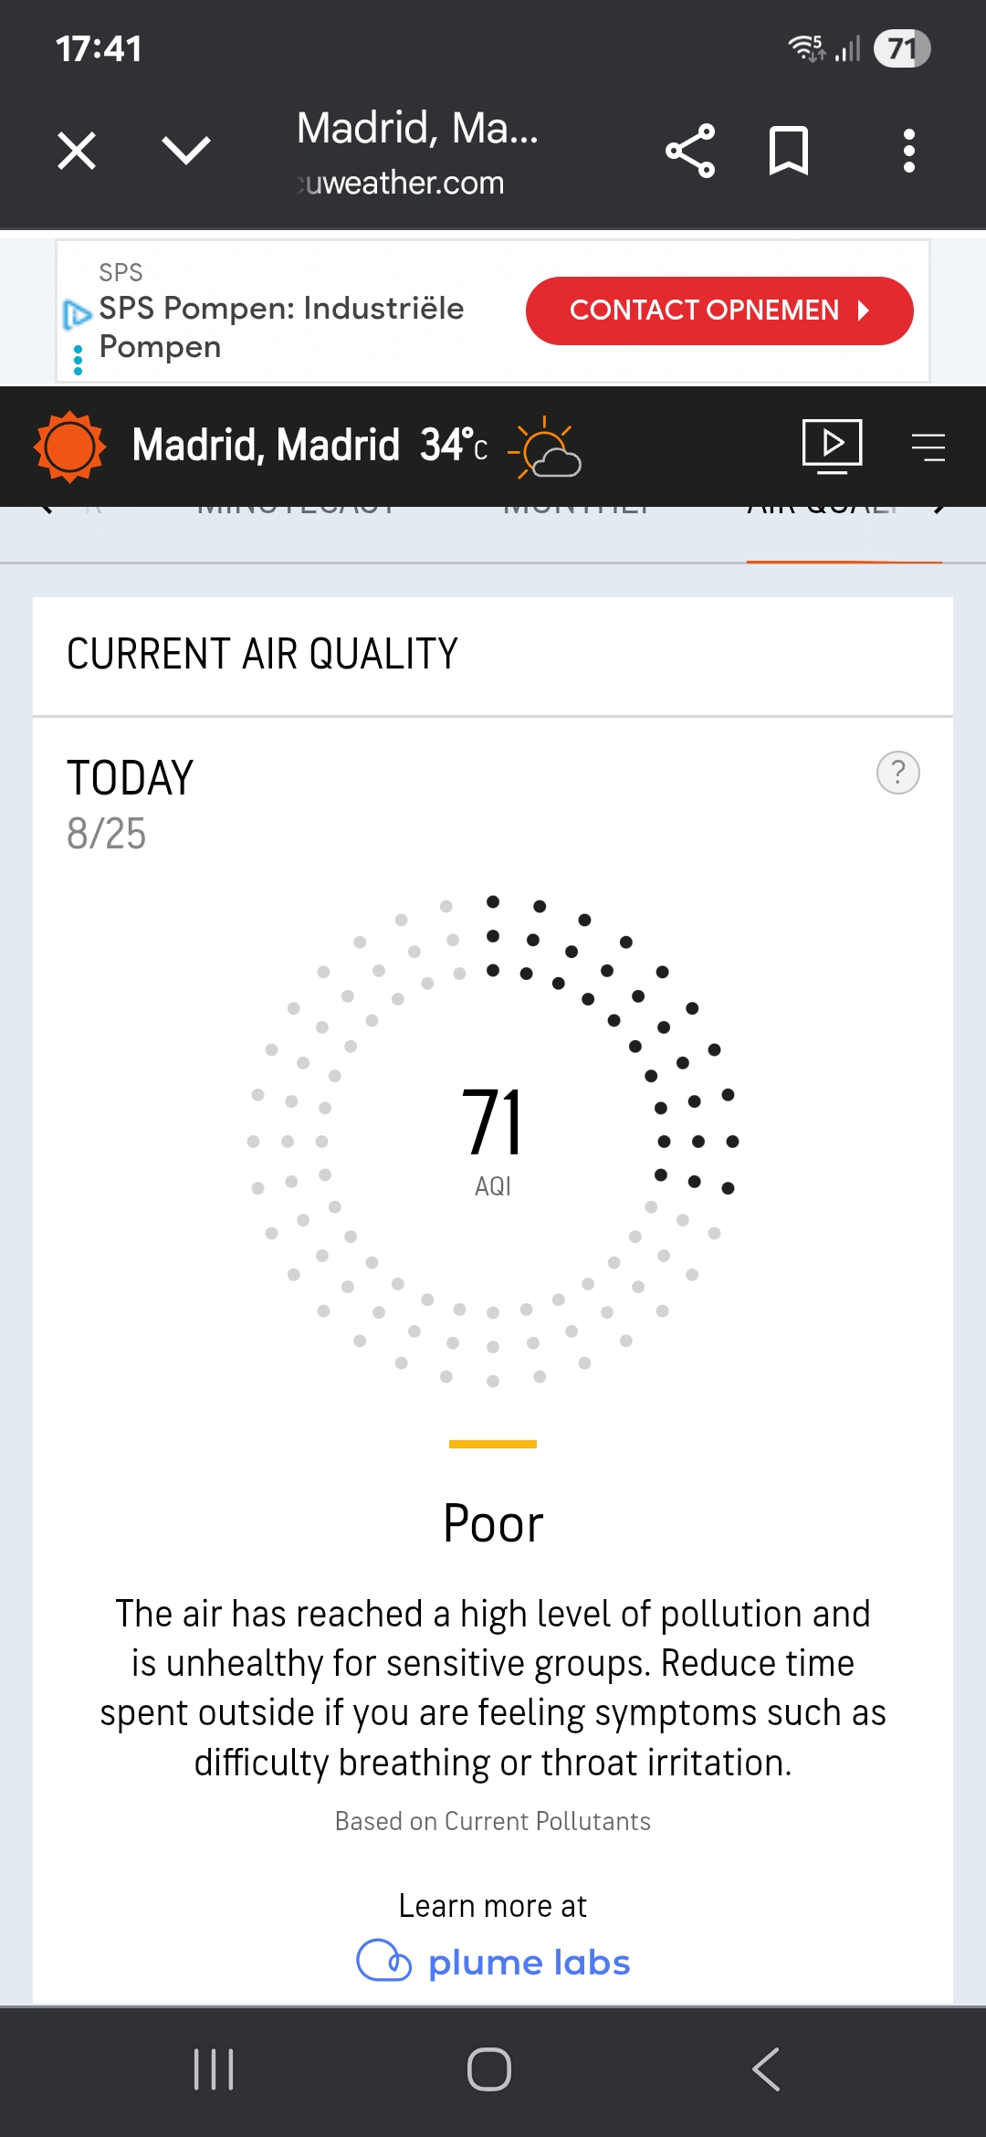
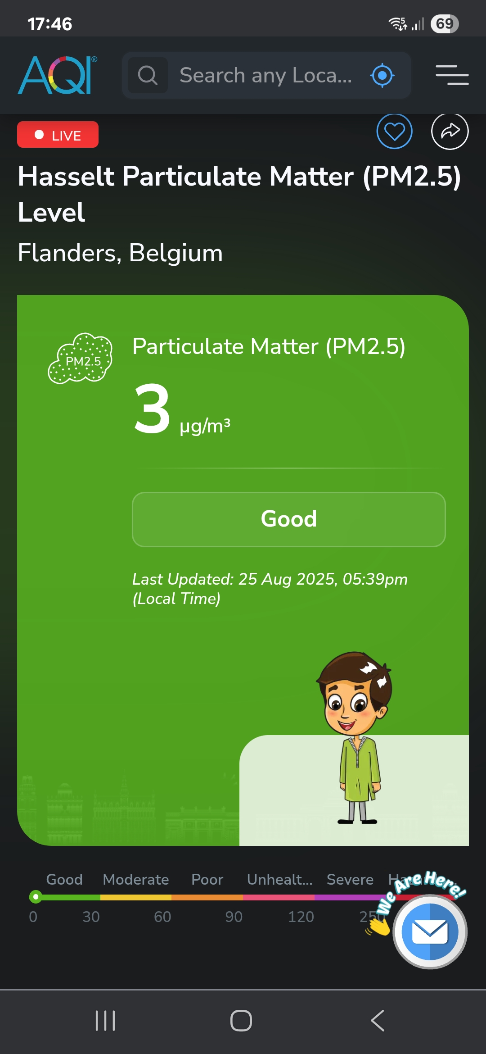
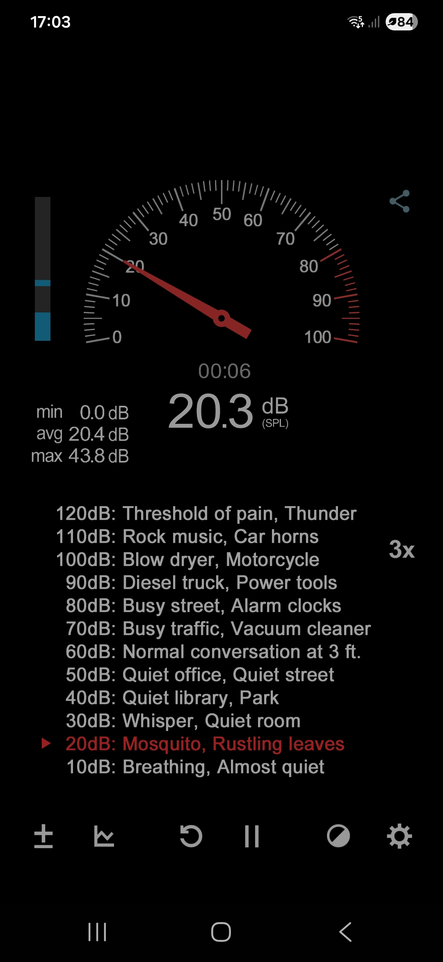
Where can I run to?

Slide 8
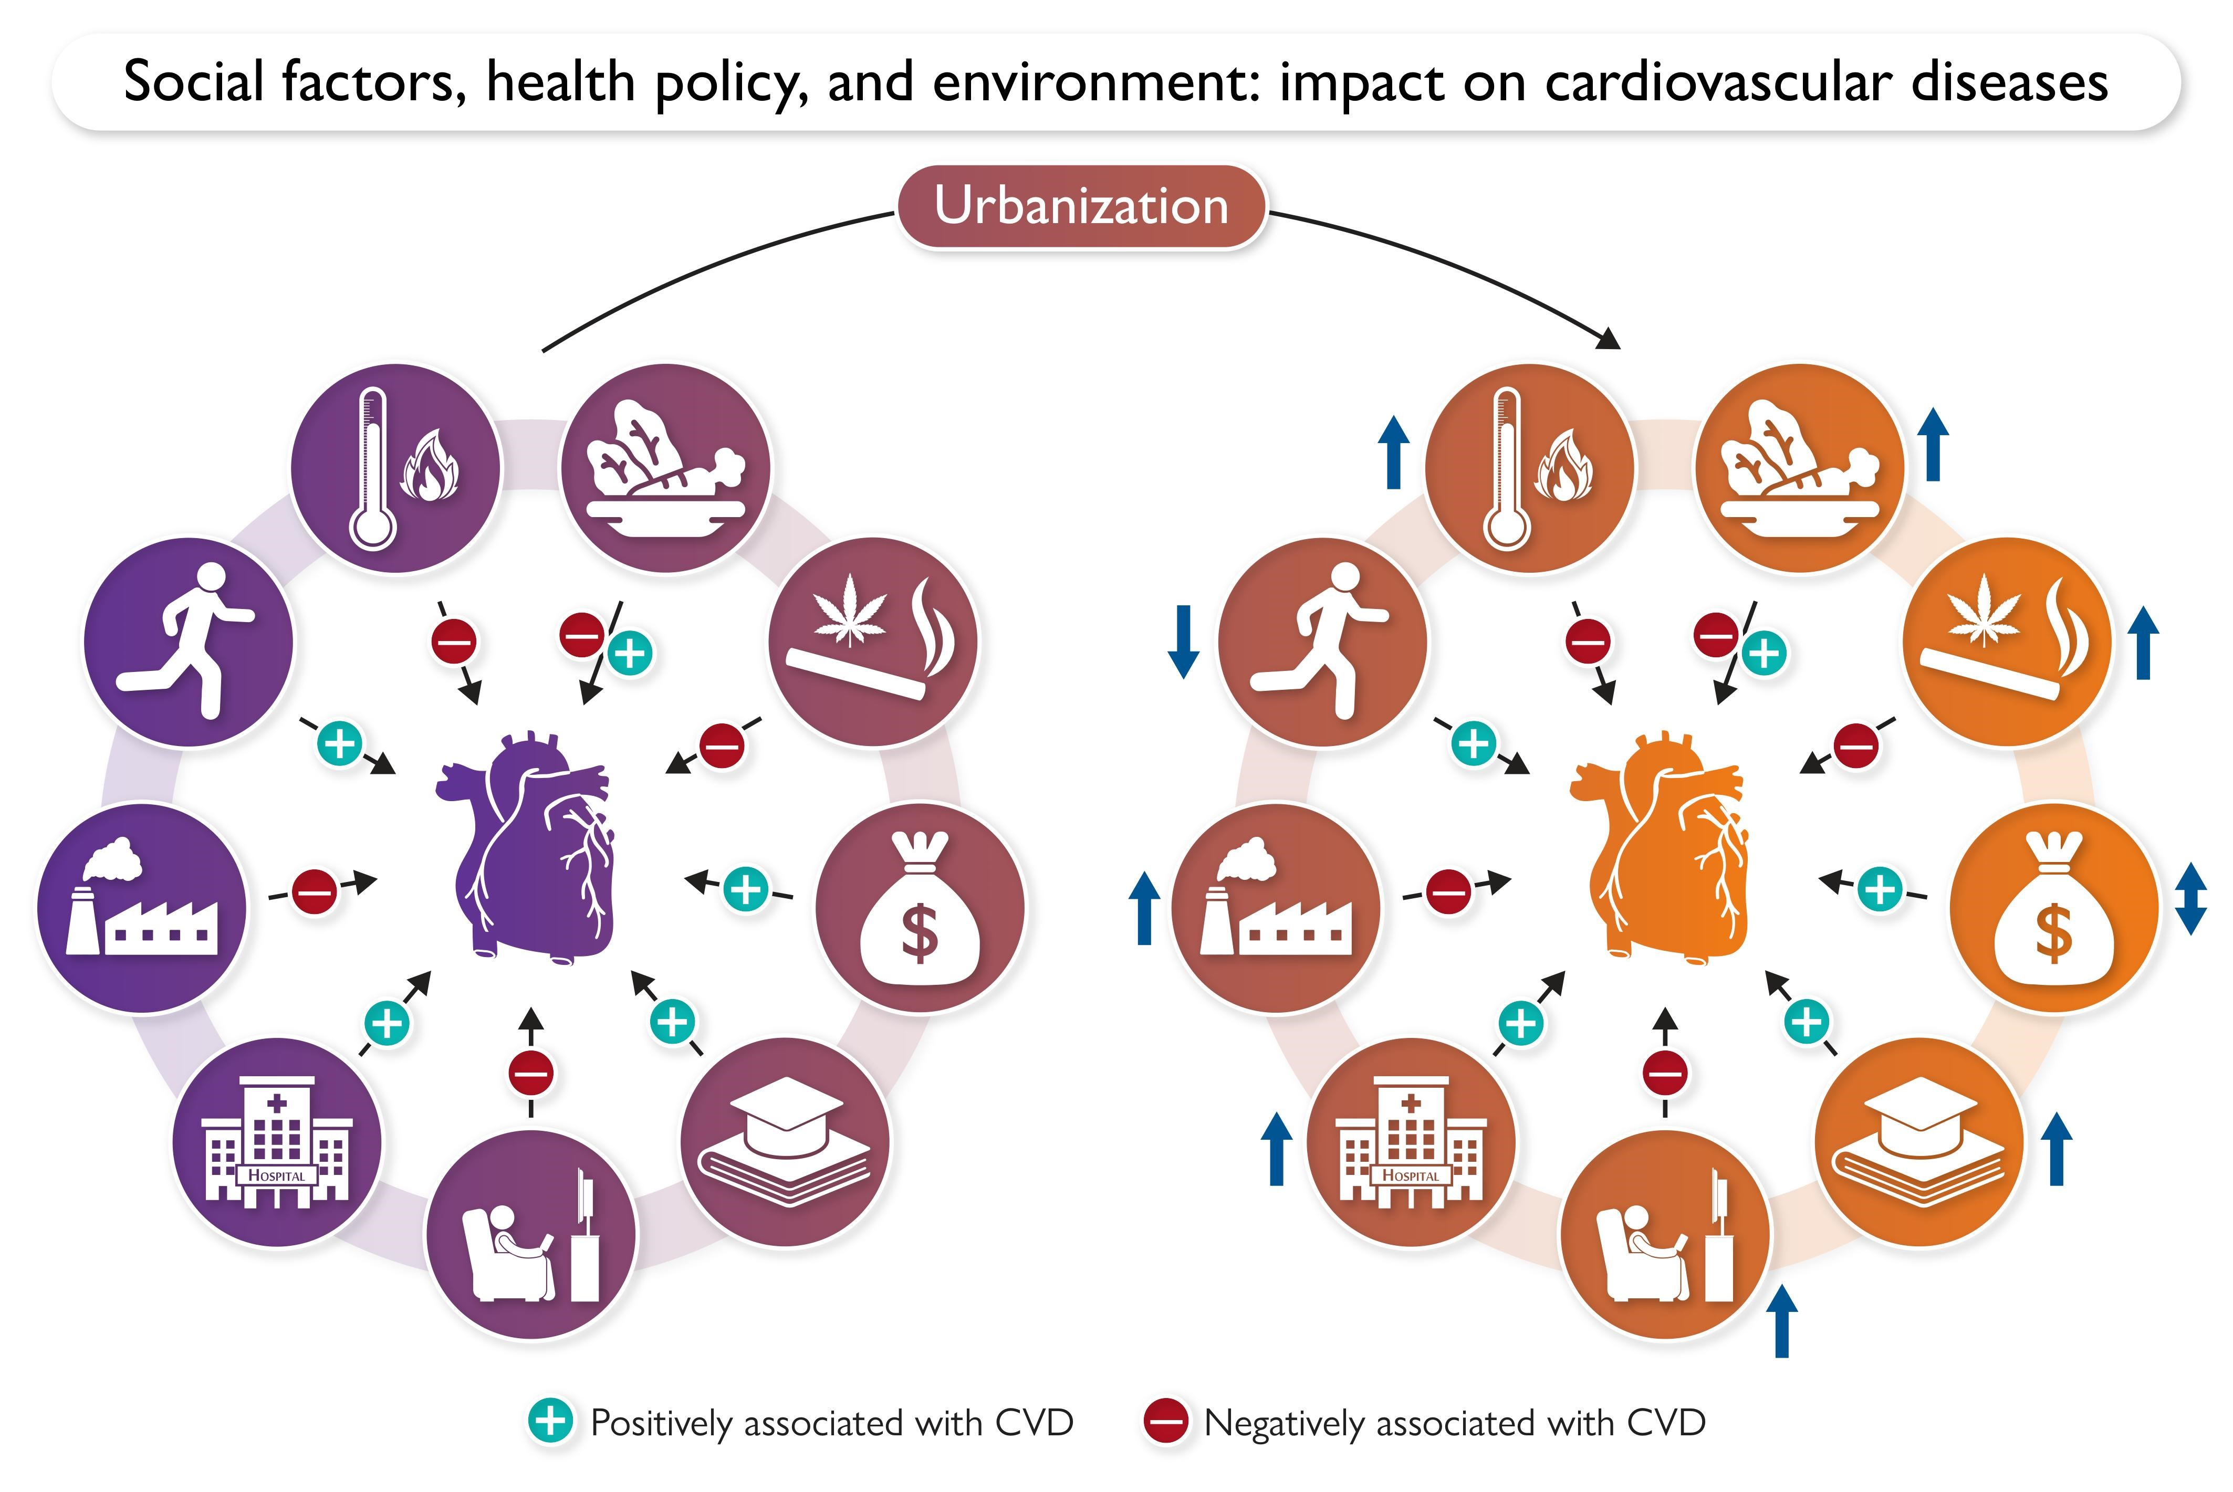
Eur Heart J, Volume 46, Issue 30, 7 August 2025, Pages 2959-2973

Slide 9
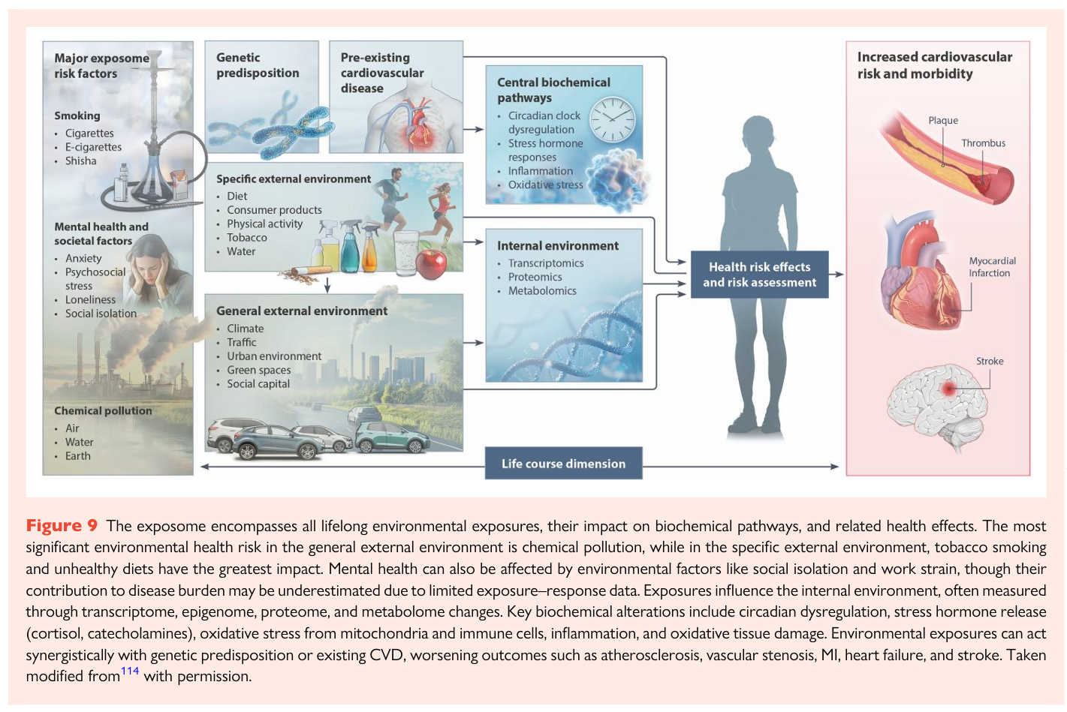
Cardiovascular Research, 2025, Pages 1-26

Slide 10
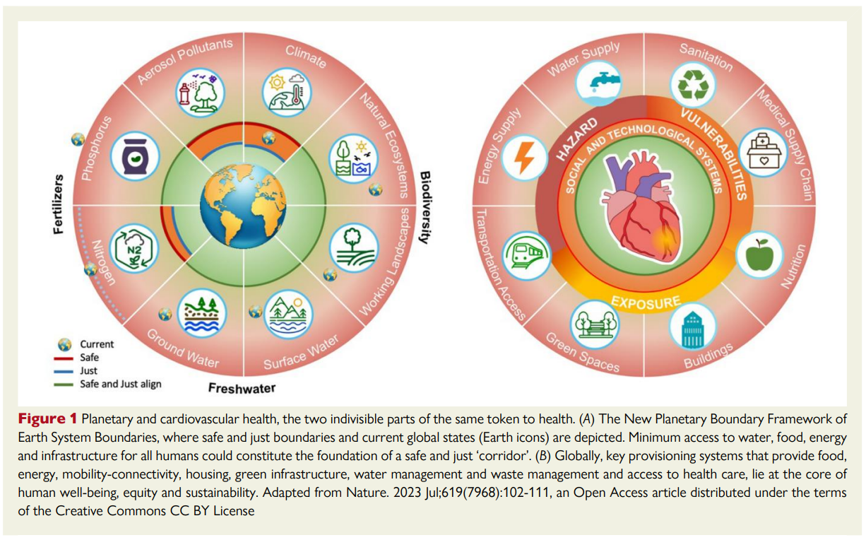


Slide 11
Thanks for listening
paul.dendale@uhasselt.be

