Slide 1
EU CV health plan: cardiometabolic disease in perspective
Professor Thomas F. Lüscher, MD, FRCP, FESC
ESC President

Slide 2
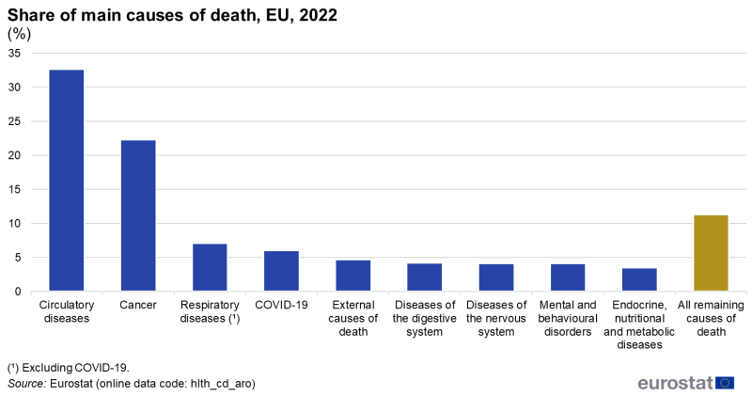

ESC CV CRT Round Table on CardioMetabolic Disease
Confidential – for internal use only – ESC Board March 2026 summary

Slide 3

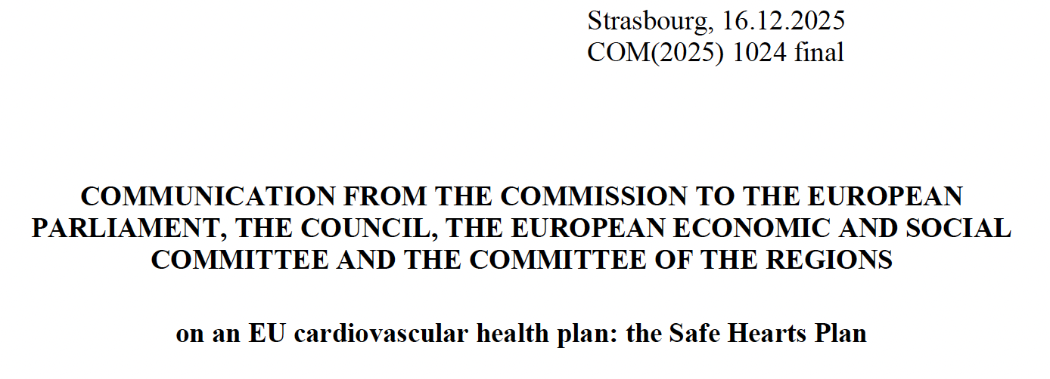
ESC CV CRT Round Table on CardioMetabolic Disease
Confidential – for internal use only – ESC Board March 2026 summary

Slide 4
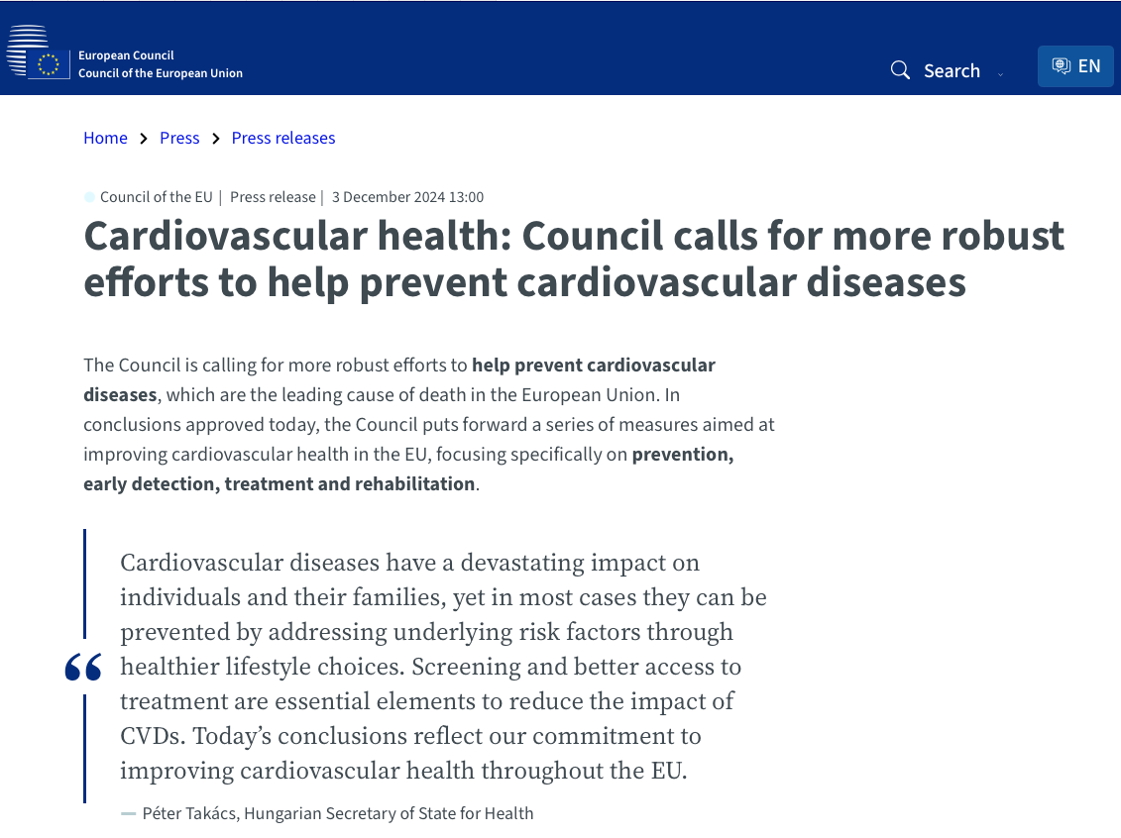
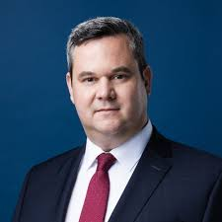
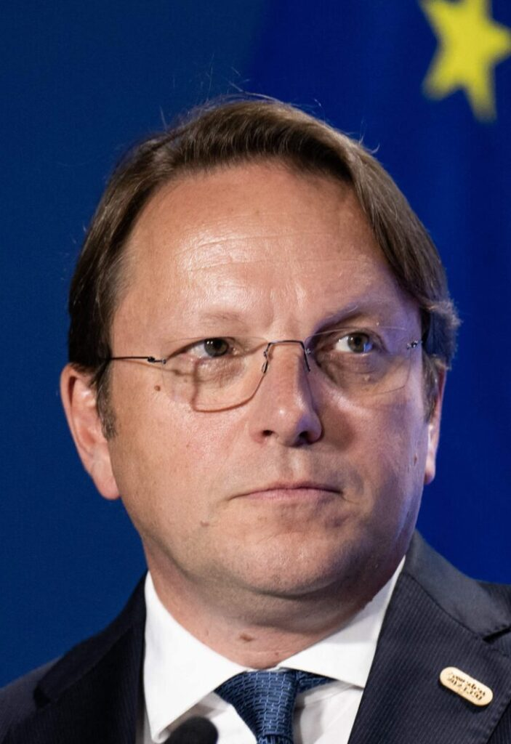
ESC CV CRT Round Table on CardioMetabolic Disease
Confidential – for internal use only – ESC Board March 2026 summary

Slide 5
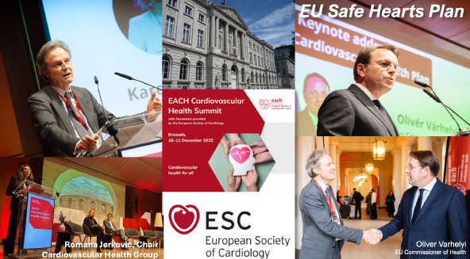
ESC CV CRT Round Table on CardioMetabolic Disease
Confidential – for internal use only – ESC Board March 2026 summary

Slide 6
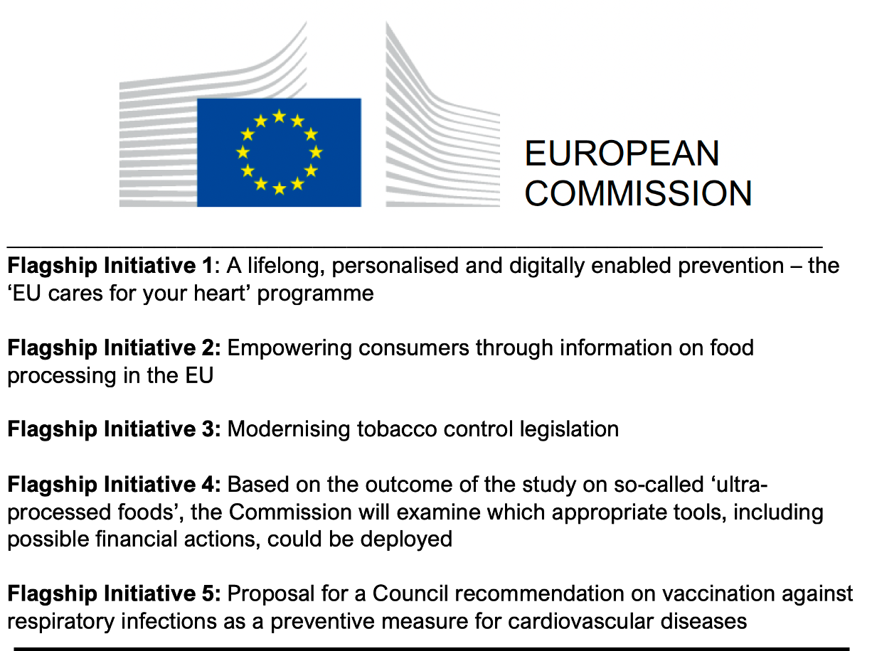
ESC CV CRT Round Table on CardioMetabolic Disease
Confidential – for internal use only – ESC Board March 2026 summary

Slide 7
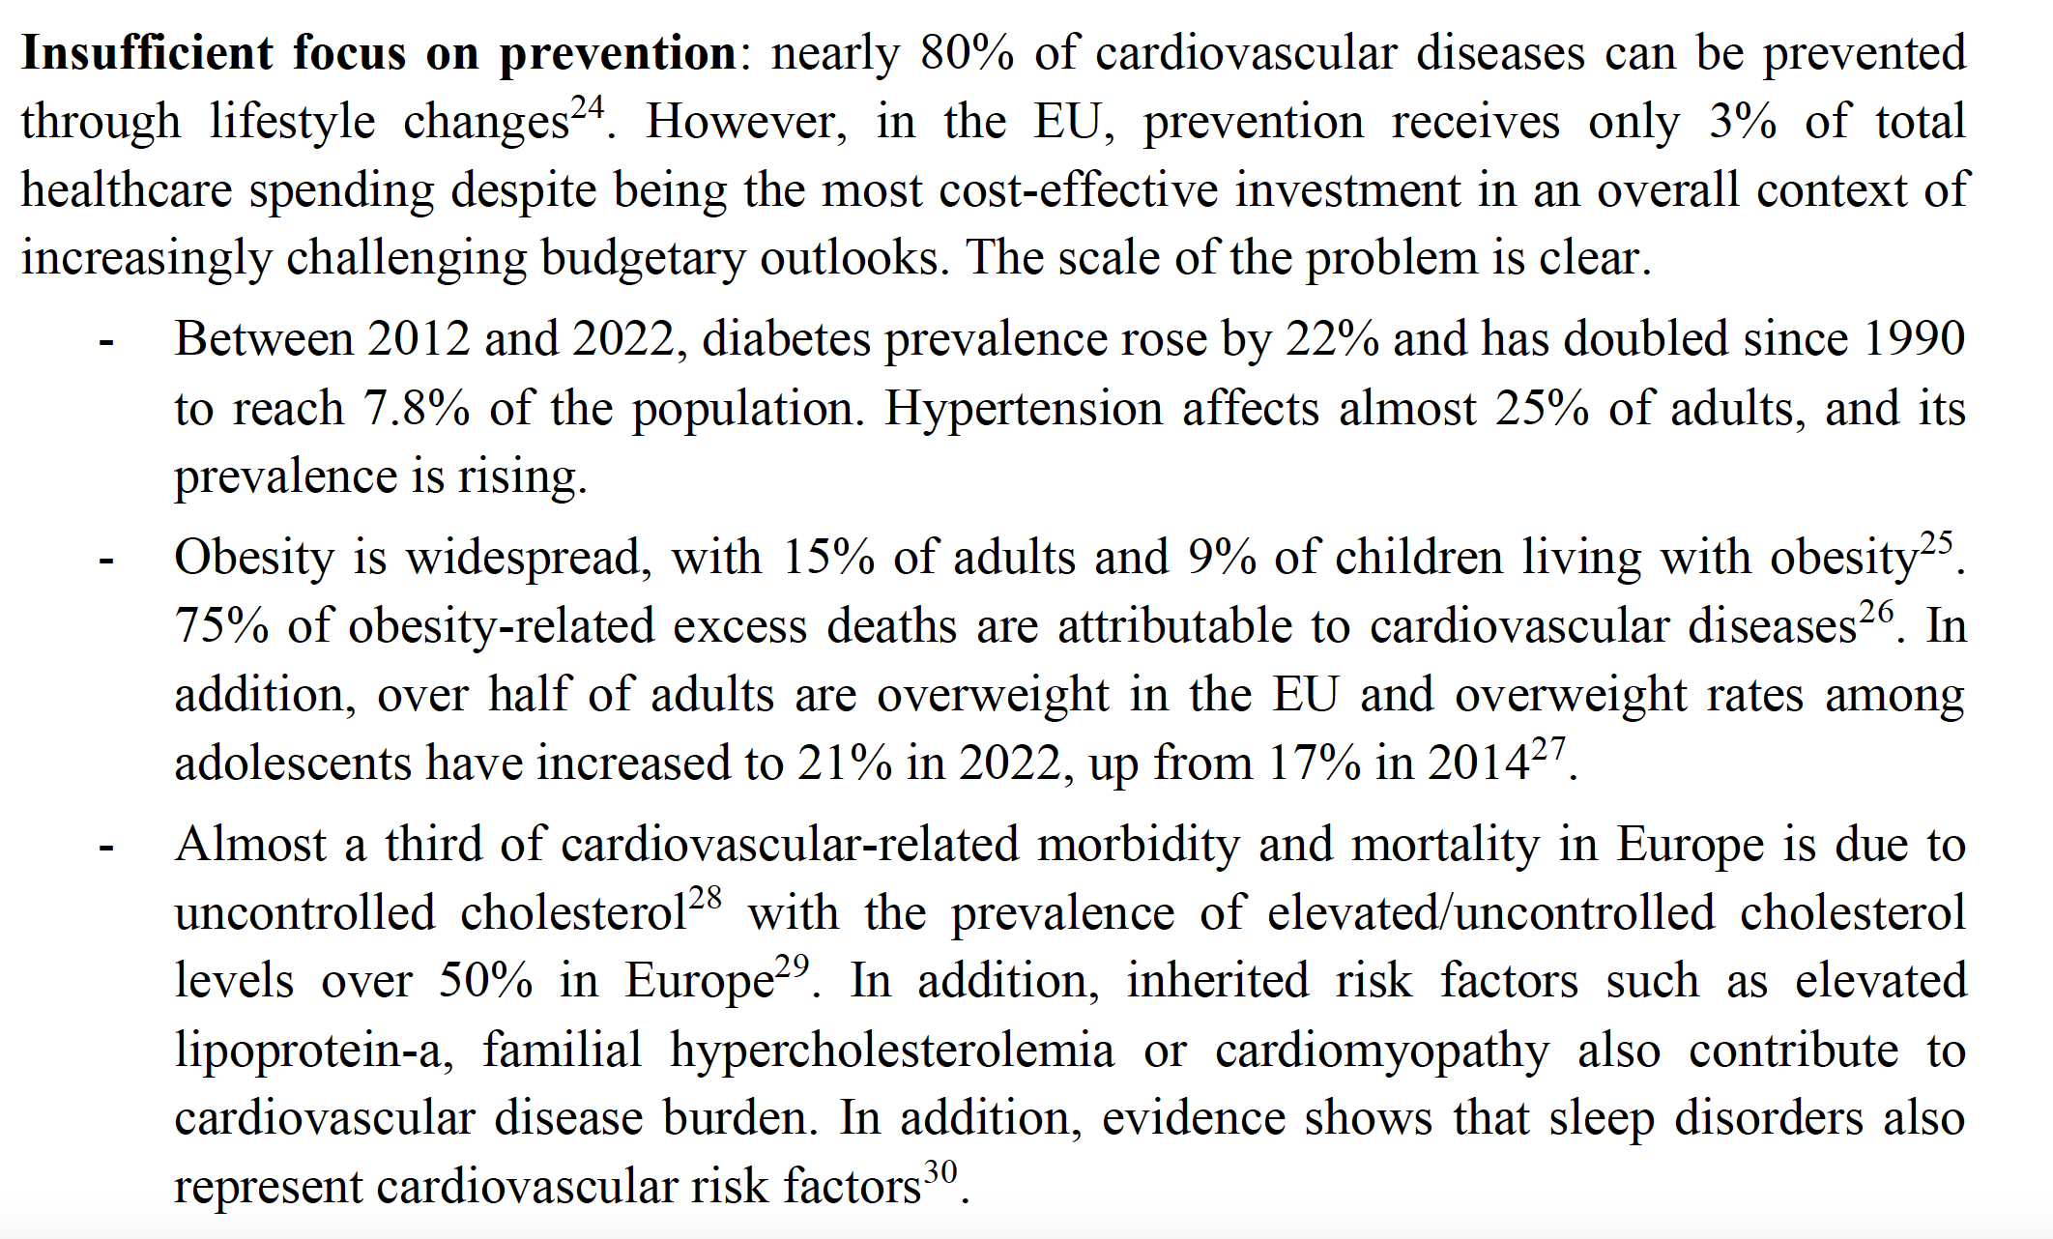


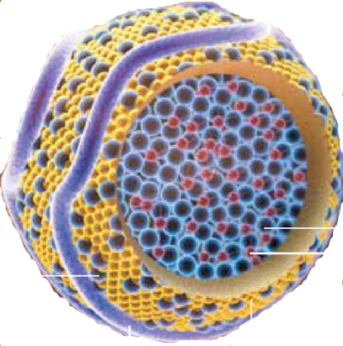
ESC CV CRT Round Table on CardioMetabolic Disease

Slide 8
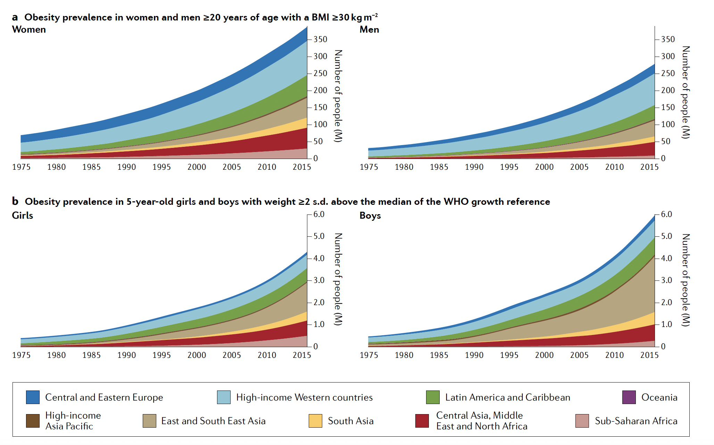





ESC CV CRT Round Table on CardioMetabolic Disease
Obesity Prevalence in Children or Adults with BMI 30kg/m²
In 40 years?!?
Obesity Prevalence in 5-year-old Children with Weight 2 SD above Median

Slide 9
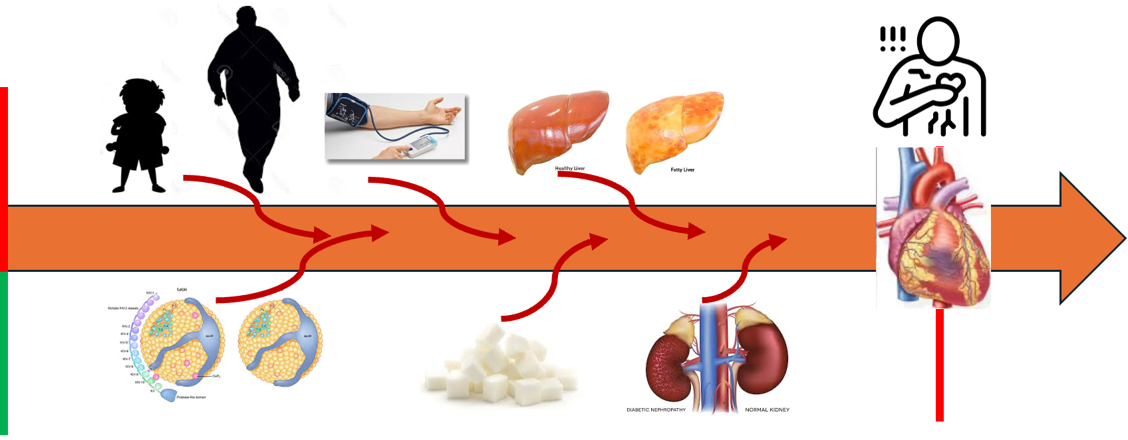
ESC CV CRT Round Table on CardioMetabolic Disease
Cardiometabolic Medicine is really Cardiovascular Medicine:
The new Cardiology Generalist

Slide 10
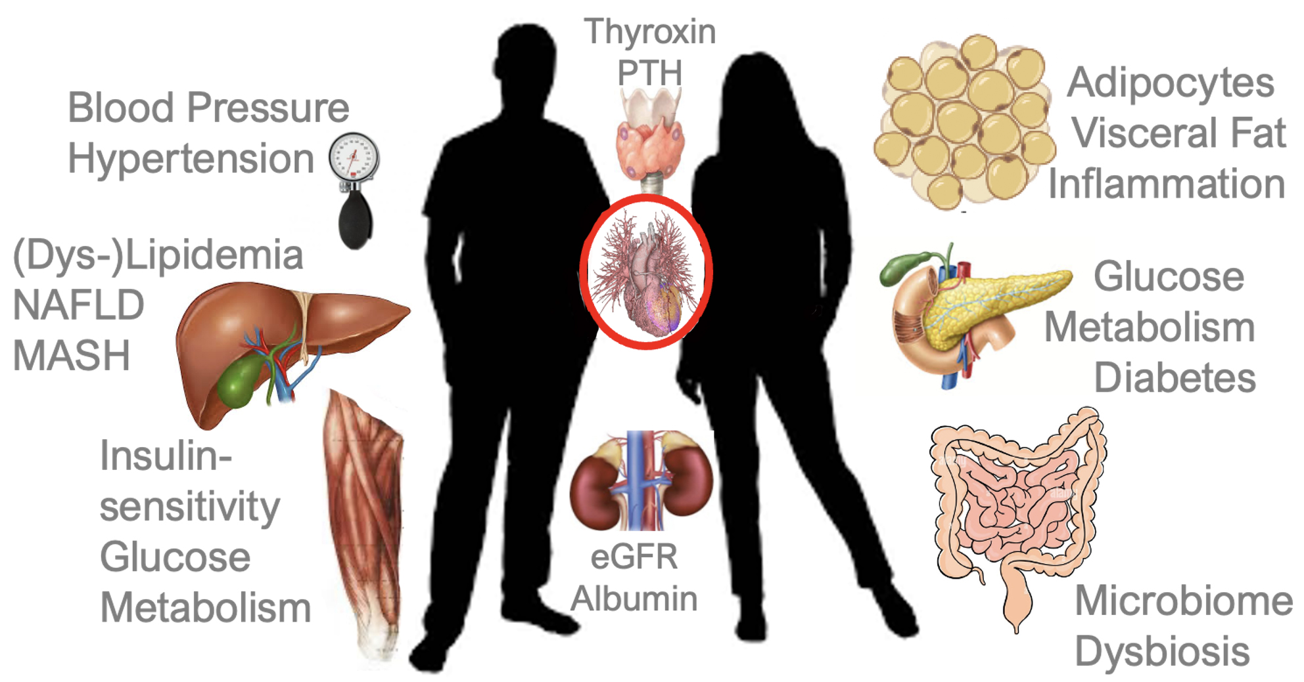
ESC CV CRT Round Table on CardioMetabolic Disease
Confidential – for internal use only – ESC Board March 2026 summary

Slide 11
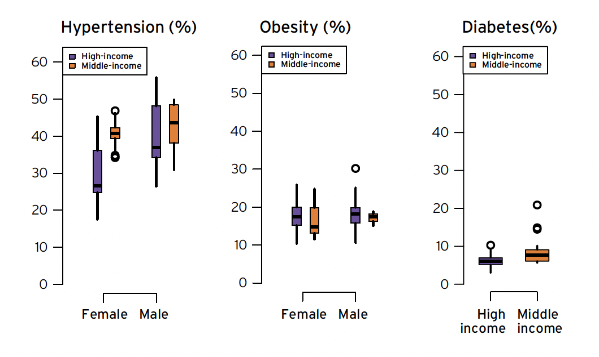
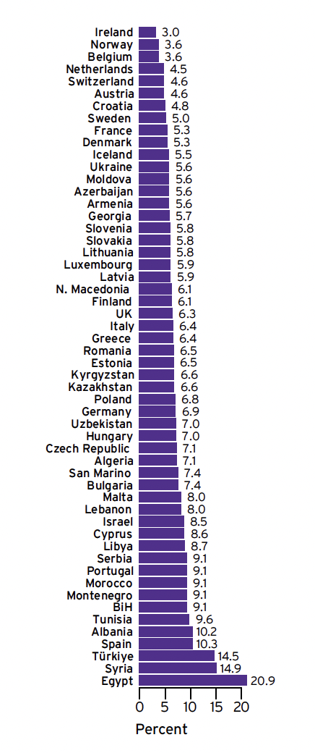
ESC CV CRT Round Table on CardioMetabolic Disease
Diabetes

Slide 12
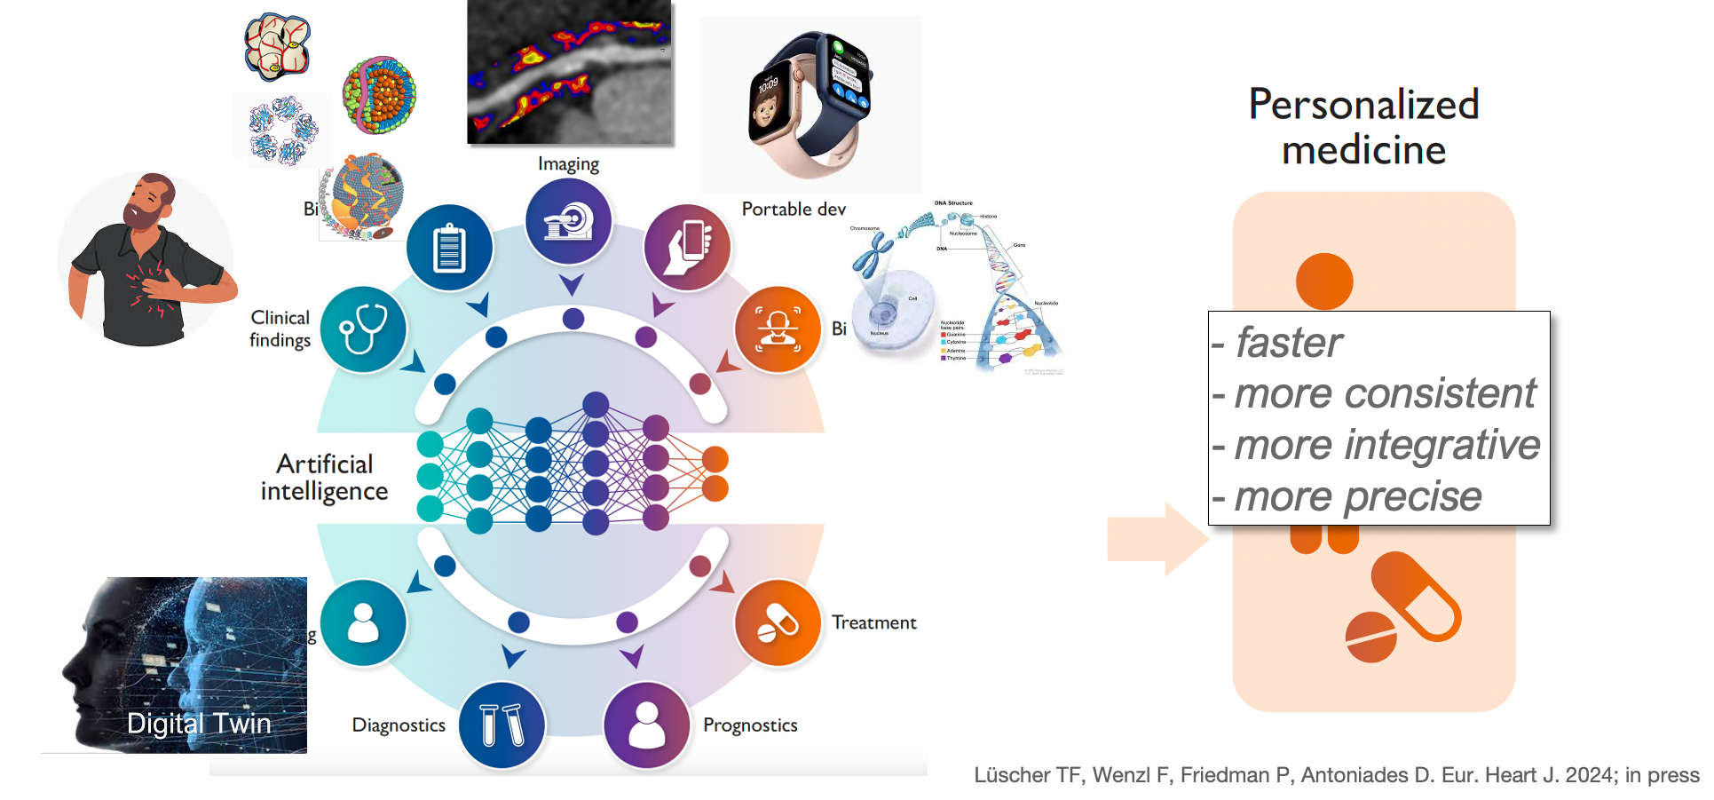
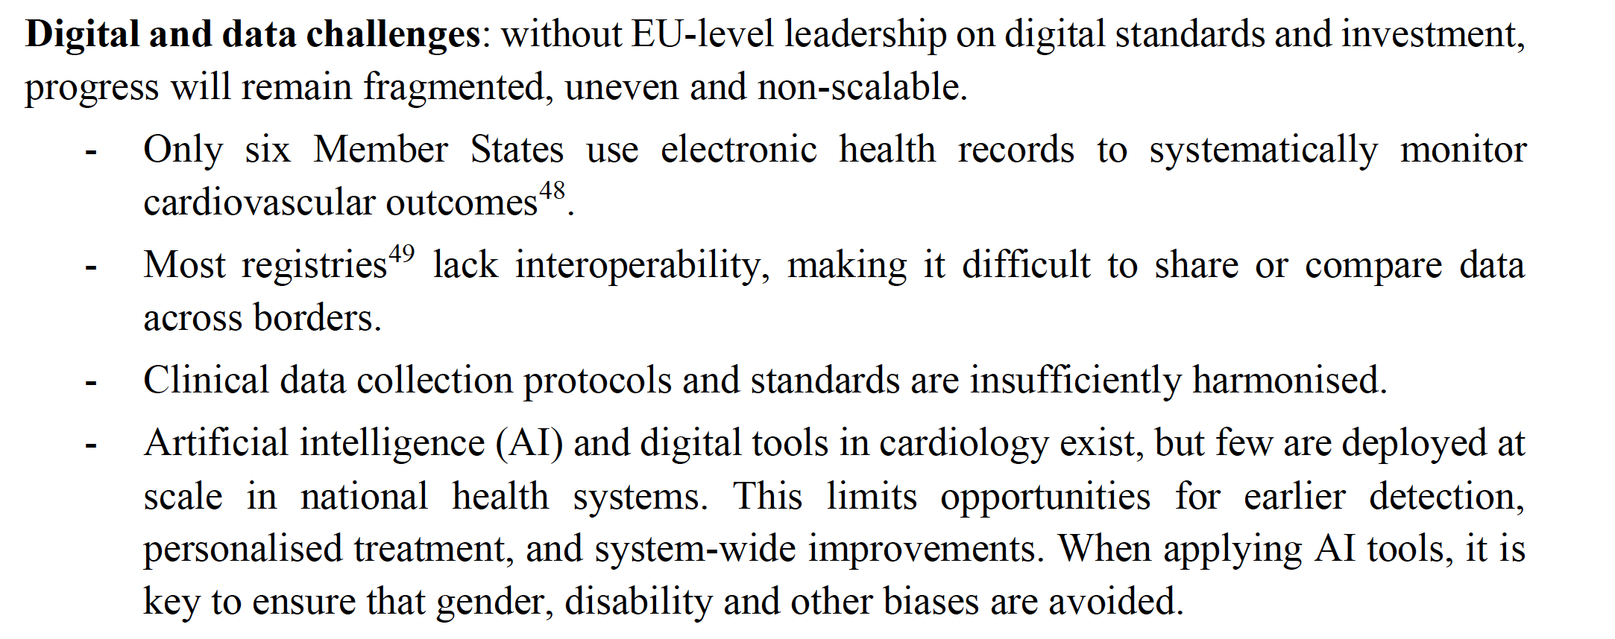
ESC CV CRT Round Table on CardioMetabolic Disease

Slide 13
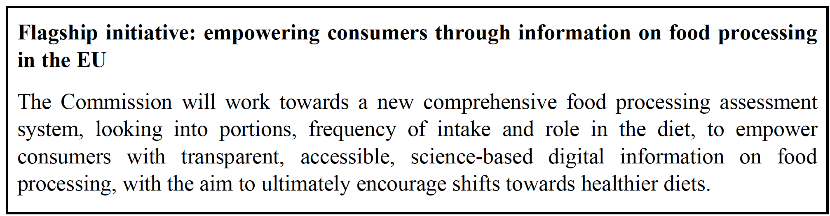
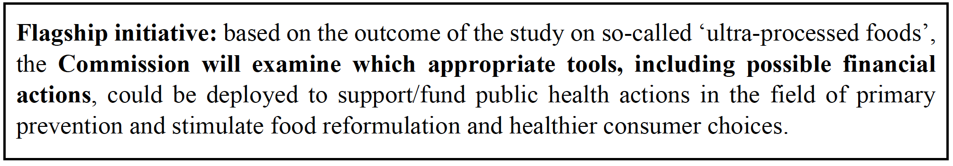

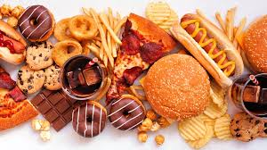

ESC CV CRT Round Table on CardioMetabolic Disease

Slide 14
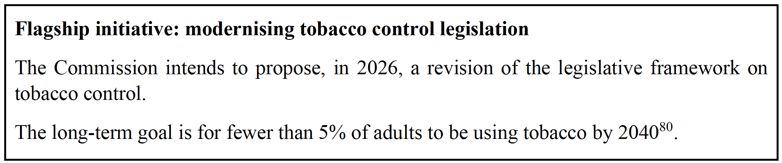
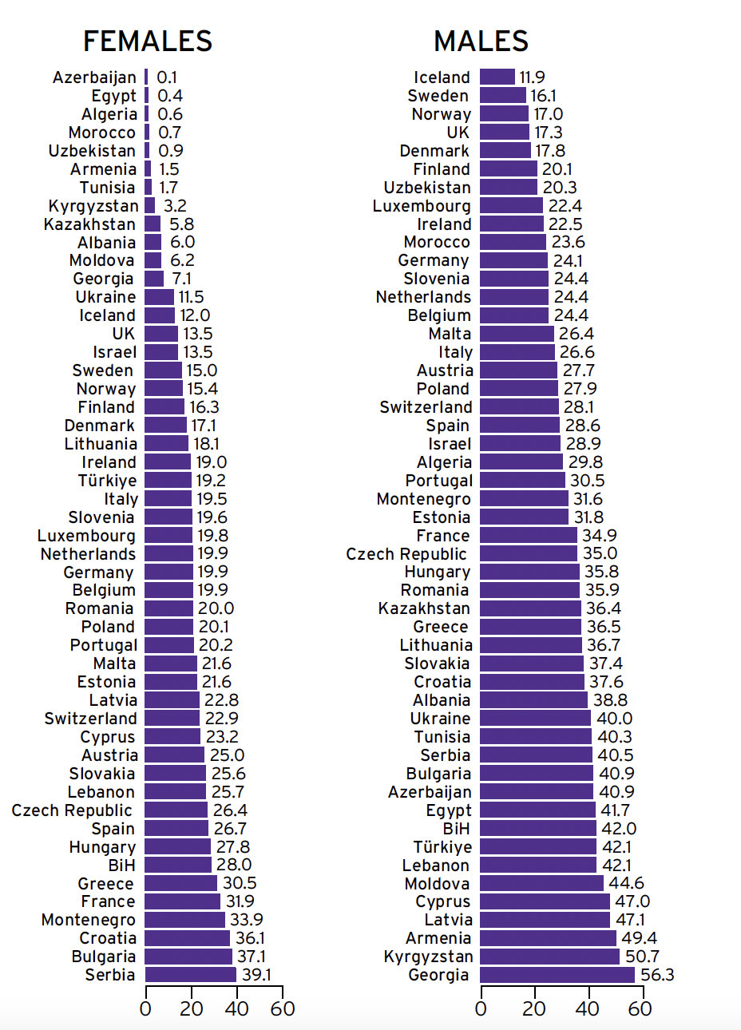
ESC CV CRT Round Table on CardioMetabolic Disease

Slide 15
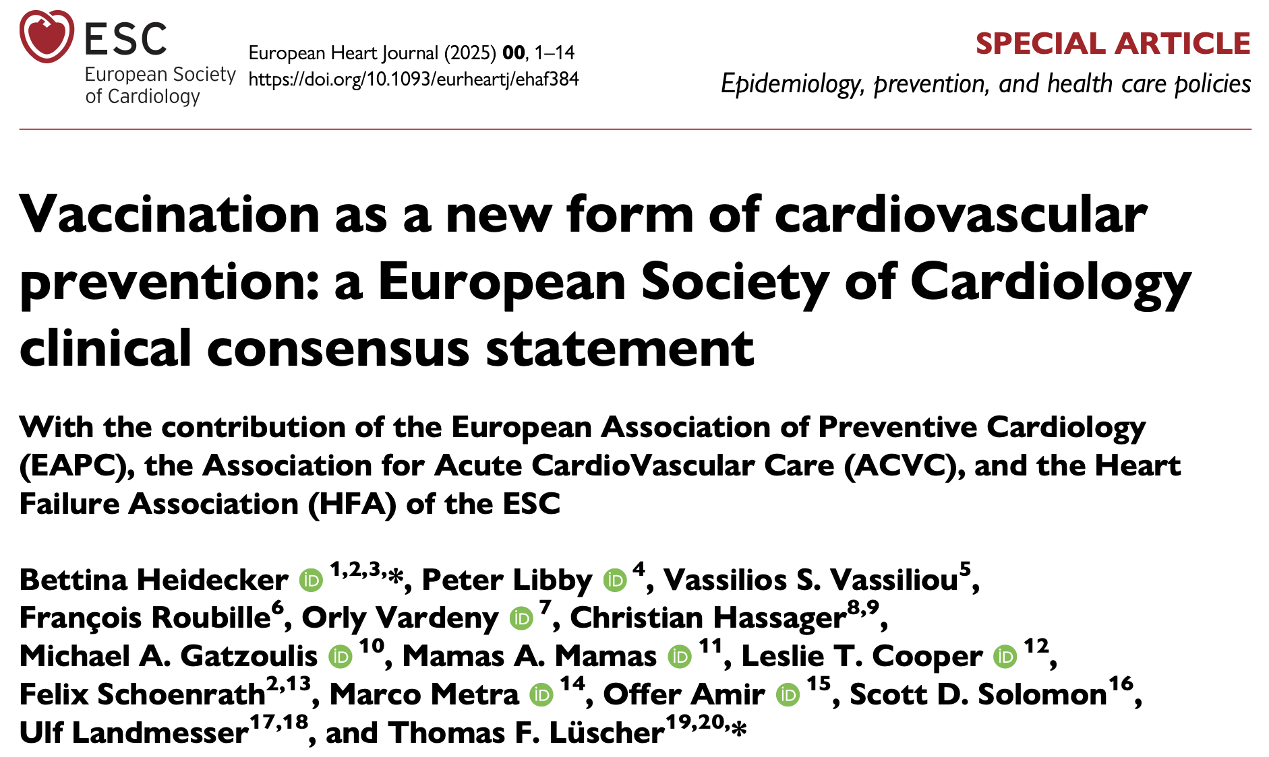
ESC CV CRT Round Table on CardioMetabolic Disease

Slide 16
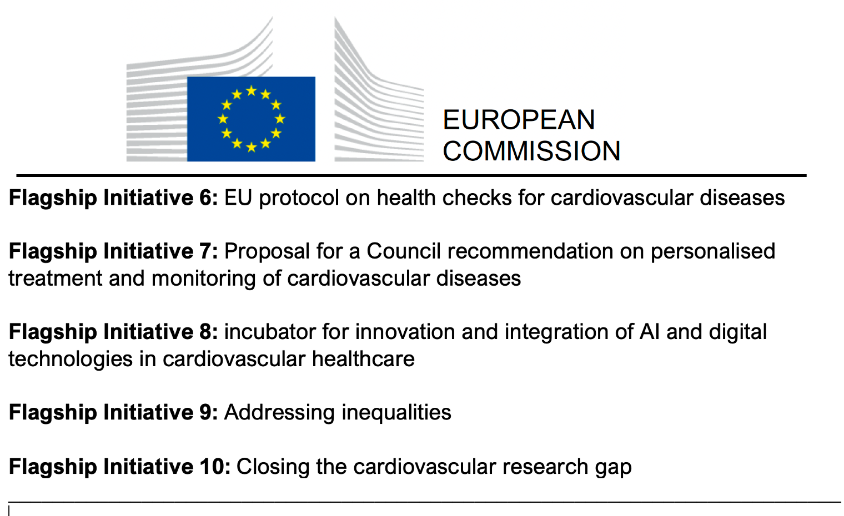
ESC CV CRT Round Table on CardioMetabolic Disease

Slide 17
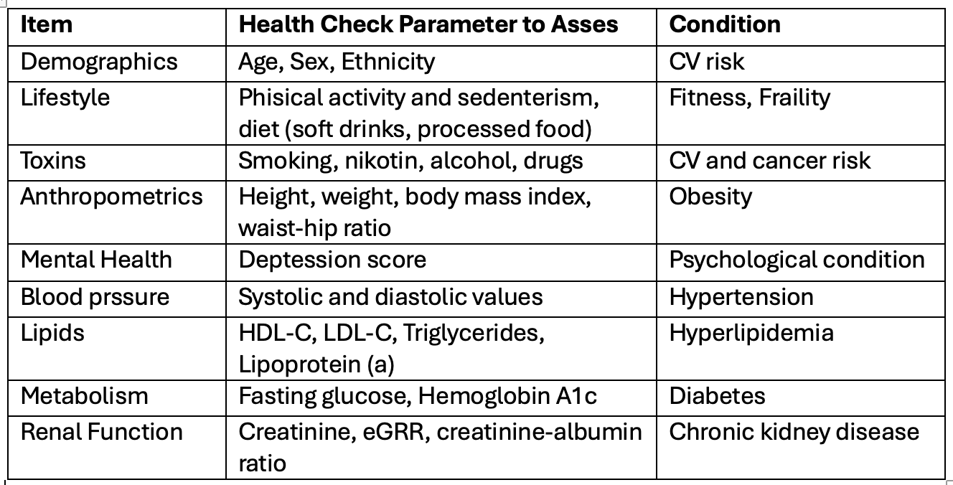
ESC CV CRT Round Table on CardioMetabolic Disease
The EU Cardiovascular Health Check

Slide 18
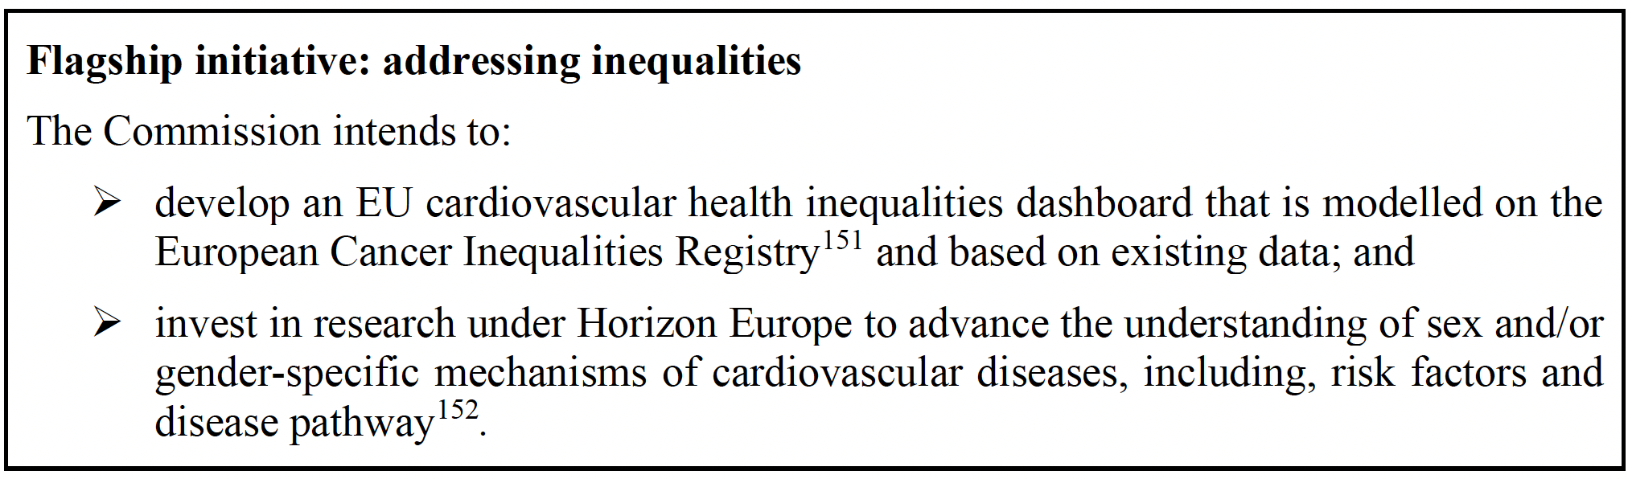
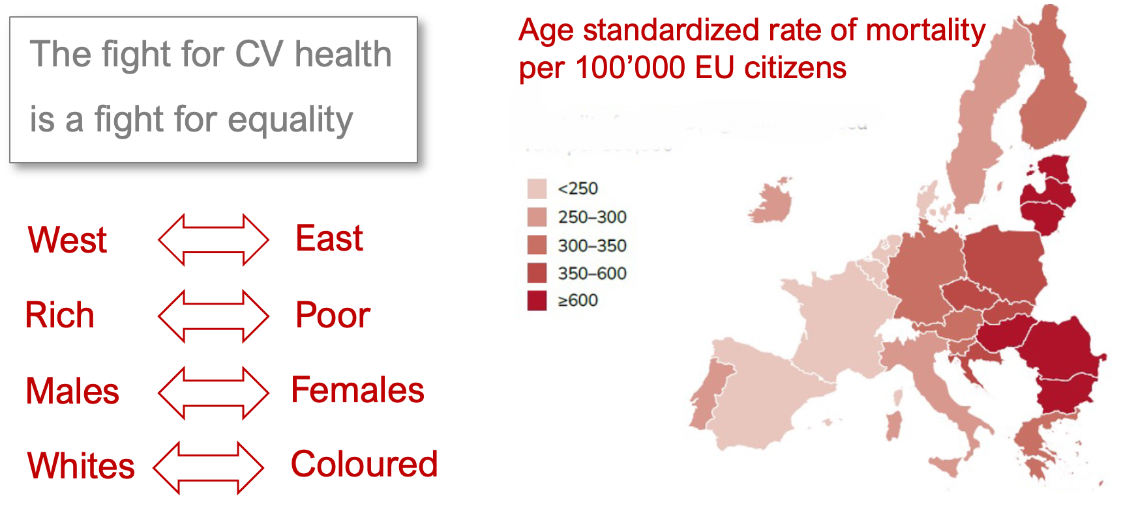
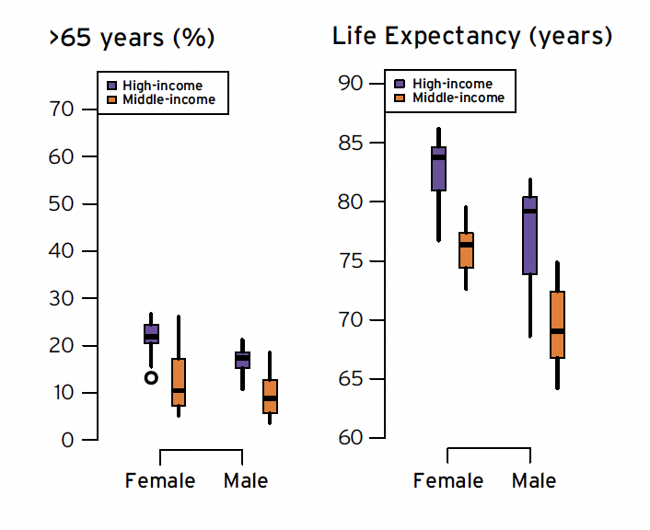
ESC CV CRT Round Table on CardioMetabolic Disease

Slide 19
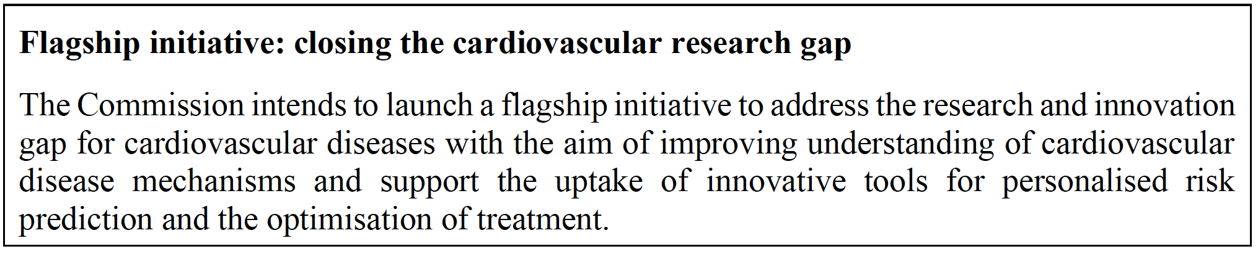
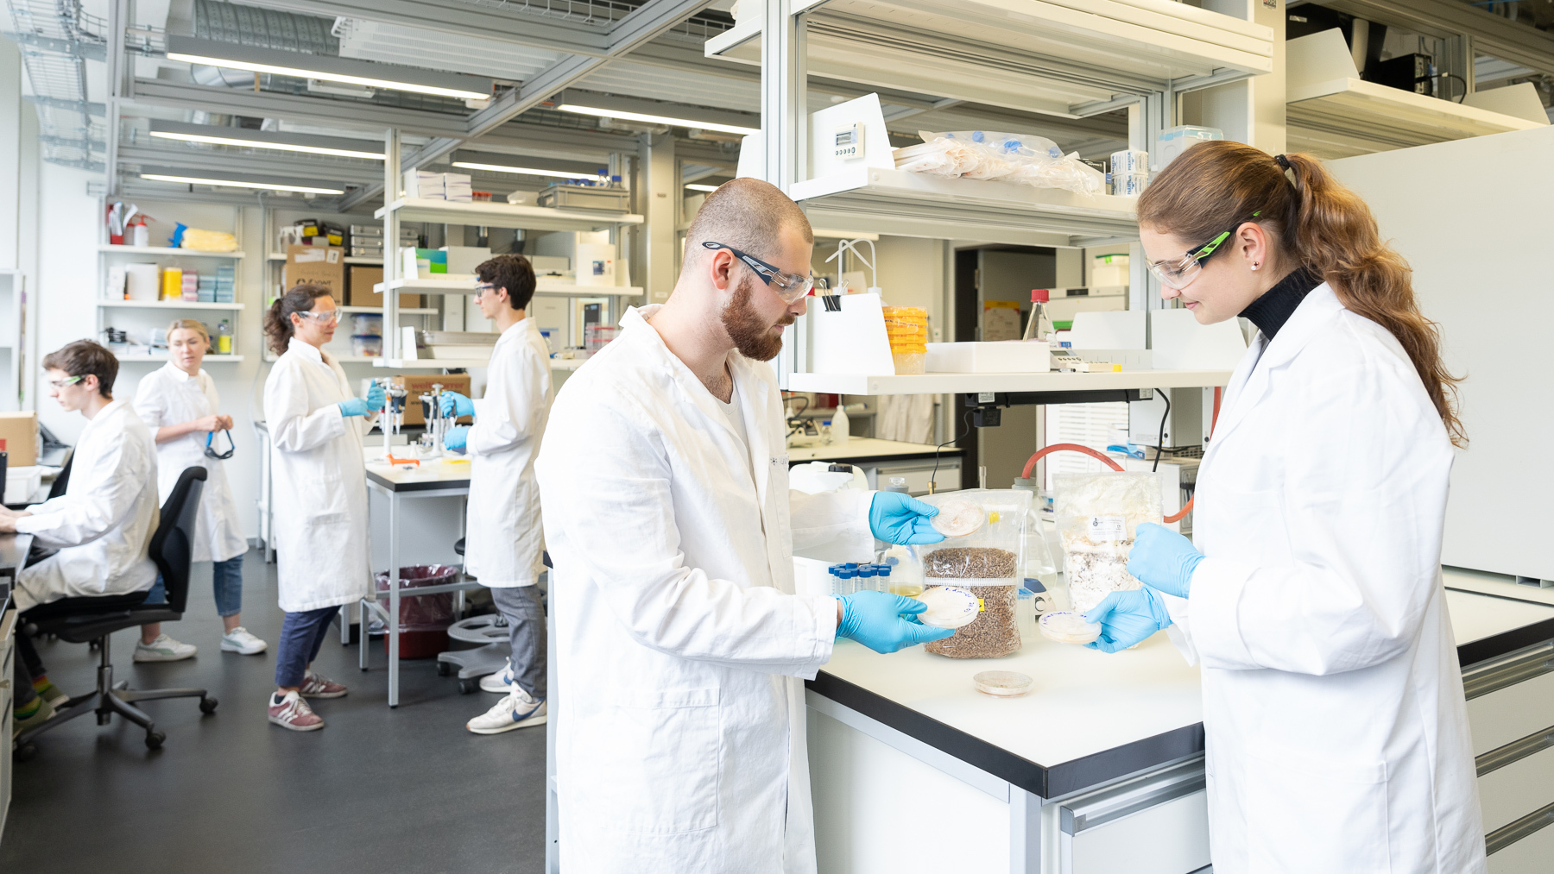


ESC CV CRT Round Table on CardioMetabolic Disease

Slide 20
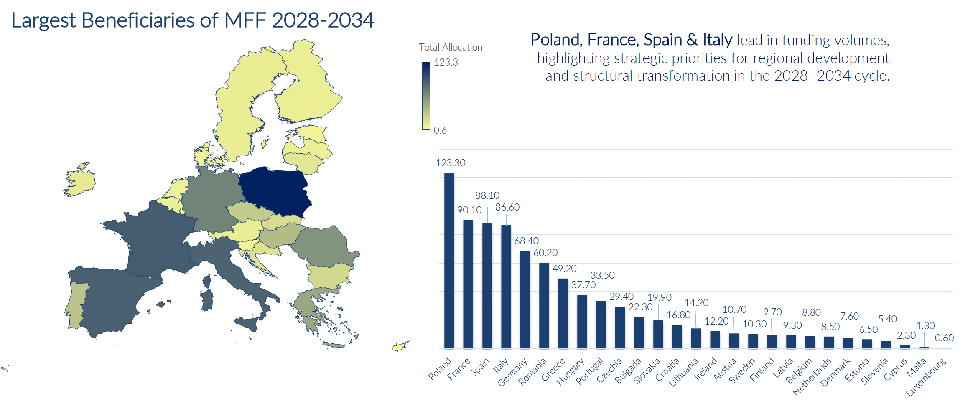
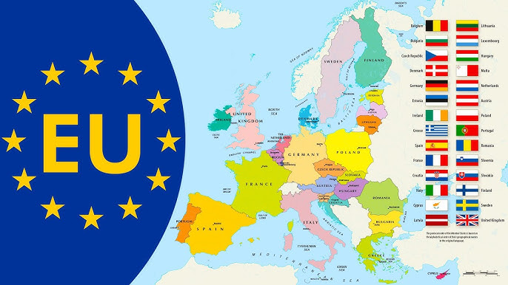
ESC CV CRT Round Table on CardioMetabolic Disease
EU Financial Plan 2028 - 2034
EU Budget
HORIZON
European Competitivness Fund
National Regional Partnership Plan (NRPP)

