Slide 1





ESC Cardiovascular Round Table on Cardiometabolic Disease
Bratislava, 18-19 March 2026
Patterns, causes and risk factors (classical and emergent)
of cardiometabolic disease
Francesco Cosentino, MD, PhD, FESC
Unit of Cardiology
Department of Medicine
Karolinska University Hospital
Stockholm

Slide 2
Disclosures
Francesco Cosentino
Research grants: Swedish Research Council, Swedish Heart & Lung Foundation, Karolinska Institutet, European Foundation for the Study of Diabetes, Swedish Diabetes Foundation, King Gustav V and Queen Victoria Foundation.
Advisory board/speaker: AstraZeneca, Boehringer Ingelheim, Bristol Myers Squibb, Lilly, Merck Sharp & Dohme, Novo Nordisk, Pfizer, Neopharmed, Berlin Chemie.

Slide 3
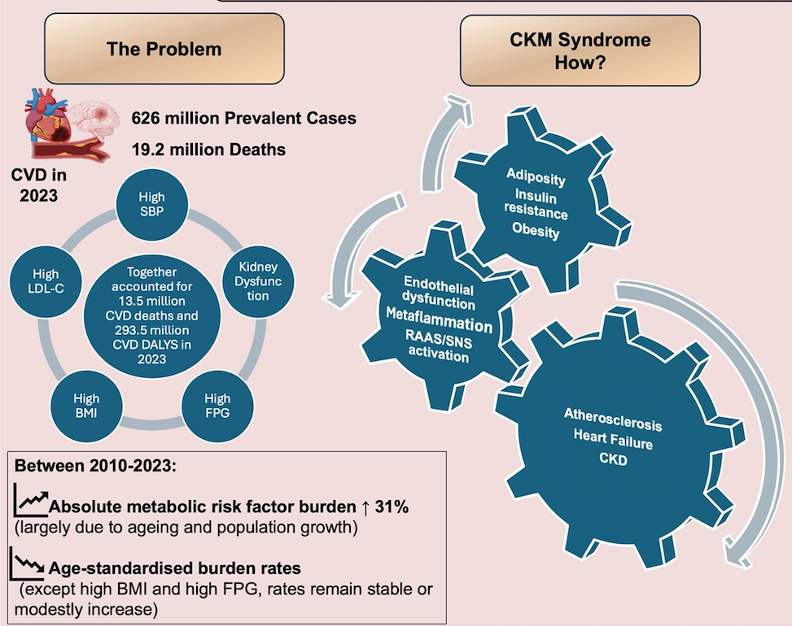
Global Burden of Cardiometabolic Risk
Despite declines in age-standardised burden rates, the absolute metabolic risk factor burden continues to rise.
CKM syndrome represents the convergence of several conditions
driving
Manla Y, .Cosentino F. CV Research 2026 (submitted)
DALYs: disability-adjusted life years

Slide 4
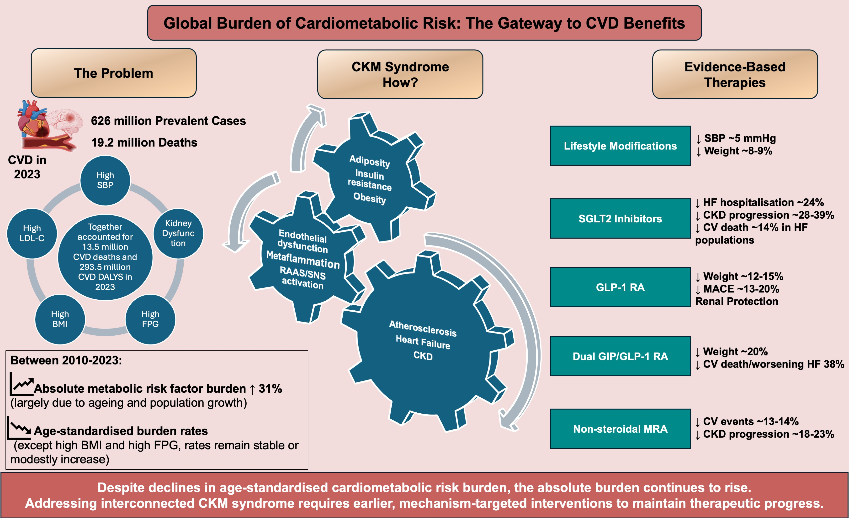
Global Burden of Cardiometabolic Risk
This interconnected pathophysiology supports a shift from isolated risk-factor management
toward integrated, mechanism-based prevention.
Manla Y, .Cosentino F. CV Research 2026 (submitted)

Slide 5
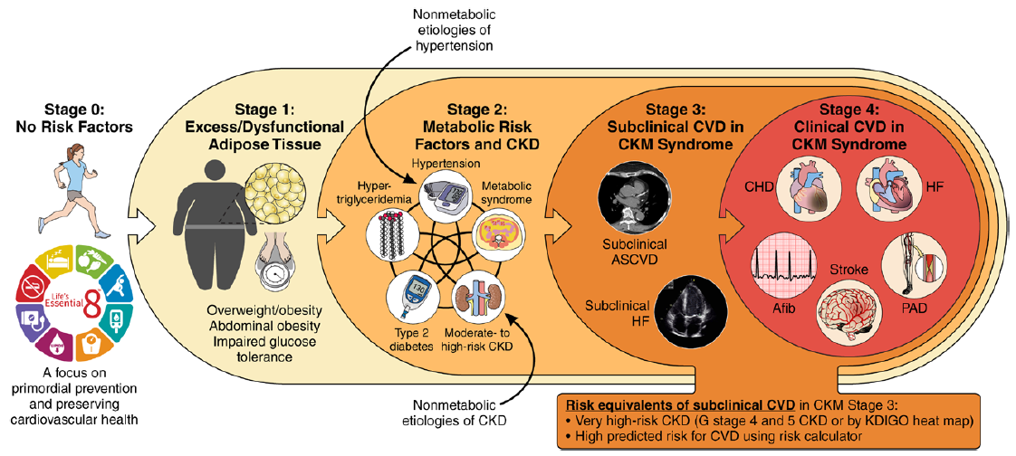
Classical CKM staging construct of AHA
Reflecting progressive pathophysiology and increasing CVD risk along the spectrum of CKM syndrome
Ndumele et al Circulation 2023

Slide 6
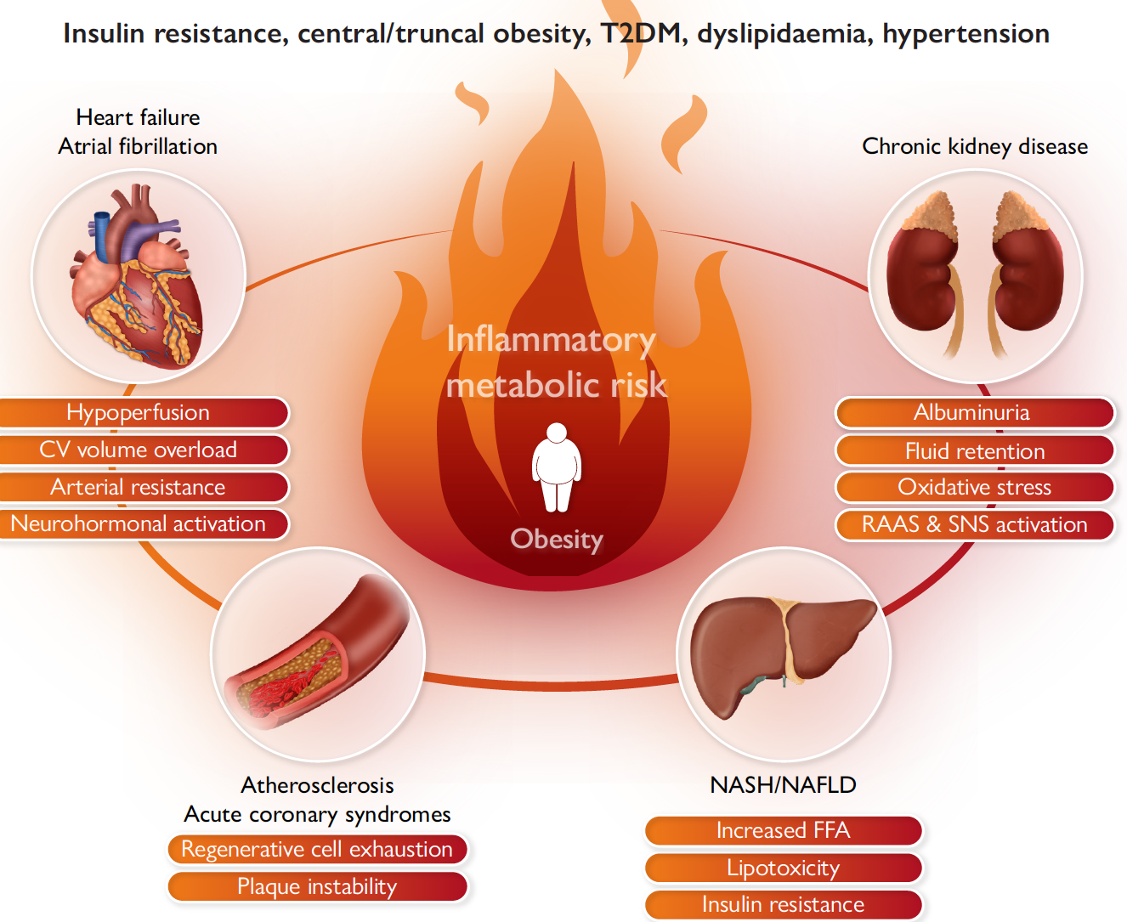
Mechanisms of cardio-renal metabolic risk
Cosentino et al Eur Heart J 2023

Slide 7
Cardio-renal metabolic risk: main drivers
Adipose tissue dysfunction and metabolic dysregulation amplified by inflammatory, endothelial, and neurohormonal pathways, leads to target organ injury.

Slide 8

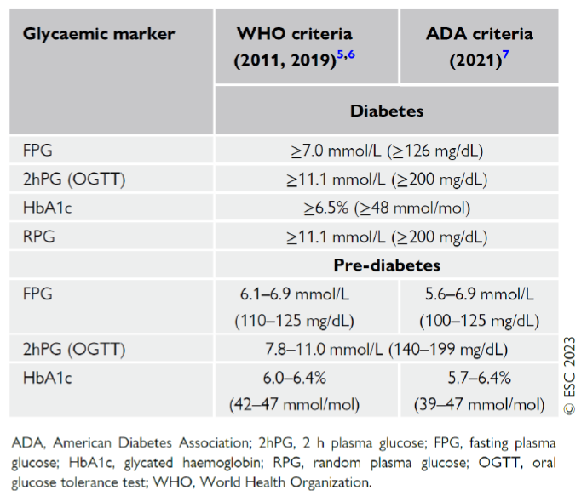
Emergent risk factor of CMD
Prediabetes/Intermediate Hyperglycaemia
WHO/ADA diagnostic criteria
A dysgl state that predict and precede dev of T2D. Such a condition is character by
Marx N et al. European Heart Journal; 2023

Slide 9
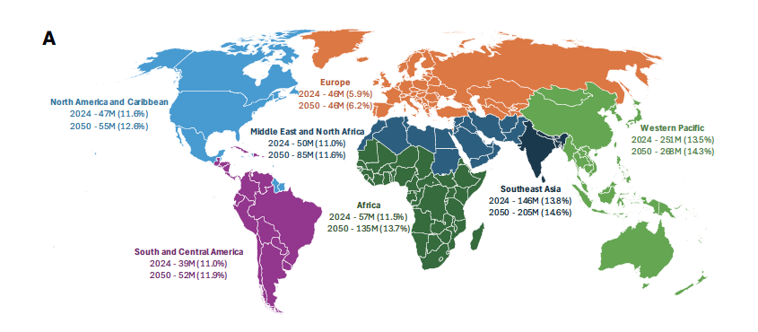
Global and Regional Prediabetes Prevalence
ADA updates for 2024 and projections for 2050
In 2024 635 millions (≈12%) of the global adult population were estimated to have IGT, by 2050 it is projected an increase up to 846,5 millions with projections that prediabetes cases could reach 1 billion by 2050.
Rooney MR, Diabetes Care 2025

Slide 10
The relationship of ASCVD risk and dysglycaemia
is a continuum
CV risk begins very early, well before the threshold
It is important to screen for dysglycemia
If we consider the elevated rate of diabetes development in people with pre-diabetes, the increased CV risk with IGT and the recently-established ability of some new drugs to prevent progression to T2D and future cardiovascular outcomes, not to screen for may reduce the odds to identify & optimize care for many people who are at high, lifetime risk of CV events
Progression of T2D
Insulin resistance
Hepatic glucose production
Insulin level
Incretin effect
4–7 years
Beta-cell function
Postprandial glucose
Fasting plasma glucose
Development of microvascular complication
Development of macrovascular complications
Impaired glucose tolerance
Diabetes
Doubts have, however, been raised about the possibility to prevent events by lifestyle
or pharmacological interventions in patients with prediabetes.
Diabetes diagnosis
Adapted from Ryden L et al. Eur Heart J 2013

Slide 11
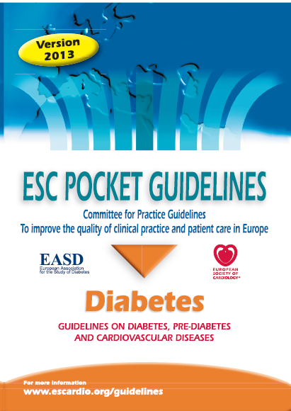
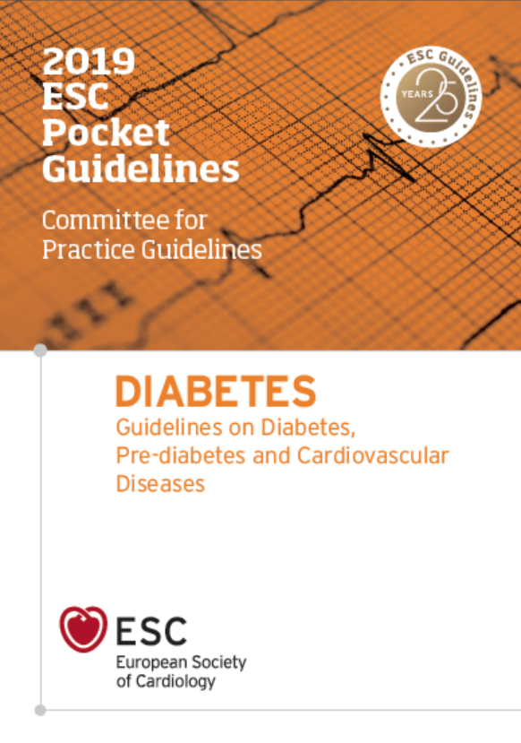
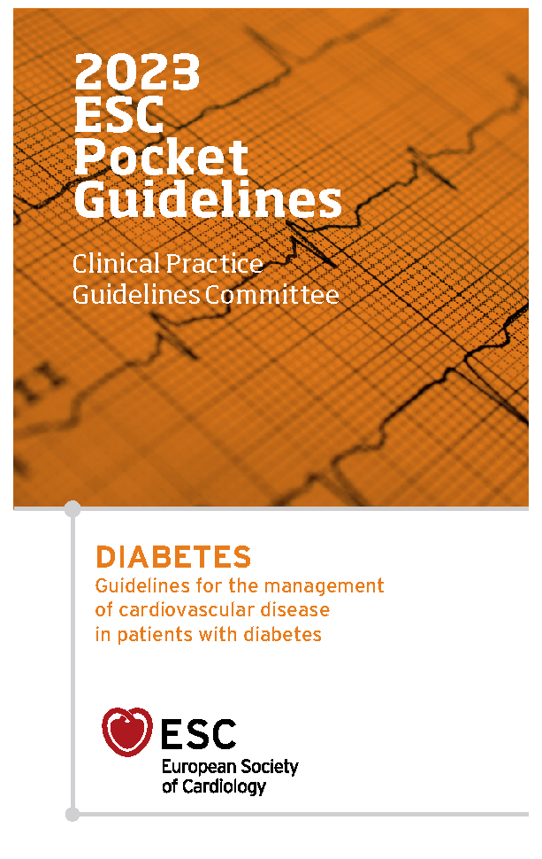
ESC Guidelines addressing diabetes, pre-diabetes and CVD
Version 2007
Version 2013
Version 2019
Version 2023
In collaboration with EASD
This led the authors of the
In contrast to
The rationale “…… Compared to patients with diabetes, there are no dedicated outcome trials that have provided data on the reduction of CV events”.

Slide 12
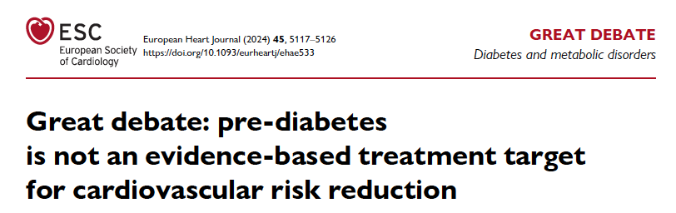

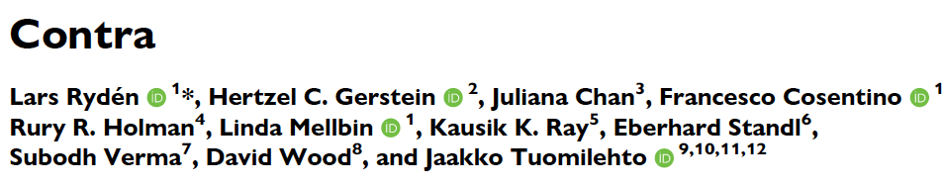
This opinion not accepted

Slide 13
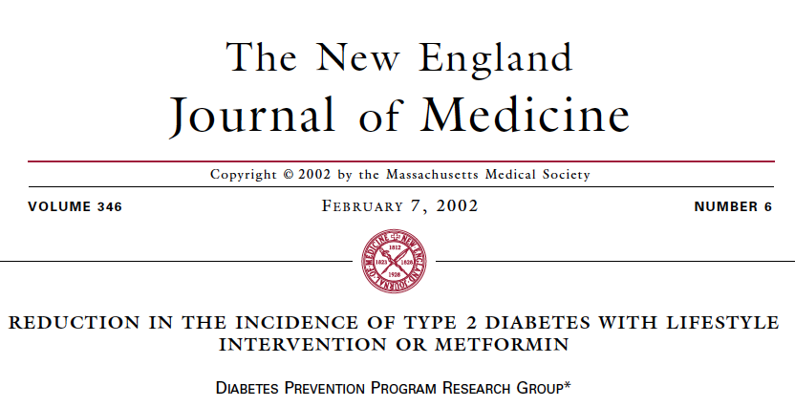
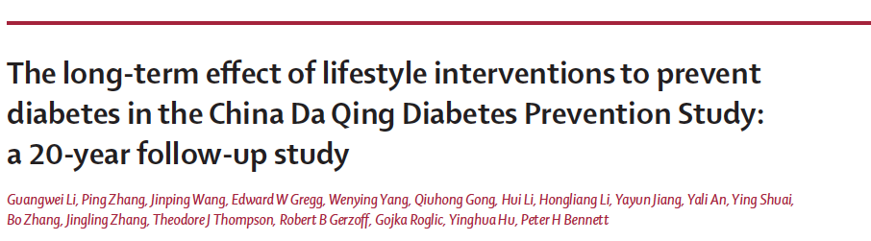
Two landmark trials established the foundation of
diabetes prevention strategies
Diabetes Prevention Program (DPP)
DaQing Diabetes Prevention Study
THE LANCET
Promoting lifestyle interventions prevents
or delays incident T2D
Participants were randomized to either intensive lifestyle intervention (aiming for ≥7% weight loss via calorie/fat reduction and ≥150 min/week physical activity), metformin, or placebo plus standard advice
Clinics delivered diet, exercise, or diet-plus-exercise lifestyle programs versus control
However, such preventive programmes did not include any defined glycemic target nor tested whether normalisation of glucose levels in such pts can prevent MACE

Slide 14
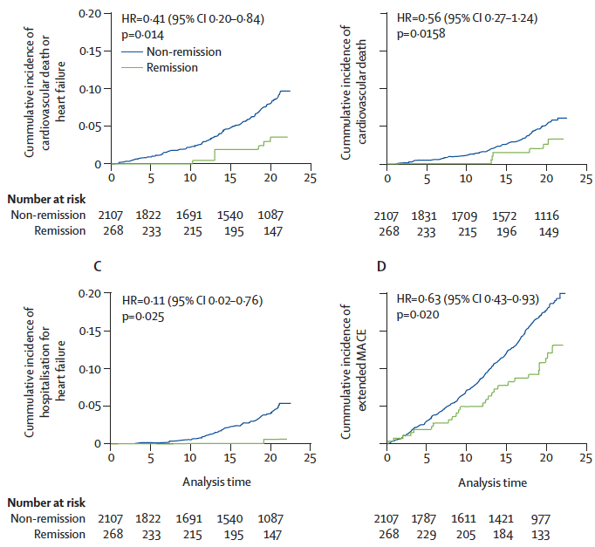
Recent joint post-hoc analyses of DPPOS and DaQingDPOS
Prediabetes Remission Concept in Cardiovascular Prevention
US-diabetes prevention program outcome study
Combining dietary and activity related measures.
Remission after 1 y of intervention, defined as
- FPG <100 mg/dL (5.6 mmol/L)
- OGTT <140 mg/dL (7.8 mmol/L)
- HBA_{1c} 5.7% (39 mmol/L)
Median follow-up: 20 years
Remission to normal glucose is associated
with a lower incidence of CV death or HHF
Vazquez Arreola E. et al. Lancet Diabetes Endocrinol 2026

Slide 15
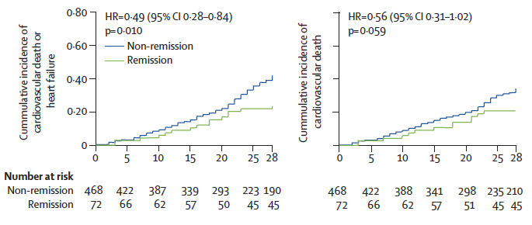
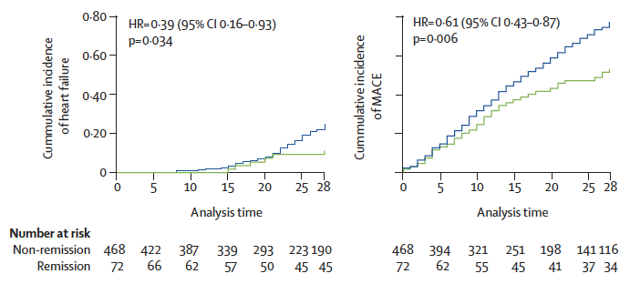
Prediabetes remission on CV outcomes
Post-hoc analysis from Da Qing Diabetes Prevention Outcome Study
Remission after 6 yrs of intervention
Median follow-up: 30 years
Lower risk of composite endpoint
Pooled meta-analysis of both studies the
aHR for CV death or HHF was 0.47 and
for all-cause mortality 0.63
These benefits remained robust
after adjusting for baseline CV risk
The results indicate that remisssion is
associated with a long-lasting
legacy effect on CV events
Vazquez Arreola E. et al. Lancet Diabetes Endocrinol 2026
differential risk at baseline was not the major driver of the observed CV benefits, disputing whether pred in itself is an actionable target in addition to RF characterizing it

Slide 16
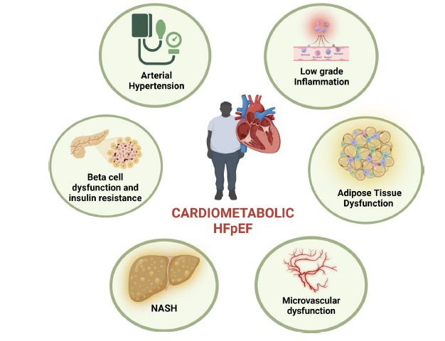
Why prevention of heart failure outcomes
may be the first major “win”
HF is tightly linked to features
that precedes diabetes by years
In this perspective, remission is not
merely “avoiding diabetes,”
but modifying the biology that leads
to heart failure
Preventing heart failure by restoring
metabolic health would be a major step forward
Gorica E et al. Cardiovasc Diabetol. 2025
yet the incidence continues to rise

Slide 17
Target is not to treat prediabetes but achieve
its remission
A new approach to cardiometabolic disease prevention
Cardiometabolic Disease
Treat
BP to a
defined
target
Lower
LDL
to target
Achieve
prediabetes
remission
Targeted return to normoglycemia represents a more cardiology-consistent and clinically actionable concept
as a diagnostic label/an outcome-linked state

Slide 19
Importance of screening for dysglycaemia
Population with risk factors for cardiovascular disease
Glucose metabolism by different tests
FINDRISC Questionnaire
OGTT = FPG + 2hPG and HbA1c
Conclusions
Hidden dysglycaemia very common
FINDRISC score
Did not reduce the need for blood tests
Blood tests
FPG single best for T2D
OGTT best for IGT
Pragmatic strategy (21% less OGTT)
FPG followed by OGTT if IFG
EUROASPIRE IV
n =2395
12 European countries
Treatment for hypertension and/or dyslipidaemia
No cardiovascular disease
No glucose perturbation
Dysglycaemia
39 %
IGT 20%
DM 19%
Shahim et al Cardiovasc Diabetol 2018; 17:21

Slide 20
Dysglycaemia screening and its prognostic impact in patients with CAD
from the EUROASPIRE IV and V cohort studies
EUROASPIRE IV
EUROASPIRE V
8364 patients with coronary artery disease
No diabetes
investigated with OGTT & HbA1c
Time index event – median 1.1 years Females 24%
Mean age 63±10 years
EAIV 2012-2013 n= 3 932
EAV 2017-2018 n= 4 432
Ferrannini et al. Lancet Diab Endocrin 2024

Slide 21
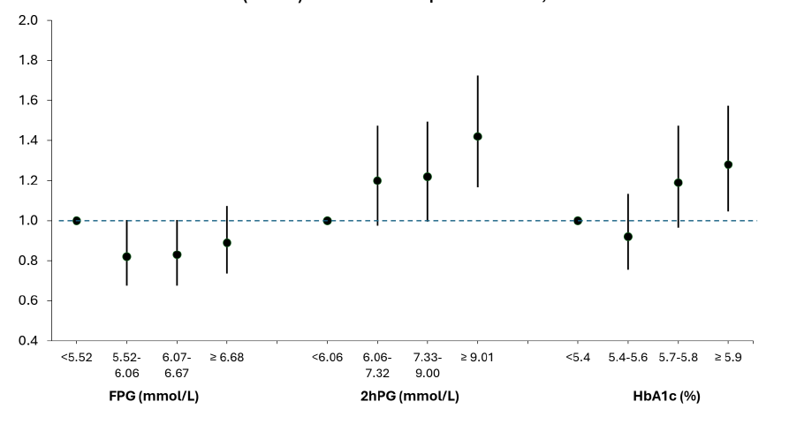
Screening for dysglycaemia
Prognostic capacity
2hPG better predicts future CV events in patients with CAD and
should be recommended as the primary screening tool for dysglycemia
Hazard ratios and 95% CI for cardiovascular events by quartiles of FPG, two-hour postload glucose (2hPG) and HbA1c.
Both FPG and HbA1c are inferior
in diagnostic and prognostic capability
A multivariate model the effect of HbA1c on CV events is driven by 2hPG
Ferrannini et al. Lancet Diab Endocrin 2024

Slide 22
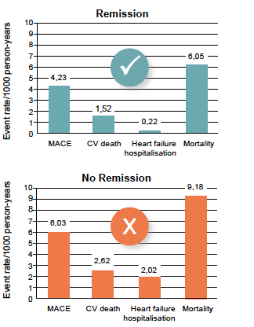
Targeting remission represents a new approach to cardiometabolic disease prevention
Remission of prediabetes
Multicomponent
lifestyle intervention
programmes focusing
on glycaemic targets
Progression to T2D

Slide 23
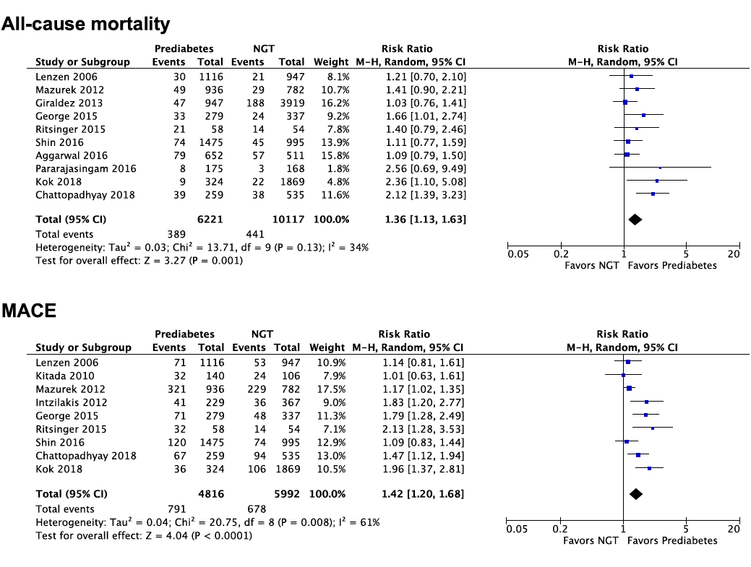
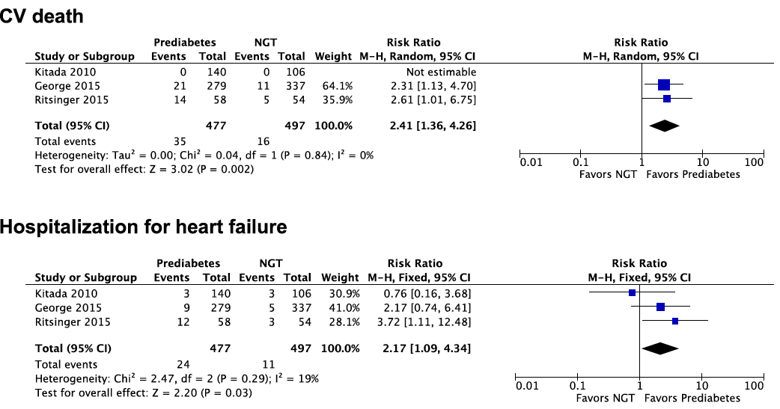
Strong association between prediabetes and recurrent MACE/mortality in patients after acute MI with no history of diabetes
A meta-analysis of 19 studies (n=41.509, median follow-up 3.1 years)
Outcomes in newly discovered prediabetes vs NGT
Prediabetes has higher mortality and MACE risk than NGT
Aggressive risk reduction strategies in this population with prediabetes, are warranted.
Laichuthai N et al. Diabetes Care 2020

Slide 24
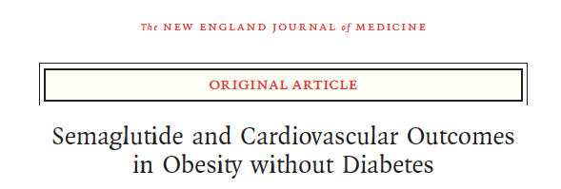
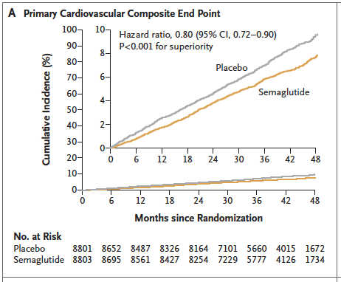
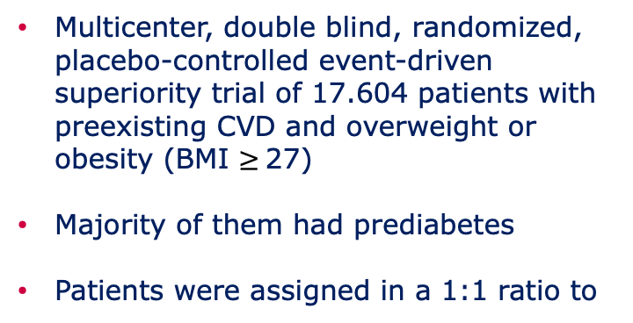
SELECT Trial - Cardiovascular efficacy
Multicenter, double blind, randomized, placebo-controlled event-driven superiority trial of 17.604 patients with preexisting CVD and overweight or obesity (BMI $≥$27)
Majority of them had prediabetes
Patients were assigned in a 1:1 ratio to
Once-weekly sc
semaglutide (2.4 mg)
Placebo
Gold standard outcome valid for drug registration & GL recos
Mean Follow up: 39.8 months
Lincoff AM et al. New Engl J Med 2023

Slide 25
Prediabetes Remission Concept
in Cardiovascular Prevention
Current concepts in prediabetes focus on halting progression to diabetes, the idea that the risk profile can be improved represents a new, more optimistic (albeit more aggressive) goal, and is the basis of the prediabetes remission concept.
The results from the post-hoc analysis of the Diabetes Prevention Program Outcome Study (DPPOS) and the DaQing Diabetes Prevention Outcome Study (DaQingDPOS)

