Slide 1


How to deal with the
Determinants of Cardiometabolic Health
Massimo Piepoli, MD, PhD, FESC, FHFA

Slide 2
Disclosures
Speaker memberships/leadership (not related to the topic)
Editor in Chief of EHJ-QCCO
Chair of the Scientific and Research Committee of the EAPC
Chair of the study group of the HFA Committee on Prevention
Member of the 2021 ESC Heart Failure Guidelines Task Force
Past ESC Vice President
Research grants (paid to the institution):
Italian Pharmaceutical Agency Grant
Italian Ministry of Health CV-Risk-It Study

Slide 3
Summary
The problems
Changes in Habits
Barriers to implementation of preventive strategies
Areas of interventions

Slide 4
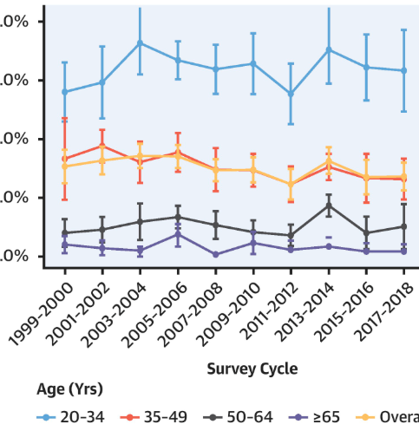
Cardiometabolic health in US
55,081 U.S. adults in the National Health and Nutrition Examination Survey, in 2017-18
6.8% of U.S. adults had optimal cardiometabolic health
Declining from 1999-2000 (P trend = 0.02), in control of
  Adiposity: from 33.8% to 24.0%
  Glucose: 59.4% to 36.9%;
Improvements in control on blood lipids: from 29.9% to 37.0%
Health disparities by age, sex, education, and ethnicity:
  Education: lower vs higher education (5.0% vs 10%)
  Ethnicity: Mexican American vs non-Hispanic White (3.2% vs 8.4%)
40%
30%
20%
10%
0%
<35 y
<50 y
<65 y
>65 y
O'Hearn M, et al. JACC. 2022;80(2):138-151.

Slide 5
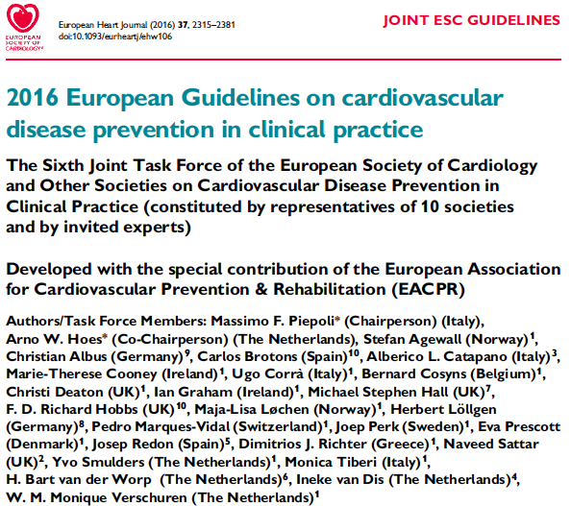
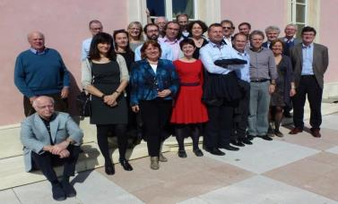

Notes:
Talented, hard workers, transparent, honest, correct

Slide 6
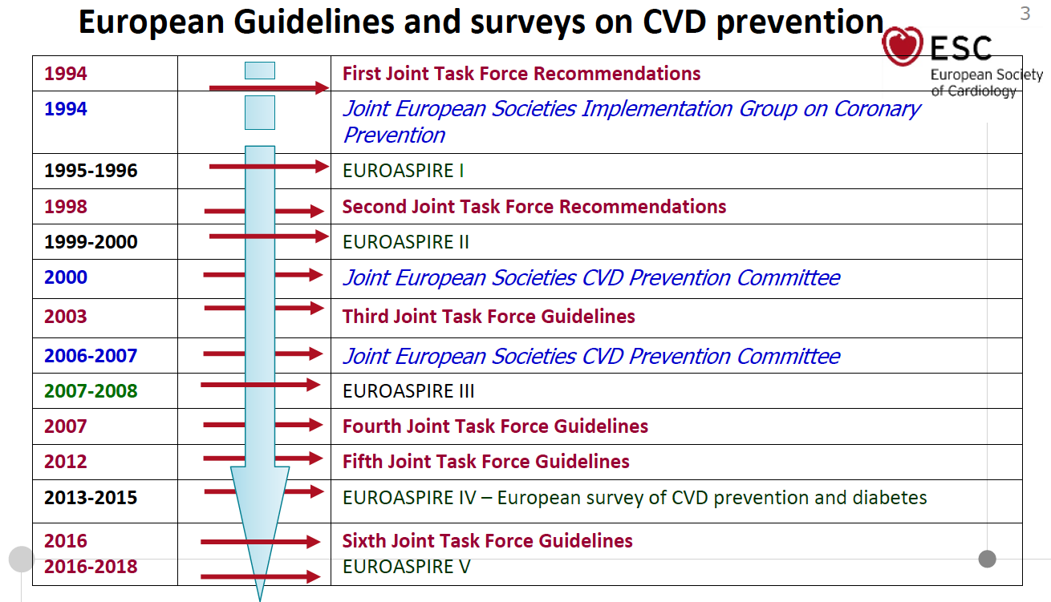

Slide 7


Proportion of coronary patients achieving lifestyle, risk factor and therapeutic targets for cardiovascular disease prevention defined in the Joint European Societies Guidelines on CVD prevention

Slide 8
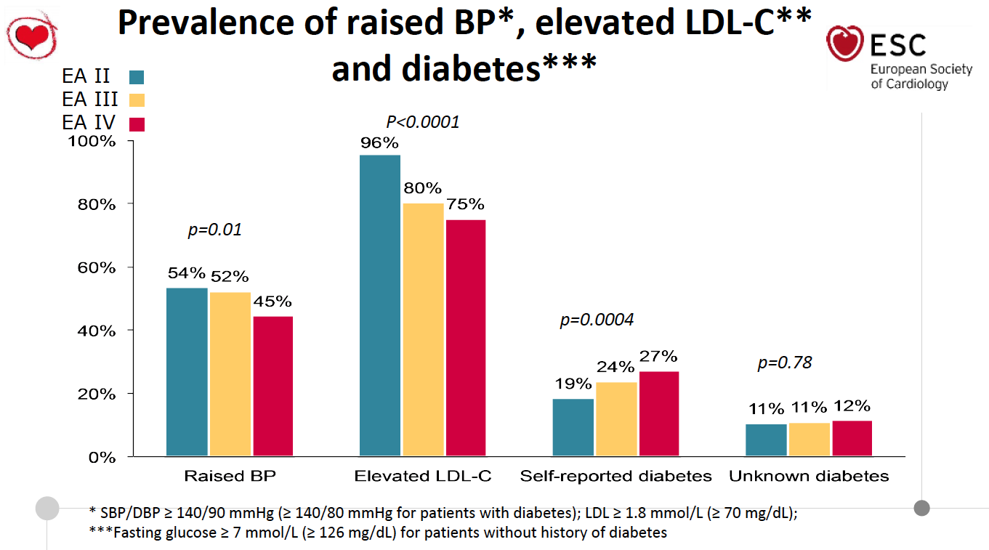
2000
2007
2015
2018
EA V
Kotseva et al. EUROASPIRE V
Eur J Prev Cardiol 2018
68%
46%
29%

Slide 9
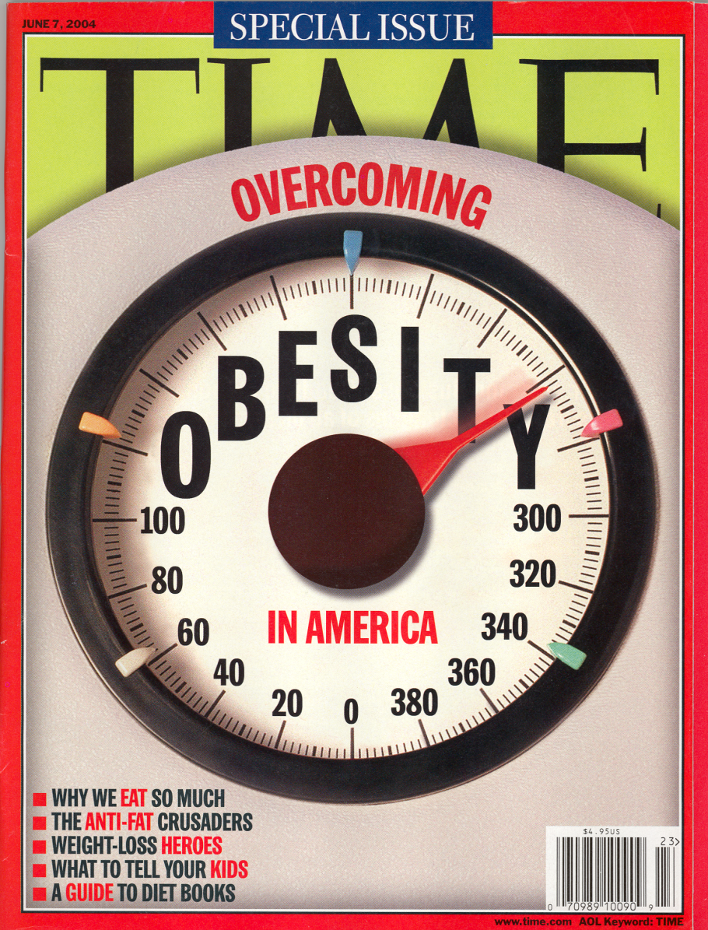

Slide 10
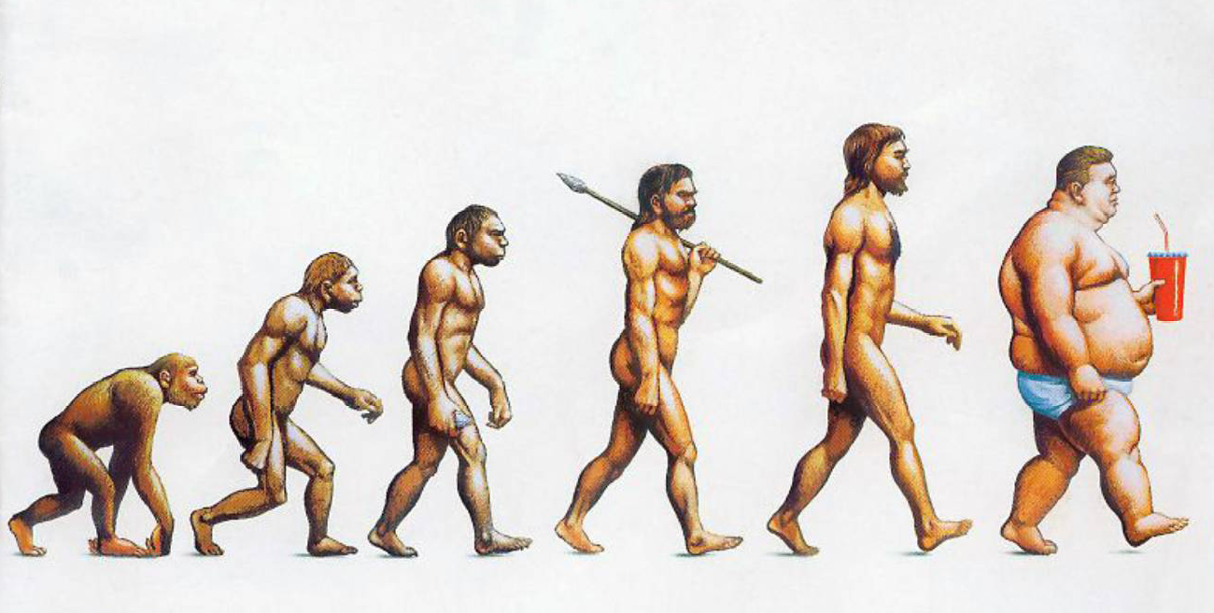
Evolution

Slide 11
Physical activity of Europeans ....
Seldom
Never
Elite athlete
(>5 h/Wk)
Irregular (1-3 h/wk)
Leisure (3-5 h/wk)
TK-Bewegungsstudie „Beweg Dich, Deutschland!“, Prof. Manfred Güllner, forsa, 30. Juli 2013

Slide 12
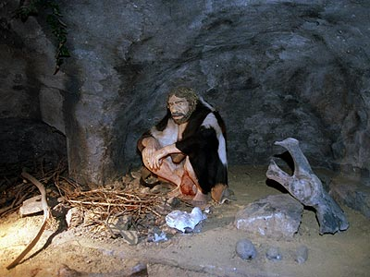
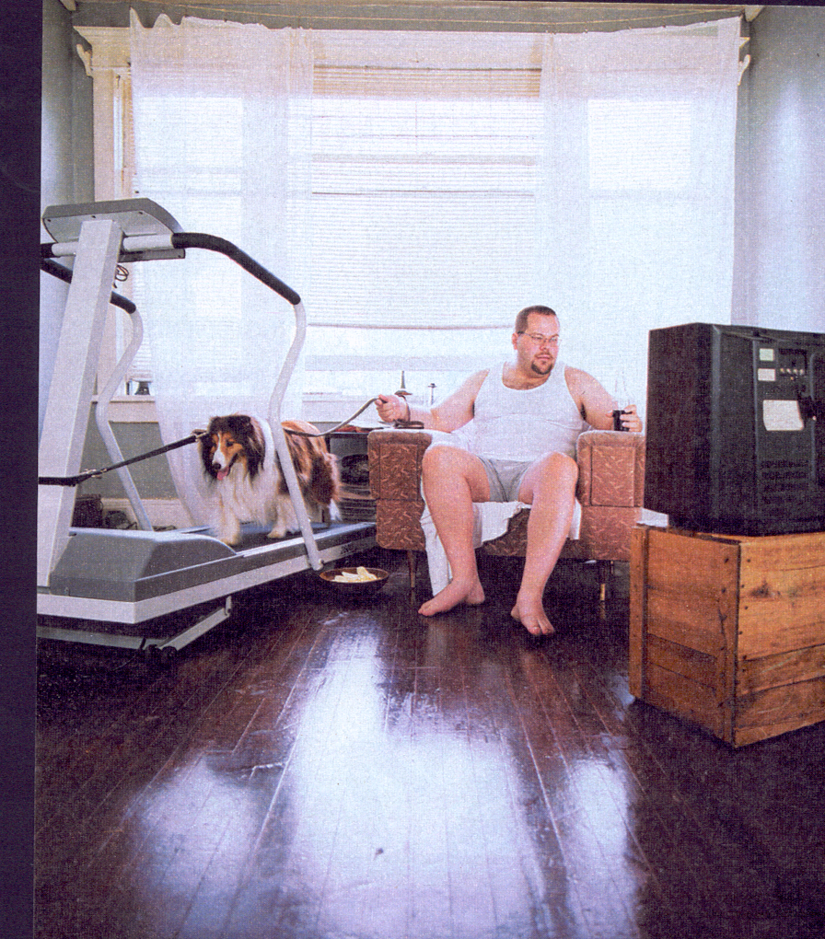
Development from the Neandertalian…
Activity of 25 km ..... to < 1 km per day

Slide 13
Development from the Neandertalian…
Activity of 25 km ..... to < 1 km per day

Slide 14
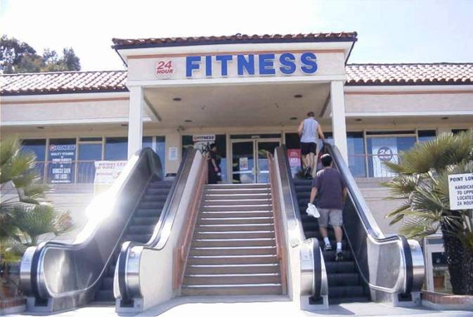
Knowledge is not sufficient –
American Diabetes Congress
Eur Soc Card Congress
Avoid physical activity…..

Slide 15



Slide 16
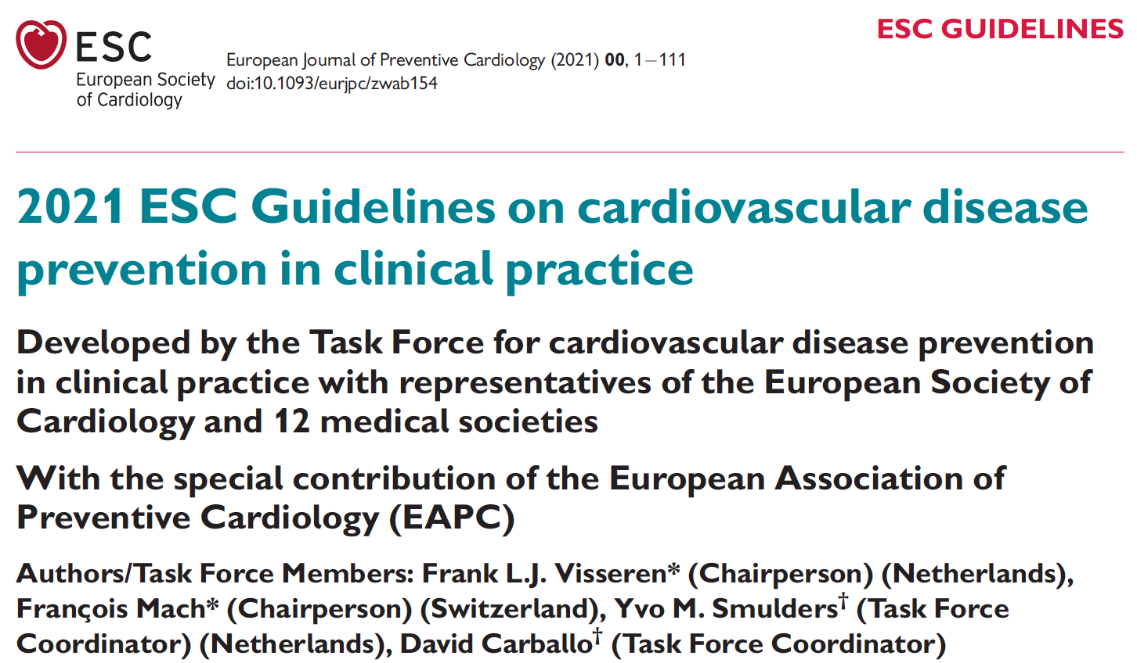

Slide 17
What is new in the 2021 CVD Prevention Guideline?
Stepwise approach to individualised CVD prevention
SCORE2 and SCORE2-OP (10 y risk of all CV events, fatal and nonfatal) for 4 geographic regions
Age-specific risk threshold in apparently healthy people
Estimation of lifetime CVD risk and treatment benefit
Shared decision making by taking patient specific conditions, preferences, CVD risk and treatment into account
Recomendation on environment
Signaling potential cost issues

Slide 18
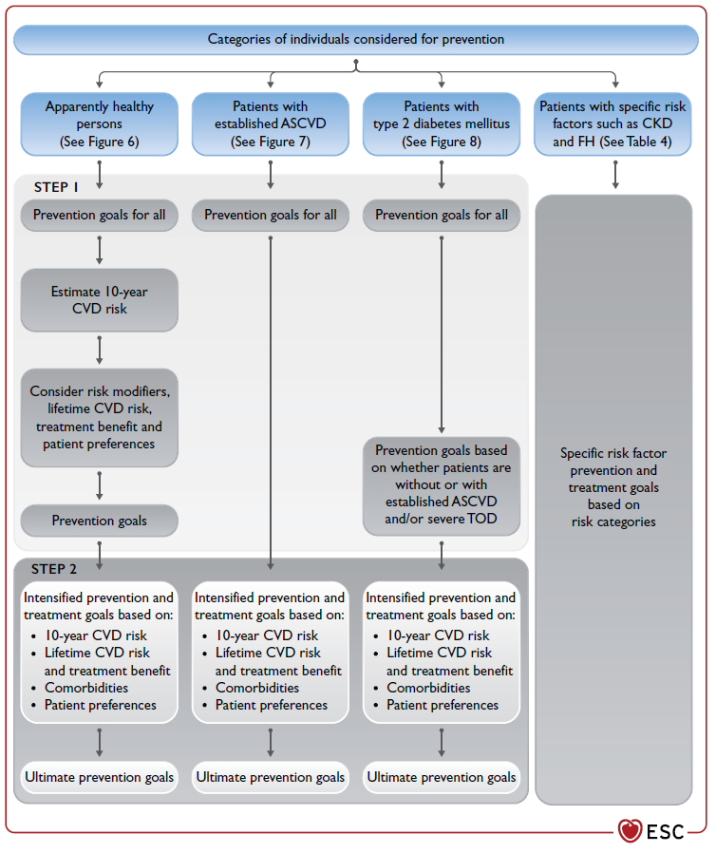
Personalisation and step-wise approach
STEP 1
Prevention goals for all
Estimation of CVD risk (for healthy)
Treatment goals
STEP 2
Intensified prevention
Treatment goals

Slide 19
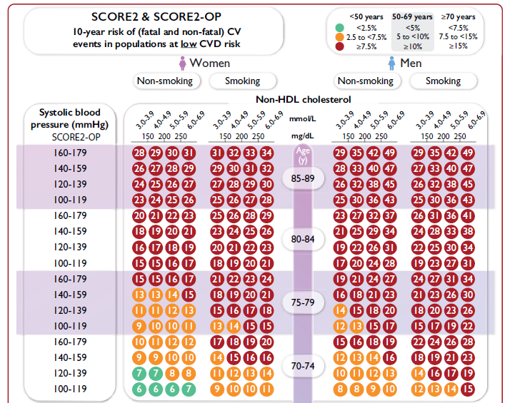
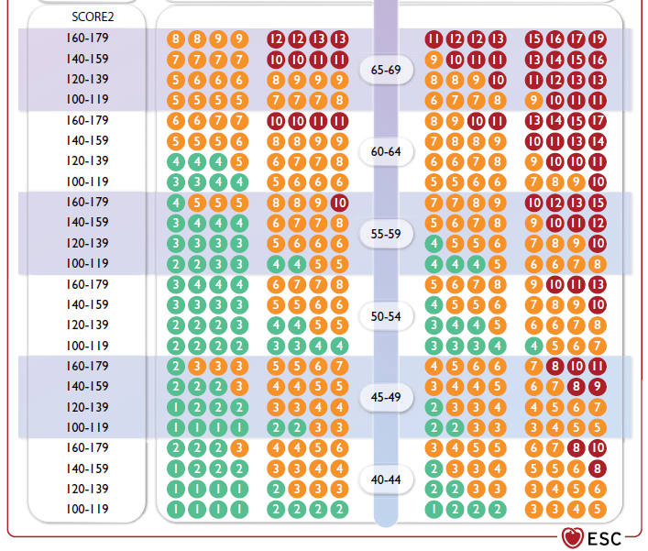
SCORE2

Slide 20
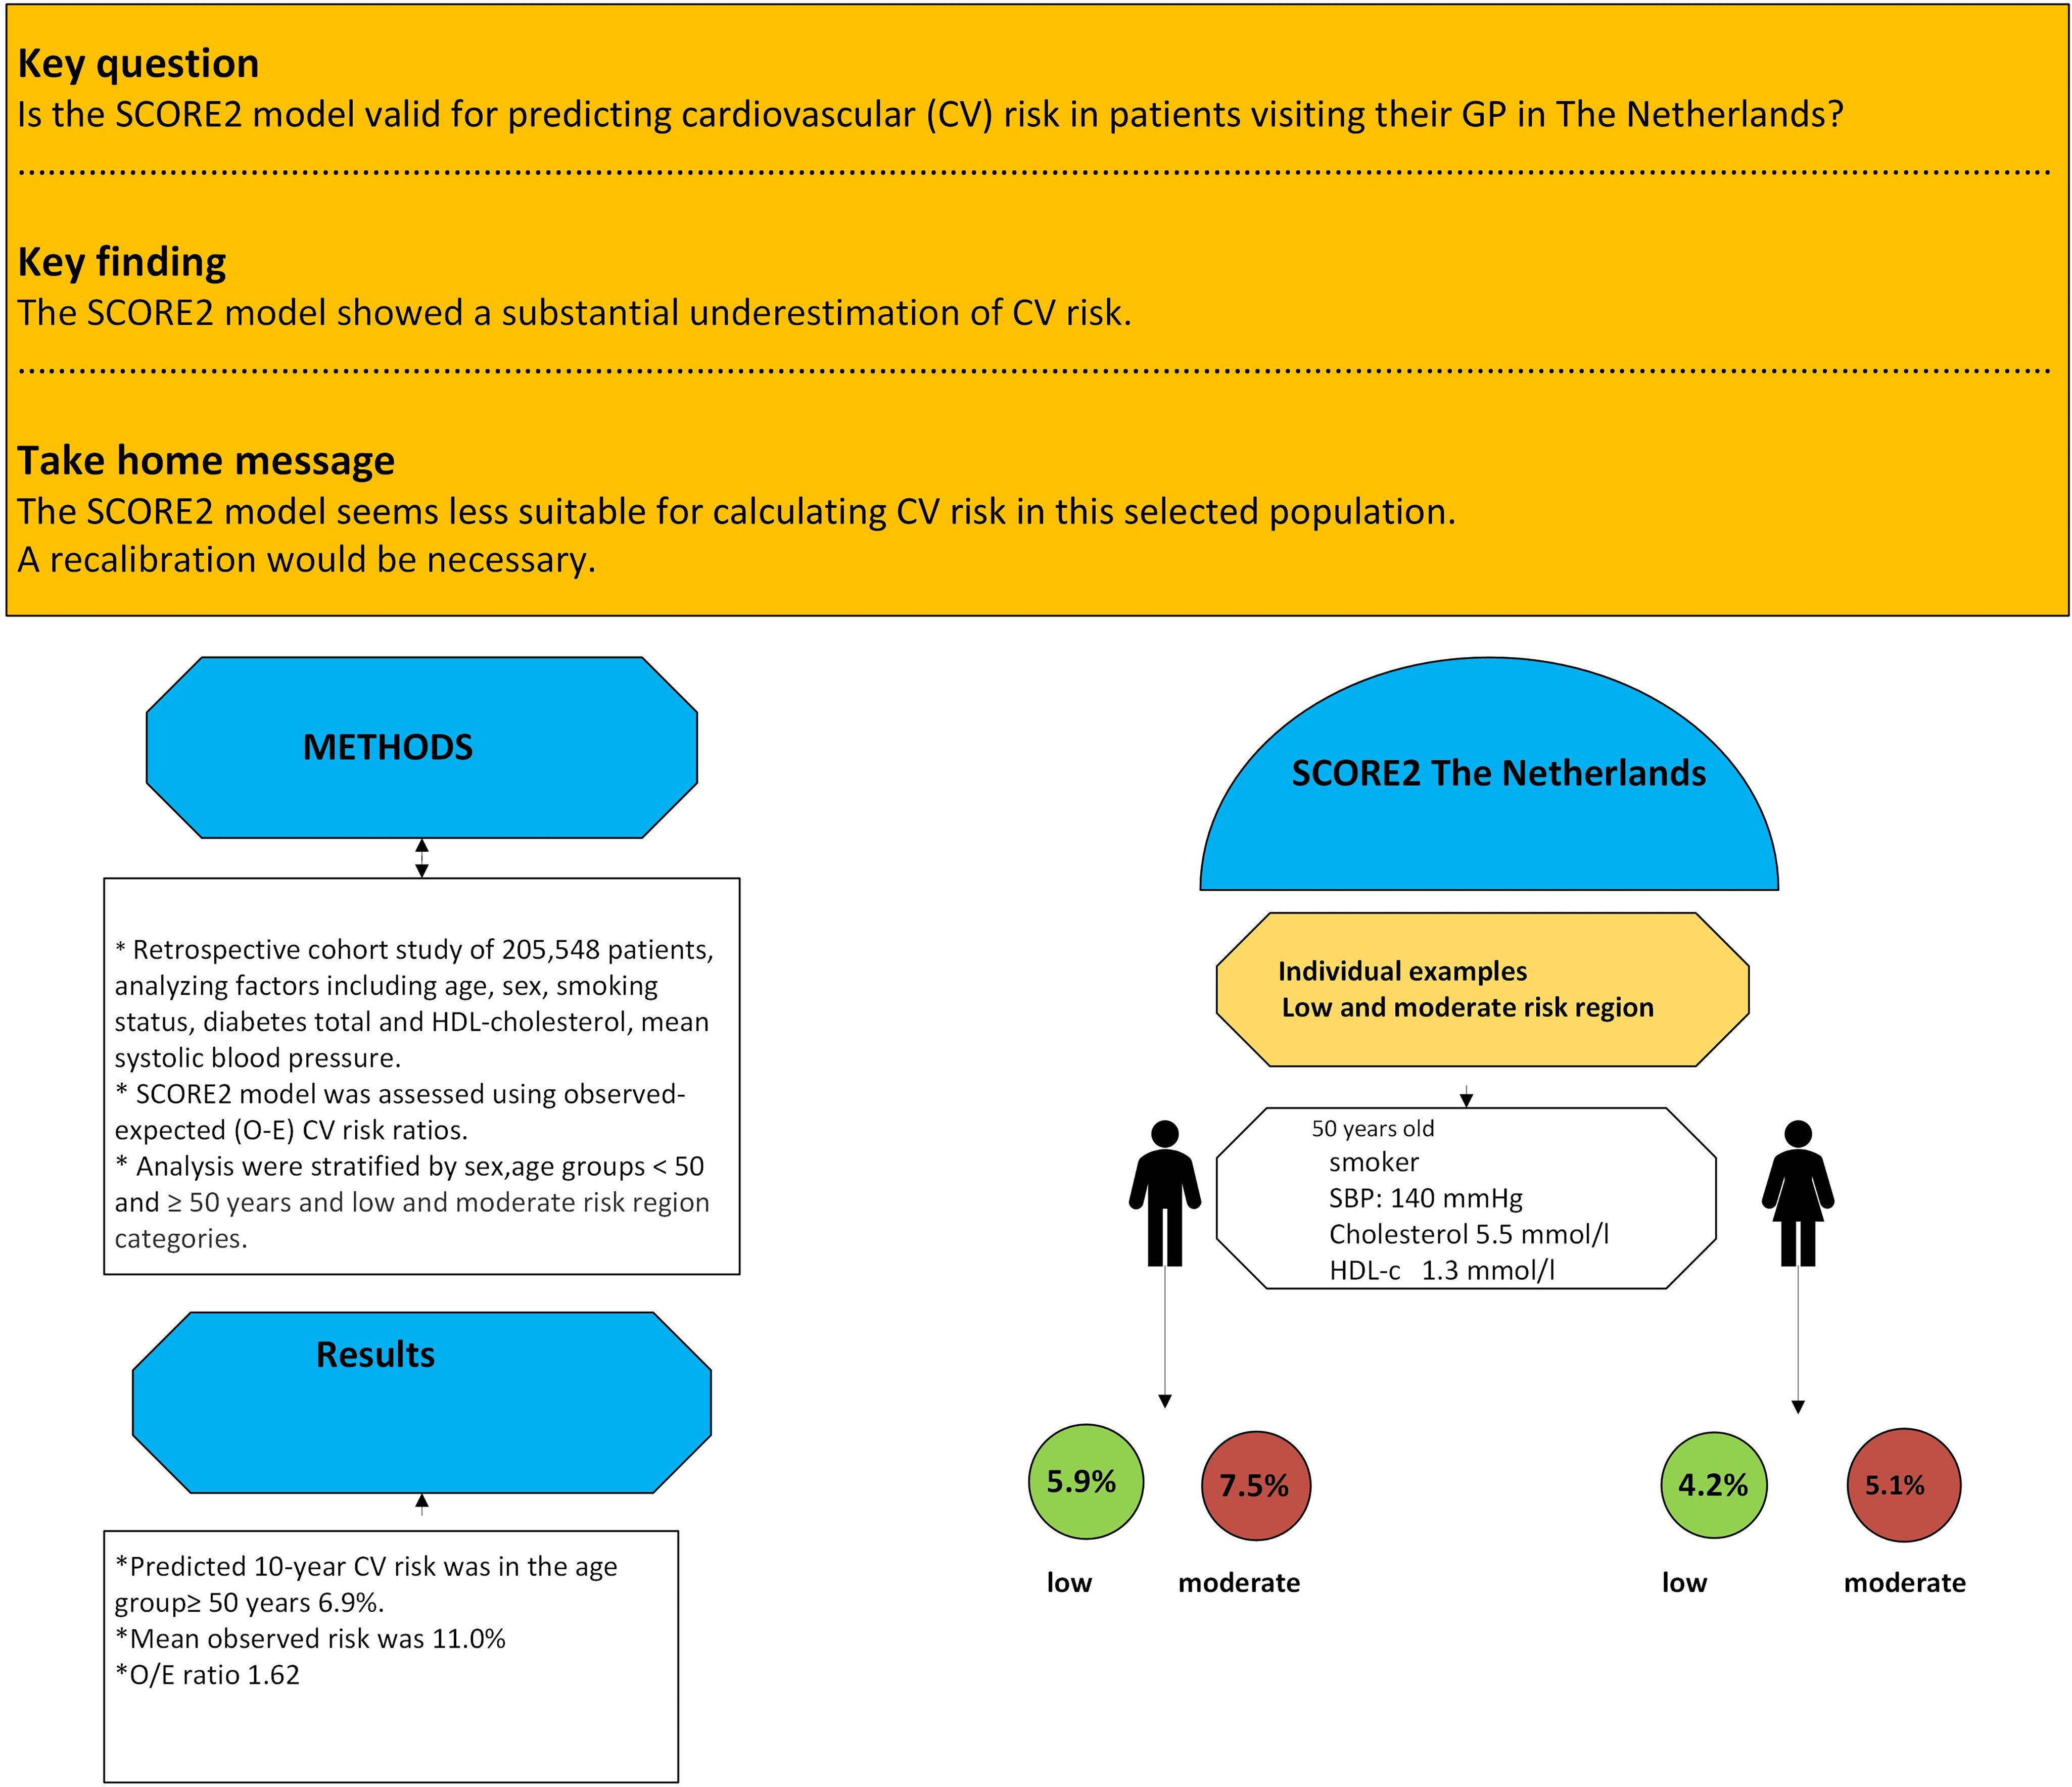
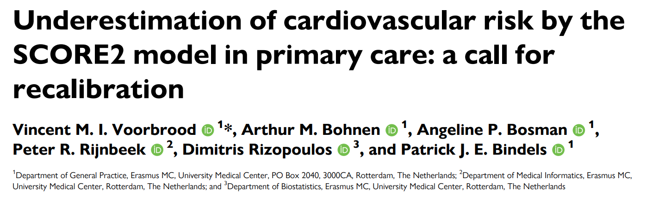
Retrospective cohort study of 205,548 individuals, analysing risk factors (age, sex, smoking, DM, HDL-c, SBP)
SCORE2 model was assessed using observed-expected ratio
Analyses were stratified by sex, age <50 and >50 years and region
50 years old
Smoker
SBP: 140 mmHg
Col 5.5 mmol/l
HDL-c 1.3 mmol/l
The SCORE2 model
showed a substantial underestimation of CV risk
Seems less suitable for calculating CV risk in this selected population
A recalibration would be necessary
RESULTS
7.5%
5.1%
Predicted 10-year CV risk was 6.9%
Mean observed risk was 11.0%
Observed-Expected ratio was 1.62
Eur. J. Prev. Cardiol., zwaf253

Slide 21
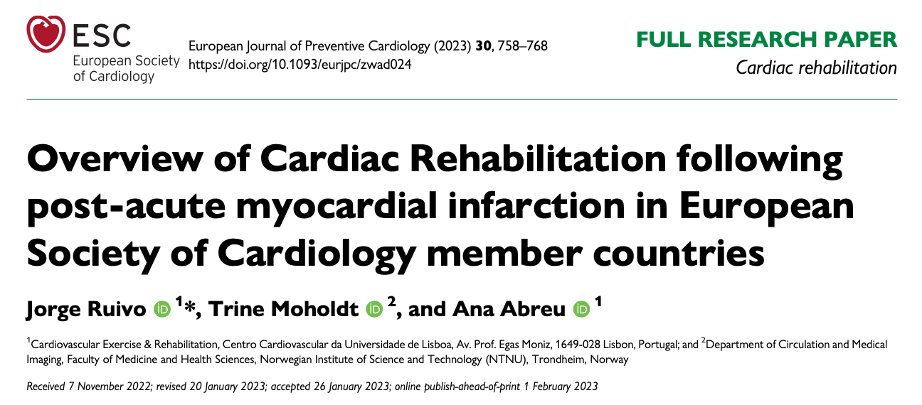

Slide 22
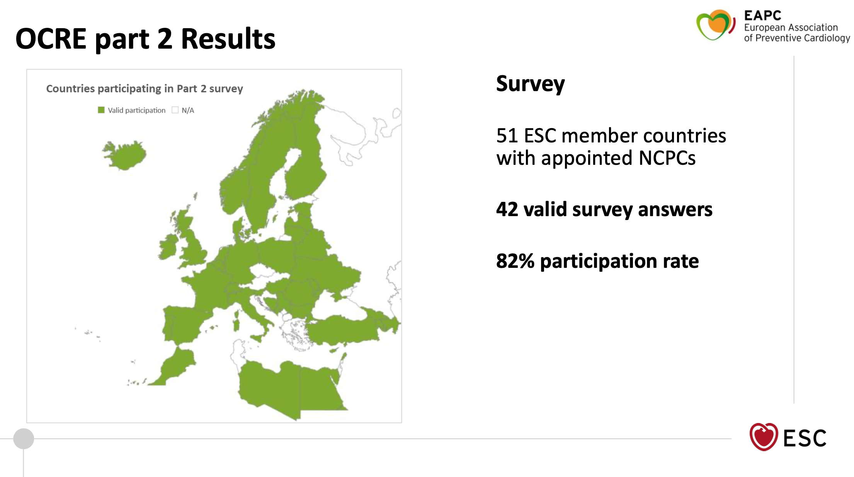

Slide 23

Barriers to Preventive Measure
Patient Level
Staff and Practical Barriers
Healthcare System
Education
Notes:
Image source: Microsoft 365 content library
Limited patient awareness and understanding of cardiac rehabilitation often result in low referral and participation rates. Healthcare system constraints, such as lack of resources, staffing, or funding, further restrict access. Additionally, transportation difficulties, comorbidities, and social or psychological factors can prevent heart failure patients from attending rehabilitation programmes.

Slide 24
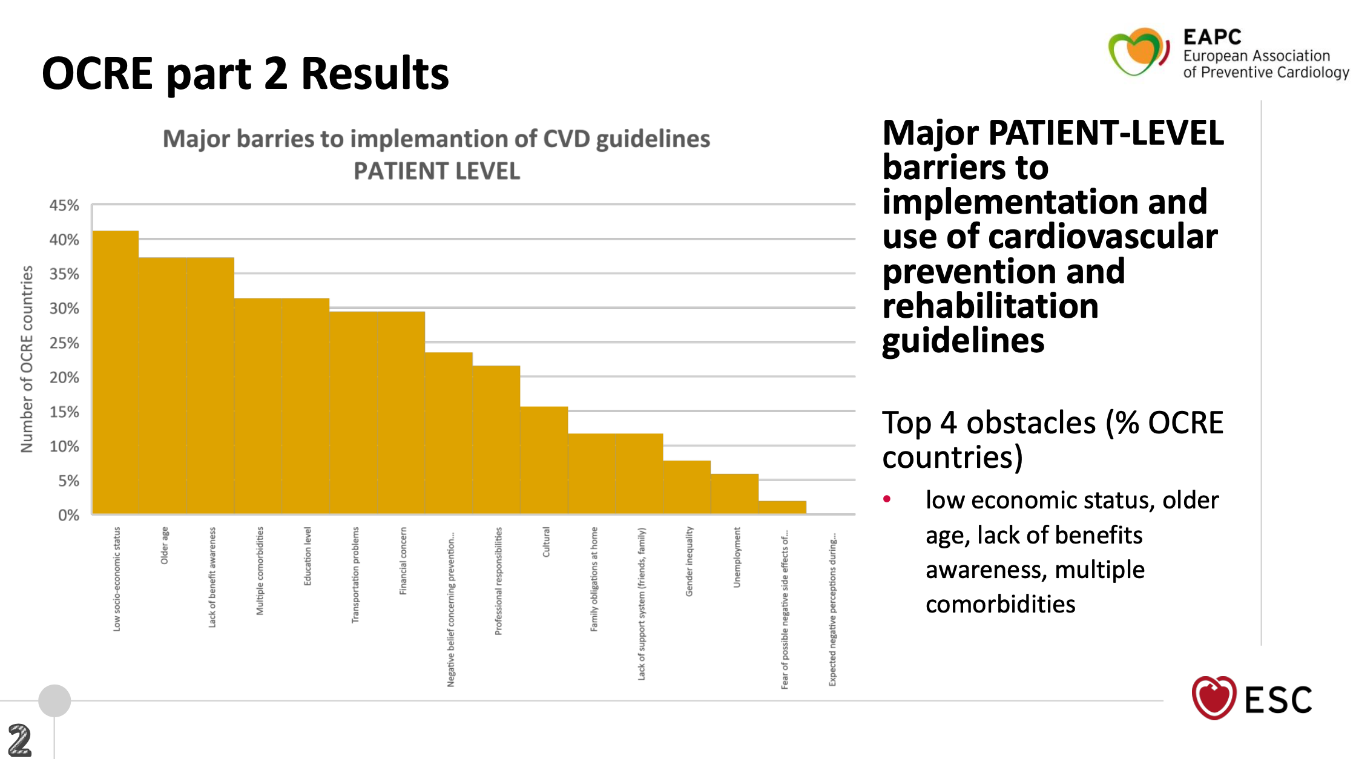

Slide 25
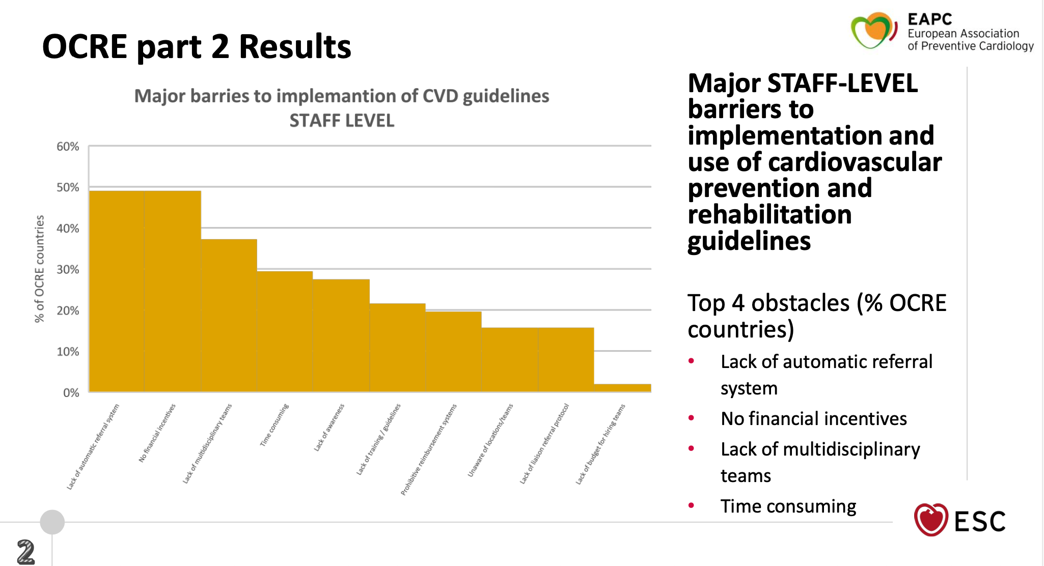

Slide 26
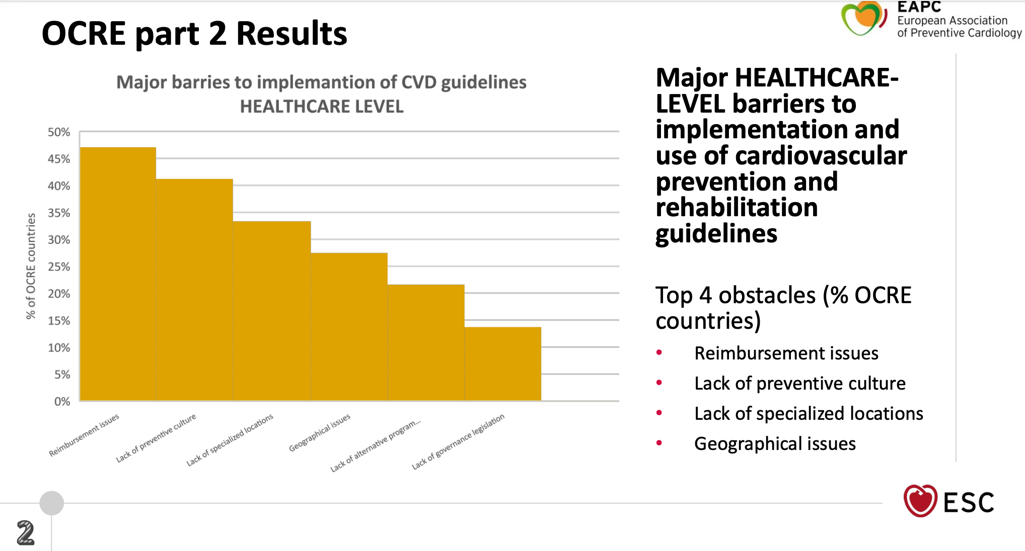

Slide 27
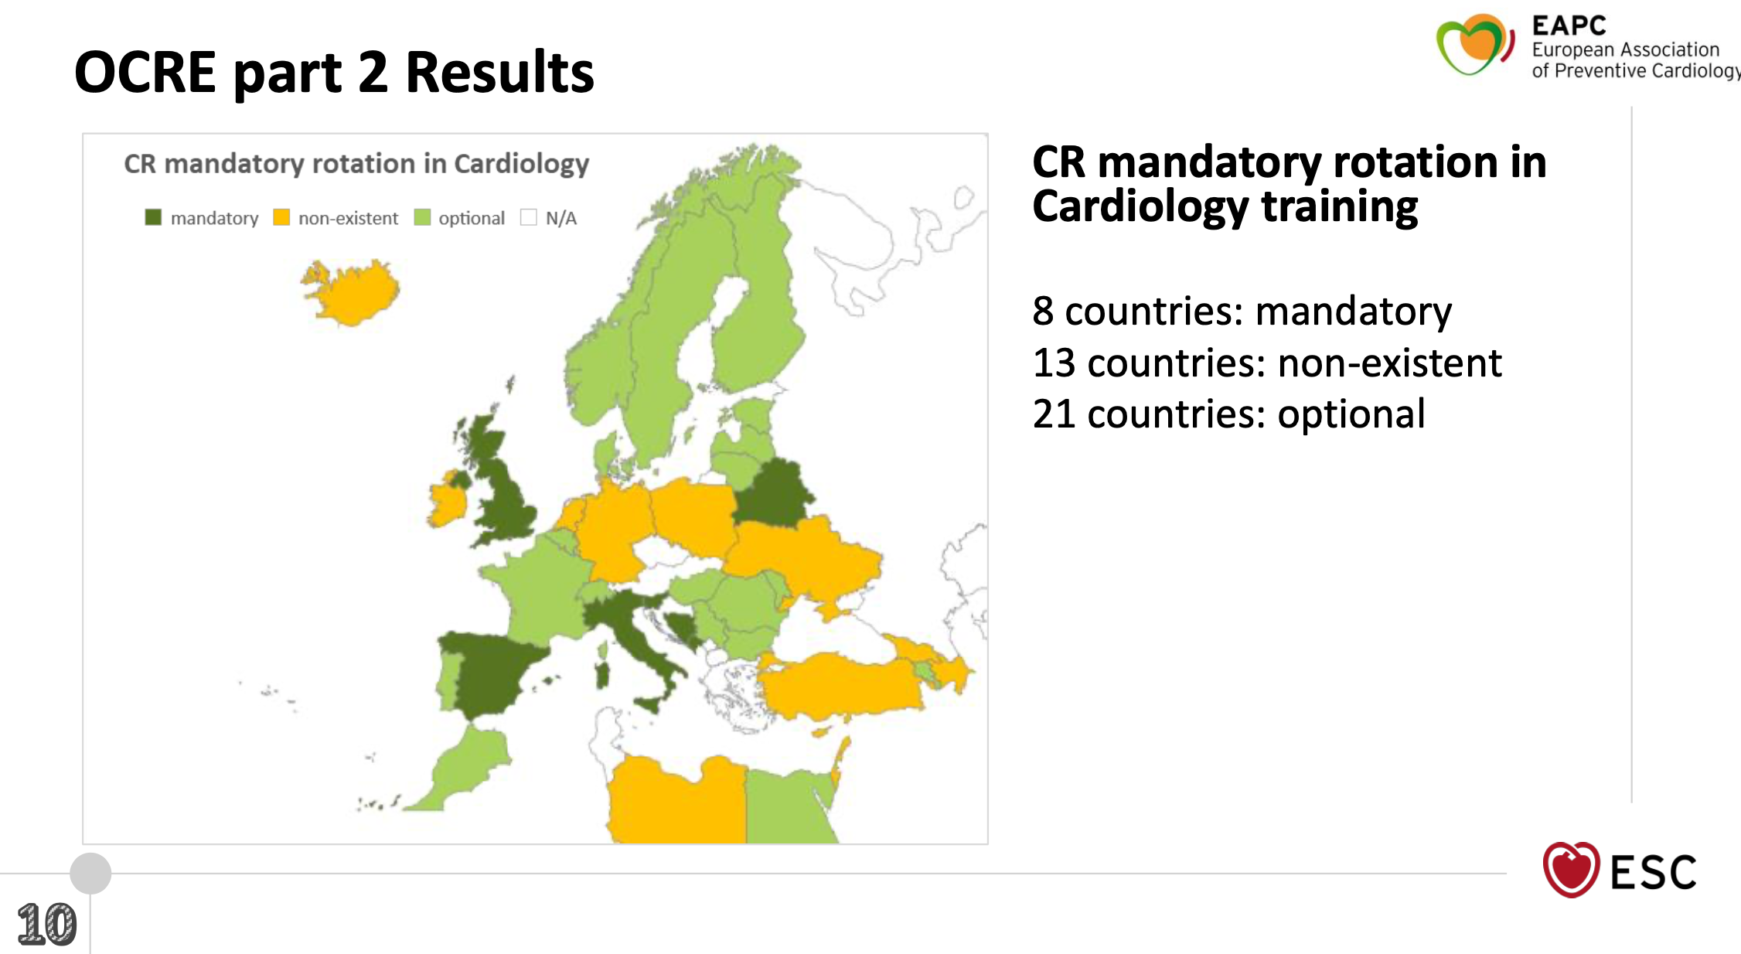


Slide 28

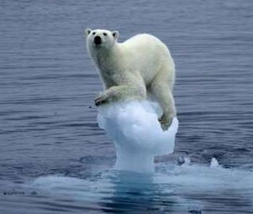
Exercise training in HF
unsolved Issues
Poor prescription
Poor adherence

Slide 29
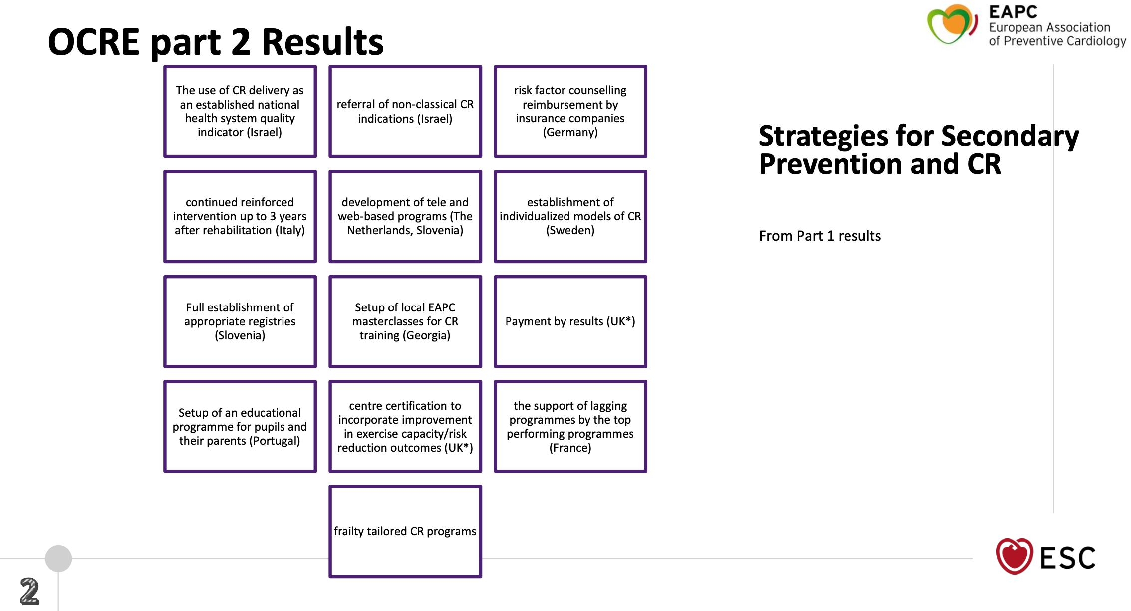
Strategies for Preventive Measure implementation
Organisation
Financial incentives
Education
Certification / quality ass.
Personalisation

Slide 30

Grazie
massimo.piepoli@unimi.it

